Slide 1
Director’s Preliminary Cost and Schedule Review of Project X: Introduction and Overview
Steve Holmes
Project X Director’s Review
March 16, 2009
http://www.fnal.gov/directorate/OPMO/Projects/PX/DirRev/2009/03_16/review.htm

Slide 2
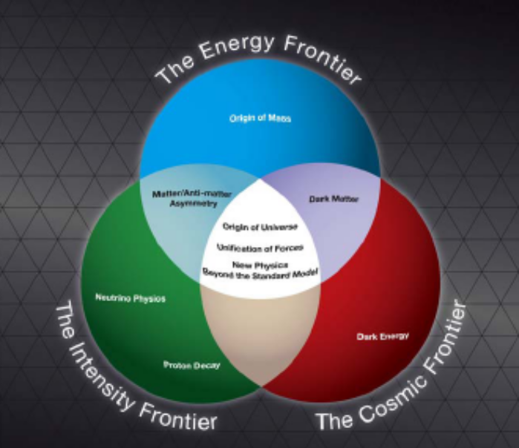
Role in Fermilab’s Future
Fermilab Long Range Plan
Fermilab is the sole remaining U.S. laboratory providing facilities in support of accelerator-based Elementary Particle Physics.
The Fermilab long-term
strategy is fully aligned
with the HEPAP/P5 plan:
  Energy and intensity frontiers
  share strong reliance on
  accelerators
“The panel recommends an R&D program in the immediate future to design a multi-megawatt proton source at Fermilab and a neutrino beamline to DUSEL… “
  (www.science.doe.gov/hep/files/pdfs/P5_Report%2006022008.pdf)

Slide 3
Role in Fermilab’s Future
Evolution of the Accelerator Complex
A multi-MW Proton Source (aka Project X) is the lynchpin of Fermilab’s strategy for future development of the accelerator complex:
  Energy Frontier:
  Tevatron → ILC or Muon Collider as options for the Fermilab site
    Aligned with ILC technology development;
    Preserves Fermilab as potential site for ILC or a Muon Collider
  Intensity Frontier:
  NuMI→ NOνA→ LBν/μ2e→ multi-MW Proton Source → NuFact
    Steady increase in power and baseline length up to 2 MW @ 1300 km;
    Several x 100 kW to rare processes experiments;
    Preserves Fermilab as potential site for a Neutrino Factory

Slide 4
Guidelines for Reviewers
This is not a technical review.
  The technical design was looked at by the Accelerator Advisory Committee in February
    (AAC were told “this is not a cost review”)
  To first order you should accept that the configuration described will meet the technical goals.
  To second order we expect to utilize your technical expertise to identify areas of particular risk, either technical or cost, and/or opportunities for reductions.
This is not a baseline estimate
  Baseline configuration is not established
  Level of detail in the basis of estimates is not at baseline level
  The DOE Order asks for a cost estimate range ⇒ This is a single point in time snapshot, developed very early in the process.

Slide 5
Guidelines for Reviewers
Review of the schedule is secondary to the cost estimate
  Estimates are tied to a resource loaded, “technically limited”, schedule
    CD-0 July 2009
    CD-1 December 2010
    CD-2 July 2012
    CD-3 August 2013
    CD-4 March 2018
  There has been no effort to either optimize or load level the schedule
Scope of the estimate
  Hydrogen bottle through extraction kickers (MI and Recycler)
  CD-0 to CD-4
    CD-4 = complete hardware checkout
RD&D
PED

Slide 6
Guidelines for Reviewers
Discussion of the PED profile should be confined to the Project Management breakout
  All other breakout sessions should address the adequacy of the RD&D plan as supporting the needs of the construction project
Breakout sessions speakers will be presenting estimates in FY2009 dollars (M&S) and person-years, with no overheads and no contingency
  Overheads, escalation, and contingency are applied at the highest level and will be discussed in the Project Management breakout
The specific role of collaborators is not integrated into the estimate
  Labor is estimated as if provided by Fermilab staff
    Fermilab labor rates are used
  (With a few exceptions within the RD&D estimate)

Slide 7
Review Structure
Three plenary talks:
  Description of the initial configuration – Paul D.
  High level description of systems and interfaces – Sergei N.
  Description of cost estimating methodology and high level estimate summary – Jim K.
Seven breakout sessions
  Project Management/Cost/Schedule Black Hole (WH2NW)
  Cavities & Cryomodules 1 North (WH1NW)
  RF Theory Conf Rm (WH3NE)
  Main Injector/Recycler/Beam Transfers Hornets Nest (WH8N)
  Instrumentation and Controls Req Room (WH4NW)
  Cryogenics Snake Pit (WH2NE)
  Conventional Facilities Confessional (WH5NE)

Slide 8
Summary
The preliminary TPC estimate is $1.49B
We hope the committee will concur in our view that:
  The ICD represents a complete, well defined, scope
  The preliminary estimate is a complete representation of the ICD
  The methodologies used and the estimated costs are reasonable for this stage of the project
  The preliminary estimate is sufficiently detailed and based on conservative assumptions
  Opportunities for reduction of the estimate, while preserving the core mission needs, exist
  The preliminary estimate is likely to represent the upper range of a subsequent baseline cost

