Slide 1

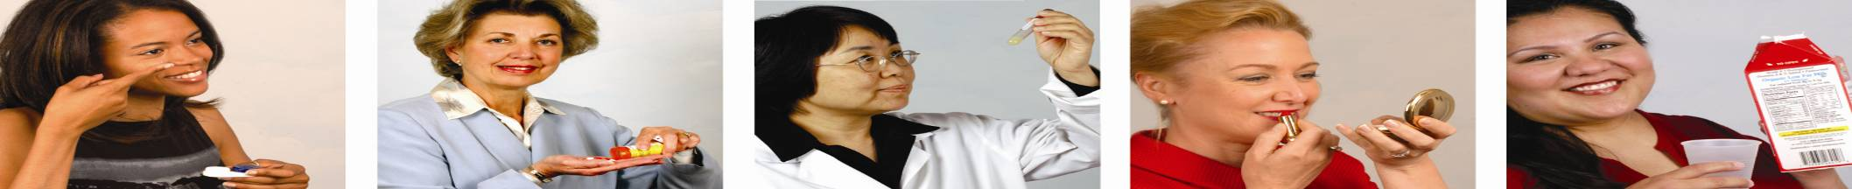

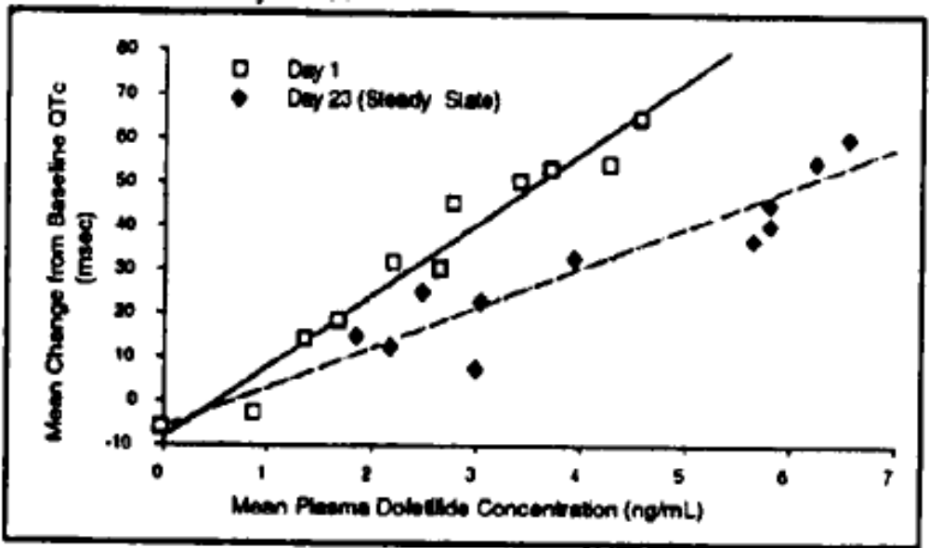
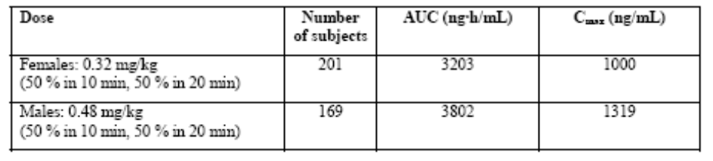
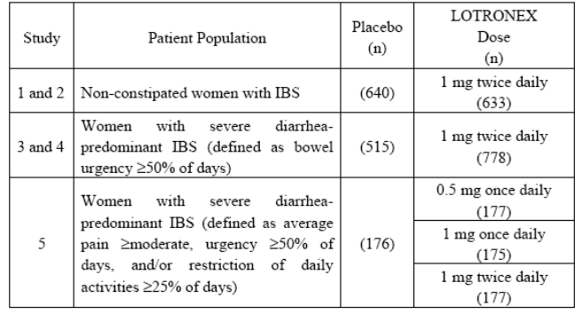
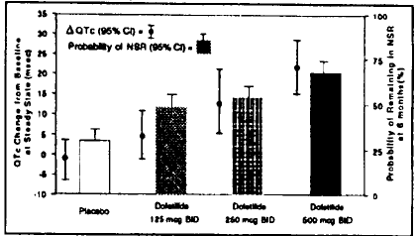
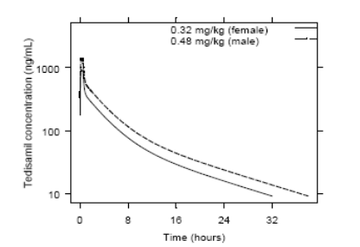
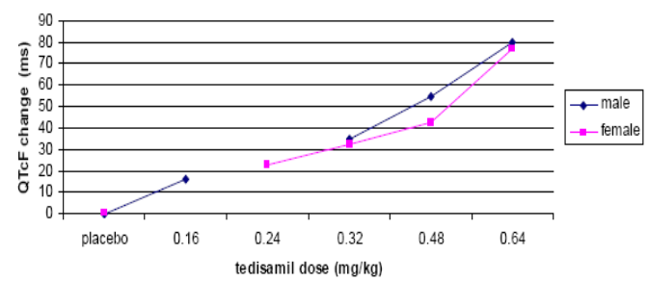
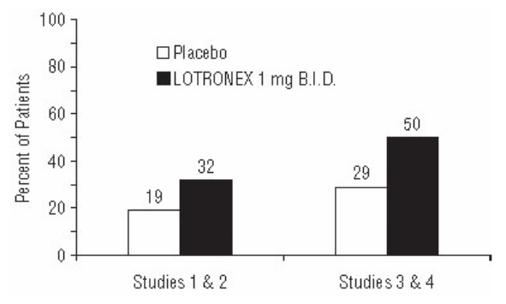
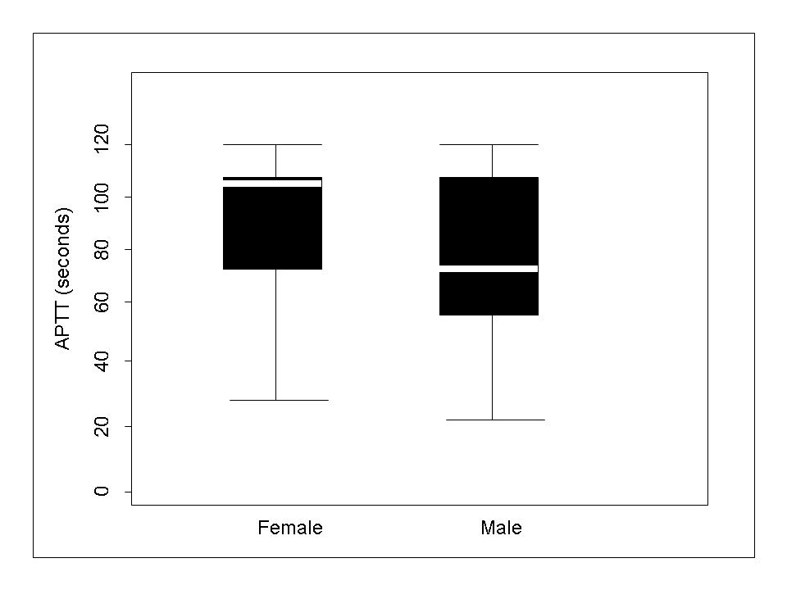
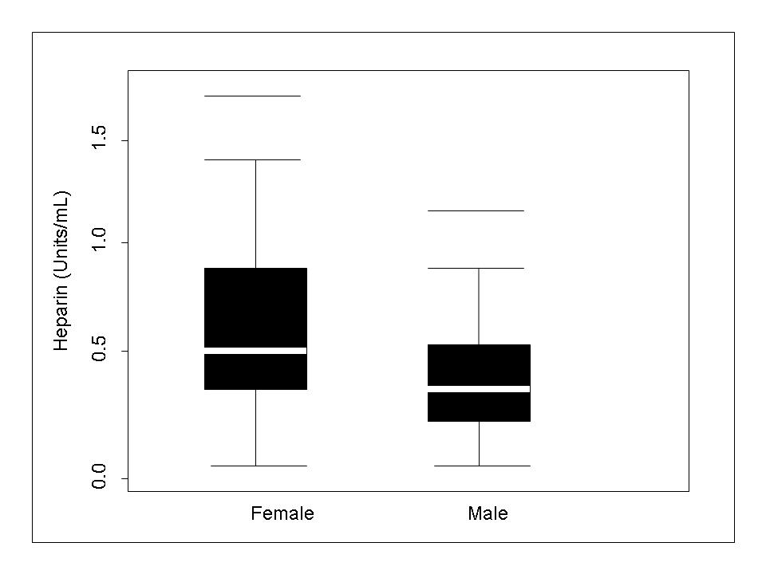
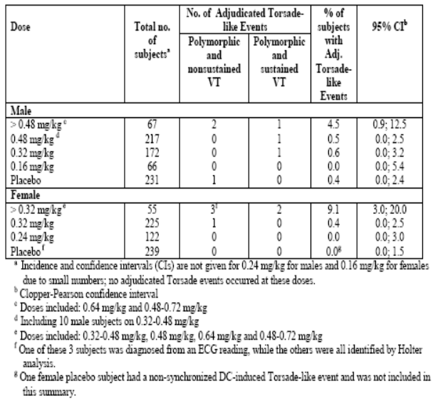
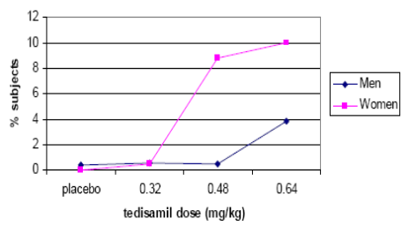
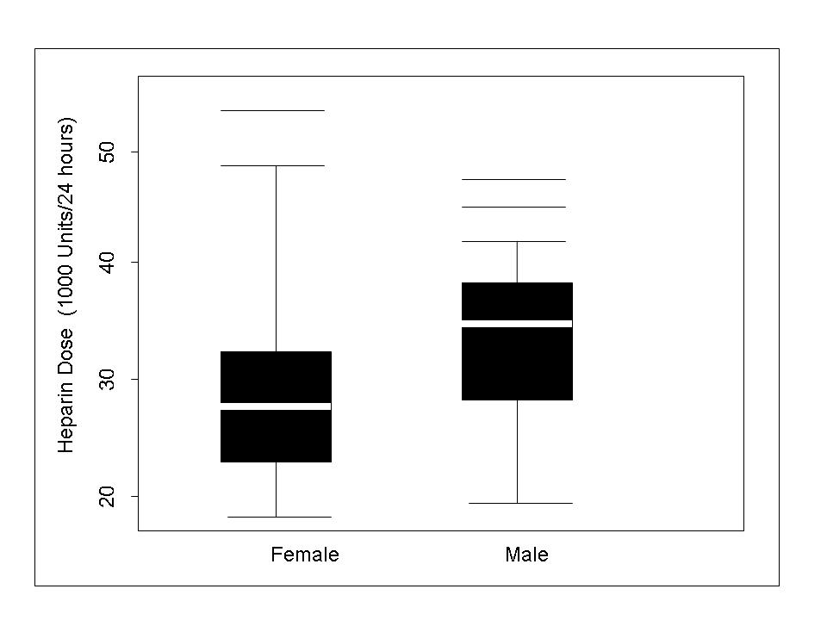
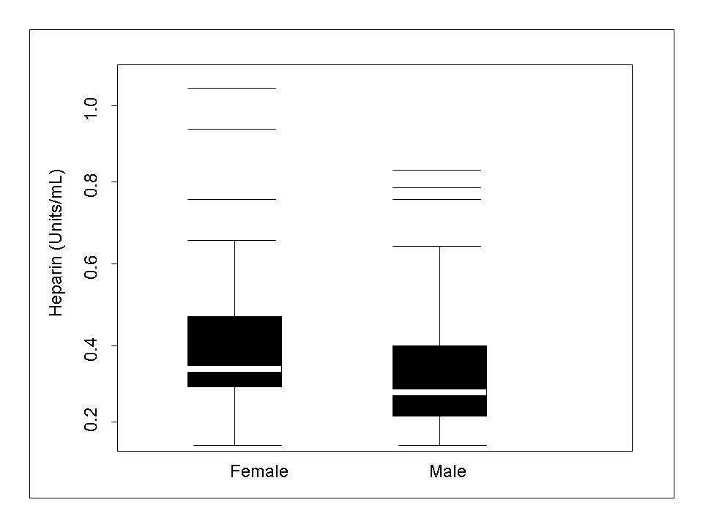
The Science of Sex Differences in the
Pharmacokinetics and Pharmacodynamics of Drugs - Case studies
Figure 1. Mean predose serum uric acid concentration on days -1 to 7 with administration of daily doses of febuxostat 80 mg on days 1 to 7
Emmanuel O. Fadiran, Ameeta Parekh and Kathleen Uhl, Office of Women’s Health, FDA, Rockville, MD
INTRODUCTION
Men and women differ in the way certain drugs are disposed of in the body (PK) and in the way that they respond to these drugs (PD)¹. Thus, the current practice in clinical trials is to include women to investigate sex-related (hormonal, physiological, molecular, and reproductive) and gender-related (cultural and behavioral, economic) influences on drug PK and PD². Adverse drug events are more prevalent in women than in men³. The significance of sex and gender-related differences in drug response as well as the concern for women's health in general is clearly expressed in the NIH Agenda on Research in Women's Health for the 21st Century. The NIH Revitalization Act of 1993, provided a clear mandate for the inclusion of women in clinical trials and was followed by the publication of guidelines for the conduct of clinical studies in women by the Food and Drug Administration⁴. Subsequently, the FDA published an algorithm for sex-based analysis in drug development in 1995⁵ as a tool for the conceptualization and design of clinical trials focusing on differences between men and women.
Four examples are presented that illustrate sex differences in the PK and/or PD of drugs.
Figure 1: Mean QTc-Concentration Relationship in Young Volunteers Over 24 Days
Case 2: TEDISAMIL
No PK Sex Differences
PD Sex Differences (safety)
Class III antiarrhythmic drug that prolongs the cardiac action potential duration and refractory period discussed at the FDA Cardiovascular and Renal Drugs Advisory Committee Meeting, December 12, 2007
Indication: rapid conversion of new onset atrial fibrillation/flutter
PK similar between men and women (Table 2, Figure 3).
PK/PD modeling showed that the total tedisamil dose is the only factor identified to significantly influence the relationship between tedisamil exposure and QTc Fridericia (QTcF) (Figure 4).
The effect of tedisamil on QTcF is not influenced by demographics or clinical covariates
Meta analysis of 5 Phase III studies
  Good efficacy in men and women
  Gender difference in safety (Tables 3 & 4, Figure 5)
Case 3: HEPARIN
PK Sex Differences
PD Sex Differences
Heparin is prescribed frequently in hospitals because thromboembolism and coronary thrombosis are very common disorders
Many studies have suggested that women, particularly those who are elderly, have a poorer outcome from coronary thrombosis and venous thromboembolism than men for which the underlying mechanism has not been fully elucidated.
The effect of sex on the anticoagulant response to heparin is not clear
Case 4: ALOSETRON
PK Sex Differences
PD Sex Differences (Efficacy)
Alosetron is a potent and selective 5-HT3 receptor antagonist. 5-HT3 receptors are ligand-gated cation channels that are extensively distributed on enteric neurons in the human gastrointestinal tract, as well as other peripheral and central locations.
Indication: indicated only for women with severe diarrhea-predominant irritable bowel syndrome (IBS).
Alosetron is metabolized by CYP2C9 and 1A2. Similar serum metabolic profiles in men and women
Plasma concentrations were 30% to 50% lower and less variable in men compared to women given the same oral dose.
Population pharmacokinetic analysis in IBS patients confirmed that alosetron concentrations were 27% lower in men.
Phase II studies showed that efficacy was preferentially observed in females compared to males and the differential sex effect was not readily explained by pharmacokinetic differences.
Phase III clinical trials were carried out in women (Table 5 & Figure 10).
Heparin – The Study
Campbell et al⁸ conducted a randomized, controlled trial to in 198 patients (105 women, 93 men) with proximal deep vein thrombosis to determine whether there were effects of sex on heparin therapy.
All patients received an intravenous bolus of 5000 USP units of heparin followed by a continuous intravenous infusion of heparin at an initial infusion rate of 40,000 units per 24 hours for patients classified at low risk for bleeding and 30,000 units per 24 hours for high-risk patients.
Blood samples for determining heparin levels were drawn at the same time intervals as those for APTT values.
Table 2: Pharmacokinetic Parameters at the Recommended Doses in AFib/AFl Subjects (meta-analysis)
Table 5. Efficacy Studies Conducted in Women With IBS
Results
Figures 6 to 9 show the sex difference for APPT and heparin exposure
After adjusting for the known effects of patients' age and weight on heparin therapy, there was a tendency to lower heparin dose requirements in women (regression coefficient -3.2. p = 0.058).
Increasing age was associated with higher heparin levels in women and lower heparin levels in men (when weight and heparin dose were accounted for regression coefficient for interaction 0.014. p = 0.009).
The results are consistent with a pharmacological basis for increased bleeding complications in women
Case 1: DOFETILIDE
PK Sex Differences
PD Sex Differences (Safety)
Antiarrhythmic drug with Class III (cardiac action potential duration prolonging) properties.
Indications: maintenance of normal sinus rhythm in patients with atrial fibrillatlon/atrial flutter of greater than one week duration who have been converted to normal sinus rhythm and for the conversion of atrial fibrillation and atrial flutter to normal sinus rhythm.
Renal function was the single most important factor Influencing dofetilide clearance.
Approximately 80% of a single dose is excreted in urine, of which approximately 80% Is excreted as unchanged dofetilide.
The clearance of dofetilide decreases with decreasing creatinine clearance. As a result the half-life of dofetilide is longer in patients with lower creatinine clearances.
Figure 2: Relationship Between Dofetilide Dose, QTc Increase and Maintenance of NSR.
Figure 3: Simulated PK profile showing a rapid decline in plasma tedisamil concentrations
Figure 4: QTcF change from BL at the end of infusion as a function of dose (Clinical review document)
Figure 10. Percent of Patients With Urgency on >5 Days/Week at Baseline Who Improved to No More Than 1 Day in the Final Week
Fig 6: Box plots of APTT values in men and women 4 to 6 hours after initiation of heparin therapy
Fig 7: Box plots of heparin levels in men and women 4 to 6 hours after the initiation of heparin therapy
Incidence of TdP and death in women and men
Table 3
Figure 5
Plausible explanations for lack of efficacy of alosetron in men
Sex differences are exhibited by the serotonin 5-HT1A receptor and serotonin transporter (5-HTT) - Women have significantly higher 5-HT1A receptor and lower 5-HTT binding potentials throughout the cortical and subcortical brain regions, and exhibit a positive correlation between 5-HT1A receptor and 5-HTT binding potentials in the region of the hippocampus, hence sex differences in the prevalence of psychiatric disorders such as depression and anxiety¹¹
Colonic transit time has been shown to be significantly lower in healthy women as compared to healthy men
Sex differences have been reported in the brain serotonin’s synthesis rate- markedly lower serotonin synthesis in the female brain compared to men¹²
Administration of alosetron in humans results in alterations in cortisol production. Cortisol production is under hormonal control and consequently sex plays a role
Alosestron demonstrates significant PD (efficacy) but no significant PK sex differences.
CONCLUSIONS: These 4 case studies illustrate sex differences in the PK and/or PD of drugs and support the need for adequate assessment of safety and efficacy by sex during drug development.
Dose-Response and Concentration Response for increase in QT Interval is directly related to dofetilide dose and plasma concentration (Figures 1 & 2)⁶
Individualized dosing is based on the calculation of creatinine clearance that takes into consideration age, body weight, sex and baseline QT which is higher in women.
The incidence of other ventricular arrhythmias was similar in female patients receiving dofetilide and patients receiving placebo.
Although no study specifically investigated this risk, in post-hoc analyses, no increased mortality was observed in females on dofetilide compared to females on placebo.
Dofetilide is contraindicated In patients with congenital or acquired long QT syndromes and patients with a baseline QT Interval or QTc >440 msec (500 msec in patients with ventricular conduction abnormalities)
Fig 8: Box plots of heparin doses in women and men during days 2 to 4 of treatment with heparin
Fig 9: Box plots of heparin levels in men and women between days 2 and 4 of heparin therapy.
Table 4: Deaths
Table 1: Sex differences in the PK and PD of Dofetilide
 | Tedisamil | Placebo
ALL | 0.6% 6/944 | 0.6% 3/470
Male | 0.2% 1/512 | 0.9% 2/231
Female | 1.2% 5/402 | 0.4% 1/239
Parameter | Women Relative to Men
Clearance | 12-18% lower
Plasma Concentration | 14-22% lower
Risk of Torsade de Pointes (TdP)
Sex Differences in QT effects & TdPs
There are well documented differences in QT effect and incidence of TdPs between males and females.
Women tend to have longer QT intervals between puberty and at least 55 years of age, perhaps due to lower parasympathetic tone, or estrogen- or metabolic-related changes.
Women are more susceptible to malignant arrhythmias than men, and there is an increased incidence of TdPs among women when treated with Class III antiarrhythmics, which is a consistent finding with all Class III agents approved for atrial fibrillation.
The reason for the female predominance in drug-induced TdP remains unclear.
Dofetilide exhibits both PK and PD (safety) sex differences. The observed difference in incidence of TdPs cannot be explained by the sex differences in the PK of dofetilide alone.
Sex Differences in QT effects & TdPs
Causes QT prolongation
  Torsades de Pointes is a major safety concern
  Increased risk in women:
    Bradycardia, hypotension, ventricular arrhythmias
    Thromboembolic events ?
*** Proposed sex-specific dosing regimen
“Should tedisamil be approved for the conversion of atrial fibrillation?”
  Advisory Committee members voted unanimously NO
Plausible Explanation for the Sex Differences in Anticoagulant Response to Anticoagulants
There are age-related changes in various coagulation factors, which differ in men and women. Heparin interacts with and binds to many components of blood some of which change with age or vary between men and women
There are differences in weight and body composition between men and women, as well as changes that occur with aging that can affect drug disposition
There are differences in fat composition and lean mass between men and women that change with aging. It is also possible that there were differences in concomitant diseases between the men and women in this study, and either the diseases or treatments could account for sex differences in heparin disposition
Heparin exhibits both PK and PD sex differences.
REFERENCES
1. Drugs 1995;50:222-39.
2. Principles of Clinical Pharmacology 2001;21:265-275.
3. Drugs 1995;50:l-6.
4. NIS Publication No. 99-4386; 1999, p. 147-66.
5.http://www.fda.gov/womens/Executive.html
6. Tikosy Labeling: http://www.accessdata.fda.gov/drugsatfda_docs/label/1999/20931lbl.pdf
7. AC ref for tedisamil
http://www.fda.gov/ohrms/dockets/ac/07/briefing/2007-4327b2-01-solvay-backgrounder.pdf
http://www.fda.gov/ohrms/dockets/ac/07/briefing/2007-4327b2-02-fda-backgrounder.pdf
http://www.fda.gov/ohrms/dockets/ac/07/minutes/2007-4327m-02-minutes-final-tedisamil-dec12.pdf
8. Clin Invest Med April 1998;21(2), 71-78.
9. Lotronex Labeling: http://www.fda.gov/cder/foi/label/2008/021107s013lbl.pdf
10. Lotronex Review: http://www.fda.gov/cder/foi/nda/2000/21107a_Lotronex.htm
11. Neuroimage 2008 Feb 1; 39 (3): 1408-19
12. Proc Natl Acad Sci, USA 1997;94:5308-5313.
3 times
There are well documented differences in QT effect and incidence of TdPs as noted above (Case 1)
Tedisamil exhibits PD (safety) but no PK sex differences.

