Slide 1
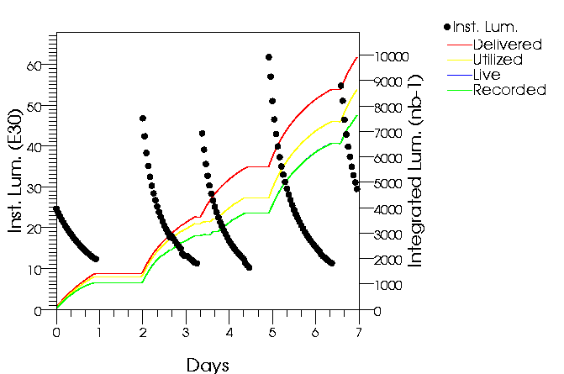
D0 Data Taking Summary: March 1 to March 7
Luminosity
  Delivered 9.9pb-1
  Recorded 7.6pb-1
Data taking efficiency
  77% weekly
Backgrounds
  P and pbar halo are within specs
Beam position
  Within specs
Number of events collected
  14mln

Slide 2
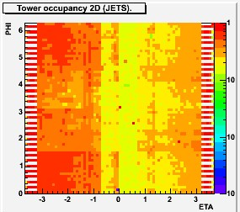
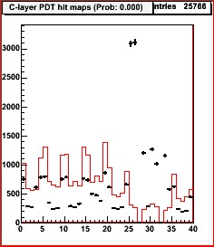
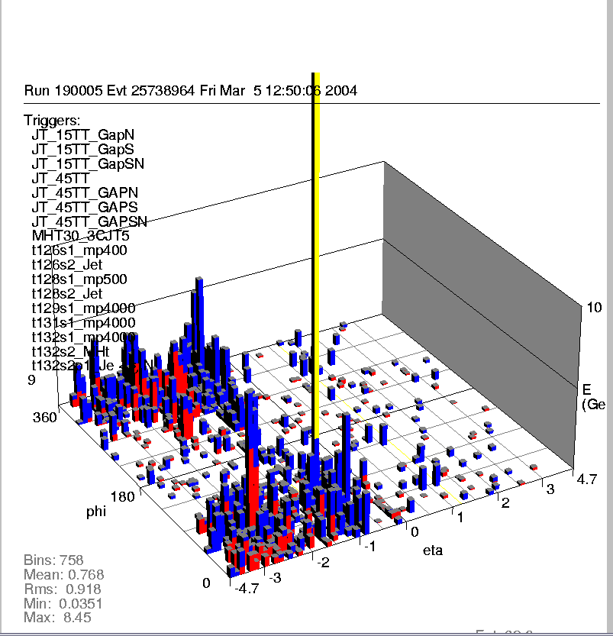
Calorimeter and Muon Noise
Since late Sunday, February 29th (should not we skip February 29ths ?)
  New never before seen type of noise affected D0 calorimeter and muon system
Calorimeter
On-line plots
Muon Hits Plot

Slide 3
Source of Noise?
The noise have been detected quickly and by Monday we learned
  Physics data taking is badly affected
    Considerable number of events have clear signature of noise
  Noise is correlated with toroid magnet been turned ON or OFF
    Noise starts at ~250A current in toroid coils
      Nominal current is 1500A
    Noise is coming from noisy power supply?
    Noise is coming from failed power supply filtering capacitors?
    Noise is coming from another D0 component which is affected by fringe magnetic field?

Slide 4
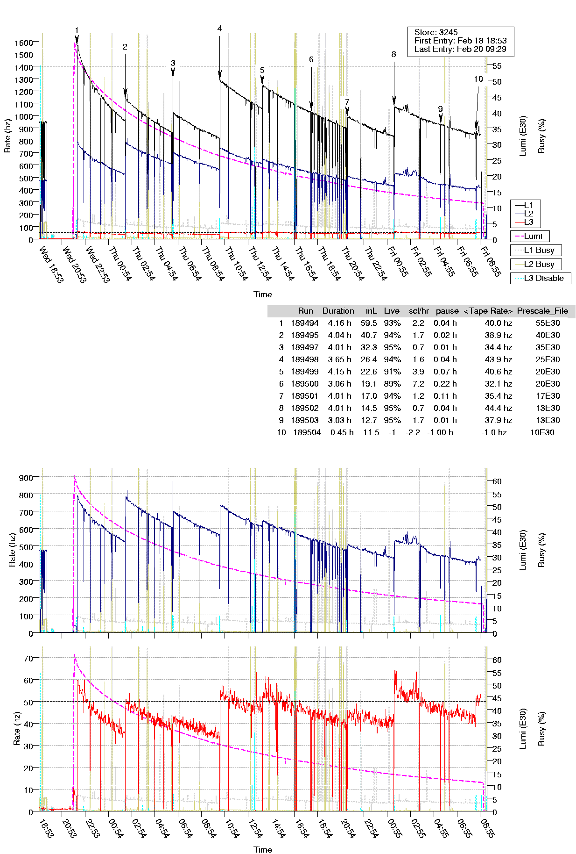
Data Taking
Mostly stable physics data taking without major problems
Largest sources of downtime
  Fast dump of solenoid magnet on Tuesday
    Operator mistake, lost ~1.5 hours – long term resolved
  Problems during Sunday morning store start
    Level 2 muon system issues, ~1 hour lost – plan for long term solution in place
  All other issues been resolved on a time scale of below ~20 minutes
    129 hours in stores
    124 hours of data taking
One access request
  Forward proton detector power supply failure - fixed

Slide 5
Do D0 Detectors Observe Radiation Aging?
After 3 years of data taking and ~10% of expected Run II luminosity delivered it is time to (re)evaluate situation with radiation aging
  Should not get missed among multiple other tasks D0 is performing
D0 has experienced painful muon drift chambers aging issues during Run I
  ~50% of chambers not used for physics analysis
    Use of un-tested organic materials during construction
    Aging effects seen with charges as low as ~1mC/cm
  Closest to the interaction region chambers have electrodes replaced (~20%) for Run II
  Other chambers have higher flow rate and gas filtering in re-circulation system
    Run II shielding reduced particle fluxes by factor of ~10 per unit of delivered luminosity
  Fast heating of the wires method is developed to “clean” the wires
Lessons (D0 plus other detectors)
  Radiation aging is very dangerous – you can damage your detector badly
  There are un-expected issues with detectors aging which are very difficult (impossible?) to test before real data taking
    Neutron doses vs gamma doses, etc.
  We have to constantly monitor for signs of “aging” and act well in advance before problems become severe

Slide 6
Radiation Aging
Major questions to be answered
  What is currently total integrated dose for the “hottest” part of the sub- detector?
    Could be in rads, or in charge/unit of wire for gas detectors
    Should be normalized by total delivered luminosity
    Direct measurements (TLDs, currents) or MC simulation
  What are doses when detector performance expected to start to deteriorate
    Based on manufacturers specs
    Based on studies
    Are we getting close?
  Do we actually observe any changes in detectors performance – critical!
    For example
      Number of phe per mip in the case of fiber tracker
Will have a series of presentations from D0 about detailed status of radiation aging starting from silicon detector next week

Slide 7
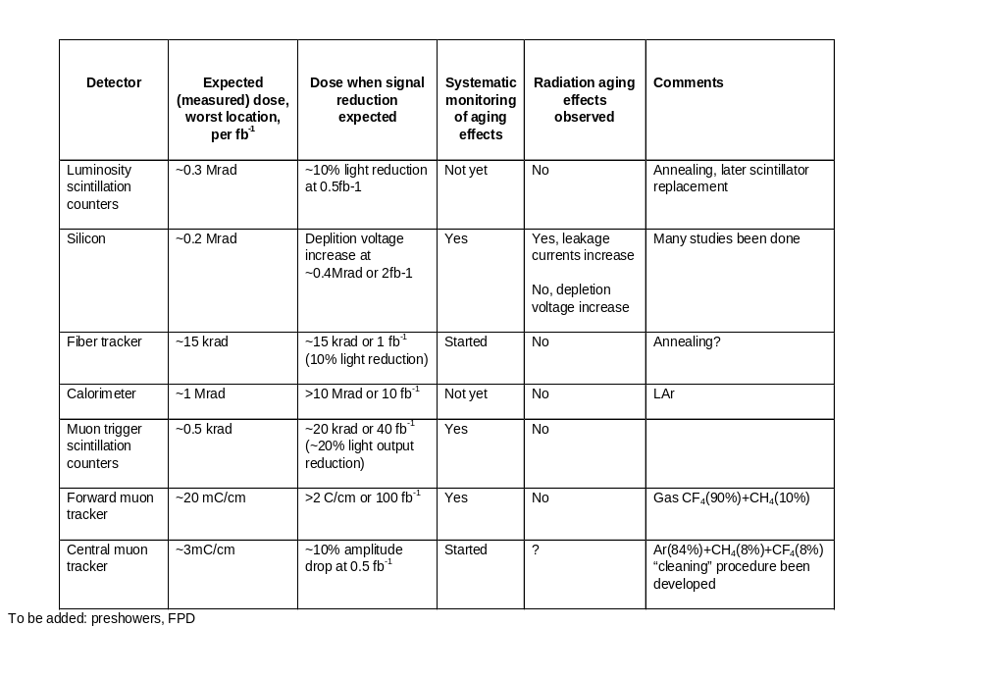
D0 Detectors Radiation Aging Summary
.

Slide 8
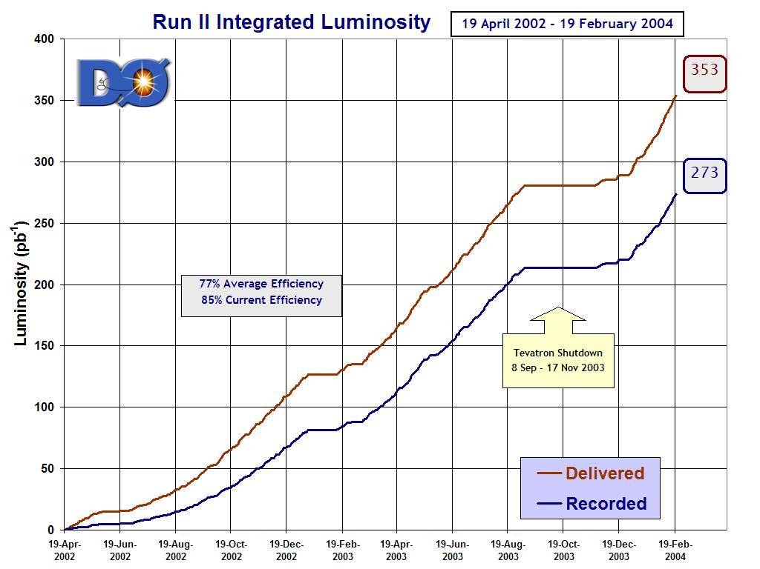
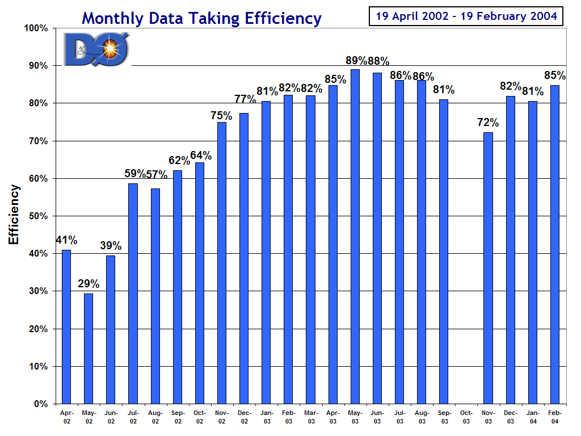
D0 Summary
Smoothly collecting physics data
  Data taking efficiency last week is good ~87%
    Almost 10 pb-1 recorded
    Best day in terms of recorded luminosity – during record store on Thursday
  Problems affected data taking are all understood and resolved
This week is D0 collaboration meeting (at Fermilab)
  Major focus is physics analysis for coming winter and summer conferences
  Data samples well above Run I
  Detectors are more complex then in Run I – more time/efforts needed to understand them well
  Many interesting results are coming
    66 talks during Sunday –Tuesday D0 Physics Workshop this week!

