Slide 1
State of Washington
Department of Community, Trade & Economic Development
Human Resource Management Report
October 16, 2006

Slide 2
Logic Model
Managers Accountability for Workforce Management
Plan & Align Workforce
Hire
Workforce
Deploy
Workforce
Develop Workforce
Reinforce Performance
Articulation of managers HRM accountabilities. HR policies. Workforce planning. Job classes & salaries assigned.
Qualified candidate pools, interviews & reference checks. Job offers. Appts & per-
formance monitoring.
Work assignments& requirements defined. Positive workplace environment created. Coaching, feedback, corrections.
Individual development plans. Time/ resources for training. Continuous learning environment created.
Clear performance expectations linked to orgn’al goals & measures. Regular performance appraisals. Recognition. Discipline.
Staffing levels & competencies aligned with agency priorities. Mgr’s HRM accountabilities are understood.
Best candidate hired & reviewed during appointment period. Successful performers retained.
Workplace is safe, gives capacity to perform, & fosters productive relations. Staff know job rqmts, how they’re doing, & are supported.
Learning environment created. Employees are engaged in develop-
ment opportunities & seek to learn.
Employees know how performance contributes to success of orgn. Strong performance rewarded; poor performance eliminated
Foundation is in place to build and sustain a productive, high performing workforce.
The right people are in the right job at the right time.
Time & talent is used effectively. Employees are motivated & productive.
Employees have competencies for present job & career advancement
Successful performance is differentiated & strengthened. Employees are held accountable.
State government has workforce depth & breadth needed for present and future success
Employees are committed to the work they do & the goals of the organization
Productive, successful employees are retained
Agencies are better enabled to successfully carry out their mission. The citizens receive efficient government services.

Slide 3
Human Resource Management Report
Standard Performance Measures
Plan & Align Workforce
Percent current position/competencies descriptions
Percent supervisors with current performance expectations for workforce management
Time-to-fill funded vacancies
Percent satisfaction with candidate quality New Hire-to-Promotional ratio
Percent turnover during review period
Percent employees with current performance expectations
Employee survey ratings on “productive workplace” questions
Leave usage (sick, LWOP, unscheduled leave)
Overtime usage
Number & type of non-disciplinary grievances
Percent employees with current annual individual development plans
Employee survey ratings on “learning/development” questions
Percent current performance evaluations
Employee survey ratings on “performance accountability” questions
Number/type of disciplinary issues, actions, appeals disposition
Turnover rates and types (e.g., retirement, resignation, etc.)
Turnover rate of key occupational categories and of workforce diversity
Employee survey ratings on “commitment” questions
Hire Workforce
Measures to add in the future:
Current workforce plans that align staff with business priorities
Safety and Workers Compensation measures
Competency gap analysis measure
Recognition/reward measure
Others to be determined
Deploy Workforce
Develop Workforce
Reinforce Performance
Ultimate Outcomes

Slide 4
Overall foundation & management accountability system to build & sustain a high performing workforce
Plan & Align Workforce |
HR Management Report category:
Performance Measures
Percent current position/competency descriptions
Percent supervisors with current performance expectations for workforce management
Agency-wide Percent Current Position & Competency Descriptions
90%
Analysis:
CTED will strive to increase percentage of current position and competency descriptions
SPACE FOR AGENCY’S DISCRETIONARY USE
Action Steps:
XXX
XXX
XXX
XXX
XXX
XXX
XXX
Notes:
Notes:
Plan & Align Workforce is the foundation for the remaining four key HRM functions.
Ideally, each agency should have a comprehensive workforce plan that aligns staffing levels and competencies with business priorities, and identifies strategies to close workforce gaps. Most agencies do not have a workforce plan (a key reason WA did not get an A on Grading of the States). A future action step is to institute workforce planning in the state.
Right now, as a starting point, managers need to know what their HRM responsibilities and performance expectations are. This includes an understanding of the master agreement provisions and new HR policies. Of the XX agencies with represented employees that responded to our inquiry, XX had trained the majority of their managers on those provisions.
Next, a management accountability system needs to be in place. At this point, our best measure is whether managers are receiving performance evaluations. However, what needs to happen is implementation of the Managers HRM Report Card, so that those meaasures are incorporated in the evaluations.

Slide 5
Overall foundation & management accountability system to build & sustain a high performing workforce
Plan & Align Workforce |
HR Management Report category:
Performance Measures
Percent current position/competency descriptions
Percent supervisors with current performance expectations for workforce management
Percent supervisors with current performance expectations for workforce management
100%
Analysis:
CTED is committed to continuing to ensure performance expectations for workforce management is communicated to their manager
SPACE FOR AGENCY’S DISCRETIONARY USE
Action Steps:
NA
Notes:
Notes:
Plan & Align Workforce is the foundation for the remaining four key HRM functions.
Ideally, each agency should have a comprehensive workforce plan that aligns staffing levels and competencies with business priorities, and identifies strategies to close workforce gaps. Most agencies do not have a workforce plan (a key reason WA did not get an A on Grading of the States). A future action step is to institute workforce planning in the state.
Right now, as a starting point, managers need to know what their HRM responsibilities and performance expectations are. This includes an understanding of the master agreement provisions and new HR policies. Of the XX agencies with represented employees that responded to our inquiry, XX had trained the majority of their managers on those provisions.
Next, a management accountability system needs to be in place. At this point, our best measure is whether managers are receiving performance evaluations. However, what needs to happen is implementation of the Managers HRM Report Card, so that those meaasures are incorporated in the evaluations.

Slide 6
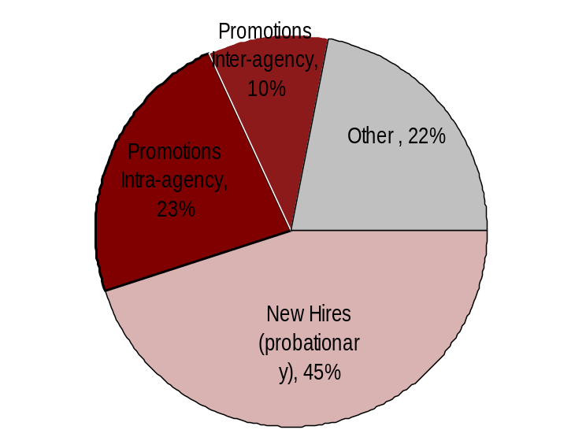

Hire Workforce |
HR Management Report category:
Right People in the Right Job at the Right Time
Performance Measures
Days to fill vacancies
% satisfaction with candidate quality
% new hires; % promotional hires
% separation during review period
Analysis:
XXX
XXX
XXX
XXX
XXX
XXX
XXX
XXX
Hiring Balance - FY 2006
Total of 82 appointments
Days to Fill Vacancies
Other (3,926)
This data will be reported by agencies to DOP in April 2007
Action Steps:
XXX
XXX
XXX
XXX
XXX
XXX
XXX
Candidate Quality
(managers’ satisfaction rating)
Separation during Review Period
This data will be reported by agencies to DOP in April 2007
*
* Released
** Voluntary
*
Other = transfers, demotions, reassignments, movement in lieu of RIF, etc.
Notes:
Notes:

Slide 7
Deploy Workforce |
HR Management Report category:
Employee time and talent is used effectively. Employees motivated.
Performance Measures
Percent employees with current performance expectations
Employee survey ratings on “productive workplace” questions
Overtime usage
Sick leave usage Number & type of non-disciplinary grievances and disposition
Percent employees with current performance expectations
100%
Analysis:
CTED has met 100% two years in a row. The agency is committed to this goal on a continuing basis
SPACE FOR AGENCY’S DISCRETIONARY USE
Action Steps:
NA

Slide 8
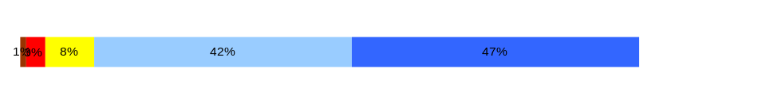
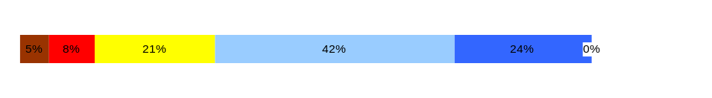
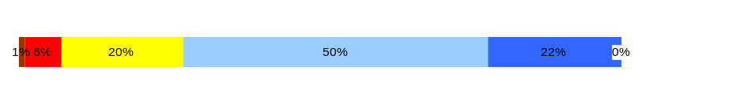
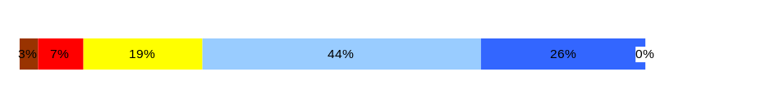
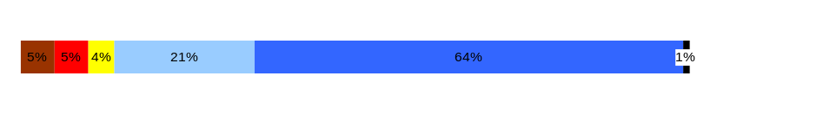
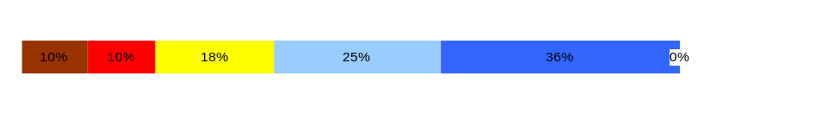
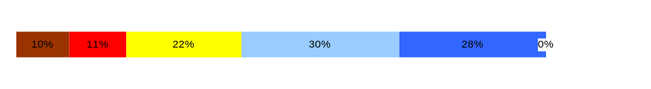
Deploy Workforce |
HR Management Report category:
Employee time and talent is used effectively. Employees motivated.
Performance Measures
Percent employees with current performance expectations
Employee survey ratings on “productive workplace” questions
Overtime usage
Sick leave usage Number & type of non-disciplinary grievances and disposition
Do employees have the day-to-day support
needed to enable successful job performance?
Analysis:
XXX
XXX
XXX
XXX
XXX
XXX
Q4. I know what is expected of me at work. (4.3)
Q1. I have opportunity to give input on decisions affecting my work. (3.5)
Q2. I receive the information I need to do my job effectively. (3.8)
Q6. I have the tools and resources I need to do my job effectively. (3.8)
Q7. My supervisor treats me with dignity and respect. (4.3)
Q8. My supervisor gives me ongoing feedback that helps me improve
my performance. (3.7)
Q9. I receive recognition for a job well done. (3.3)
Overall average score for “productive workplace” questions is 3.8
Action Steps:
XXX
XXX
XXX
XXX
SPACE FOR AGENCY’S DISCRETIONARY USE

Slide 9
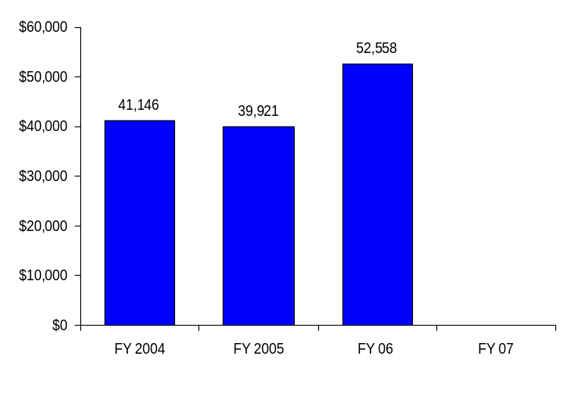
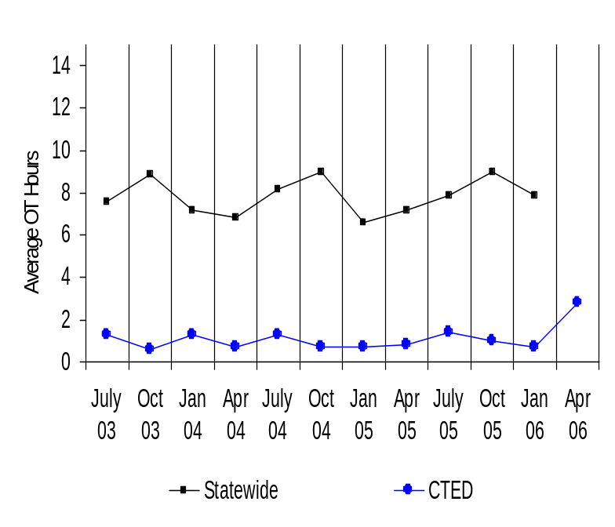
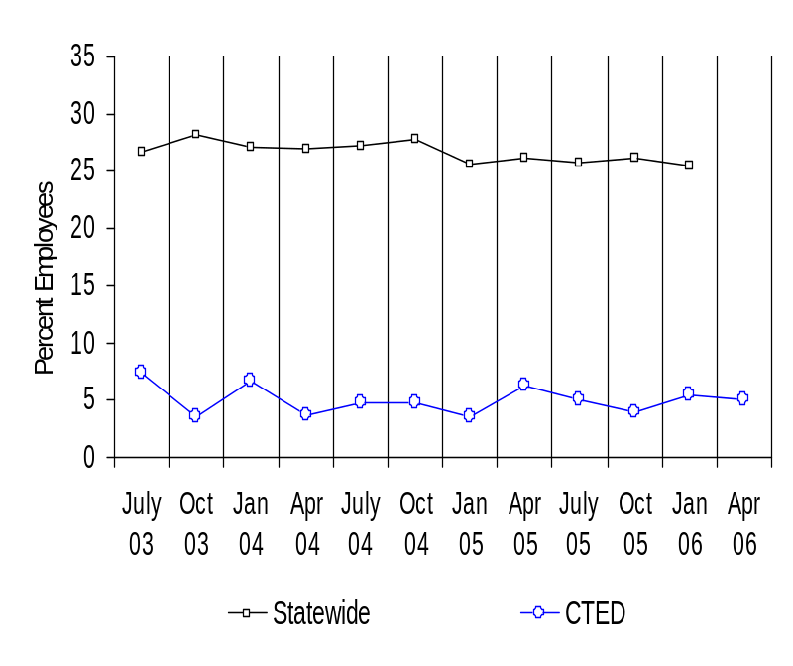
Deploy Workforce |
HR Management Report category:
Employee time and talent is used effectively. Employees motivated.
Performance Measures
Percent employees with current performance expectations
Employee survey ratings on “productive workplace” questions
Overtime usage
Sick leave usage
Number & type of non-disciplinary grievances and disposition
Agency Overtime Costs
Analysis/Action Steps:
XXX
XXX
XXX
XXX
XXX
XXX
Average Overtime Hours (per capita)
Percent Employees Getting Overtime

Slide 10
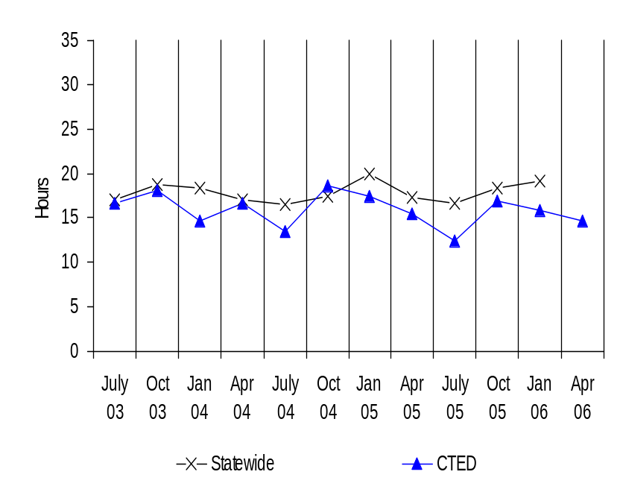
Deploy Workforce |
HR Management Report category:
Employee time and talent is used effectively. Employees motivated.
Performance Measures
Percent employees with current performance expectations
Employee survey ratings on “productive workplace” questions
Overtime usage
Sick leave usage
Number & type of non-disciplinary grievances and disposition
Average Sick Leave Use
(per capita)
Analysis/Action Steps:
XXX
XXX
XXX
XXX
XXX
XXX
Per Capita Sick Leave Use
Just Those Who Took Sick Leave
Ave. Sick Leave Hours Used per Qtr*
% of Earned Sick Leave
Ave. Sick Leave Hours Used per Qtr*
% of Earned Sick Leave
Statewide
17.8
hours
74%
22.9
hours
95%
CTED
17.1
hours
71
%
21.9
hours
91%
* Average since July 03

Slide 11
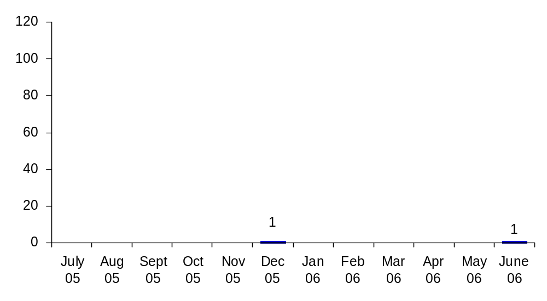
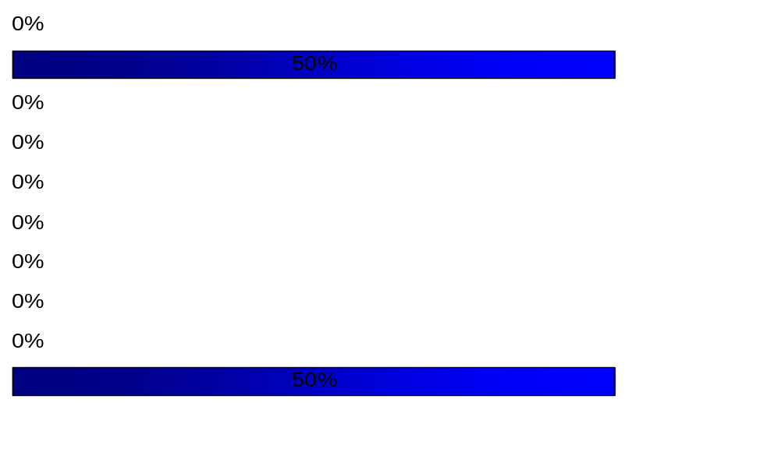
Deploy Workforce |
HR Management Report category:
Employee time and talent is used effectively. Employees motivated.
Performance Measures
Percent employees with current performance expectations
Employee survey ratings on “productive workplace” questions
Overtime usage
Sick leave usage
Number & type of non-disciplinary grievances and disposition
Number of Grievances
Type of Grievances (July 05 – May 06)
Grievance Disposition
Pending: 1
Resolved: 1
XXX
XXX
XXX
XXX
Discipline
Compensation
Overtime
Work Hours
Bid System
Leave
Hiring/Appts
Non-discrimination
Management Rights
All other

Slide 12
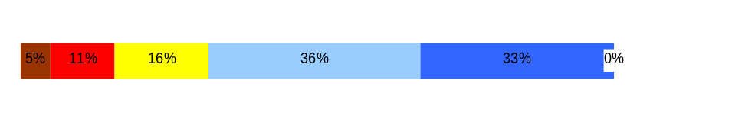
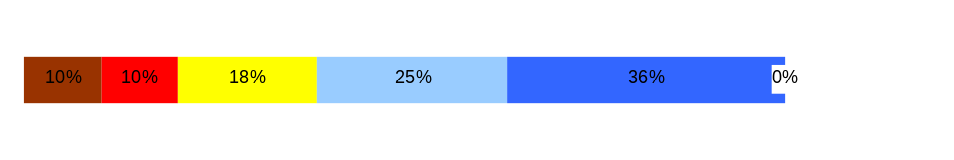
Employees have competencies for present job and future advancement
Develop Workforce |
HR Management Report category:
Performance Measures
Percent employees with current annual individual development plans
Employee survey ratings on “learning & development” questions
Analysis:
CTED has met 100% two years in a row. The agency is committed to this goal on a continuing basis
Percent employees with current Individual Development Plans
100%
Overall average score for “Learning & Development” questions is 3.65
Employee perceptions on
learning and development
Q5. I have opportunities at work to learn and grow. (3.6)
Q8. My supervisor gives me ongoing feedback that helps me improve
my performance. (3.7)
Action Steps:
NA
Never
Seldom
Occasionally
Usually
Always
SPACE FOR AGENCY’S DISCRETIONARY USE
94%
Notes:
Notes:

Slide 13
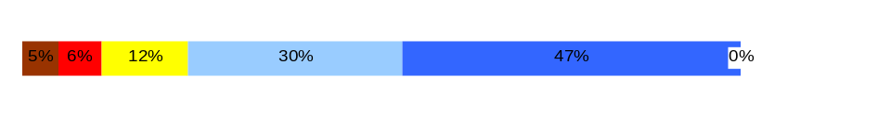
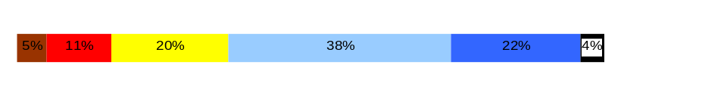
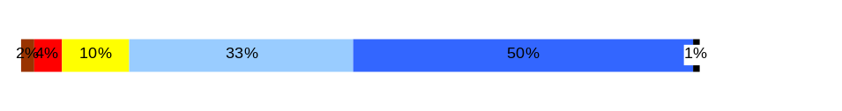
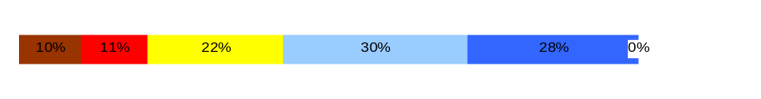
Successful performance is differentiated & strengthened. Employees are held accountable.
Reinforce Performance |
HR Management Report category:
Performance Measures
Percent employees and managers with current annual performance evaluations
Employee survey ratings on “performance and accountability” questions
Number and type of disciplinary issues, actions, appeals disposition
Percent employees with current performance evaluations
100%
Analysis:
CTED has met 100% two years in a row. The agency is committed to this goal on a continuing basis
Do employees see a meaningful linkage between their performance and the success of the organization?
Q3. I know how my work contributes to the goals of my agency. (4.1)
Q10. My performance evaluation provides me with meaningful information about my performance. (3.4)
Q11. My supervisor holds me and my co-workers accountable for performance. (4.1)
Q9. I receive recognition for a job well done (3.3)
Overall average score for “performance & accountability” questions is 3.7
Action Steps:
NA
Never
Seldom
Occasionally
Usually
Always

Slide 14
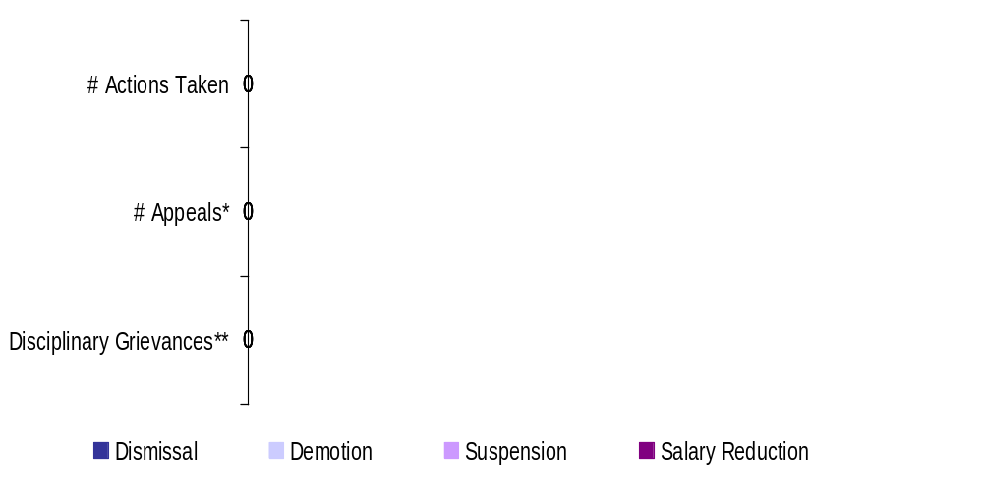
Successful performance is differentiated & strengthened. Employees are held accountable.
Reinforce Performance |
HR Management Report category:
Performance Measures
Percent employees and managers with current annual performance evaluations
Employee survey ratings on “performance and accountability” questions
Number and type of disciplinary issues, actions, appeals disposition
Formal Disciplinary Actions, Appeals, Grievances
FY 2006 to date (July 1, 2005- February 28, 2006)
Analysis:
NA
* Non-represented employees ** Represented employees
Action Steps:
NA
Issues Leading to Disciplinary Action
NA
Disposition of Disciplinary-related Grievances or Appeals
NA

Slide 15
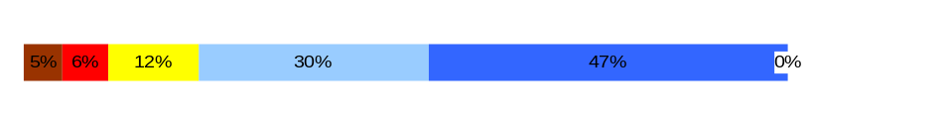
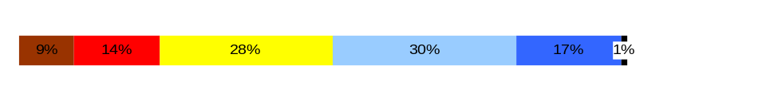
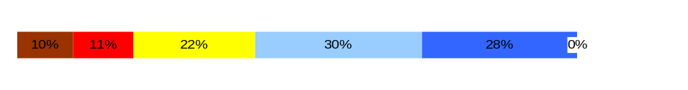
Ultimate Outcomes
HR Management Report category:
State has workforce breadth & depth for present & future success.
Employees are committed to the work they do and the goals of the organization.
Successful, productive employees are retained.
Performance Measures
Employee survey ratings on “commitment” questions
Turnover rates and types (e.g., retirement, resignation, etc.)
Turnover rate of key occupational categories - TBD
Diversity profile [& turnover TBD]
Indicators of Employee Commitment
Analysis:
XXX
XXX
XXX
XXX
XXX
XXX
Q3. I know how my job contributes to the goals of my agency. (4.1)
Q12. I know how my agency measures its success. (3.4)
Q9. I receive recognition for a job well done (3.3)
Overall average score for “performance & accountability” questions is 3.6
Action Steps:
XXX
XXX
XXX
XXX
Never
Seldom
Occasionally
Usually
Always
Notes:
Notes:

Slide 16
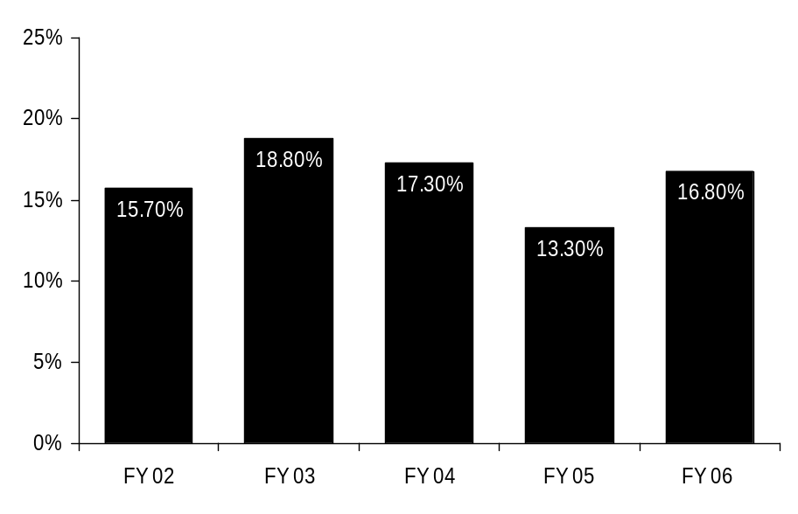
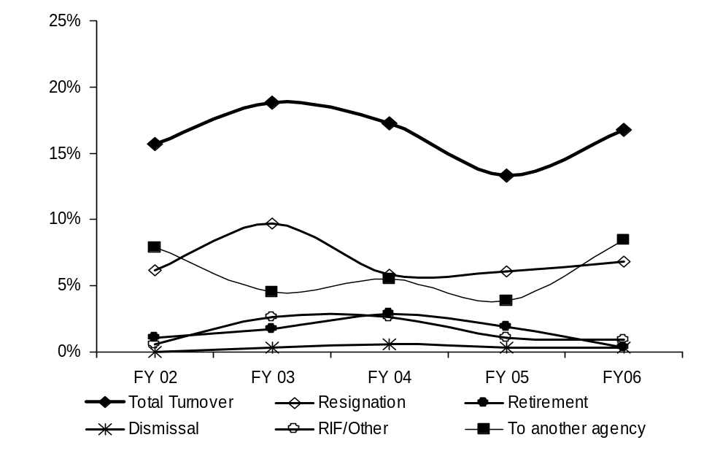
Ultimate Outcomes | continued
HR Management Report category:
Performance Measures
Employee survey ratings on “commitment” questions
Turnover rates and types (e.g., retirement, resignation, etc.)
Turnover rate of key occupational categories - TBD
Diversity profile [& turnover TBD]
Agency-wide Turnover
[leaving agency]
Analysis:
XXX
XXX
XXX
XXX
XXX
XXX
Action Steps:
XXX
XXX
XXX
XXX
Agency Workforce Turnover Breakdown
Notes:
Notes:
Trend Factors:
HRISD – Project ending – if current trend continues = 8% by end of FY06
DIR – Change in leadership – if current trend continues = 7% by end of FY06
CERS & PSD - Reorganized – if current trend continues = 4% by end of FY06
ASD Stable and low rate – if current trend continues = .33% by end of FY06
OEDS – Stable and low rate – if current trend continues = 1.5% by end of FY06

Slide 17
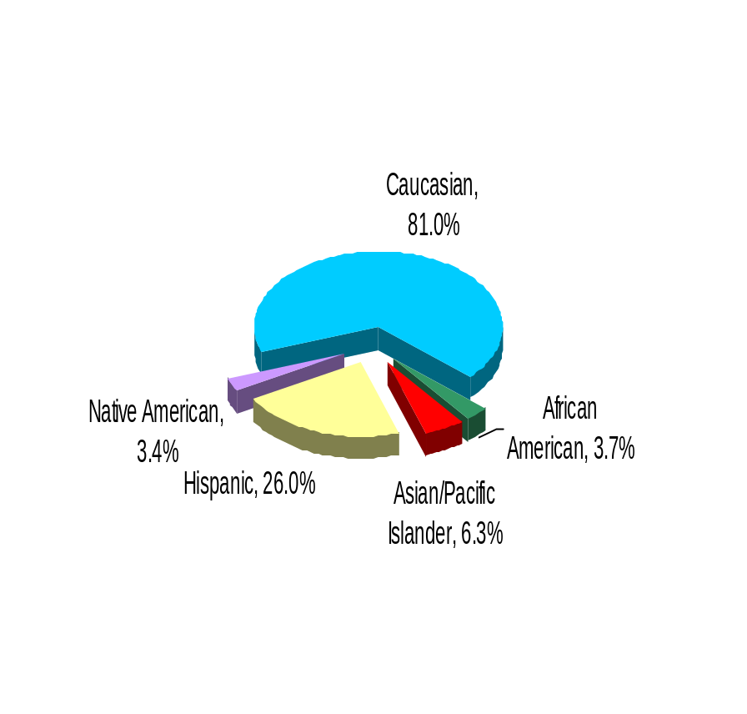
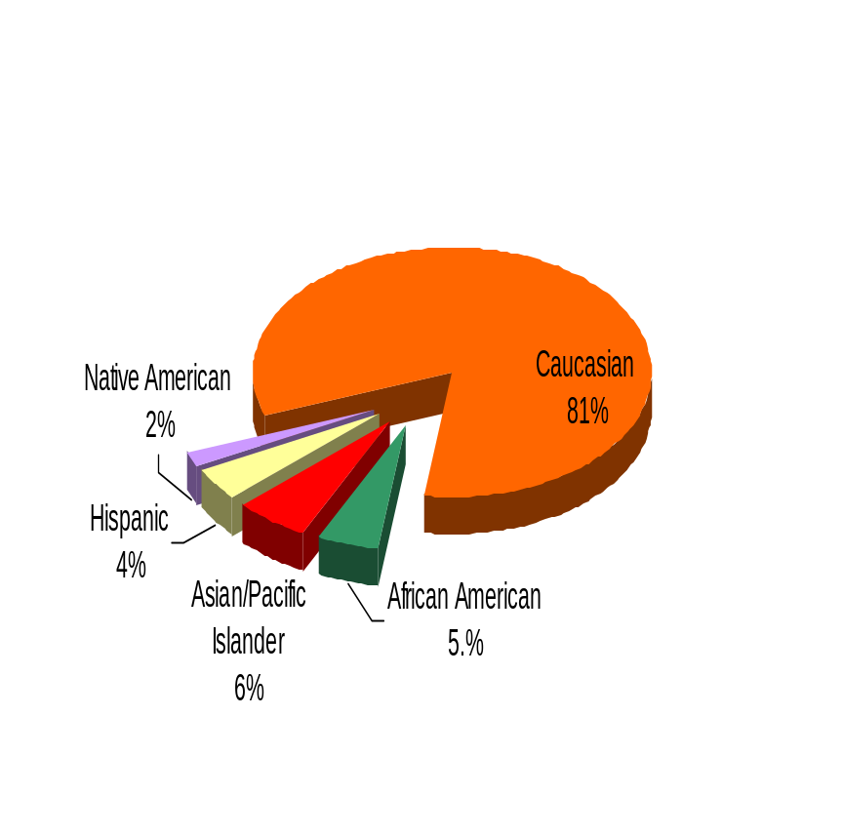
Ultimate Outcomes | continued
HR Management Report category:
Performance Measures
Employee survey ratings on “commitment” questions
Turnover rates and types (e.g., retirement, resignation, etc.)
Turnover rate of key occupational categories - TBD
Diversity profile [& turnover TBD]
CTED
Diversity Profile CTED State
Women 65.6% 52%
Persons with disabilities 4.3% 5%
Vietnam Veterans 4.9% 7%
Disabled Veterans 1.4% 2%
Persons over 40 NA 76%
People of color 16% 17.5%
WA State Government
Notes:
XXX
XXX
XXX
XXX
Notes:
Notes:
Trend Factors:
HRISD – Project ending – if current trend continues = 8% by end of FY06
DIR – Change in leadership – if current trend continues = 7% by end of FY06
CERS & PSD - Reorganized – if current trend continues = 4% by end of FY06
ASD Stable and low rate – if current trend continues = .33% by end of FY06
OEDS – Stable and low rate – if current trend continues = 1.5% by end of FY06

