Slide 1
California Incentives For
Renewable Markets
Timothy N. Tutt
California Energy Commission
(916) 654-4590

Slide 2
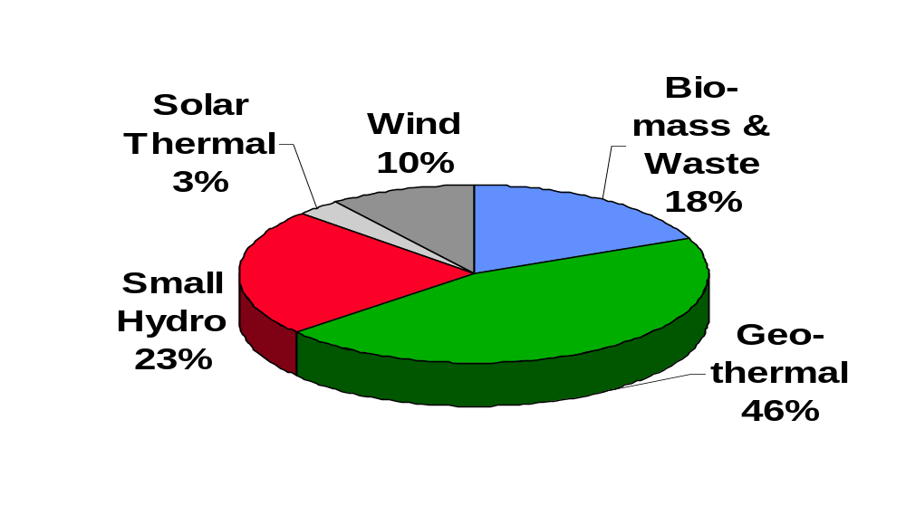
California Renewable Energy
27,500 GWh in 1998

Slide 3
Background: Electricity Deregulation
Key Elements of AB 1890
  Established Power eXchange and Independent System Operator
  Recovery of stranded costs over four-year transition period
  Funds to Support Public Purpose Programs
    Non-bypassable surcharge: System Benefit Charge
    Four Programs Supported: Renewables, Energy Efficiency, Low Income, and Research & Development
  Retail Competition
    Customer Choice, Green Market, Consumer Education
    10% Residential Rate Decrease; No Shopping Credit
Notes:
Public Purpose Support
Renewables, EE, Low Income, and R&D
Retail Competition
Aggregation
Customer Choice
Green Market
Consumer Education
SB 90 implemted the Commission’s policy report

Slide 4
Renewable Portfolio Standard or System Benefit Charge?
Straight RPS lets market players decide how and when to meet standard - cost is unknown
RPS with price cap still lets market decide, but cost is capped and level of renewables is unknown
SBC collects money for some kind of administrative allocation:
  level of renewables is unknown
  Can be made market-oriented - maximize reactivity with market decisions

Slide 5
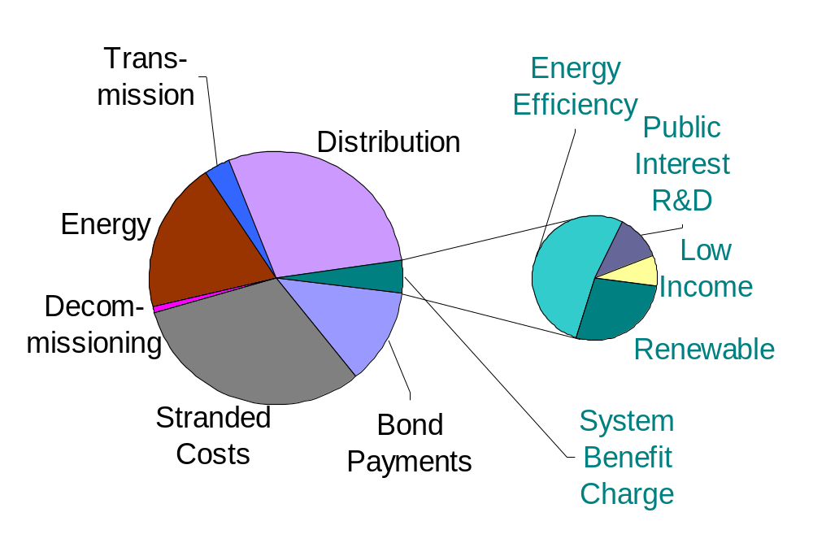
California Bill After Restructuring

Slide 6
Renewables Program
$540 Million established to support New, Existing, and Emerging Renewable Technologies
Funds Allocated to Four “Accounts”
  Existing Technologies ($243 Million)
  New Technologies ($162 Million)
  Emerging Technologies ($54 Million)
  Customer-Side Purchases ($81 Million)
    $76 Million to Consumer Credit Subaccount,
    $5 Million to Consumer Education Subaccount

Slide 7
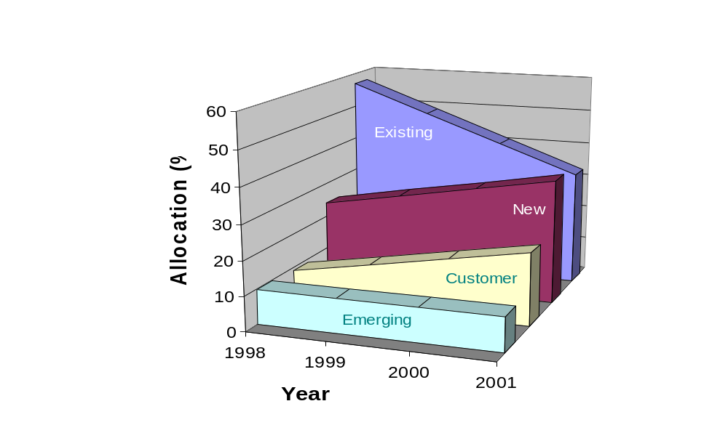
Ramping Allocations by Year

Slide 8
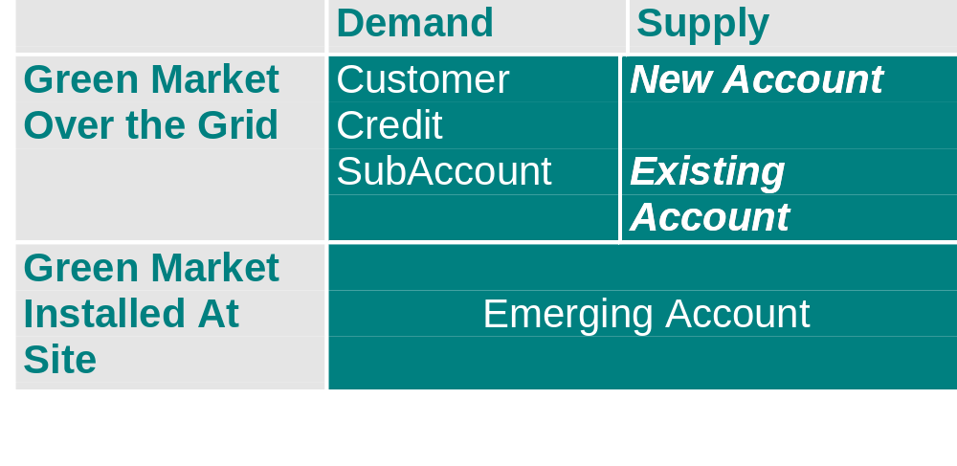
Assisting Green Market
Notes:
Incentives for purchasing eligible renewable energy through direct access marketplace
Program intent is to ‘jump-start’ the renewable or green market in California
Barriers: generally higher energy cost and high start-up marketing costs to move customers from long-time status quo in difficult period
Existing Account assists competitive transition for renewable power plants operating prior to 9/26/96
New Account “jump-starts” investment in new renewable power plants for the competitive market
Incentives for small distributed systems that primarily offset customer’s electricity load (self-generation)
Four technologies: Photovoltaic, Solar Thermal, Small Wind, and Fuel Cells (using renewable fuel)

Slide 9
Over the Grid Supply:
Market-Driven Payments
Existing Account production incentives (cents/kWh) are the lesser of:
  a payment cap (either 1 or 1.5 cents/kWh)
  a target price minus the market electricity price
  the available funds divided by the eligible generation
New Account production incentives (cents/kWh) are:
  the result of bidding in an auction
  paid only for first five years of generation after startup
Notes:
Market prices for each potential bidders power is expected to reflect value of
Capacity
Voltage support
Transmission costs
Many environmental costs

Slide 10
Over the Grid Supply: Results
New Account:
  auction induced 55 winning bids which laid claim to entire $162 million available
    300 MW of wind, 157 MW of geothermal, 70 MW of landfill gas, 12 MW of biomass, 2 MW of digester gas, 1 MW of small hydro
    Full amount of $162 million allocated at an average incentive of 1.2 cents/kWh
  all projects expected to pass Milestone #1 by this month
Existing account:
  $55 million paid out, $21 million rollover in 1998
  nearly 50 facilities “off the cliff” but continue operating

Slide 11
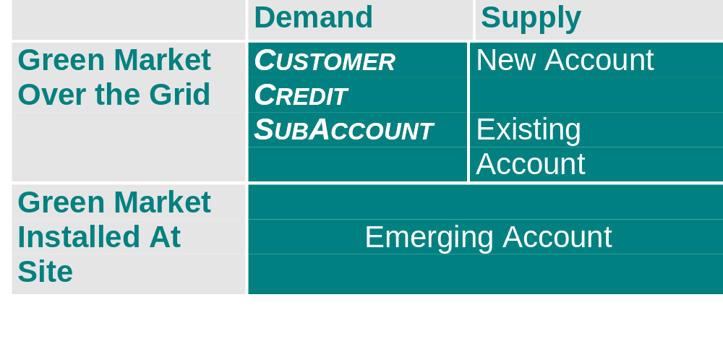
Assisting Green Market

Slide 12
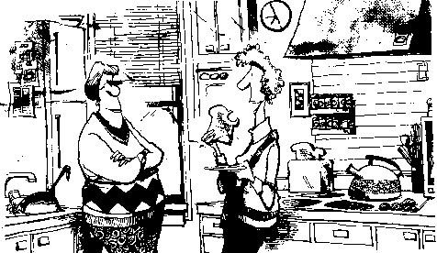
Now that’s crisp, reliable, hassle-free toast, and at peak hours with no long waits! Who do you say is your electricity provider?

Slide 13
Over the Grid Demand:
Market-Driven Payments
Incentives constant at 1.5 cents/kWh for six month intervals at beginning, but starts “floating” as demand grows significantly
Only direct access transactions eligible
Administrative costs reduced by distributing funding through energy service providers
Incentive $ capped for large Commercial and Industrial customers (> 20 KW) at $1,000/year
  Cap removed if incentive stays at 1.5 cents/kwh in 1999

Slide 14
Over the Grid Demand: Results
14 marketers have registered as renewable providers offering 27 products containing a percentage of renewable energy
Six marketers have submitted invoices covering up to 12 months for $5 million
Market expected to continue to grow rapidly in 1999
Recent development: at least 3 products priced lower than conventional energy through PX

Slide 15
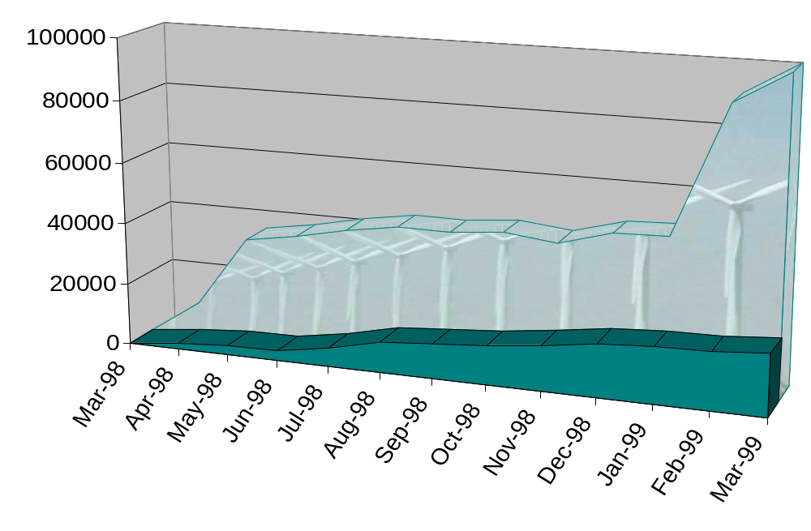
Participants in Customer Credit

Slide 16
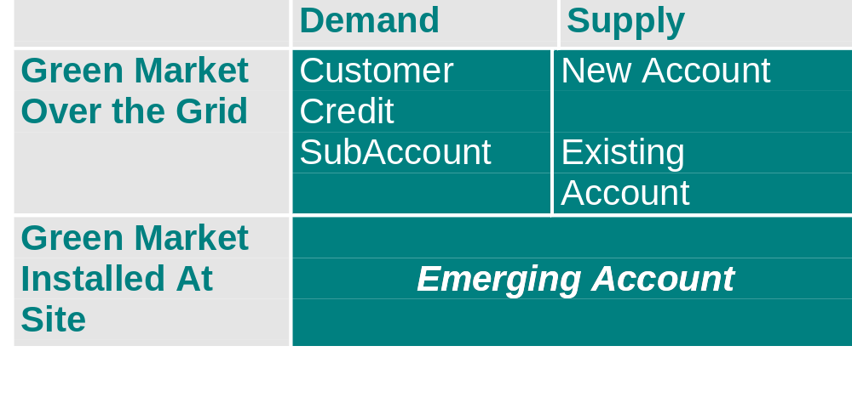
Assisting Green Market

Slide 17
Installed at Site Demand/Supply:
Market-Driven Payments
Buydown incentives decrease over time: foreshadowing decrease in technology costs
  $3.00, 2.50, 2.00, 1.50, 1.00 per watt, or
  50%, 40%, 30%, 25%, 15%, whichever is less
Technology must be installed prior to payment
Technology must be creditable:
  Installation by liscensed professional or do-it-yourself
  5-year warranty required on equipment/installation
  UL Listing or 1 year demonstrated operation in market
Notes:
Past initial R&D stage, but still high cost compared to alternatives:
Competitive barrier for these technologies is economies of scale
Program intent is to increase demand and help drive production costs down.

Slide 18
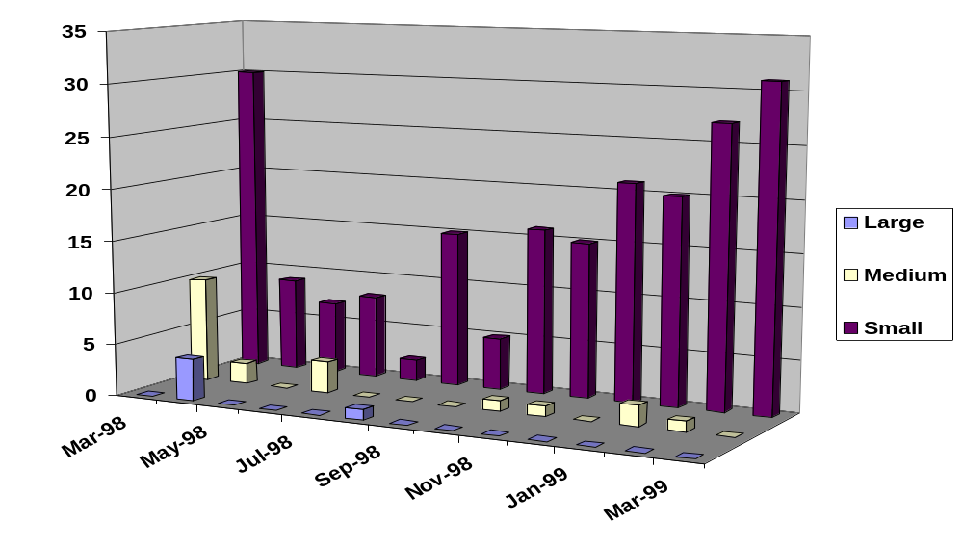
Installed at Site: Results
Notes:
~ 200 buydown reservation requests received totalling over $8 million
About $5 million reserved for large projects (>100 kW)
Over $3 million reserved for smaller systems
So far, systems >100kW have reserved majority of funds
Nearly $630K in payments have been made for installed systems to date
Block 1 funds for larger and medium systems all reserved

Slide 19
In Conclusion
Very Encouraged By Results So Far
SBC Structure Seems Workable - Can Be Made Market-Oriented
Next Piece of Puzzle To Get In Place -
  Consumer Education Campaign
    $5.4 million to fund campaign
    Opting For Stakeholder Coalition
    Asking For Leveraging
Questions:
  Does Program Funding Continue Beyond Transition?
  How To Structure Next Steps

