Slide 1

RF phase shaking for bunch distribution modification
Alexey Burov
June 11, 2010

Slide 2
Motivation
Tevatron bunches are known to demonstrate longitudinal instability sometimes called as “dancing bunches” [1]. Similar phenomena happen at other machines as well.
There are some theoretical indications showing that this instability is sensitive to a derivative of the phase space density f '(J)=df/dJ at small actions, f '(J→0).
Distributions with flat or even positive slope of the distribution density at small actions appear to be more beneficial [2].
However, IBS always tries to make this derivative negative, df/dJ-f/J_{rms} . Thus, the problem emerges - is it possible to zero this derivative or even change its sign by one or another meaning?

Slide 3

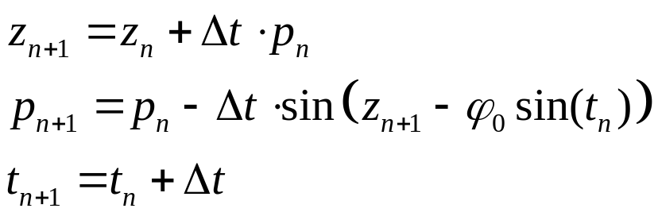

RF phase shaking
It is known that the distribution function tends to flatten inside resonance separatrices. Thus, the desired change of the distribution may be achieved by introducing a proper resonance for small amplitude particles. Due to nonlinearity of the synchrotron motion, large amplitude particles could be only slightly disturbed by that.
Technically, easiest way for that would be modulation of the RF phase with a synchrotron frequency for small amplitude particles. Then, a width of the affected area is determined by an amplitude of that phase modulation .

Slide 4




Simulations
To see how this mapping changes the distribution function, tracking of N=10⁴ particles was simulated on a base of Mathematica. Original distribution over unperturbed actions J was taken as
with the total emittance , close to the bucket acceptance
The amplitude of the RF phase modulation was taken . The synchrotron phase advance was taken as , and the simulation time Tsim=500 synchrotron radians = 80 synchrotron periods.

Slide 5
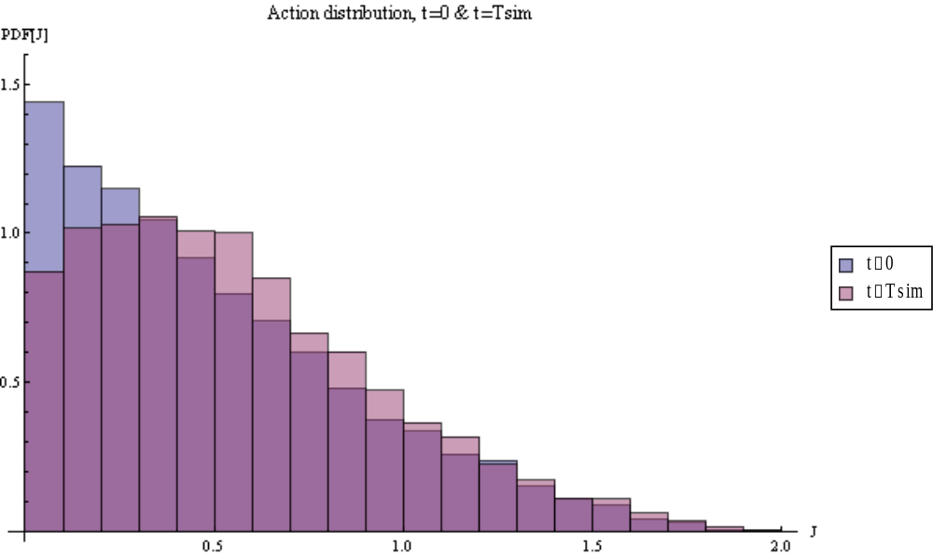
Simulation results: action distribution
Fig. 1. Initial (blue) and final (pink) distributions over action. Overlapping area is violet.

Slide 6
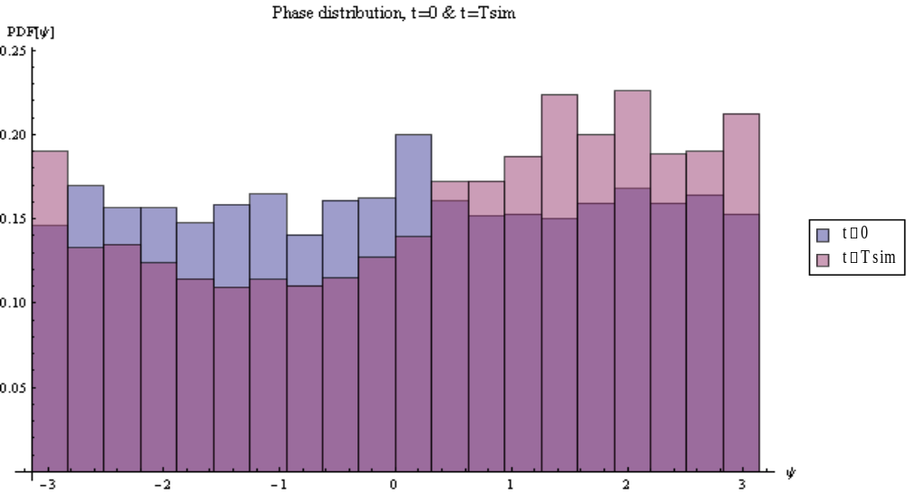
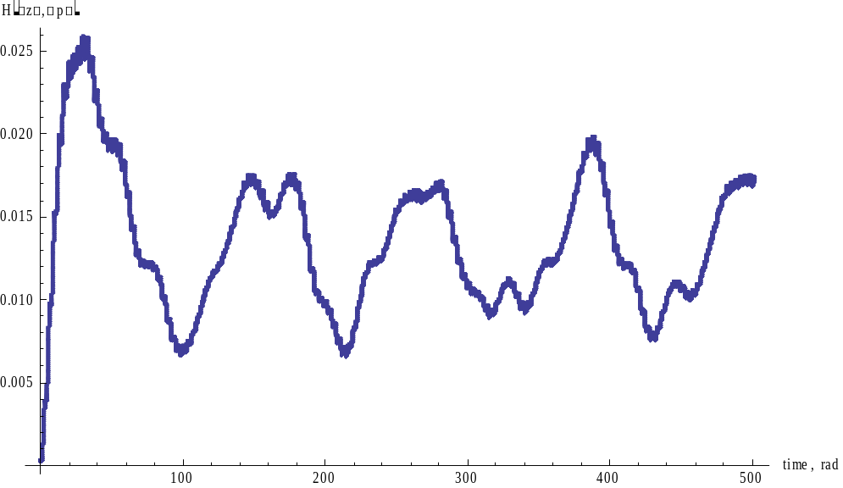
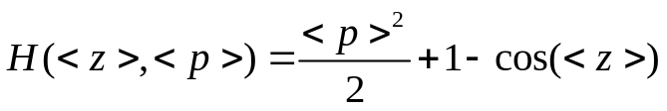


Excited centroid motion
Phase distribution shows
some coherent excitation.
Fig. 3. Centroid Hamiltonian as a function of time.

Slide 7
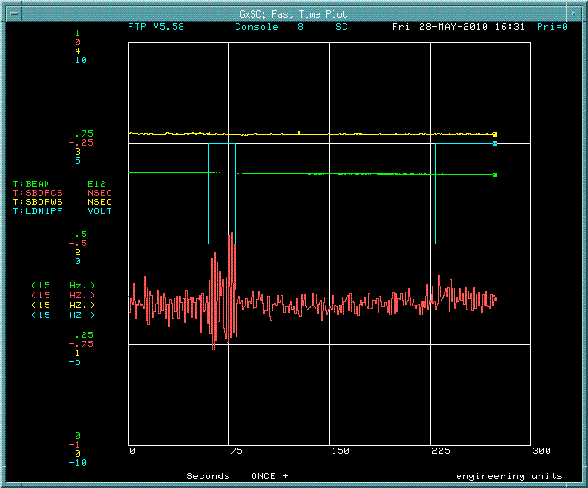
First studies (C.Y. Tan)
RF phase shaking at Tevatron: 4.5 (at ~ 50-75 s) and 1 (at 225 s)
at 87.47 Hz (measured synchrotron frequency).
Note immediate coherent decay at 75 s when the shaker got off.

Slide 8
Conclusions
RF phase modulation is clearly working tool for flattening of the distribution function. From this point of view, it should help to stabilize longitudinal instability [2].
Although RF phase modulation itself excites coherent motion at some level, it should not make a significant problem. Indeed, this RF modulation is needed only for ~ 100 synchrotron revolutions or so, and after that it has to be switched off. The provided distribution should be stable, so any coherent motion should decay.
The simulation mapping does not take into account the wake field. Wakes lead to potential well distortion, depressing synchrotron frequencies, so slightly reducing the required frequency of the RF modulation.
Continuing beam studies are needed with the bunch profile measurements.

Slide 9
Referencies
R. Moore et al., “Longitudinal bunch dynamics in the Tevatron”, Proc PAC 2003, p. 1751.
A. Burov, to be published.
I am thankful to V. Lebedev for multiple discussions.

