Slide 1
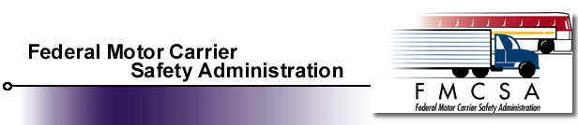
Talking Freight Seminar
Presenter
Chuck Horan
Director of Enforcement and Compliance

Slide 2
  Overview:
    Who we are
    Our Industry
    Mission
    Programs

Slide 3
  Who we are:
    OMC part of Federal Highway
    MCSIA 1999
    January 2000 FMCSA
    1000 strong
      HQ-Staff
      4-Service Centers
      Division Offices in Each State
      Mexico and Canadian requirement
      Force multiplier – MCSAP

Slide 4
  Our Industry
    Interstate commerce Fed Jurisdiction
    662,392 Truck and Bus companies
      7,927,280 Large trucks
    20,094 Passenger carrier companies
      669,780 Commercial busses
    43,543 HM companies
      1.1M HM shipments daily
    All vehicles 225,684,815
    CDL drivers 11 million

Slide 5
  Mission
  Reduce crashes, injuries, and fatalities involving large trucks and buses.
    Develop and enforce data-driven regulation
    Focus efforts on high risk carriers
    Education
  GOAL: Reduce the large truck fatality rate by 41% from 1996 to 2008. This reduction translates into a rate of 1.65 fatalities in truck crashes per 100 million miles of truck travel.

Slide 6
  Programs
    Federal Motor Carrier Safety Regulations
    Hazardous Material Regulations
    Commercial Drivers License
    Motor Carrier Safety Identification and Information Systems
    New Entrant Safety Assurance Process
    Motor Carrier Safety Assistance Program (MCSAP)
    Performance and Registration Information System Management (PRISM)

Slide 7
  Programs continued
    Border and International Safety
    Safety Education and Outreach
    Household Goods program

Slide 8
  Motor Carrier Safety Regulations (FMCSRs)
    Develop maintain and enforce federal regulations
      Promote carrier safety, industry productivity and new technologies
    Establish safe operating requirements
      Commercial Vehicle Drivers
      Carriers
      Vehicles
      Equipment

Slide 9
  Hazardous Material Regulations (HMRs)
    Partner with RSPA
      Ensure safe and secure transportation of HM
      Classification of HM
      Proper packaging
      Employee training
      Hazard communication
      Operational requirements
  FMCSA might be characterized as RSPAs enforcement arm for HM over the road shipments

Slide 10
  Commercial Drivers License (CDL)
    Develop, monitor, ensure compliance with the commercial driver licensing standards for:
    Drivers
    Carriers
    States

Slide 11
  Motor Carrier Safety Identification and Information Systems
    National and State crash statistics
    Current analysis
    Detailed motor carrier safety performance data to industry and public
  Data used by State and Federal enforcement to target inspections and investigations

Slide 12
  New Entrant Safety Assurance Program
    Aprox. 4800 per month
    Educate new carriers
      18 month monitoring

Slide 13
  Motor Carrier Safety Assistance Program (MCSAP)
    Federal Grant to State
      Hire staff
      Implement strategies to enforce FMCSRs and HMRs
      Conduct roadside inspection
      Review motor carrier FMCSR compliance
      Detect and correct
        CMV defects
        Driver deficiencies
        Unsafe motor carrier practices

Slide 14
  Performance & Registration Information Systems Management (PRISM)
    Tie motor carrier safety with vehicle registration
    Identify at the vehicle level who is responsible for safety
    Continuous monitoring prohibiting carriers from operating by removing license plates

Slide 15
  Research and Technology
    Gain fundamental and applied knowledge in order to develop new methods and technologies to enhance truck and bus safety and security

Slide 16
  Border and International Safety
    Develop compatible motor carrier safety requirements and procedures
    Ensure motor carriers, drivers, and vehicles from Mexico and Canada operating in the US meet the same safety standards as US carriers

Slide 17
  Safety Education and Outreach
    Implement educational strategies to increase motor carrier compliance with the safety regulations
    Reduce the likelihood of a CMV crash
    Messages are aimed at all highway users
      Passenger car drivers
      Truck drivers
      Pedestrians
      Bicyclists

Slide 18
  Household Goods Program
    Regulate interstate household good movers
    Register with the agency
    Enforcement focused
      Capability increased
      Program strengthened

Slide 19
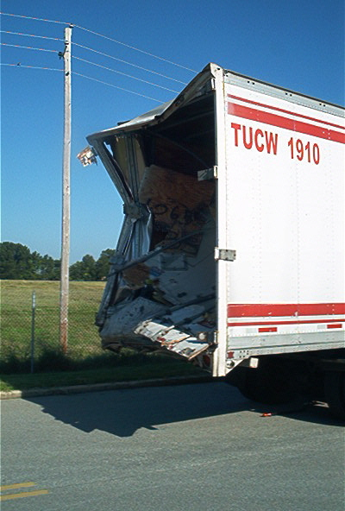
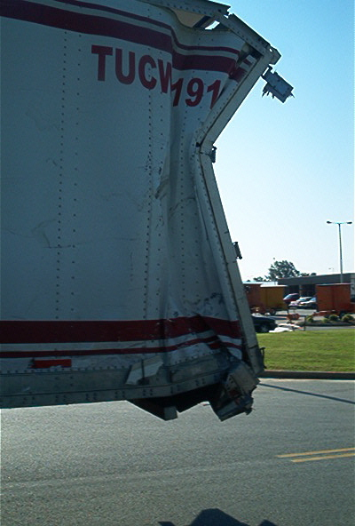

Slide 20
