Slide 1
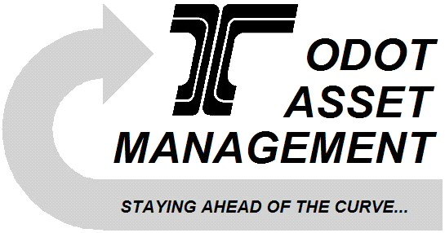
1 - A robust Asset Management Data Collection and Storage System that contains corporate data for transportation features and their condition that is consistent, unduplicated, understandable, reliable, accurate, current and owned by the responsible ODOT Business Line.
2 – A fully automated, flexible and complete Asset Management Data Reporting System that performs cross-asset analysis and monitors the inventory, condition and performance of assets within ODOT’s jurisdiction.
3 – Implement an integrated, useable, and reliable Asset Management system that provides information, analysis tools and processes, so that funding allocation decisions are broad-based across various asset categories; and that provides the tools and information necessary for life-cycle management of ODOT assets.
Transportation Asset
Management
ODOT’S Performance Roadmap
January 2006
Goals
Contact Us
Transportation Development
Division Liaison:
Dave Ringeisen 503-986-4171
Technical Services/Central
Services Liaison:
Laura Wipper 503-986-4092
ODOT Asset Management: http:/www.oregon.gov/odot/td/asset_mgmt/
FHWA Office of Asset Management: http:/www.fhwa.dot.gov/infrastructure/asstmgmt/
AASHTO Asset Management: http:/www.assetmanagement.transportation.org/tam/ aashto.nsf/
More Info

Slide 2
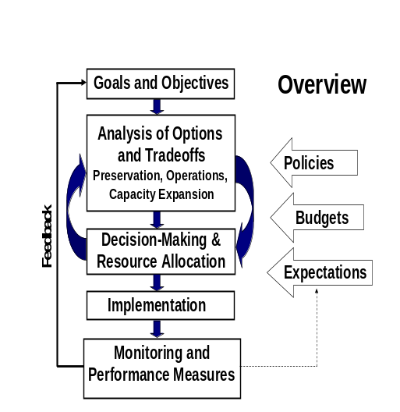
ODOT Vision
What Will it Mean for Me?
Asset Management Overview
ODOT’s assets are managed strategically by utilizing integrated and systematic data collection, storage, analysis and reporting standards on a broad range of transportation system assets, optimizing funding and life cycle decisions for operations, maintenance and construction business functions.
Ultimately you will have:
the right information
available to the right levels of business
at the right times
to support the right decisions
Key Elements of Asset Management
Managed
Business
Process
Strategic
Information
Legislators,
Stakeholders
Implementation Structure
Strategic Goals
Inventory of Assets
Data Collection and Storage Standards
Robust Asset Reporting and Analysis including Cross-Asset Analysis
Customer Focused
System Oriented
DOT Executives
Division Heads
Section Heads
Steering Committees:
Executive
Asset/OTMS
Asset/OTMS Tactical
Various Working Committees & Groups
Agency Staff
Tactical
Information
Coordination across Organizational Units
Transportation Asset Management Guide – (NCHRP) Project 20-24(11)

