Slide 1
Special cardiac safety concerns:
QT prolongation and Valvulopathy
Shari L. Targum, MD, FACC, FACP
Medical Team Leader
  Division of Cardiovascular and Renal Products, CDER, FDA

Slide 2
Detecting safety signals
  Common, severe, drug-related: can detect in controlled, clinical trials (size ~ what % can be ruled out)
  Rare, severe, drug-related: sometimes detected in clinical trials if single case interpretable (e.g., Stevens-Johnson) or via surrogate or biomarker (e.g., QT prolongation)
  Spontaneous events ↑ rate with drug: single event usually not interpretable;
    large enough controlled trial or epidemiologic study (large hazard ratio) (e.g., valvulopathy)

Slide 3
QT prolongation and valvulopathy—different issues: what do they share?
Drug-related effects
Associated with significant risk
Both concerns have led to withdrawal of drugs from the market….
Originally detected post-approval, now efforts to detect earlier in development…

Slide 4
QT Prolongation

Slide 5
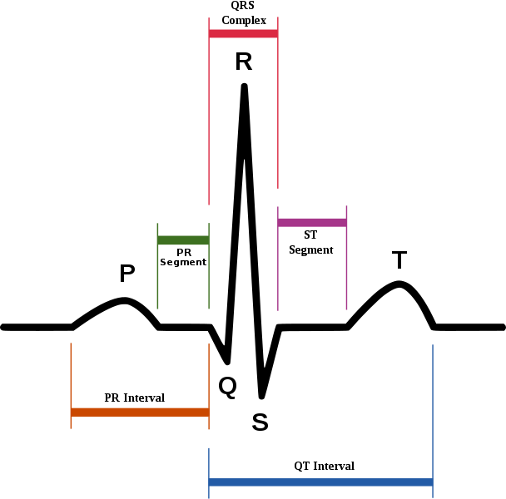

Slide 6
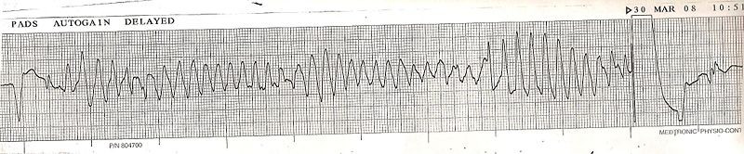
Torsade de pointes: polymorphic ventricular tachycardia
Rare, but life-threatening. Associated with prolonged QT.

Slide 7
Background
Late 1990s-2005
  Drug withdrawals due to TdP (terfenadine, cisapride)
  Agency Working Group on QT prolongation
  Early Concept Paper, then joint effort with Health Canada, then ICH
  ICH E14 (final version: 2005): advanced the notion of a “thorough QT study” (TQT) for all New Molecular Entities

Slide 8
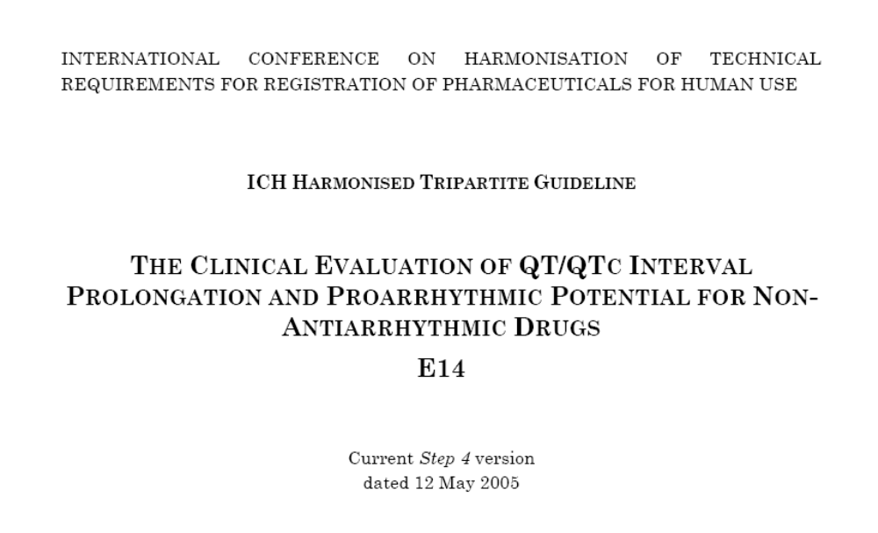
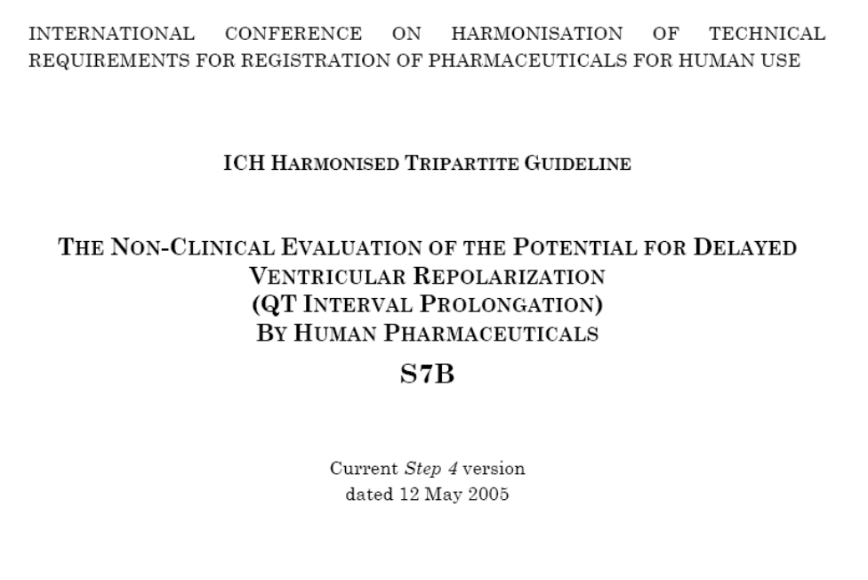
ICH E14/ S7B: Current FDA Policy
Available at
www.ich.org

Slide 9
QT policy
Pre-clinical studies not considered adequate to rule out risk
Most systemically available drugs need a “thorough QT” study
Threshold for potential clinical importance set very low (10 ms; a few percent of normal)
Failure to rule out 10 ms leads to heightened monitoring during phase 3—and approval or labeling implications

Slide 10
Thorough QT Study Purpose
Characterize the concentration-response relationship
Characterize QT effects of the drug under near “worst case” scenario
  ECG sampling at peak concentrations (drug/metabolites)
  Exposure at supratherapeutic concentrations
  Sufficient duration of dosing/sampling to characterize effects

Slide 11
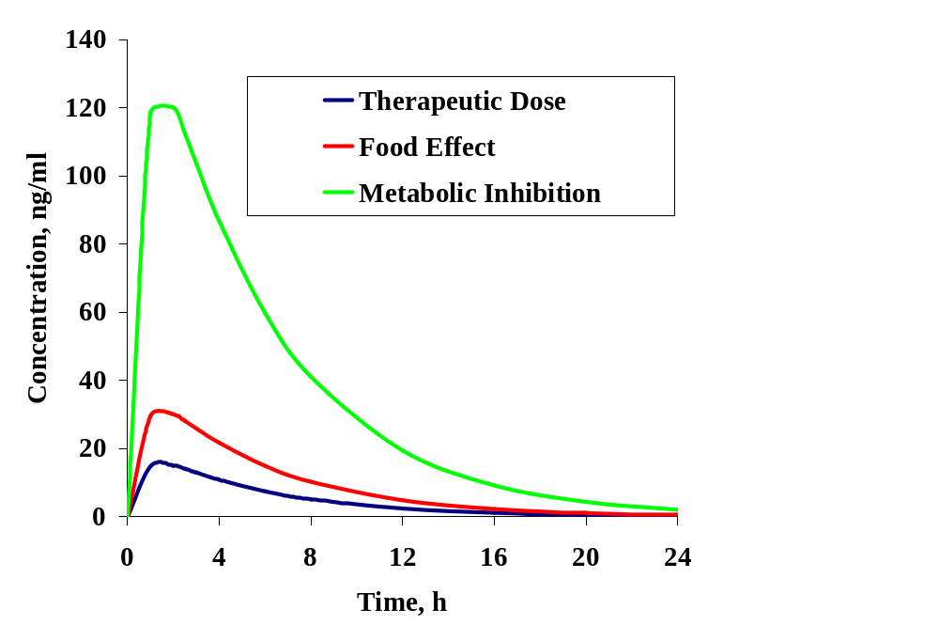
Dose Selection
How to define a supratherapeutic dose

Slide 12
What if the study is positive?
    Need to explore further (examine adverse events, explore vulnerable populations)
    More intensive monitoring
    Might alter development (choose a different dose, different target population, etc.)
    Look for benefits that might offset risk

Slide 13
Problems with this approach…
QT studies difficult and expensive
Relationship to risk (arrhythmia) not constant
Unknown public health consequences of compounds removed from pharmaceutical pipeline

Slide 14
Valvulopathy

Slide 15
Obesity and weight loss
Big public health problem today
Long recognized problem in society
Weight loss medication as solution?

Slide 16
Background
Appetite suppressants in the management of obesity
  Fenfluramine (1973): racemic mixture*- increased serotonin, associated with depression
  Dexfenfluramine (1996)* thought to be safer
  Phentermine (1959) still in use
Combination (fen-phen) was never FDA approved
*withdrawn in 1997

Slide 17
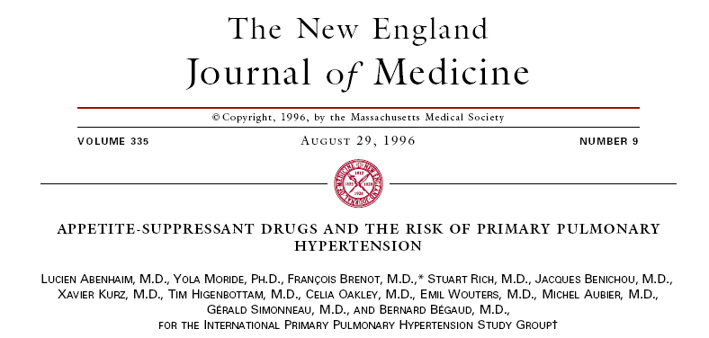
Case-control study in Europe: odds ratio 23.1 associated with use > 3 months.
Notes:
Case-control study in Europe which showed an odds ratio of 23.1 associated with use > 3 months.

Slide 18
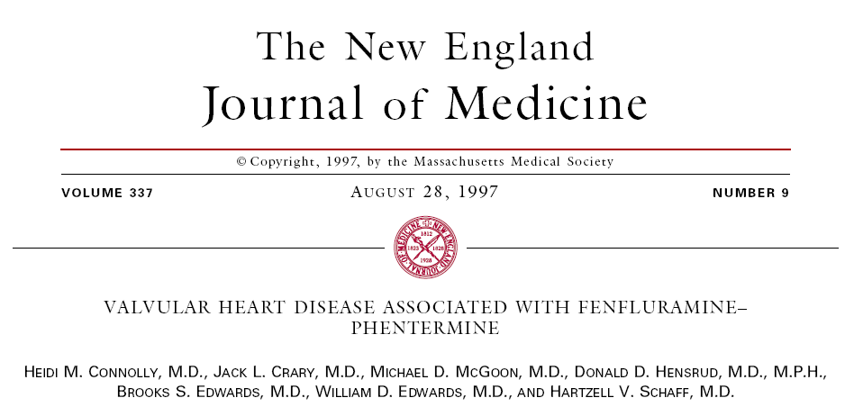
24 women, no prior heart disease, mean rx duration 11 months.
Fenfluramine and dexfenfluramine voluntarily withdrawn on Sept. 15, 1997
Notes:
Combination not approved by FDA; but total # prescriptions exceeded 18 million.
24 women with no history of HD, who developed cardiac symptoms or murmur. Mean duration rx about 11 months.

Slide 19
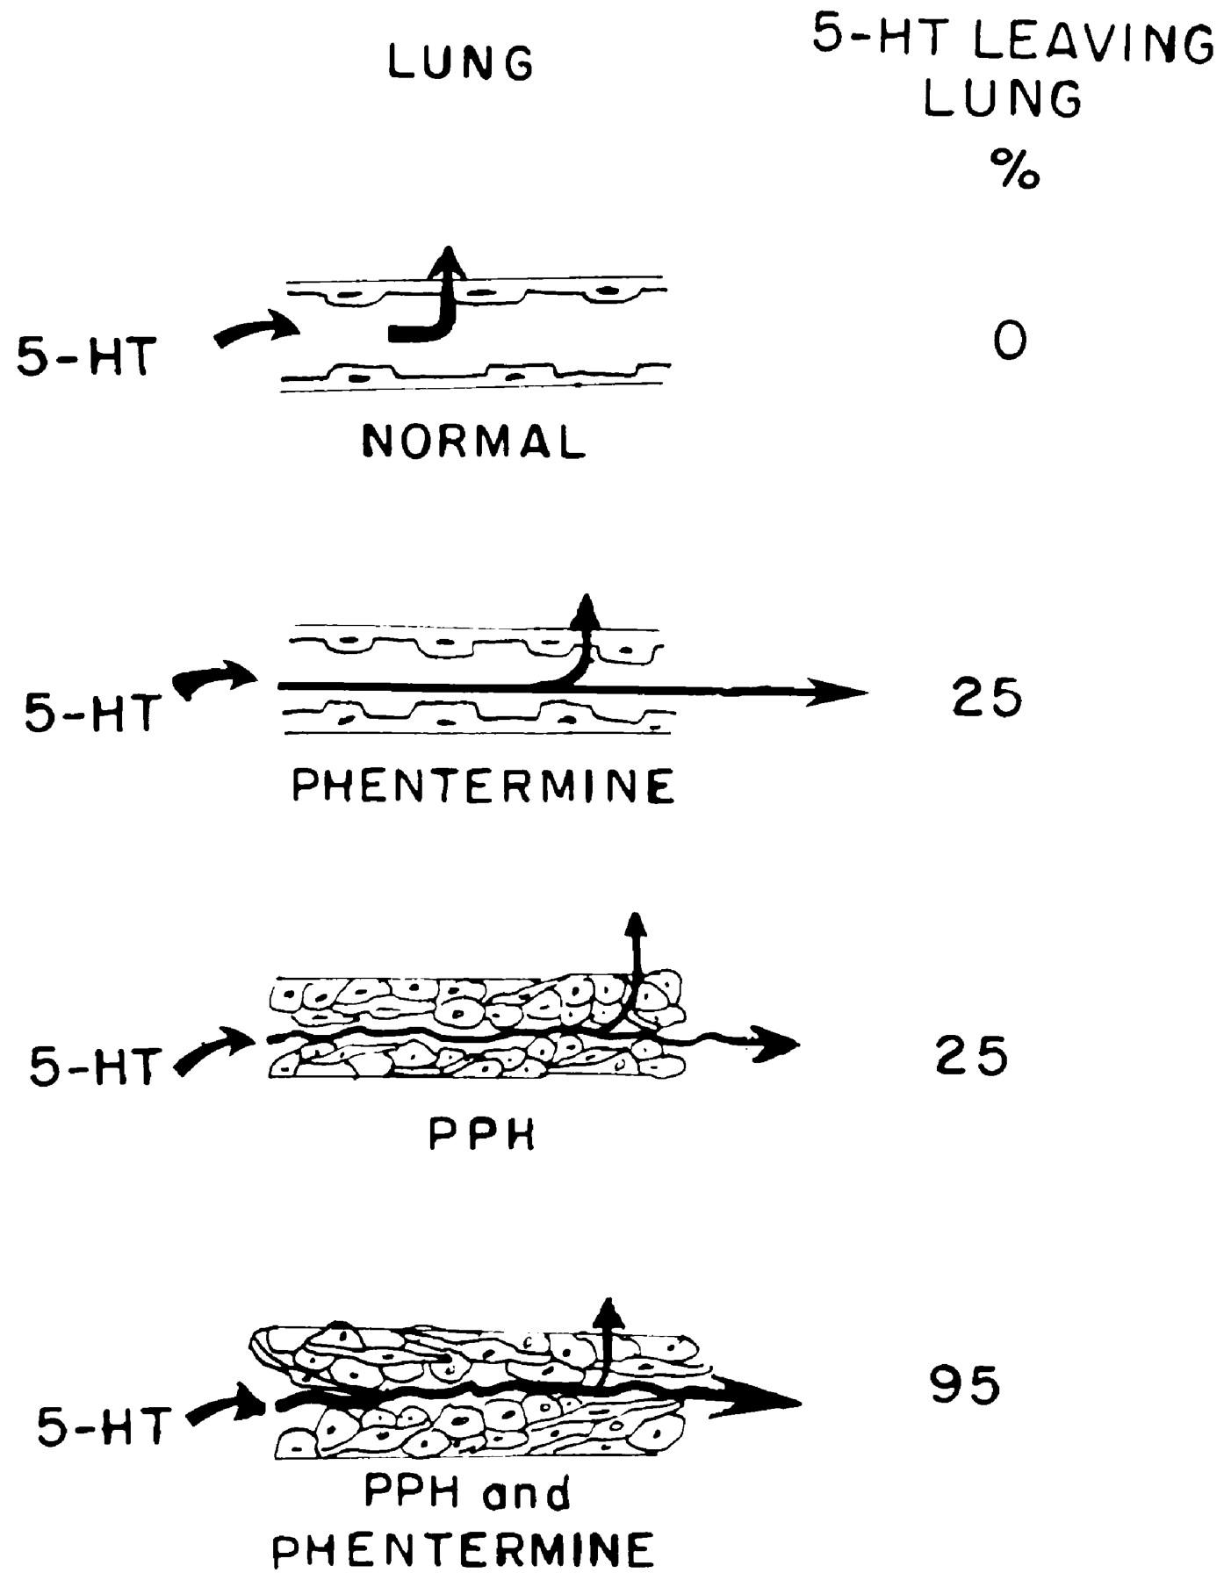

.
Fishman A P Circulation 1999;99:156-161
Copyright © American Heart Association

Slide 20
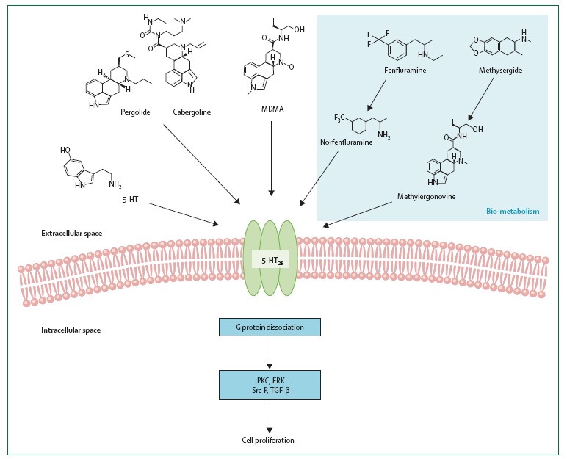
Source: Bhattacharyya et. al. Lancet 2009; 374: 577-85

Slide 21
Summary
Concerns about QT prolongation and valvulopathy have led to drug withdrawals.
Torsade de pointes is a rare, life-threatening ventricular tachycardia. QT prolongation is measured with pharmacokinetic data in TQT studies as part of risk assessment.
Drug-associated valvulopathy has been detected post-approval, via cases and epidemiologic studies. Common mechanism appears to be 5HT-2B receptor.

Slide 22
Thank you
shari.targum@fda.hhs.gov

