Slide 1
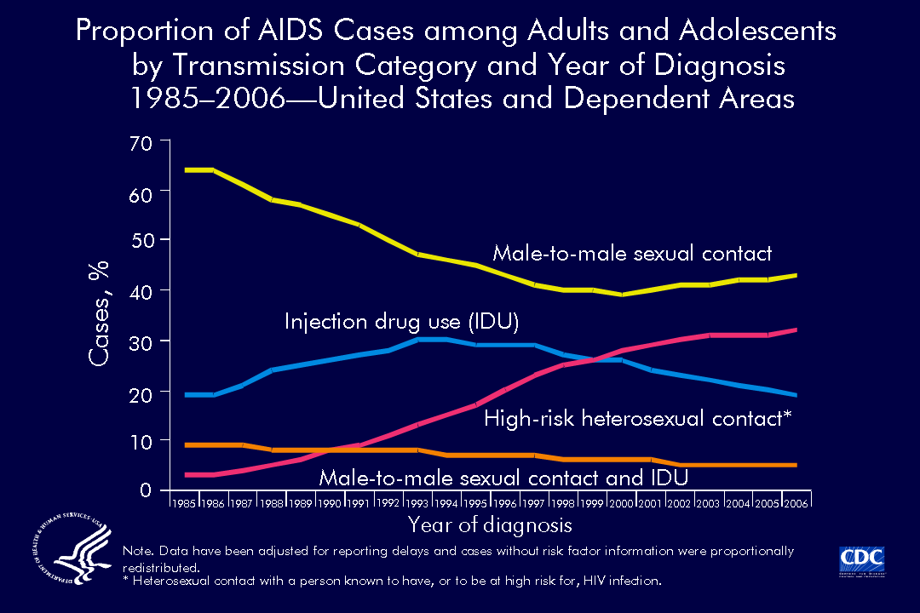
Notes:
The proportional distribution of AIDS cases by transmission category has shifted since the beginning of the epidemic. In 1985, male-to-male sexual contact accounted for 64% of all AIDS cases; in 2006, this transmission category accounted for 43% of all AIDS cases.
The proportion of AIDS cases attributed to injection drug use increased during 1985–1994 and then slightly decreased, accounting for 19% of cases in 2006.
The proportion of AIDS cases attributed to male-to-male sexual contact and injection drug use decreased from 9% in 1985 to 5% in 2006.
The proportion of AIDS cases attributed to high-risk heterosexual contact increased from 3% in 1985 to 32% in 2006.
The remaining AIDS cases were those attributed to hemophilia or the receipt of blood or blood products and those in persons without an identified risk factor.
The data have been adjusted for reporting delays and cases without risk factor information were proportionally redistributed.

