Slide 1
State of Washington
Department of Licensing
Human Resource
Management Report
Plan & Align Workforce
Hire Workforce
Deploy Workforce
Reinforce Performance
Develop Workforce
October 2007

Slide 2
Managers’ Logic Model for Workforce Management
Outputs
Initial Outcomes
Intermediate Outcomes
Plan & Align Workforce
Articulation of managers HRM accountabilities. HR policies. Workforce planning. Job classes & salaries assigned.
Managers understand HRM accountabilities. Jobs, staffing levels, & competencies aligned with agency priorities.
Foundation is in place to build and sustain a productive, high performing workforce.
Hire
Workforce
Qualified candidate pools, interviews & reference checks. Job offers. Appts & per-
formance monitoring.
Best candidate hired & reviewed during appointment period. Successful performers retained.
The right people are in the right job at the right time.
Ultimate Outcomes
Employees are committed to the work they do & the goals of the organization
Productive, successful employees are retained
State has workforce depth & breadth needed for present and future success
Deploy
Workforce
Work assignments& requirements defined. Positive workplace environment created. Coaching, feedback, corrections.
Workplace is safe, gives capacity to perform, & fosters productive relations. Staff know job rqmts, how they’re doing, & are supported.
Time & talent is used effectively. Employees are motivated & productive.
Develop Workforce
Individual development plans. Time/ resources for training. Continuous learning environment created.
Learning environment created. Employees are engaged in develop-
ment opportunities & seek to learn.
Employees have competencies for present job & career advancement
Agencies are better enabled to successfully carry out their mission. The citizens receive efficient government services.
Reinforce Performance
Clear performance expectations linked to orgn’al goals & measures. Regular performance appraisals. Recognition. Discipline.
Employees know how performance contributes to success of orgn. Strong performance rewarded; poor performance eliminated
Successful perf is differentiated & strengthened. Employees are held accountable.

Slide 3
Standard Performance Measures
Plan & Align Workforce
Percent supervisors with current performance expectations for workforce management
Management profile
Workforce planning measure (TBD)
Percent employees with current position/competencies descriptions
Time-to-fill funded vacancies
Candidate quality
Hiring Balance (Proportion of appointment types)
Separation during review period
Percent employees with current performance expectations
Employee survey ratings on “productive workplace” questions
Overtime usage
Sick leave usage
Non-disciplinary grievances/appeals filed and disposition (outcomes)
Worker safety
Percent employees with current individual development plans
Employee survey ratings on “learning & development” questions
Competency gap analysis (TBD)
Percent employees with current performance evaluations
Employee survey ratings on “performance & accountability” questions
Disciplinary actions and reasons, disciplinary grievances/appeals filed and disposition (outcomes)
Reward and recognition practices (TBD)
Ultimate Outcomes
Hire
Workforce
Employee survey ratings on “commitment” questions
Turnover rates and types
Turnover rate: key occupational categories
Workforce diversity profile
Retention measure (TBD)
Deploy
Workforce
Develop Workforce
Reinforce Performance

Slide 4
Plan & Align Workforce
Outcomes:
Managers understand workforce management accountabilities. Jobs and competencies are defined and aligned with business priorities. Overall foundation is in place to build & sustain a high performing workforce.
Performance Measures:
Percent supervisors with current performance expectations for workforce management
Management profile
Workforce Planning measure (TBD)
Percent employees with current position/ competency descriptions
Workforce Management Expectations
Percent supervisors with current performance expectations for workforce management = 100%
Analysis:
Workforce management expectations were first provided to all supervisors via email from the agency Director.
Subsequently, agency leadership core competencies and expectations were developed which included workforce management expectations.
These competencies form the foundation of the DOL Leadership Level 1 and 2 curricula which all supervisors are required to take within three years of becoming a supervisor.
Leadership core competencies have also been embedded into the Supervisor Performance and Development Plan document to ensure that all leaders are evaluated on their workforce management skills.
A series of half-day workshops on leadership was developed for agency leaders who wished to further explore various aspects of leadership. The forums were facilitated by members of the Executive Leadership Team.
A Leadership Topic of the month is provided to agency supervisors via the Intranet. Each topic includes a discussion guide for supervisors to use with their staff.
Action Steps:
Continue on current course.
Total # of supervisors with current performance expectations for workforce management = 233
Total # of supervisors = 233
Core expectations applicable to all
DOL supervisors and managers
Understand and communicate the vision, mission and values of the organization.
Provide for the meaningful involvement of others in the workplace and foster team spirit.
Engage in effective problem solving and quality decision-making.
Promote service delivery and customer focus.
Build and maintain effective relationships.
Apply effective human resource management practices, including, but not limited to, hiring, monitoring, developing, and providing performance feedback.
Make a difference.
Data as of 6/2007
Source: DOL Human Resources Office

Slide 5
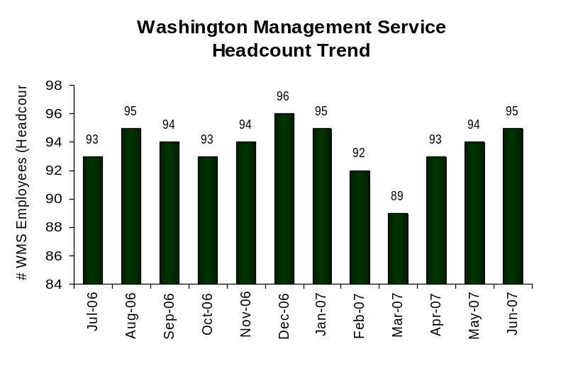
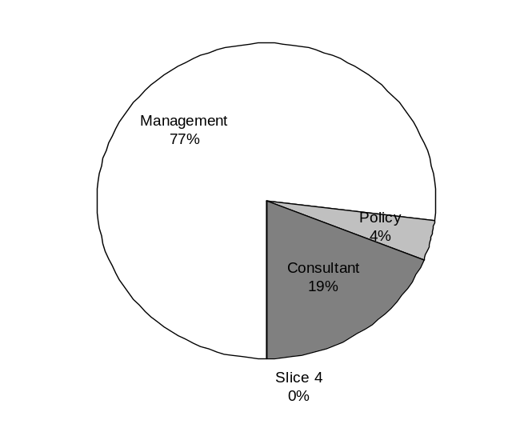
Plan & Align Workforce
Outcomes:
Managers understand workforce management accountabilities. Jobs and competencies are defined and aligned with business priorities. Overall foundation is in place to build & sustain a high performing workforce.
Performance Measures:
Percent supervisors with current performance expectations for workforce management
Management profile
Workforce Planning measure (TBD)
Percent employees with current position/ competency descriptions
Management Profile
WMS Employees Headcount = 95
Percent of agency workforce that is WMS = 7.4%
Managers* Headcount = 111
Percent of agency workforce that is Managers* = 8.6%
* In positions coded as “Manager” (includes EMS, WMS, and GS)
Analysis:
Last biennium’s mid-management reduction targets were met, and a new base percentage of 7.8% WMS was set by DOP.
Action Steps:
Continue to review management positions to ensure proper inclusion and evaluation.
Implement full agency classification plan review during 07-09 biennium to ensure that all non-management work is appropriately classified and compensated within the Washington General Service.
Management 73
Consultant 18
Policy 4
Data as of 6/ 2007
Source: HRMS/BW

Slide 6
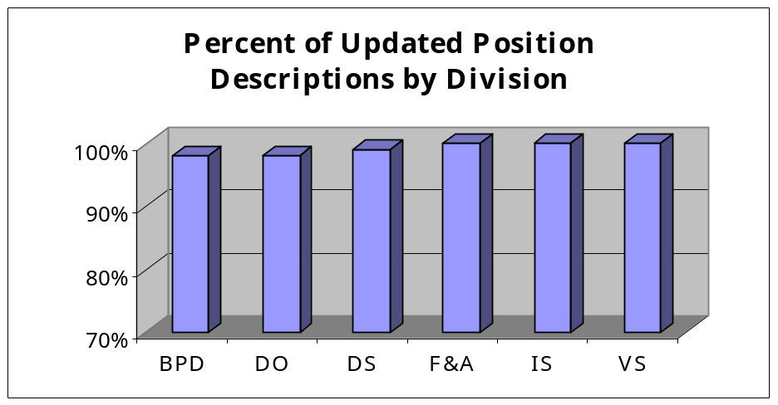
Plan & Align Workforce
Outcomes:
Managers understand workforce management accountabilities. Jobs and competencies are defined and aligned with business priorities. Overall foundation is in place to build & sustain a high performing workforce.
Performance Measures:
Percent supervisors with current performance expectations for workforce management
Management profile
Workforce Planning measure (TBD)
Percent employees with current position/ competency descriptions
Current Position/Competency Descriptions
Percent employees with current position/competency descriptions = 99%*
Analysis:
The act of asking for the data on a regular basis has caused the completion rate to increase dramatically.
Positions are not posted without an updated position description and job analysis.
The Job Analysis form was recently modified to more easily and accurately capture required and desired competencies.
Action Steps:
Review Job Analyses as they come in for quality.
Reformat and expand our Job Analysis / Position Description writing class for Leadership Level 1 training series.
Continue to provide assistance to supervisors on completion of the Position Description and Job Analysis forms.
Total # of employees with current position/competency descriptions* = 1152
Total # of employees* = 1160
*Applies to employees in permanent positions, both WMS & GS
Data as of 6/2007
Source: DOL Human Resources Office

Slide 7
Hire Workforce
Outcomes:
Best candidates are hired and reviewed during appointment period. The right people are in the right job at the right time.
Performance Measures
Time-to-fill vacancies
Candidate quality
Hiring Balance (proportion of appointment types)
Separation during review period
Time-to-fill / Candidate Quality
Time-to-fill Funded Vacancies
Average number of days to fill*: 68 Calendar Days
Number of vacancies filled: 173
*Equals # of days from creation of the requisition to job offer acceptance
Time Period: 01/01/2007 – 08/15/2007
Analysis:
DOL does not use E-recruiting to maintain time-to-fill statistics.
Count for the average number of days begins from the time HR receives paperwork to request recruitment.
It takes HR an average of 13.5 days to process paperwork and prepare recruitment announcement for posting on E-recruiting.
Our announcements are open for 8.4 days on an average.
It takes the Recruitment Team an average of 8.5 days to screen applicants in order to certify eligible candidates to the hiring manager.
The majority of our time to fill is spent from the time a recruitment is certified to the time a new employee starts work with DOL, an average of 37.6 days. SAP only allows for state employee movement into the agency on the first and sixteenth of each month, which also adds to the time gathered for this statistic.
Action Steps:
Conduct process improvement efforts within the HR office to reduce number of days spent processing paperwork and preparing announcement.
Employ a mechanism to track dates that positions are offered rather than start date of employee to improve accuracy of data.
Survey hiring managers for Candidate Quality information.
Candidate Quality
Of the candidates interviewed for vacancies, how many had the competencies (knowledge, skills & abilities) needed to perform the job?
  Number = [XXX] Percentage = [XXX]
Of the candidates interviewed, were hiring managers able to hire the best candidate for the job?
  Hiring managers indicating “yes”:
  Number = [XXX] Percentage = [XXX]
  Hiring managers indicating “no”:
  Number = [XXX] Percentage = [XXX]
Time Period: [mm/dd/yyyy – mm/dd/yyyy]
No Data Available
Data as of 10/2007
Source: DOL Human Resources Office

Slide 8
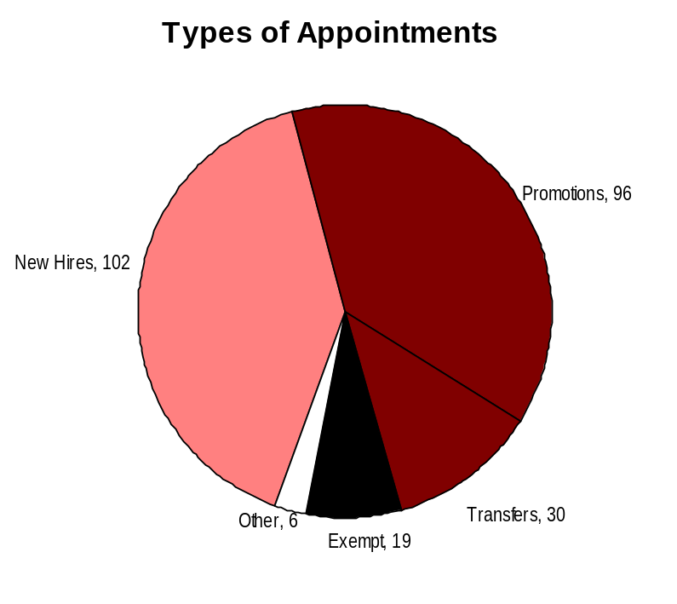
Hire Workforce
Outcomes:
Best candidates are hired and reviewed during appointment period. The right people are in the right job at the right time.
Performance Measures
Time-to-fill vacancies
Candidate quality
Hiring Balance (proportion of appointment types)
Separation during review period
Hiring Balance / Separations During Review Period
Analysis:
The ratio of new hires to promotions is well balanced and reflects the proportion of entry-level positions to higher level jobs.
The agency has provided extensive training and consultation to hiring supervisors regarding the selection process. Competencies, skills, and abilities are identified at the front of the process and selection methods are developed to best evaluate those skills. This work up-front should result in the hiring of high quality candidates.
Where good job matches have failed, probationary separations are happening (8 voluntary separations, plus 4 of the 10 involuntary).
Where inappropriate behavior in new hires is happening, supervisors are using the probationary period appropriately and separating these employees. (6 of 10 involuntary separations were for misconduct).
Action Steps:
Ensure that managers are conducting thorough reference checks and providing realistic job previews during the interview/selection process.
Implement candidate evaluation process along with a long-term follow-up to better determine whether recruitment and selection processes are providing outstanding employees.
Total number of appointments = 253*
Time period =7/2006 through 6/2007
Includes appointments to permanent vacant positions only; excludes reassignments
“Other” = Demotions, re-employment, reversion & RIF appointments
Separation During Review Period
Probationary separations - Voluntary 8
Probationary separations - Involuntary 10
  Total Probationary Separations 18
Trial Service separations - Voluntary 5
Trial Service separations - Involuntary 0
  Total Trial Service Separations 5
Total Separations During Review Period 23
Time period = 7/2006 through 6/2007
Data as of 6/2007
Source: HRMS/BW

Slide 9
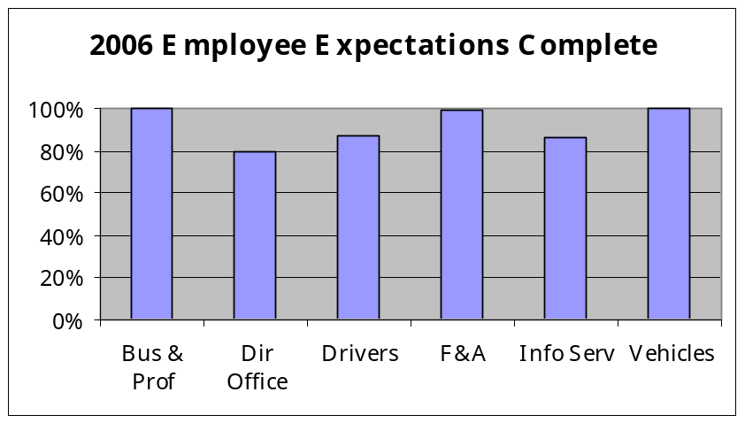
Deploy Workforce
Outcomes:
Staff know job expectations, how they’re doing, & are supported. Workplace is safe, gives capacity to perform, & fosters productive relations. Employee time and talent is used effectively. Employees are motivated.
Performance Measures
Percent employees with current performance expectations
Employee survey ratings on “productive workplace” questions
Overtime usage
Sick leave usage
Non-disciplinary grievances/appeals filed and disposition (outcomes)
Worker safety
Current Performance Expectations
Percent employees with current performance expectations = 92%*
Analysis:
This data reflects the second year that all evaluations were due in the 90-day period of September through November. This has greatly increased our completion rate.
This year’s evaluations are due November 30, 2007. The Director has established the expectation that all supervisors’ evaluations will include comments regarding their efforts toward completion of their staffs’ evaluations.
Expectations for the new year are typically completed at the time the performance evaluation is completed. Those areas where the senior leaders are highly committed to their completion are the areas where they’re getting done.
Action Steps:
Begin using new HRMS tracking system to ensure that new employee planning documents are completed.
Continue stressing the importance of setting, reviewing, and assessing performance expectations for all staff.
Total # of employees with current performance expectations* = 1115
Total # of employees* = 1212
*Applies to employees in permanent positions, both WMS & General Service
Data as of 6/2007
Source: DOL Human Resources Office

Slide 10
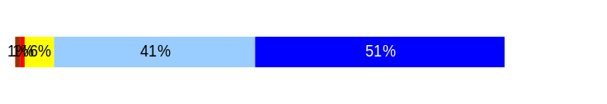
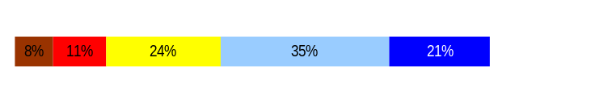
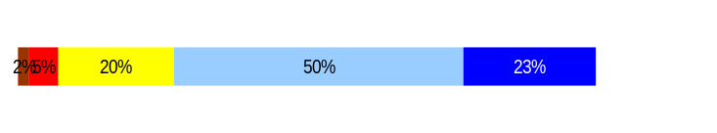
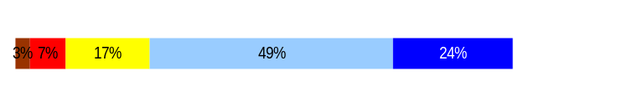
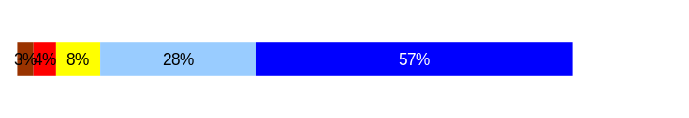
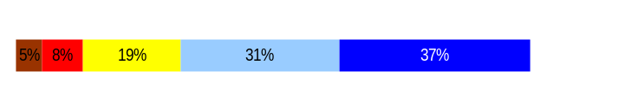
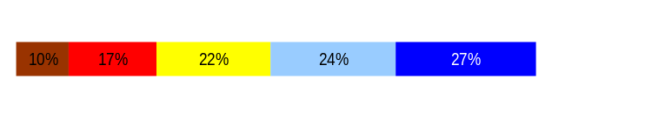
Deploy Workforce
Outcomes:
Staff know job expectations, how they’re doing, & are supported. Workplace is safe, gives capacity to perform, & fosters productive relations. Employee time and talent is used effectively. Employees are motivated.
Performance Measures
Percent employees with current performance expectations
Employee survey ratings on “productive workplace” questions
Overtime usage
Sick leave usage
Non-disciplinary grievances/appeals filed and disposition (outcomes)
Safety and Workers Compensation (TBD)
Employee Survey “Productive Workplace” Ratings
Avg
Q4. I know what is expected of me at work.
Q1. I have opportunity to give input on decisions affecting my work.
Q2. I receive the information I need to do my job effectively.
Q6. I have the tools and resources I need to do my job effectively.
Q7. My supervisor treats me with dignity and respect.
Q8. My supervisor gives me ongoing feedback that helps me
improve my performance.
Q9. I receive recognition for a job well done.
Analysis:
Efforts over the last two years stressing the importance of quality performance plans and sound human resource management is paying off.
Action Steps:
Continue to emphasize in leadership training the importance of establishing expectations, goals and performance standards.
In leadership classes participants discuss the importance of connecting with employees, showing appreciation and praise where appropriate for their work.
Human Resource staff is beginning to meet with division teams and facilitate discussions about recognition. One division established a recognition task force.
A logic model was developed for use by supervisors in linking the work of the employee to agency success and public safety.
4.4
3.5
3.9
3.8
4.3
3.9
3.4
Never
Seldom
Occasionally
Usually
Always
Overall average score for Productive Workplace Ratings: 3.9
Data as of 3/2006
Source: DOL Human Resources Office

Slide 11
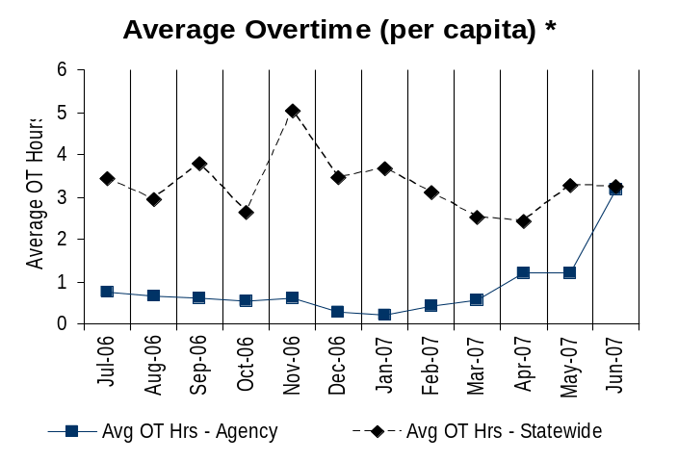
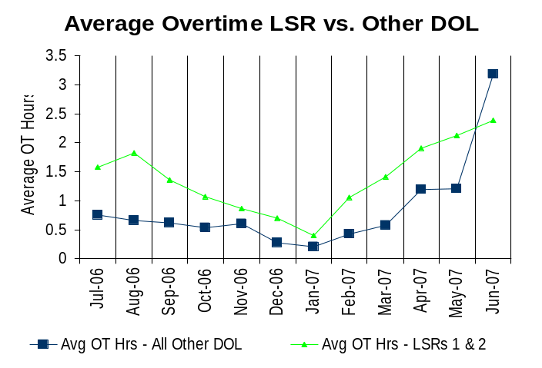
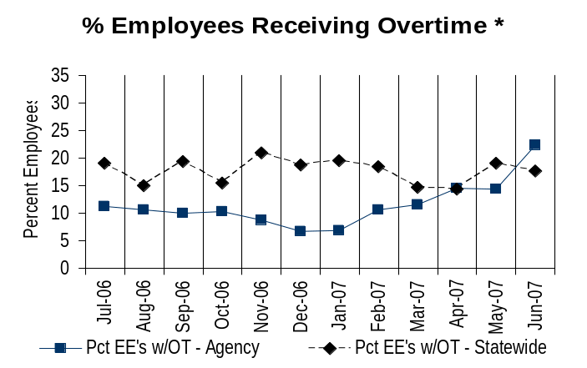
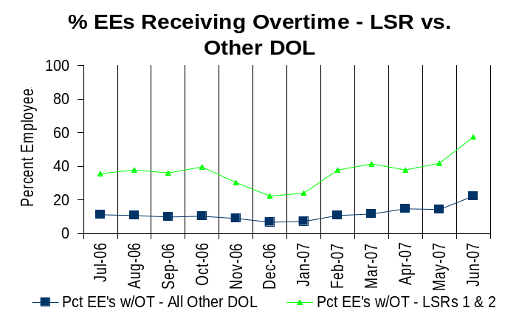
Deploy Workforce
Outcomes:
Staff know job expectations, how they’re doing, & are supported. Workplace is safe, gives capacity to perform, & fosters productive relations. Employee time and talent is used effectively. Employees are motivated.
Performance Measures
Percent employees with current performance expectations
Employee survey ratings on “productive workplace” questions
Overtime usage
Sick leave usage
Non-disciplinary grievances/appeals filed and disposition (outcomes)
Worker safety
Overtime Usage
Overall agency avg overtime usage – per capita, per month: 85.42**
*Statewide overtime values do not include DNR
**Overall agency avg overtime usage – per capita, per month = sum of monthly OT averages divided by number of months
Overall agency avg employees receiving overtime per month: 11.48%**
*Statewide overtime values do not include DNR
**Overall agency avg employees receiving overtime per month = sum of monthly OT percentages divided by number of months
See analysis on next slide
Data as of 6/2007
Source: HRMS/BW

Slide 12
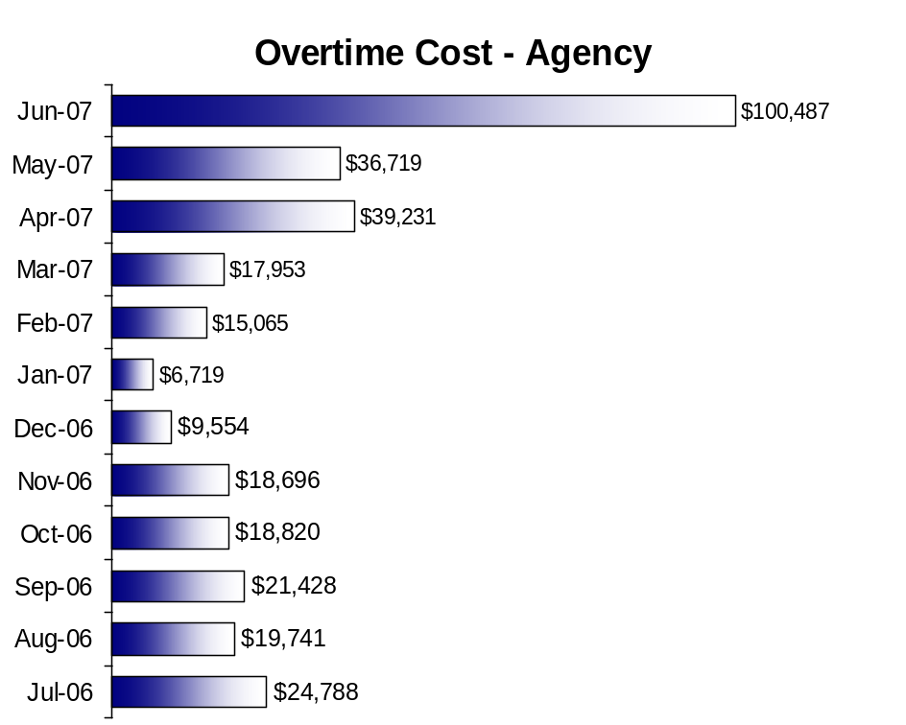
Analysis:
In general, overtime is well within acceptable parameters.
The large spike beginning in April and peaking in June was caused by one of our largest processing sections, as they used end of biennium funds to work down backlogs.
On average, 63% of the overtime is being worked by our driver licensing field employees, Licensing Services Representatives 1 and 2.
LSRs often work small segments of overtime to ensure customers are served at the end of the day. Although LSRs do adjust shifts when possible, because of staffing shortages, they have been unable to flex workweeks to avoid overtime.
During the summer months, due to higher than usual volumes, offices have conducted drive tests on Saturdays or Mondays when the offices are usually closed.
Statewide in-service training also impacted overtime costs in the fall.
Action Steps:
We are putting on a swing shift for six months to address backlogs in Driver Records.
Ensure field offices are staffed to funded levels.
Flex employee time within workweeks where possible.
Hire additional on-call employees where needed during summer months to supplement drive testing.
Data as of 6/2007
Source: HRMS/BW

Slide 13
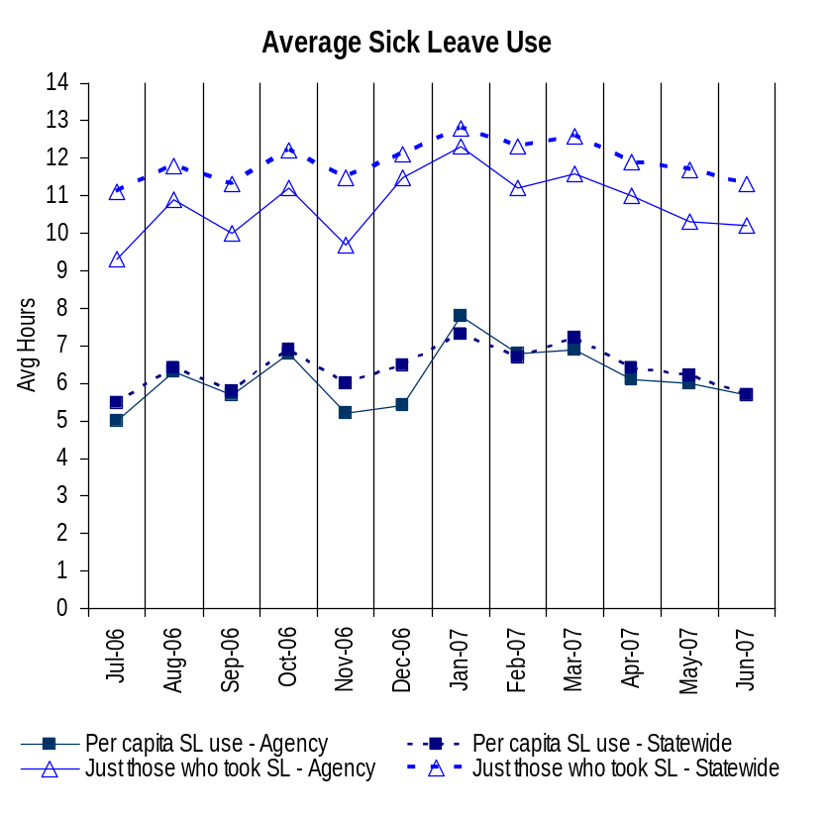
Deploy Workforce
Outcomes:
Staff know job expectations, how they’re doing, & are supported. Workplace is safe, gives capacity to perform, & fosters productive relations. Employee time and talent is used effectively. Employees are motivated.
Performance Measures
Percent employees with current performance expectations
Employee survey ratings on “productive workplace” questions
Overtime usage
Sick leave usage
Non-disciplinary grievances/appeals filed and disposition (outcomes)
Worker safety
Sick Leave Usage
Analysis:
DOL remains slightly below the statewide average in sick leave use per capita and considerably lower in sick leave use for those who used sick leave.
Of the total 1257 employees employed during this reporting period, only 33% took more sick leave than they accrued which accounted for 60% of the total leave used.
The remaining 67% of agency employees used an average of only 3.6 hours per month, which is well within an acceptable range.
Of the sick leave used, 66% was used for personal illness or injury, while 16% was used for preventative care. This is an increase of two (2) percentage points over the last reporting period.
Action Steps:
Implement agency wellness program targeted at promoting healthy lifestyle choices.
Develop a sick leave use education program for staff and managers that focuses on the responsible use of sick leave.
Develop reporting tools to assist supervisors in the review and analysis of leave use.
Continue to collaborate with like organizations on best practices and strategies to reduce sick leave use.
By December 2007, shift 3% of sick leave use from personal illness to preventative care. This represents approximately 1250 hours of sick leave.
Sick Leave Hrs Used / Earned (per capita)
Avg Hrs SL Used (per capita) - Agency | % of SL Hrs Earned (per capita) - Agency
6.2 Hrs | 80.2%
Avg Hrs SL Used (per capita) – Statewide* | % of SL Hrs Earned (per capita) – Statewide*
6.4 Hrs | 82.5%
Sick Leave Hrs Used / Earned (those who took SL)
Avg Hrs SL Used (those who took SL) - Agency | % SL Hrs Earned (those who took SL) - Agency
10.8 Hrs | 136.2%
Avg Hrs SL Used (those who took SL) – Statewide* | % SL Hrs Earned (those who took SL) – Statewide*
11.9 Hrs | 148.4%
Sick Leave time period = 7/2006 through 6/2007
* Statewide data does not include DOL, DOR, L&I, and LCB
Source: DOL HR Café System

Slide 14
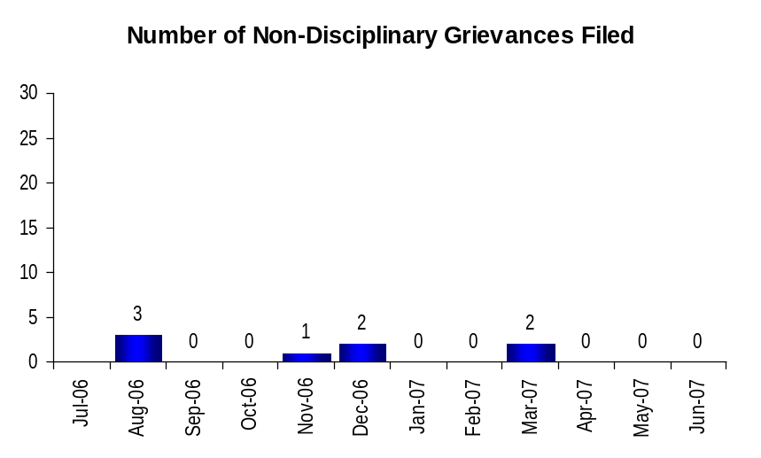
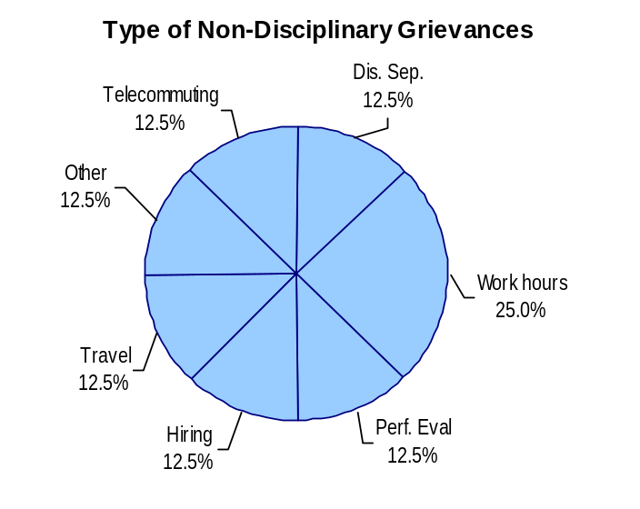
Deploy Workforce
Outcomes:
Staff know job expectations, how they’re doing, & are supported. Workplace is safe, gives capacity to perform, & fosters productive relations. Employee time and talent is used effectively. Employees are motivated.
Performance Measures
Percent employees with current performance expectations
Employee survey ratings on “productive workplace” questions
Overtime usage
Sick leave usage
Non-disciplinary grievances/appeals filed and disposition (outcomes)
Worker safety
Non-Disciplinary Grievances (represented employees)
Total Non-Disciplinary Grievances = 8
Non-Disciplinary Grievance Disposition*
Outcomes determined during 07/06 through 06/07
4 withdrawn after step 2
2 modified at step 1
1 withdrawn after step 3
1 withdrawn after step 1
Analysis:
In general, staff issues are being resolved at the onset or in the informal resolution process.
Modifications were a result of supervisor treating staff inconsistently and not following just cause elements.
Withdrawals were a result of supervisor following appropriate steps and there was no violation of the contract.
Action Steps:
Supervisor coaching on just cause elements.
Supervisor coaching on consistency throughout regions.
* There may not be a one-to-one correlation between the number of grievances filed (shown top of page) and the outcomes determined during this time period. The time lag between filing date and when a decision is rendered can cross the time periods indicated.
Data as of September 26, 2007
Source: DOL Human Resources Office

Slide 15

Deploy Workforce
Outcomes:
Staff know job expectations, how they’re doing, & are supported. Workplace is safe, gives capacity to perform, & fosters productive relations. Employee time and talent is used effectively. Employees are motivated.
Performance Measures
Percent employees with current performance expectations
Employee survey ratings on “productive workplace” questions
Overtime usage
Sick leave usage
Non-disciplinary grievances/appeals filed and disposition (outcomes)
Worker safety
Non-Disciplinary Appeals (mostly non-represented employees)
Filings for DOP Director’s Review
Time Period = 07/06 through 06/07
0 Job classification
0 Rule violation
0 Name removal from register
0 Rejection of job application
0 Remedial action
0 Total filings
Filings with Personnel Resources Board
Time Period = 07/06 through 06/07
0 Job classification
0 Other exceptions to Director Review
0 Layoff
0 Disability separation
0 Non-disciplinary separation
0 Total filings
Non-Disciplinary appeals only are shown above.
There is no one-to-one correlation between the filings shown above and the outcomes displayed in the charts below. The time lag between filing date and when a decision is rendered can cross the time periods indicated.
Total outcomes = 0
Time Period = 07/2006 through 06/2007
Total outcomes = 0
Time Period = 07/2006 through 06/2007
Source: DOL Human Resources Office

Slide 16
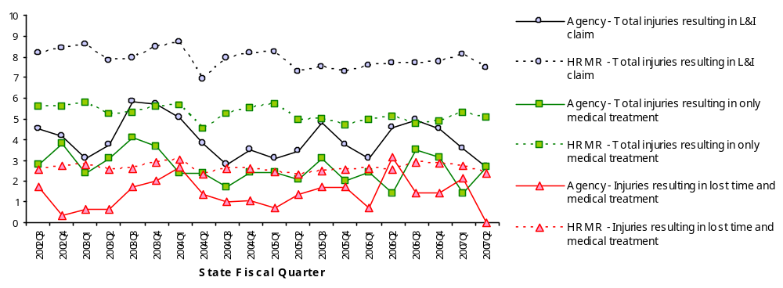
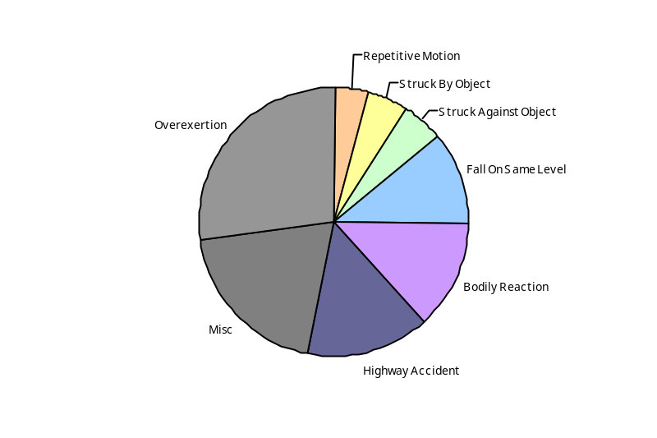
Deploy Workforce
Outcomes
Staff know job expectations, how they’re doing, & are supported. Workplace is safe, gives capacity to perform, & fosters productive relations. Employee time and talent is used effectively. Employees are motivated.
Performance Measures
Percent employees with current performance expectations
Employee survey ratings on 'productive workplace' questions
Overtime usage
Sick leave usage
Non-disciplinary grievances/appeals filed and disposition outcomes
Worker Safety
Worker Safety: Department of Licensing
Analysis:
Injuries experience seasonal peaks at Q3 from an additional 5 to 14 injuries gradually declining through 2007Q2
30% of peaks associated with accidents during driving exams
Major source of injuries involve joint overextensions/sprains
All classes of injuries are below HRMR rates
Action Plan:
Work with Driver Examining management to implement mitigation strategies to increase drive test safety. Possible strategies include:
  Training/written exam portions on inclement weather driving habits and /recognizing hazards
  Establish procedures on the inspection of driving exam routes and identification and labeling of risks
  Training on risk management for testers and drivers
  Enhance safety briefings prior to driver exams
Training on proper lifting; ergonomics, recognizing hazards
“Time out” (3 min) d/w/m for employee workplace inspections
Allowed Annual
Claims Rate*^:
Agency vs. All HR
Management Report
(HRMR) agencies
*Annual claims rate
is # claims / 100 FTE
1 FTE = 2000 hours
^Due to natural lag
in claim filing, rates
are expected to
increase significantly
over time
Injuries by Occupational
Injury and Illness
Classification (OIICS)
event:
For fiscal period 2002Q3
through 2007Q2
(categories under 3% or not
adequately coded are grouped
into 'misc.')
Oiics Code | Oiics Description | Percent | Number
21 | Bodily Reaction | 13% | 31
13 | Fall On Same Level | 11% | 26
41 | Highway Accident | 15% | 35
- | Misc | 20% | 46
22 | Overexertion | 27% | 63
23 | Repetitive Motion | 4% | 9
01 | Struck Against Object | 5% | 12
02 | Struck By Object | 5% | 11
Source: Labor & Industries, Research and Data Services (data as of 09/03/2007 )
Notes:
HRMR Safety Report Overview
The HRMR Safety Reports are:
- PowerPoint slides created by the Department of Labor and Industries
- Created for each state agency that is reporting their employee safety program results bi-
annually as part of their Human Resources Management Report (HRMR).
- Snapshots of five years of worker’s compensation claim data specific to that agency, as
well as a comparison to the combined data for agencies completing HRMR reports.
- There is a two quarter lag at the end of the five years.
This allows each agency’s payroll data to be entered into L&I’s computer system. This
payroll data is used to compute the number of workers per agency and quarter.
Definitions
Claim – When a covered worker sustains an occupational injury or illness, that worker files a
'claim’ for benefits. A 'claim number' is assigned, and all wage replacement payments, medical
provider bills, etc, for that worker and injury, are associated with that claim number.
Report Detail
'Allowed Annual Claim Rate'
This chart shows your agency's rate of injuries resulting in allowed
claims, by injury quarter, for on-the-job injuries and occupational illnesses. The rate for all
reporting agencies is shown for comparison.
- The rate is the number accepted claims per 200,000 annual worker hours (100 workers)
Three rates are included in this chart:
A)The total rate for all injuries resulting in a claim; the two groups listed below are
exclusive of each other.
B)The rate of injuries which required medical care, but no compensation for lost
time.
C)The rate of injuries which resulted in compensation for lost time in addition to
medical care.
'Injuries by Occupational Injury and Illness Classification (OIICS) Event’
This section contains a pie chart which shows your agency's injuries by type* and a table which
shows the percent and number of accepted claims by OIICS Event description and code.
This information is useful in identifying what causes injuries so prevention can occur. Prevention
might include root cause analysis, education, and hazard mitigation.
* Injury Type is based on the 2 digit Major Group code of the Event or Exposure section of the Occupational
Injury and Illness Classification System (OIICS). Groups with less than 3% of the
total injuries are combined into the 'Misc' category.
How to get this report for your agency:
All worker compensation reports will be available on the L&I website by the 20th of September or
the 20th of March of each year. The data will be provided in a PowerPoint slide to which you will
add your own analyses and action plans.

Slide 17
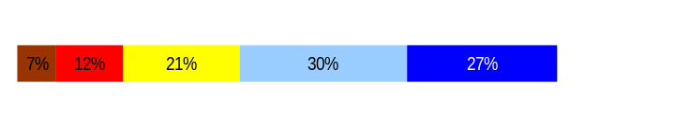
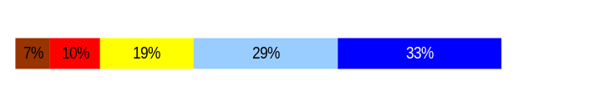
Develop Workforce
Outcomes:
A learning environment is created. Employees are engaged in professional development and seek to learn. Employees have competencies needed for present job and future advancement.
Performance Measures
Percent employees with current individual development plans
Employee survey ratings on “learning & development” questions
Competency gap analysis (TBD)
Individual Development Plans
Percent employees with current individual development plans = 92%*
Analysis:
Development plans are typically completed at the time the performance evaluation is completed. Those areas where the senior leaders are highly committed to their completion are the areas where they’re getting done.
A major challenge continues to be balancing staff interest in attending classes with the need to meet business demands.
Action Steps:
In response to one division assessment, a new approach to technical training is under development.
Leadership classes continue to stress the importance of developmental plans focusing on more than training classes.
Continue to promote the availability of training and continued education opportunities.
Total # of employees with current IDPs* = 1115
Total # of employees* = 1212
*Applies to employees in permanent positions, both WMS & GS
Employee Survey “Learning & Development” Ratings
Q5. I have opportunities at work to learn and grow.
Q8. My supervisor gives me ongoing feedback that helps me
improve my performance.
Avg
3.6
3.9
Overall average score for Learning & Development Ratings: 3.75
Data as of 3/2006 and 4/2007
Source: DOL Human Resources Office

Slide 18
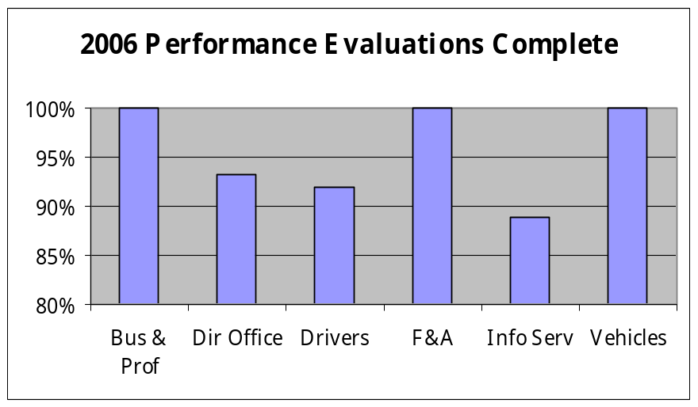
Reinforce Performance
Outcomes:
Employees know how their performance contributes to the goals of the organization. Strong performance is rewarded; poor performance is eliminated. Successful performance is differentiated and strengthened. Employees are held accountable.
Performance Measures
Percent employees with current performance evaluations
Employee survey ratings on “performance and accountability” questions
Disciplinary actions and reasons, disciplinary grievances/appeals filed and disposition (outcomes)
Reward and recognition practices (TBD)
Current Performance Evaluations
Percent employees with current performance evaluations = 95%*
Analysis:
This data reflects the second year that all evaluations were due in the 90-day period of September through November. This has greatly increased our completion rate.
By using an August to August performance period, we are able to more easily cascade down the agency’s strategic plan into individual employees’ goals and objectives.
The completion rate is higher in those divisions in which the division head actively and regularly encouraged supervisors to complete them.
Action Steps:
This year’s evaluations are due November 30, 2007. The Director has established the expectation that all supervisors’ evaluations will include comments regarding their efforts toward completion of their staffs’ evaluations.
Steps have been taken to ensure that all senior leaders emphasize evaluation completion within their divisions.
Begin using new HRMS tracking system to ensure that new employee evaluations are completed.
Total # of employees with current performance evaluations* = 1150
Total # of employees* = 1212
*Applies to employees in permanent positions, both WMS & GS
Data as of 6/2007
Source: DOL Human Resources Office

Slide 19
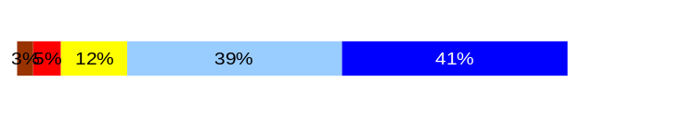
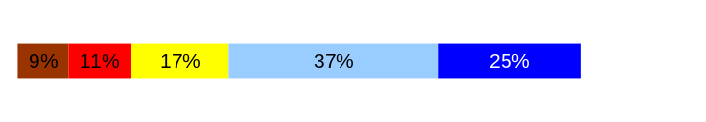
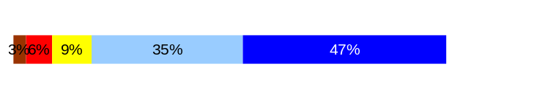
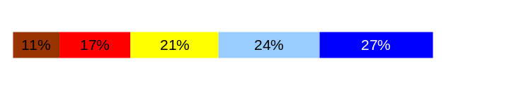
Reinforce Performance
Outcomes:
Employees know how their performance contributes to the goals of the organization. Strong performance is rewarded; poor performance is eliminated. Successful performance is differentiated and strengthened. Employees are held accountable.
Performance Measures
Percent employees with current performance evaluations
Employee survey ratings on “performance and accountability” questions
Disciplinary actions and reasons, disciplinary grievances/appeals filed and disposition (outcomes)
Reward and recognition practices (TBD)
Employee Survey “Performance & Accountability” Ratings
Avg
Analysis:
Recent work on “recognition” revealed many different definitions and expectations.
Action Steps:
In leadership classes participants discuss the importance of connecting with employees, showing appreciation and praise where appropriate for their work.
The HR staff is facilitating team discussions on the how-to of recognizing employee contributions.
Clarity of expectations set forth in performance plans, as well as “connectivity” with workplace goals, continues to be stressed.
A logic model was developed to help supervisors connect employee work to public safety.
Q3. I know how my work contributes to the goals of my agency.
Q10. My performance evaluation provides me with meaningful information about my performance.
Q11. My supervisor holds me and my co-workers accountable for performance.
Q9. I receive recognition for a job well done.
4.1
3.6
4.2
3.4
Never
Seldom
Occasionally
Usually
Always
Overall average score for “Performance & Accountability” ratings: 3.8
Data as of 3/2006
Source: DOL Human Resources Office

Slide 20
Reinforce Performance
Outcomes:
Employees know how their performance contributes to the goals of the organization. Strong performance is rewarded; poor performance is eliminated. Successful performance is differentiated and strengthened. Employees are held accountable.
Performance Measures
Percent employees with current performance evaluations
Employee survey ratings on “performance and accountability” questions
Disciplinary actions and reasons, disciplinary grievances/appeals filed and disposition (outcomes)
Reward and recognition practices (TBD)
Formal Disciplinary Actions
Disciplinary Action Taken
Time period = 07/06 through 06/07
Analysis:
Appropriate employee performance management steps are being taken across the agency.
Formal discipline is taken only in those instances where employee performance does not improve or egregious behavior occurs. In two of the four dismissals, progressive discipline worked since the employees were subjected to a lower level discipline last year and did not improve, therefore, they were dismissed.
Most supervisors use Employee Relations staff regularly to ensure compliance with best management practices and master bargaining agreements.
All supervisors are required to attend Employee Performance Management training upon becoming supervisors.
Action Steps:
Continue efforts to train and coach supervisors to work with problem performance early and often.
Continue to foster positive and effective relationships with labor representatives so we can partner to help employees succeed.
Dismissals | 4
Demotions | 0
Suspensions | 5
Reduction in Pay* | 3
Total Disciplinary Actions* | 12
* Reduction in Pay is not currently available in HRMS/BW.
Issues Leading to Disciplinary Action
Inappropriate behavior, workplace violence
Not following procedures, expectations
Conflict of interest, not following procedures
Poor performance, internet usage
Fraud
Data as of 9/26/2007
Source: DOL HR Office

Slide 21
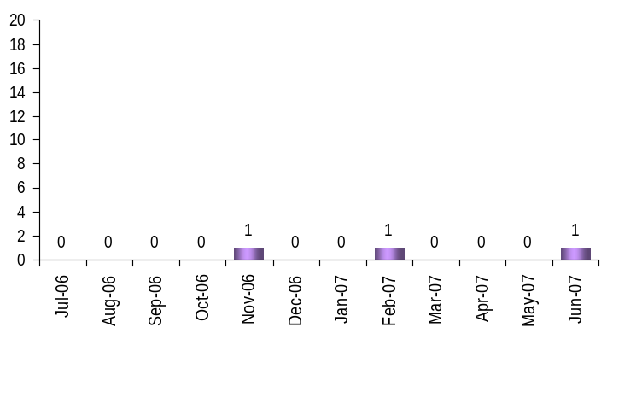

Reinforce Performance
Outcomes:
Employees know how their performance contributes to the goals of the organization. Strong performance is rewarded; poor performance is eliminated. Successful performance is differentiated and strengthened. Employees are held accountable.
Performance Measures
Percent employees with current performance evaluations
Employee survey ratings on “performance and accountability” questions
Disciplinary actions and reasons, disciplinary grievances/appeals filed and disposition (outcomes)
Reward and recognition practices (TBD)
Disciplinary Grievances and Appeals
Disciplinary Grievances
(Represented Employees)
Disciplinary Appeals
(Non-Represented Employees
filed with Personnel Resources Board)
Time Period = 7/06 through 6/07
0 Dismissal
0 Demotion
0 Suspension
0 Reduction in salary
0 Total Disciplinary Appeals Filed with PRB
Total # Disciplinary Grievances Filed: 3
There is no one-to-one correlation between the filings shown above and the outcomes displayed in the charts below. The time lag between filing date and when a decision is rendered can cross the time periods indicated.
Disposition (Outcomes) of Disciplinary Grievances
Time period = 7/06 through 6/07
Discipline affirmed at agency Director level. Withdrawn at this step.
Discipline affirmed prior to step 1 meeting. Withdrawn by Union.
Discipline settled – resigned in lieu of termination.
There were no disciplinary appeals filed for the time period of 7/06 through 6/07.
Data as of 9/26/2007
Source: DOL HR Office

Slide 22
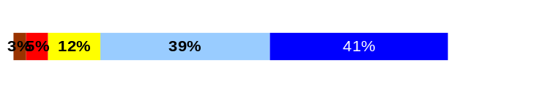
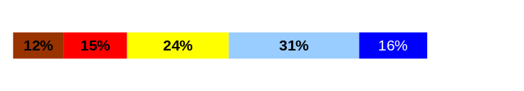
ULTIMATE OUTCOMES
Employees are committed to the work they do and the goals of the organization
Successful, productive employees are retained
The state has the workforce breadth and depth needed for present and future success
Performance Measures
Employee survey ratings on “commitment” questions
Turnover rates and types
Turnover rate: key occupational categories
Workforce diversity profile
Retention measure (TBD)
Employee Survey “Employee Commitment” Ratings
Avg
Analysis:
Efforts over past two years to link employee work to agency success is paying off.
While staff may understand how their work contributes to the business objectives, understanding how agency success is measured is still relatively unclear.
Action Steps:
Develop a means to share with staff the overall success of the agency and the factors that will be used.
Use the logic model to help connect the work of the employee to the success of the unit, program, the agency and in promoting public safety.
Q3. I know how my work contributes to the goals of my agency.
Q12. I know how my agency measures its success.
Q9. I receive recognition for a job well done.
4.1
3.2
3.4
Never
Seldom
Occasionally
Usually
Always
Overall average score for Employee Commitment ratings: 3.6
Data as of 3/2006
Source: DOL Human Resources Office

Slide 23
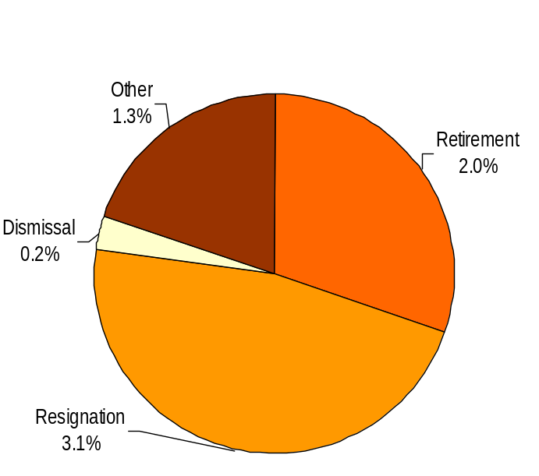
ULTIMATE OUTCOMES
Employees are committed to the work they do and the goals of the organization
Successful, productive employees are retained
The state has the workforce breadth and depth needed for present and future success
Performance Measures
Employee survey ratings on “commitment” questions
Turnover rates and types
Turnover rate: key occupational categories
Workforce diversity profile
Retention measure (TBD)
Turnover Rates
Total % Turnover (leaving state)
Time Period: 7/2006 through 6/2007
Analysis:
6.8% turnover is an acceptable rate for the agency.
DOL employees as a whole have an average tenure at the agency of 11 years. Turnover in general is not seen as an agency workforce problem.
As there are fewer and fewer “Plan 1” employees left in the workforce, retirements, which comprises over 40% of DOL’s current turnover, will likely decrease, which may cause stagnation in some areas.
Action Steps:
Implement an agency-wide exit interview program.
Seek to track movement to another agency internally.
Look at key job classes to determine whether turnover is a problem.
Total Turnover Actions: 83
Total % Turnover: 6.8%
Note: Movement to another agency is currently not available in HRMS/BW
Data as of 6/2007
Source: HRMS/BW

Slide 24
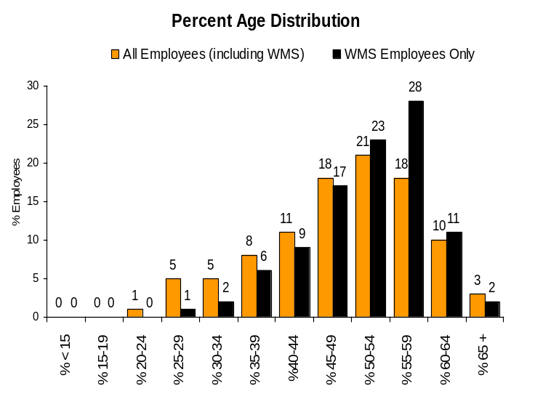
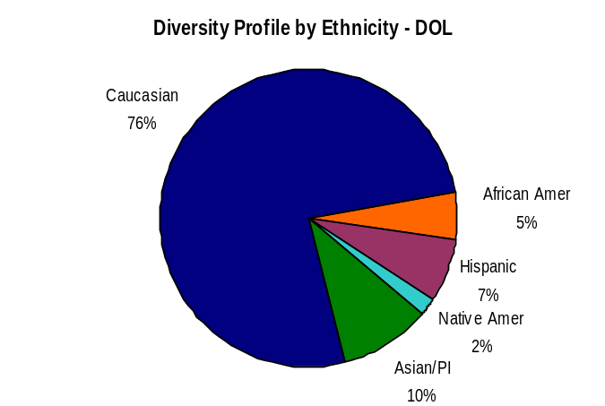
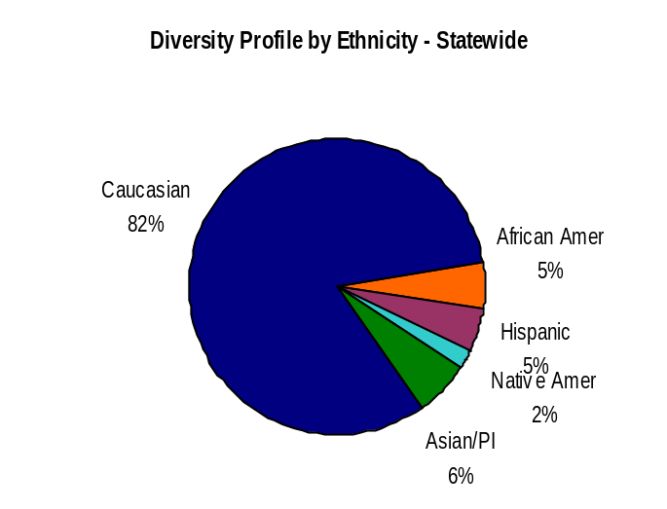
ULTIMATE OUTCOMES
Employees are committed to the work they do and the goals of the organization
Successful, productive employees are retained
The state has the workforce breadth and depth needed for present and future success
Performance Measures
Employee survey ratings on “commitment” questions
Turnover rates and types
Turnover rate: key occupational categories
Workforce diversity profile
Retention measure (TBD)
ULTIMATE OUTCOMES
Employees are committed to the work they do and the goals of the organization
Successful, productive employees are retained
The state has the workforce breadth and depth needed for present and future success
Performance Measures
Employee survey ratings on “commitment” questions
Turnover rates and types
Turnover rate: key occupational categories
Workforce diversity profile
Retention measure (TBD)
Workforce Diversity Profile
Agency State
Female 61% 52%
Disabled 6% 5%
Vietnam Vet 7% 7%
Disabled Vet 2% 2%
People of color 24% 18%
Persons over 40 81% 75%
Analysis:
DOL’s overall diversity profile remains strong.
The agency’s Affirmative Action plan was recently updated to reflect more statistically appropriate job groupings and availability calculations. As part of that plan, one of our largest job groups, Licensing Service Reps, were realigned into 3 geographic groups. That realignment showed us a previously undetected underutilizations of several affected groups in Eastern Washington.
The new plan also showed that unlike many other organizations, DOL is at parity for all people of color in the officials and administrators group, but is underutilized in several areas for the administrative support and skilled labor group.
Action Steps:
Develop targeted recruitment strategies for underutilized groups, particularly in Eastern Wa.
Data as of 6/2007
Source: HRMS/BW

