Slide 1
Test Your Knowledge About Customer Surveys!
Dennis Armstrong
Nevada Site Office
May 19, 2004

Slide 2
Customer Surveys
Pointers (What Things You Want To Know)
Types of Media Options
Employee/Customer Survey Topics (wants)
What you don't know will hurt you! – Miswording
Results

Slide 3
Pointers
Should surveys rate: truth, liking, knowledge, agreement or some other dimension?
Should there be a neutral or "I don't know" point?
Should there be a limit on the time or number of questions in a survey?
How do you know if your overall survey scores are high or low?

Slide 4
Why Did FRD Conduct a Survey?
Survey Conducted for FRD Customers
  AMSO is a new organization of NSO
    Acquired FRD, FEIMD, and OMD
  Need to understand current relationships
  FRD took lead in conducting survey
For FRD, chance for feedback and improvement
Surveyed NSO Mgr & AMs, BN, Labs, DTRA

Slide 5
Types of Media Options
Paper surveys
Web-based Internet surveys
Telephone Interviews

Slide 6
Employee & Customer Survey Topics
Autonomy | Benefits | Career Development
Climate | Communications | Company Behavior
Company Image | Compensation & Pricing | Competitive Position
Control Systems | Creativity | Culture
Customer Loyalty | Customer Service | Diversity
Employee Values | Ethics | Health
Job Satisfaction | Job Training | Life Balance
Management Style | Morale | Organizational Structure
Performance Evaluations | Policies | Pricing
Productivity & Product Delivery | Products & Services | Professional Conduct
Profit Improvement | Project Management | Quality
Recognition | Safety | Sales Assistance
Sexual Harassment | Short and Long Term Goals | Social Activities
Supervision | Teamwork | Values
Vision | Work Life | Working Relationships

Slide 7
What you don't know will hurt you!
Miswording
Wording of survey questions can influence answers!
Example: "I can always talk to my supervisor about work-related problems."
Problem: Terms such as "always" and "never" will bias the response in the opposite direction.
Result: Data will be skewed.

Slide 8
FRD Survey Questions
Establish or improve communication
Improve relationship
What major functions need improvement?
  Propose a solution
How can FRD help?
What needs to be done for success?
Open forum

Slide 9
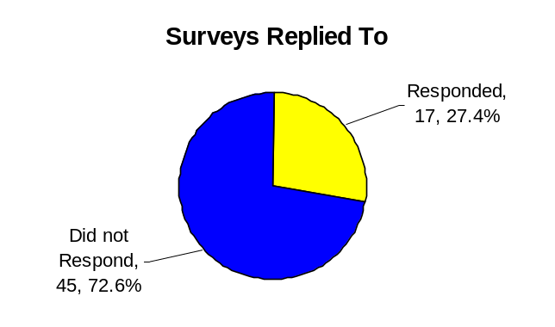
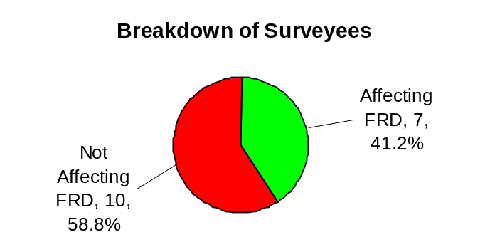
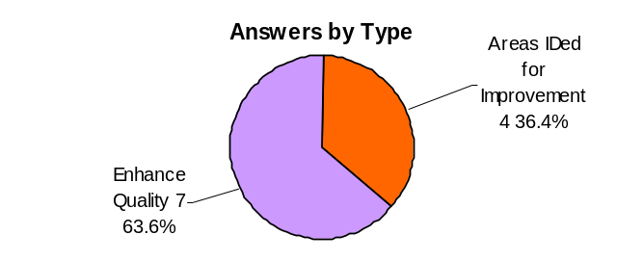
Results Impacting FRD
FRD Survey Results
Surveys Sent | Total | 62
 | Responded | 17
 | Percent Respond | 27
Surveys Responded | Total | 17
 | Affecting FRD | 7
 | Not Affecting FRD | 10
Answers aff. FRD by Type | Total | 11
 | Areas Identified for Improvement | 4
 | Enhance Quality | 7

Slide 10
Lessons Learned
Areas Identified for Improvement:
Perception of Quotas for Issues Tracking
FR should not surprise Contractor/ Laboratory Senior Management prior to issue being raised; prior discussion will be held

Slide 11
Corrective Action Plan (CAP)
11 Comments directly affecting FRD
  7 comments were deemed “in compliance” or not an FRD function
  2 comments closed at FRD retreat
  2 comments to be closed by June 30, 2004
Quotas are not used for issues tracking
Senior meeting held with FRs, Labs, AMs to discuss values & responsibilities of FRs and need for contractor response to FR concerns
Seeking to improve verbal communications

Slide 12
Summary
Follow key pointers
Lots of topics
Wording of questions crucial
Easy to tabulate results
Follow through
Questions?

