Slide 1

FDA Clinical Pharmacology Advisory Committee
Integrating Pharmacogenomics into Drug Development
Strattera Case Study
Richard D. Hockett, Jr. M.D.
Sr. Clinical Research Physician
Group Leader, Genomic Medicine

Slide 2
Pharmacogenetics & Pharmacogenomics
EMEA¹ definition: Pharmacogenomics applies genomic information to drug design, discovery and clinical development, reflecting the state or responses at cellular, tissue, individual or population levels.
PWG definition: Pharmacogenetics: the study of DNA sequence variation as it relates to differential drug response.
Pharmacogenomics: the study of the genome and its products (including RNA and protein) as it relates to drug discovery and development.
Lilly Definitions:
  Discovery Genetics utilizes genetic information to improve target identification/ verification and MOA testing.
  Pharmacogenomics utilizes gene based information to predict, assess and evaluate drug response.
1- The European Agency for the Evaluation of Medicinal Products

Slide 3

The Promise of Pharmacogenomics
"Pharmacogenomics will radically change the manner in which we develop drugs."
"Soon, we will be able to get the right drug into the right patient."
"Applying pharmacogenomics to drug development will cut cycle times to 1.5 - 2 years."
"Pharmacogenomics will be able to bring removed drugs back on the market, by predicting who is susceptible to adverse events."
How Close Are We?

Slide 4

Integrating Emerging Technology

Slide 5
Pharmacogenomics: applications and key activities
  Three broad applications
    Discovery
      Target Identification
      Mechanism of Action
      Target Differentiation
      Biomarker Identification
    Pre-clinical Toxicology
      Toxicogenomics
      In vivo Mechanism of Action
      Biomarker Identification
    Clinical
      In vivo Mechanism of Action
      Biomarker Development & Validation
  Two key activities
    Identify & Understand Targets
    Develop Human Biomarkers

Slide 6
Genetics in Drug Development Genetic Changes as Biomarkers
Disease Susceptibility Biomarkers
  Single Disease Genes (Mendelian Inheritance)
  Genetic Associations in Complex Diseases
  Genetic Changes Associated with Tumorogenesis
    Inherited Mutations
    Spontaneous Mutations in the Tumor
    Multiple Transcript Changes Leading to Reclassification
Drug Activity Biomarkers
  Genetic Polymorphisms Predicting Drug Metabolism
  DNA Variations Predicting Drug Response
  DNA Variations Predicting Adverse Events

Slide 7
Genetic in drug development
Conditions when Lilly would choose to include genetics in drug development
  Early phase development (Candidate selection through phase II)
    Animal toxicity profile to predict human toxicity
    Mechanism of action
    Early target/receptor interaction and PK/PD effects
  Phase III/Phase IV development
    When medically necessary
      Safety issue
  When test can differentiate drug
    Better response profile
    Adverse event management

Slide 8
Strattera and CYP2D6 Metabolism
Primarily metabolized by CYP2D6
  Plasma clearance
    EM 0.35 L/hr/kg PM 0.03 L/hr/kg
  AUC PM:EM 10 fold difference
  T1/2
    EM 5.2 hours PM 21.6 hours
Safety vs Tolerability vs Efficacy Issues
  Interplay has impact on label

Slide 9
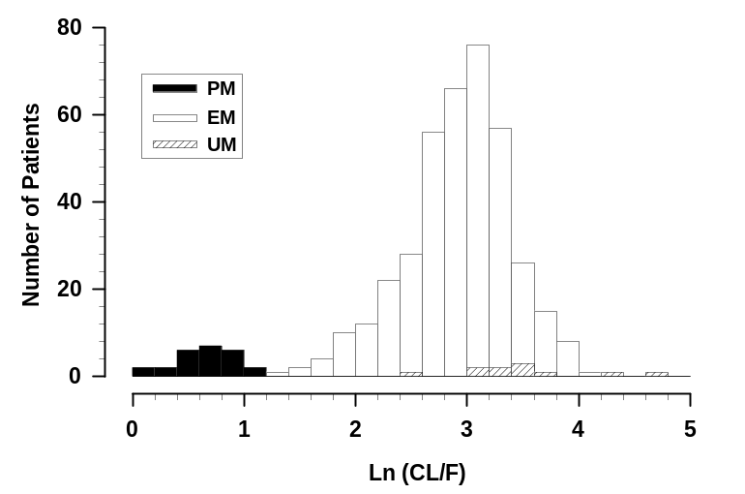
Empirical Bayesian Estimates of Clearance for each Patient in Population PK Analysis
Witcher et al. 2001. Population Pharmacokinetic Analysis of Atomoxetine in
Pediatric Patients. Population Pharmacokinetics Report. Lilly Research Laboratories.

Slide 10
CYP2D6 Polymorphisms: Assessing Safety
Initial clinical pharmacology studies above proposed maximum dose
CYP2D6 genotype obtained under double-blind conditions in clinical trials
Clinicians adjust dose and assess safety/tolerability/efficacy without knowledge of metabolic status

Slide 11
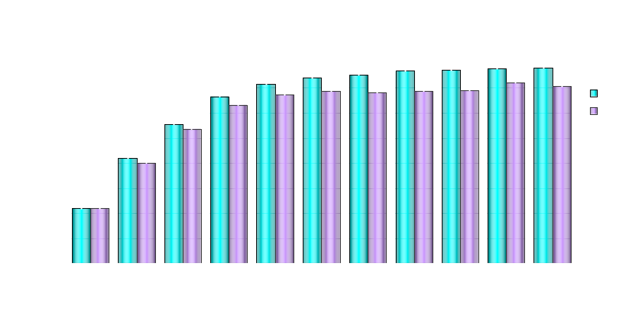
Mean Dose by Visit and Metabolic Rates
N 789/50 770/50 758/50 743/47 721/46 695/44 676/43 644/41 614/37 590/37 535/36

Slide 12
EM vs PM Summary
Safety & Tolerability
  Adverse event discontinuations - all studies
    EM 6% PM 9%
    Close label comparison Strattera 3.5% Placebo 1.5%
      Insomnia, Irritability
Efficacy
  PMs have a statistically significant decrease in ADHDRS compared to EMs

Slide 13
Strattera Label
CYP2D6 status mentioned 7 times in label
  Pharmacokinetics section
  Adverse events
  Drug:drug interaction
  Laboratory Testing
Poor metabolizers (PMs) of CYP2D6 have a 10 fold higher AUC and a 5 fold higher peak concentration to a given dose of Strattera compared with extensive metabolizers (EMs). Approximately 7% of a Caucasian population are PMs. Laboratory tests are available to identify CYP2D6 PMs. The blood levels in PMs are similar to those attained by taking strong inhibitors of CYP2D6. The higher blood levels in PMs lead to a higher rate of some adverse effects of Strattera (see adverse reactions).

Slide 14
Genetics in Drug Labelling
How to define PM status?
  Easy in some CYP P450s
    2C9 - 3 alleles, *2 and *3 are both classified as PMs
    2C19 - similar
  CYP2D6 is more problematic
    >40 alleles defined
    ~10 are currently classified as greatly decreased, or null
    At least two are classified as decreased, or intermediate
    Duplication exists, leading to classification as ultrametabolizers
    Significant variations of frequency in ethnic backgrounds

Slide 15
CYP2D6 Genotypes by Ethnicity
Caucasians
  UM = 1 - 2%
  EM = 92 - 95%
  PM = 5 - 7%
African American
  UM = 3 - 5%
  EM = 92 - 95%
  PM = 2 - 3%
Asians
  UM = ??%
  EM = 70 - 80%
  IM = 20 - 30%
  PM = ≤1%
Hispanics
  UM = ???
  EM = ???
  PM = ???

Slide 16
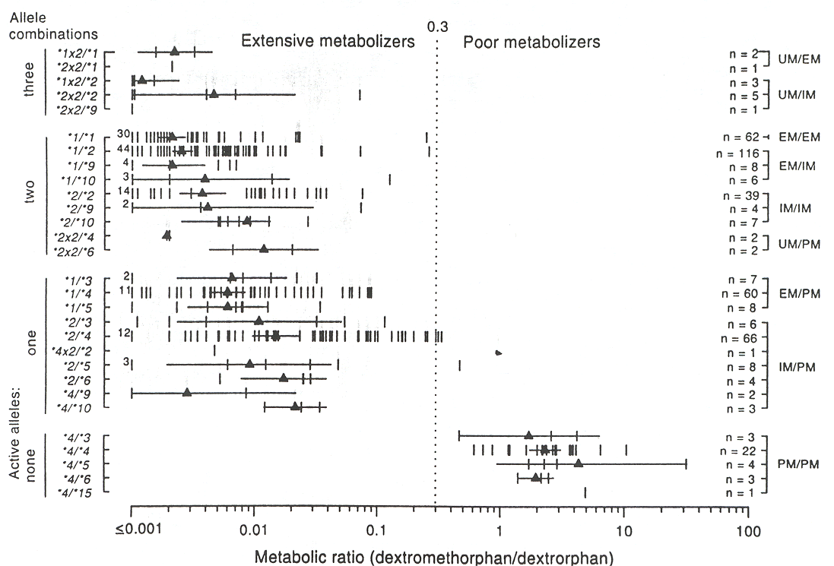
CYP2D6 Genotype vs Phenotype
CYP2D6
Sachse et al. Am J Hum Genet 60:284 1997

Slide 17
CYP2D6 Phenotyping vs. Genotyping
Phenotyping Advantages
  Phenotype is the desired designation.
  Ethical considerations are small.
  High sensitivity.
  Very Low False Negatives.
Genotyping Advantages
  Requires no extra sampling.
  Requires no follow-up visit.
  High sensitivity and specificity.
  Analysis not altered by patient taking other drugs.

Slide 18
Methodological and Other Considerations
Privacy and the Ethical, Legal and Social Implications
Utility of the information/biomarker
Translation into clinical practice
Resistance to pharmacogenomic stratification
Regulatory approval
Realistic timelines and expectations

Slide 19
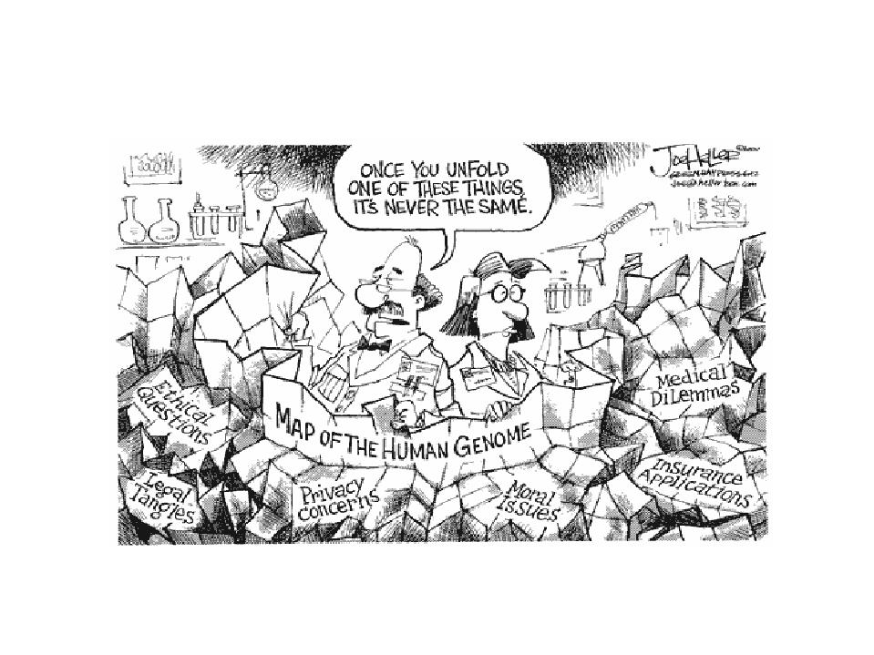
Ethical, Legal and Social Implications
Consistent guidelines for the review and approval of informed consent procedures and of pharmacogenomic protocols by ethics committees
Sampling procedures selected have important consequences for patient privacy, sample access and control, and ultimately gene discovery, and drug development
  PWG and CPMP definitions
Access to the genetic information, and the medical and medical use consequences of third parties.

Slide 20
Methodological and Other Considerations
Privacy and the Ethical, Legal and Social Implications
Utility of the information/biomarker
Translation into clinical practice
Resistance to pharmacogenomic stratification
Regulatory approval
Realistic timelines and expectations

Slide 21
Utility of the information/biomarker
Y
Best
Y
Good
Average
Poor
Response
N
N
N
Y
N
Y
N
Y
N
Y
Variation
Variation
Examples
  ErbB-2 over-expression and response to Herceptin
  ALOX5 promoter in asthma
  Cholesteryl ester transfer protein and response to statins
  B2 adrenergic gene in asthma
  RNA levels and response to 5FU in colon cancer

Slide 22
CYP2D6 Recommendations
PM genotype predicts PM phenotype in ≥99% of cases in two large studies (*3,4,5,6,&9, no interfering drugs).
To avoid confusion, FDA should specify that both phenotyping and genotyping are acceptable methods of determining PM status. This should include a recommendation for what is minimal genotyping.
The genotypic designations of UM, IM and EM have distinguishable phenotypes, but only in population studies. Classification of individual patients as UM, IM, and EM is NOT indicated by current data.
Genotyping for CYP2D6 mutants is warranted only when a compound's margin of safety is exceeded in PMs.

Slide 23
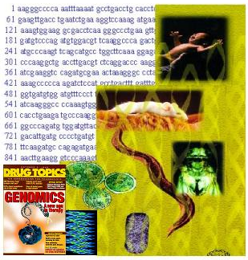
The Biotech/Genomics
Revolution:
Right Target
Right Drug
Right Patients
Right Timeline

