Slide 1
APAC National Grid
and
Trying to be all Things to all Users …
Lindsay Hood
Australian Partnership for Advanced Computing
www.apac.edu.au
lindsay.hood@apac.edu.au

Slide 2
Australian Partnership for
Advanced Computing
“providing national advanced computing,
data management and
grid services for eResearch”
Partners:
Australian Centre for Advanced Computing and Communications (ac3) in NSW
CSIRO
iVEC, The Hub of Advanced Computing in Western Australia
Queensland Cyber Infrastructure Foundation (QCIF)
South Australian Partnership for Advanced Computing (SAPAC)
The Australian National University (ANU)
The University of Tasmania (TPAC)
Victorian Partnership for Advanced Computing (VPAC)
4500 CPUs, 3PB storage

Slide 3
Changing User Base
National Collaborative Research Infrastructure Strategy
  Ambitious plan to hand out $0.5B of federal money to fund research infrastructure collaboratively
Evolving Biomolecular Platforms and Informatics $50.0M
Integrated Biological Systems $40.0M
Characterisation $47.7M
Fabrication $41.0M
Biotechnology Products $35.0M
Networked Biosecurity Framework $25.0M
Optical and Radio Astronomy $45.0M
Integrated Marine Observing System $55.2M
Structure and Evolution of the Australian Continent $42.8M
Terrestrial Ecosystem Research Network $20.0M
Population Health and Clinical Data Linkage $20.0M
Platforms for Collaboration $75.0M

Slide 4

Summer in Australia?

Slide 5
Recent Review
APAC in the future must be regarded not just as the National Facility, but as the sum of its component parts comprising:
  […]
  The National Grid
  […]
That the APAC National Grid must be the pre-eminent grid in Australia and continue extending its coverage to include capabilities wherever they exist or develop. It must also nurture and support scientific research teams, NCRIS infrastructure and international partnerships

Slide 6
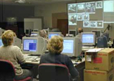
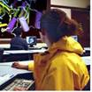
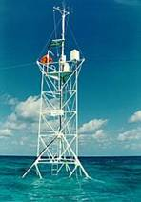
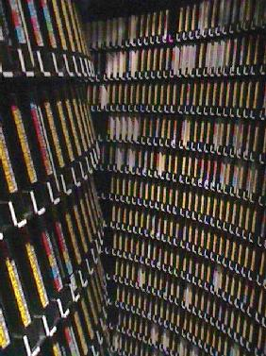

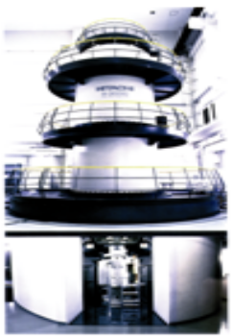
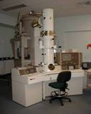
National Cyberinfrastructure
Research Teams
Data Centres
APAC National Grid
a virtual system of
computing,
data storage
and visualisation
facilities
QPSF
ac3
IVEC
APAC
NATIONAL
FACILITY
Sensor
Networks
SAPAC
ANU
CSIRO
TPAC
VPAC
Other Grids:
Institutional
International
Instruments

Slide 7
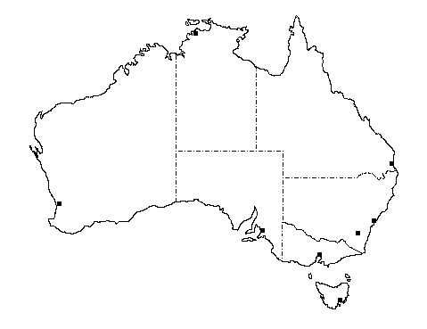
Core Grid Services – Work!!
Portal Tools:
GridSphere
Info Services:
APAC Registry
MDS2, MDS4
QPSF
(JCU)
Security:
APAC CA (PKI)
MyProxy
VOMRS
APAC
National Facility
QPSF
IVEC
ac3
Systems:
Gateways
Partners’ systems
SAPAC
ANU
VPAC
CSIRO
TPAC
Network:
AARNet3

Slide 8
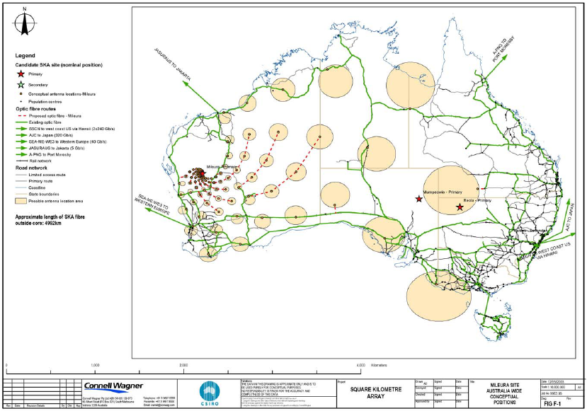

Slide 9
Gateways
Rapid churn in the middleware
  You need lots of test machines
Different communities want different middleware
  GT2, GT4, Gridsphere, SRB …
Minimises interaction with non grid-dedicated production systems
Virtualisation is well understood technology
Xen has a nice price

Slide 10
Middleware Stack
We’re using VDT
  For both GT2 and GT4
  Inclusion of VOMS/VOMRS/GUMS is nice
Actively doing QA, and finding and reporting several bugs
Add portal and data components to core VDT for other gateways
  SRB, GridSphere
Java tool Grix for simplified certificate management by users
  APAC has IGTF-audited CA

Slide 11
Gateways on a National Backbone
Installed Gateway servers at all grid sites, using VM technology to support multiple grid stacks
Cluster
Cluster
Datastore
Gateway Server
High bandwidth, dedicated, secure private network between grid sites
Layer 2 Private Network
consistency, ease of implementation, performance?
Gateway Server
Gateways supporting GT2, GT4, LCG, grid portals, and experimental grid stacks
Datastore
Cluster
HPC

Slide 12
Data services
Data is hard
  Different communities have different needs
  Complex access controls
We have gridftp between sites
  Network consistency is interesting …
SRB today; iRODS later this year
Dcache, SRM, Gfarm as communities require
Credible use cases for a global file system?

Slide 13
Registry services
MDS2, MDS4 running
Deployed Modular Information Provider to present site and aggregated information more easily
Using GLUE schema, but it’s far from satisfactory for describing real-world production HPC resources

Slide 14
Improved AAA Services
NCRIS will require e-research services to a much wider community than traditional HPC
  PKI doesn’t scale and is conceptually difficult for non computer weenies
Australian Access Federation funded
IAM Suite from MELCOE
  Shibboleth authentication plus appropriate attributes generates short lived certificate
  Tools for users to easily create shared workspaces and manage attribute release
Only a few people will need real certificates
But a year or two before being ready for prime time

Slide 15
Future Strategies
Expand the user base
  NCRIS, Merit Allocation Scheme, Partners
  Open access to core grid services
Expand the services
  Workflow engines and tools – Kepler, Taverna
  Data management: metadata support, collections registry
Expand the facilities
  Include major data centres
    data from instruments, government agencies
  Include institutional systems and repositories
Resulting changes:
  Policies: acceptable service provision
  Organisation: coordinated user support
  Architecture: scaling gateways
  Technologies: Attribute-based authorisation

