Slide 1
SIP REQUIREMENTS
UPDATE FOR SIP STEERING COMMITTEE
JUNE 1, 2007

Slide 2
8-Hour Ozone Related SIPs
RACT SIP (due September 15, 2006)
Transport SIP (deadline for EPA approval - May 25, 2007)
8-hour Attainment Demonstration SIP (due June 15, 2007)
Reasonable Further Progress SIP (due with ozone attainment SIP)
CAIR SIP (due March 31, 2007)

Slide 3
8-Hour Ozone RACT SIP
RACT =
Reasonably Available Control Technology
Required on existing stationary emission sources in non-attainment areas
Defined as the lowest emission level a facility is capable of meeting through the application of control technology, considering both technical and economic feasibility

Slide 4
8-Hour Ozone RACT SIP
States that adopted RACT under 1-hour ozone standard must review whether what was considered RACT then is still RACT –are there new technologies, less costly controls, etc.?
Decide to adopt new state RACT limits or that nothing more is needed to satisfy RACT
Submit determination to EPA as a RACT SIP

Slide 5
8-Hour Ozone RACT SIP
MassDEP reviewed RACT for two purposes:
To meet EPA’s 8-hour ozone RACT SIP requirement. Required irrespective of whether needed to attain ozone standard
As participant in OTC review of RACT categories to assess tighter RACT within OTC as regional attainment measure.

Slide 6
1-Hour RACT
EPA issued Control Technique Guidelines (CTGs) for 29 source categories of VOC emissions - established a presumptive level of control for RACT
RACT also required for all major sources of VOCs, whether or not within a CTG source category
1990 Clean Air Act extended RACT to major NOx facilities

Slide 7
MA 1-Hour RACT Compliance
Adopted VOC regulations for CTG categories (1970s/1980s)
Determined RACT on a facility-by-facility basis for non-CTG major sources
Adopted 1995 NOx RACT regulations for:
  Reciprocating Engines
  Combustion Turbines
  Municipal Waste Incinerators
  Glass Furnaces
  Boilers (>20 mmBtu/hr)

Slide 8
1-Hour RACT Results:
MA Stationary Point Source
VOC Emissions Trends
Tons per summer day
Tons per year
1990
64
17,324
1993
61
19,165
1996
43
11,580
1999
28
9,831
2002
16
5,647

Slide 9
1-Hour RACT Results:
MA 2002 VOC Emissions by Source Sector
2002 VOCs
Tons per year (TPY)
TPY % of total VOC inventory
Tons per summer day (TPSD)
TPSD % of total VOC inventory
Stationary Point
5,647
2
16
1%
Stationary area
154,170
56
302
44%
On-Road Mobile
57,186
21
152
22%
Off-Road Mobile
56,577
21
224
32%
Total
273,580
100%
702
100%

Slide 10
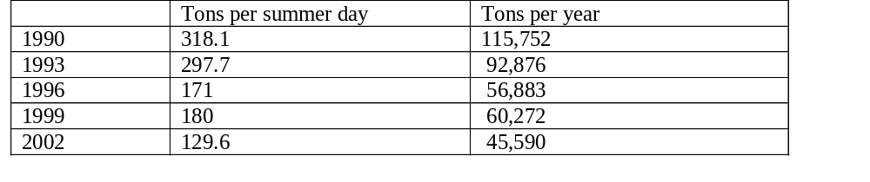
1-Hour RACT Results:
MA Stationary Point Source
NOx Emissions Trends

Slide 11
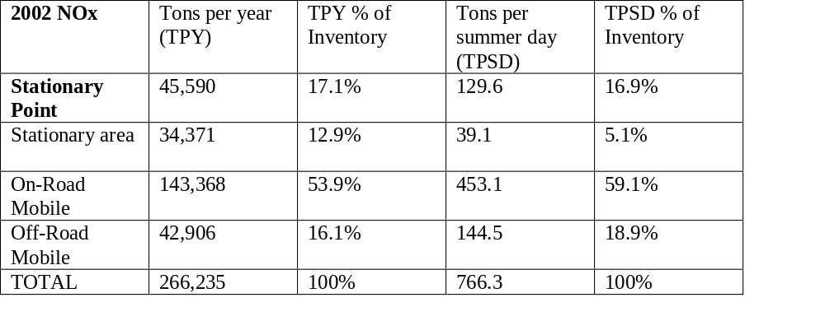
1-Hour RACT Results:
MA 2002 NOx Emissions by Source Sector

Slide 12
MassDEP 8-hour VOC RACT Review
Conclusion: 1-hour VOC RACT = 8-hour VOC RACT for all CTG categories except:
solvent metal degreasing
gasoline dispensing vapor control
asphalt paving

Slide 13
MassDEP 8-Hour NOx RACT Review
Region 1 EPA suggested MA tighten RACT for industrial, commercial and institutional (ICI) boilers and municipal waste combustors
OTC recommended tighter ICI boiler NOx controls
Expect that MA RACT SIP will conclude current NOx RACT meets 8-hour RACT requirements for NOx sources
MassCAIR constitutes RACT for sources covered by cap-and-trade program

Slide 14
Transport SIP
SIPs must contain provisions adequate to prohibit emissions within a state from:
1.Contributing significantly to nonattainment in another state, or interfering with maintenance of a NAAQS by any other state; or
2. Interfering with another state’s plans to prevent significant deterioration of air quality or to protect visibility

Slide 15
Transport SIP
April 2005 - EPA found that all 50 states had failed to submit SIPs satisfying requirements related to interstate transport
Transport SIP must address ozone, PM _{2.5}, prevention of significant deterioration (PSD) and visibility (regional haze)
EPA issued guidance - what states should do to respond to finding of failure to submit SIPs addressing transport

Slide 16
Transport SIP
EPA’s CAIR rule is based on extent to which transport from states subject to CAIR contribute to ozone and PM_{2.5} nonattainment
EPA Guidance – any state subject to CAIR satisfies transport requirements with adoption of CAIR
EPA’s CAIR concludes that Massachusetts significantly contributes to ozone nonattainment in CT and RI but does not contribute to PM_{2.5} nonattainment

Slide 17
Transport SIP
MassDEP concludes that it has addressed its contribution to ozone nonattainment in CT and RI through:
Adoption of MassCAIR
Other VOC control measures that will be part of attainment SIP

Slide 18
Transport SIP
MassDEP concludes that it does not contribute to PM_{2.5} nonattainment:
CAIR analysis shows minimal contribution from MA – well below EPA’s threshold
Nearest nonattaining PM_{2.5} monitor is in NYC area

Slide 19
Transport SIP
Consistent with EPA Transport SIP guidance, MassDEP concludes:
New Source Review permitting program addresses PSD element
Regional Haze SIP (December 2007 due date) will address contribution to visibility impairment; premature to address visibility before then

Slide 20
Reasonable Further Progress (RFP) SIP
Must show 15% reductions from 2002 base year emissions inventory
RFP reductions must be achieved by 2008 (6 years after base year)
May be 15% VOC or 15% NOx or a combination of both

Slide 21
RFP SIP
2008 projected emissions derived by applying growth factors to the 2002 base year emissions inventory
2008 projected emissions must be less than or equal to the target levels
Preliminary calculations show MA to be well within RFP targets

Slide 22
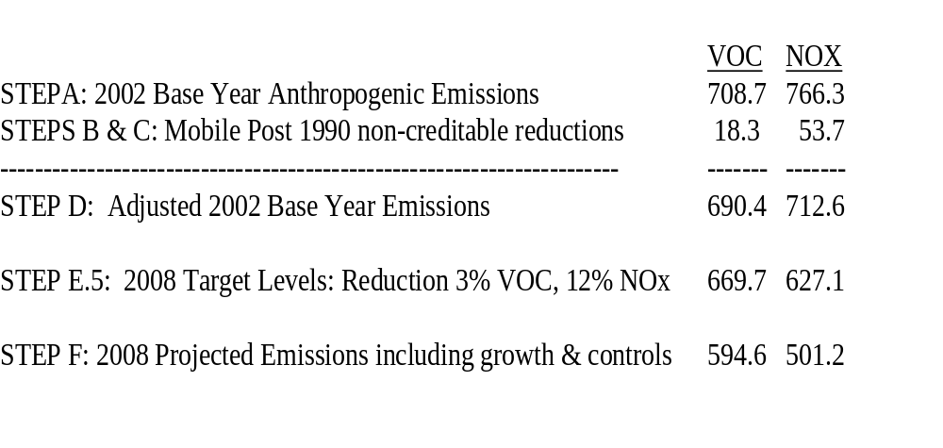
DRAFT RFP Calculation
(Numbers likely to change in final SIP)

