Slide 1
Problems on 4/29/2003
4B6 AFE-board 577 "would/would not" download during few hours on 4/24, crate 50
  No problems last week
CA5 AFE-board 487 reset itself on 4/27 eLog 198279, crate 51, returned to normal after downloading
  No problems last week
Discriminator gain switched from high to low without anybody taking resposibiliy, for all AFEs in crate 50.
  Standard mode of operation: high gain
  Since last Saturday we run with low gain
SVX0 in 9A5 AFE-board does not contribute to tracking
  cft_examine shows hits at nominal level
  Global monitoring does not show hits

Slide 2
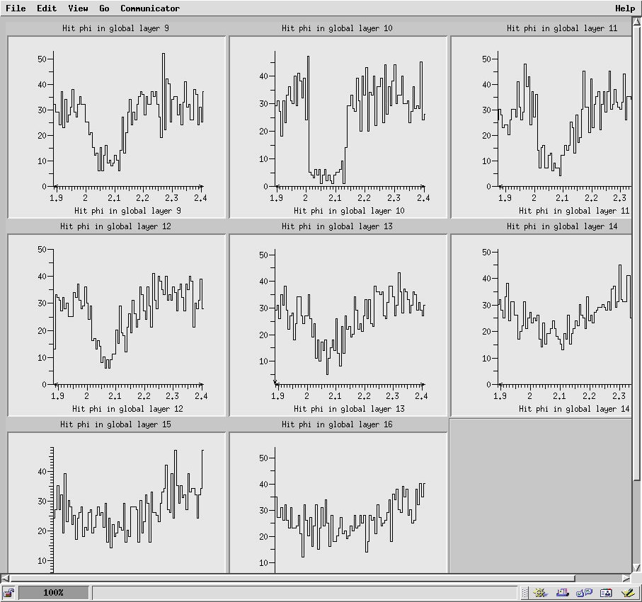
Hole in global layer 10: SVX0 IN 9A5

Slide 3
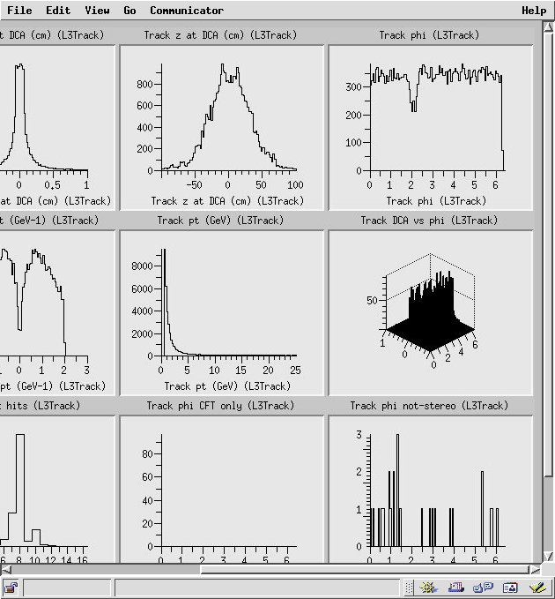
Tracks phi have hole

Slide 4
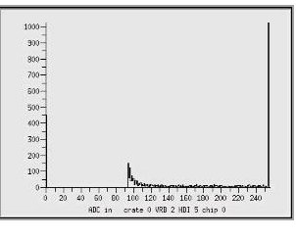
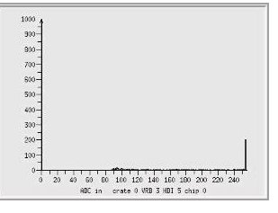
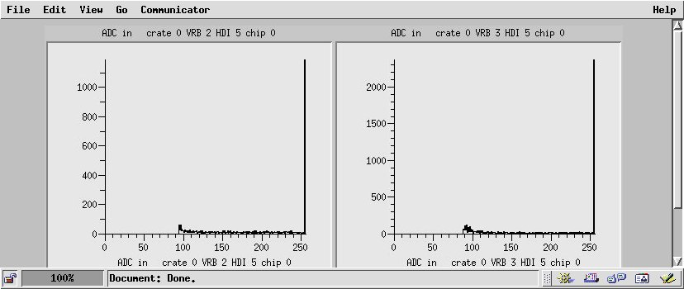
Bad chip: SVX0 on 9A5 did not contribute to tracking
Pulse height distributions
Reference chip "Bad chip"
Before swap
After swap

Slide 5
cft_examine: we need more plots
Hit maps and occupanies for raw SVX hits
Hit maps and occupancies for SVX hits above calibration thresholds

Slide 6
Last week problems
EAST CRYOSTAT temperature lowered again
Diasabled alarm on AFE power supply 12A +12V
Oscillating temperature on AFE 7B5 module 8

Slide 7
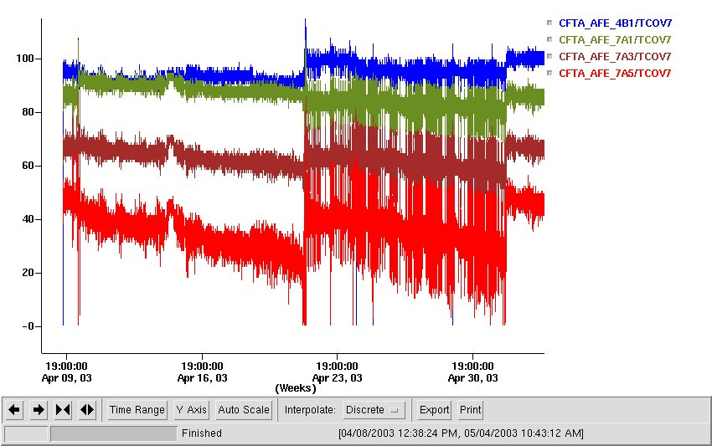

EAST CRYOSTAT temperature re-adjusted
Driven by west-most cassette (board 7A5)

Slide 8
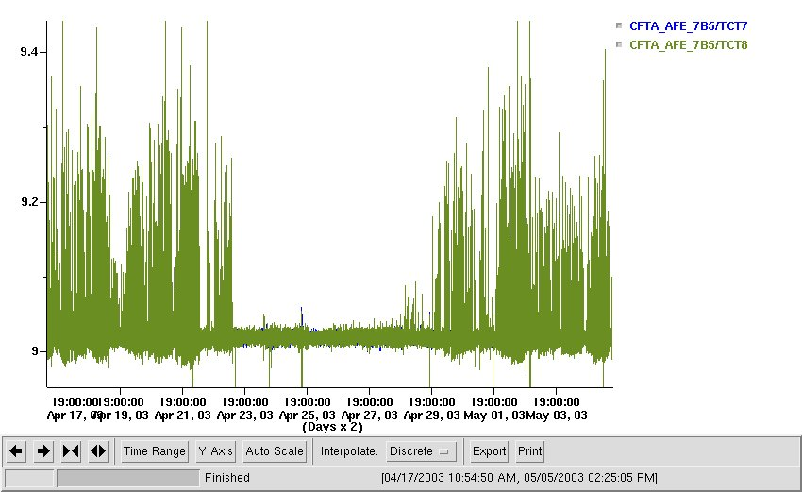
Temperature oscillating in 7B8 module 8

Slide 9
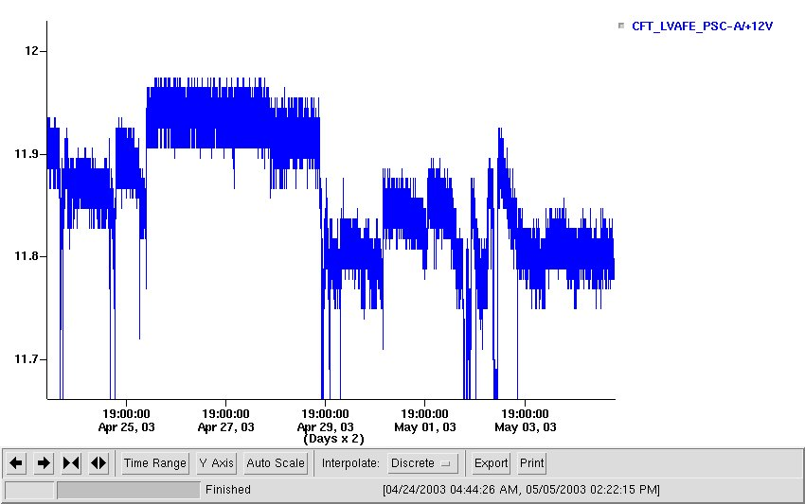
Disabled alarm on
AFE power supply 12A,+12V

Slide 10
Some problems went away
Temperature on 4B1 module 8 and 5A5 module 1 stopped oscillating
Split pedestals disapperead from SVX5 on 4B5

Slide 11
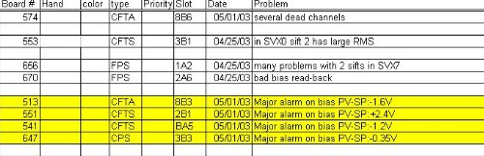
Bad boards

