Slide 1
Clinical Trial Design Issues for Drugs to Treat CHB
FDA Advisory Committee
August 7, 2002

Slide 2
Why Now?
Drug Development for CHB has increased
Additional drug availability may change types of clinical trials that are feasible
  Active Control Trials, Combination Therapies
Timing with consideration of new drug product, adefovir
Lessons learned from first two drug development programs

Slide 3
Meeting Focus
Antiviral Drugs Primarily
Phase 3 and Postmarketing Studies
Both Compensated and Decompenated Liver Disease
Aid in planning of future clinical studies

Slide 4
Key Issues
Essential Patient Populations
Selection of Controls
Choice of Primary Endpoint
Long-term follow-up/Data collection

Slide 5
Agenda: Aug. 7, 2002
8:30 Natural History and Clinical Virology of Hepatitis B,
  Jay Hoofnagle MD, NIH
9:15 Treatment Outcomes,
  Anna Lok MD, University of Michigan
10:00 Break
10:30 An industry perspective,
  Nat Brown MD, Idenix
11:00 FDA Perspective/Analysis,
  Jeff Murray M.D. and Greg Soon PhD, DAVDP
12:00 Lunch
1:00 Open Public Hearing
2:00 Questions, and discussion

Slide 6
Clinical Trial Design Issues in CHB Drug Development
Jeff Murray
FDA

Slide 7
Key Issues
Compensated and Decompensated CHB
Essential Patient Populations
Selection of Controls
Choice of Primary Endpoint
Long-term follow-up/Data collection

Slide 8
Patient Populations
Essential for Marketing Applications
Patient Demographics
  Although CHB is a global problem, regulatory guidance recommends submission of data that reasonably represents patients in the U.S.
Disease Characteristics
  HBeAg negative/positive
  Patients with drug resistant HBV
  Compensated and Decompensated
  Co-infection

Slide 9
Patient Populations
Study Inclusion Criteria
Value of lumping or splitting populations in the same study
  by presence/absence of HBeAg
  by presence/absence of other viral infections (e.g., HIV, HCV)
  previous treatments

Slide 10
Selection of Controls
Are placebo-controlled trials still feasible?
  For phase 3? For trials of shorter duration?
Use of Placebo: Considerations
  Drug availability
  Risks of Deferring Treatment
  Strength of recommendations on when to start treatment and what therapy is the best initial therapy
Active Controls: Lamivudine monotherapy?

Slide 11
Choice of Primary Endpoint
Compensated CHB
Clinical (HCC, death, cirrhosis complications)
Histology (Knodell, Ishak, Metavir)
Virologic: HBV DNA
Serologic: HBeAg loss, eAg seroconversion, sAg seroconversion
Biochemical: ALT, AST
Combinations:
  HBV DNA suppression + ALT normalization

Slide 12
Choice of Primary Endpoint
Decompensated
Child-Pugh Score
MELD score
Mortality
Transplantation
Complications
Virologic/Serologic/Biochemical

Slide 13
Endpoints
From a regulatory standpoint: Clinically meaningful
For CHB drugs, histology has been the “default” endpoint (compensated)
  direct visualization of end organ
  treatment induced changes in necro-inflammatory score predictive of progression to cirrhosis complications?
  Sensitive indicator of drug activity
In Clinical Practice, serologic endpoints often guide decisions to stop therapy, but are lower frequency events

Slide 14
Endpoint Considerations
In addition to endpoint choice...
Magnitude of change that is clinically relevant
  Knodell: 2 point change?
  Suppression of HBV DNA: to what level?
  Change in HBV DNA (continuous)
Duration: Timing of Measurement
  on/off treatment
  48 weeks or longer?
  Different endpoints may require different duration, seroconversion occurs later

Slide 15

Outcomes at 48 and 72 wks
Adefovir Study 437
% responders

Slide 16
Endpoint
Validation against histology
Correlations between other endpoints and histologic outcome
Lamivudine, adefovir data sets
An endpoint “validation” is strengthened by consistency across multiple studies and drugs
Metanalysis-Literature

Slide 17
Endpoint Validation
Mommeja-Marin H, Mondou E, Blum R. Rousseau F. Serum HBV DNA as a Marker of Efficacy during Antiviral Therapy for Chronic Hepatitis B Virus Infection: Analysis and Review of literature. Submitted for publication
One Analysis evaluated association between HBV DNA and histologic outcome.

Slide 18
HBV DNA change and Histology
Studies Analyzed
Lai et al. NEJM 1998
  Placebo, lamivudine 25mg, lamivudine 100mg QD
De man et al. Hepatology 2000
  Placebo, famciclovir 1.5g QD and 0.5g tid.
Dienstag et al. NEJM 1999
  Placebo and lamivudine 100mg QD.
Barbaro et al. J. Hepatol 2001
  Lamivudine and lamivudine + interferon
Lau et al. Hepatology 2000
  Lamivudine HBeAg - and + groups

Slide 19
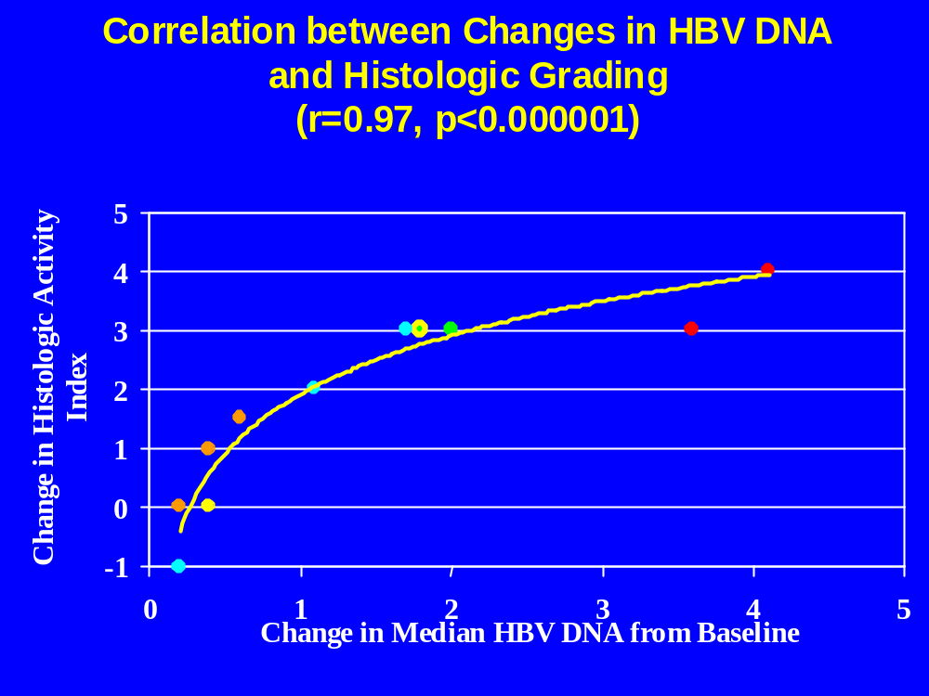

Slide 20
Endpoint Validation
FDA Analyses
Lamivudine and Adefovir data-sets
Correlations between endpoints and histologic outcome (improvement in Knodell score)
  Year 1 HBV DNA (log10)
  Change in ALT (log10)
Strength of correlation method dependent
Association weaker for HBeAg negative
Consistency of association important for validating predictive value of a surrogate

Slide 21
Long-term follow-up
48 week histologic assessment
  provides snapshot of drug efficacy
  not helpful for addressing clinical question relating to duration of therapy, assessing relapse
In addition to evaluation of a primary endpoint for registration, longer term data collection for CHB is crucial

Slide 22
Questions To The Committee

Slide 23
Patient Population
1. Please identify patient populations that are appropriate targets for treatment studies (consider attributes such as stage of disease,viral genotype, co-morbidities, lamivudine resistance, IFN-experience, pediatrics,HBeAg-/HBV DNA+)? Please Include demographics in your discussion, ie.race and ethnicity.

Slide 24
Cont. Patient Population
2. Which of the aforementioned patient subgroups is essential in a marketing application? In particular, comment on race and ethnicity, disease stage and comorbidities.

Slide 25
Control Arms
3a. Discuss the role of the following controls in the compensated liver disease group:
- Placebo controls/delay of initiation of treatment; and of what duration?
-Lamivudine (or other antiviral drug) monotherapy
-Interferon

Slide 26
Cont. Control Arms
3b. Please also discuss controls for patients with decompensated liver disease or who have failed previous regimens.

Slide 27
Study Endpoints and Timing of Evaluation
4. Consider the patient populations identified in question #1, the information presented today, and the necessity that endpoints for registration be clinically meaningful, please answer the following:

Slide 28
Cont. Endpoints...
Cont. Question #4
a. Which endpoint (or combination or endpoints) should be the primary in clinical trials? Please discuss histologic, serologic (HBeAg loss vs seroconversion; HbsAg loss vs. seroconversion), biochemical, and virologic endpoints.

Slide 29
Cont. Endpoints...
b. When should the assessment of the primary endpoint be made?
c. List the most appropriate secondary endpoints and rank them in order of importance.

Slide 30
Cont. Endpoints...
5. For histologic endpoints, what is the preferred method of histologic scoring? What degree of change in histologic score is clinically meaningful?
6. For virologic endpoints, which assay is best suited for clinical trials? What is the appropriate cutoff point for HBV DNA (eg < 10⁵, <10⁴, etc)? Should viral genotyping be done and why?

Slide 31
Cont. Endpoints...
7. For Patients with decompensated liver disease, please discuss the feasibility/validity of the following alternative endpoints:
- mortality
- change in Child Pugh or MELD score (or its components)
- transplant/no transplant
- occurrence of liver disease assciated illness (variceal bleed, SBP, etc)

Slide 32
Long Term Follow-Up
8. Beyond the assessment of the primary endpoint for registration, what is the appropriate duration of studies for treatment of chronic hepatitis B infection, and what kind of information should be gathered?

