Slide 1
NASA
Goddard Center Director’s Colloquia
The Inquiring Organization
Practical Perspectives for the 21st Century
Marilee G. Adams, Ph.D.
November 13, 2002

Slide 2
Asking questions is the pivotal skill of the learning organization.
There’s no change without learning.
There’s no learning without questions.

Slide 3
Agenda
The Inquiring Organization
Power of Questions
Mindsets for Questioning
Exercise: Q-Storming™
Q & A
Copyright©2001 Marilee Goldberg Adams, Lambertville, NJ

Slide 4
Learning Objectives
Introduce concept and practices of inquiring organizations
Reinforce scientific question thinking skills for organizational benefit
Distinguish questions that help progress from those that hinder it
Provide practical applications of strategic inquiry tools

Slide 5
The Inquiring Organization
Each individual values and utilizes the skills of question thinking and question asking.
The culture reflects this in the way that everyone works together.
The organization has formal structures and practices that support strategic inquiry in all functions and at all levels.

Slide 6


Slide 7
Blocks to Questioning
Question Reluctance
Assumptions
Culture or relationship that
discourages questions

Slide 8
Judger Mindset Learner Mindset
Learner/Judger Mindset Model™
Human nature
Advocating
Automatic
Judgmental, biased
Know-it-already
Inflexible, rigid
Point of view: only own
Win-Lose relating
Debate
Feedback seen as hurtful
Operates in “attack or defend” mode
Human spirit
Inquiring
Thoughtful
Accepting, unbiased
Inquisitive researcher
Flexible, adaptive
Point of view: includes others
Win-Win relating
Dialogue
Feedback seen as helpful
Operates in resolution, & innovation-seeking mode

Slide 9
Learner/Judger Questions
Judger Questions
Learner Questions
What’s wrong?
Whose fault is it?
How can I stay in control?
How could I lose?
How could I get hurt?
Why bother?
What’s right?
For what am I responsible?
What is the big picture?
What’s the most useful thing to do?
What can I learn?
What’s possible?

Slide 10
Learner Mindset way of being is based in:
* Acceptance * Curiosity
* Not knowing * Flexibility

Slide 11
Curiosity is our greatest resource for accessing
Learner Mindset.

Slide 12
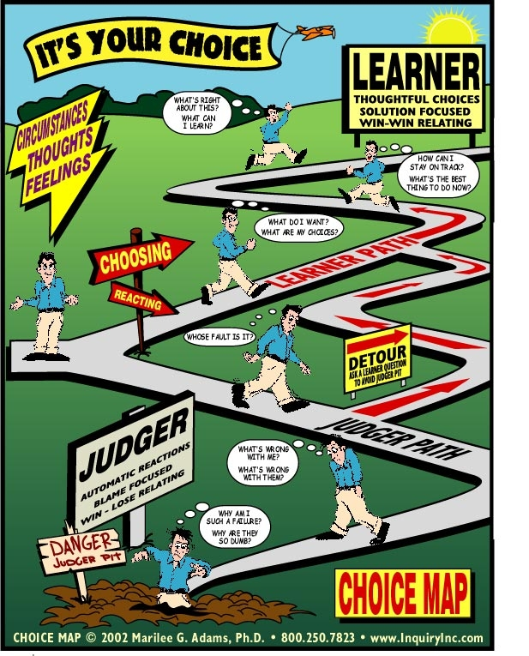

Slide 13
Judger Costs
Innovation
Organizational effectiveness
Learning community
Notes:
Learner/Judger in the Body
Learner/Judger Dyads

Slide 14
Learner/Judger Exercise
Consider some current challenge.
What Judger aspects or questions
(in self, others, or the organization) could be impeding progress?

Slide 15
Inquiring Leaders
Characteristic # 1
Inquiring leaders have an insatiable, non-judgmental curiosity. They place a high value on continuous learning and growing for themselves and others. They model question asking that is constructive rather than criticizing (Learner rather than Judger).

Slide 16
Inquiring Leaders
Characteristic # 2
Inquiring leaders challenge assumptions and beliefs. They solicit honest feedback. They are willing to suspend their own opinions in the face of new data. They are courageous and risk takers. They are willing to “not know” and “not be right.”

Slide 17
Inquiring Leaders
Characteristic # 3
Inquiring leaders listen carefully and thoroughly. Their listening is focused by accepting internal questions such as, “What’s useful/right about this?” “What can I learn?” “What can I contribute?” and “What is the big picture here?” Their listening is not focused by blaming questions such as, “What’s wrong?” and “Whose fault is it?”

Slide 18
Inquiring Leaders
Characteristic # 4
Inquiring leaders establish a culture of inquiry in their organizations. This is one that encourages and reinforces questioning and learning. These leaders mandate and reward standard practices of strategic inquiry throughout the organization.

Slide 19
Inquiring Leaders
Characteristic # 5
Inquiring leaders are committed to encouraging and teaching those in the leadership pipeline to take advantage of these strategic inquiry perspectives, practices, and skills.

Slide 20
Practices of
Inquiring Organizations
Question Map
AAR (After Action Review)
Choice Map
Learner/Judger Mindset Model
Q-Prep
Q-Storming
Others . . .

Slide 21
Question Map™
Phase One
Phase Two
Phase Three
Phase Four
Questions
For Reflection
Questions for
Strategizing
Innovation
And
Decisions
Questions for Action
Questions for Speculation
Relationship
Information
Closed-ended
AAR
Open-ended

Slide 22
INNOVATION—in ideas, products, services, or processes— always begins with a new question, or an old question asked newly.

Slide 23
A PARADIGM SHIFT occurs when a question is asked inside the current paradigm that can only be answered from outside of it.

Slide 24
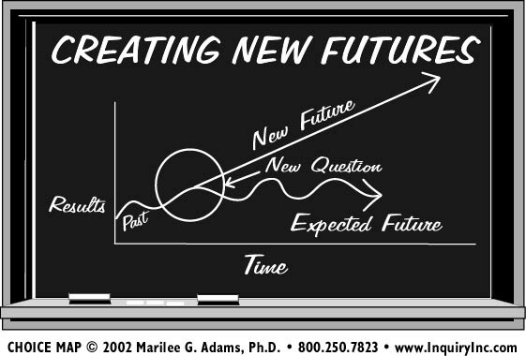

Slide 25
Group Exercise
Q-Storming
Most any problem can be solved
with enough right questions.
A question not asked is
a door not opened.

Slide 26
Q & A
Take-Aways

Slide 27
“The important thing is not to stop questioning.”
Albert Einstein
InquiryInc
www.InquiryInc.com
609-397-9100
Copyright © 2002 InquiryInc Pennington, NJ

