Slide 1
State of Washington
Department of Fish and Wildlife
Human Resource
Management Report
Plan & Align Workforce
Hire Workforce
Deploy Workforce
Reinforce Performance
Develop Workforce
October 15, 2007
Jeff Koenings Ph.D.
Director

Slide 2
Managers’ Logic Model for Workforce Management
Outputs
Initial Outcomes
Intermediate Outcomes
Plan & Align Workforce
Articulation of managers HRM accountabilities. HR policies. Workforce planning. Job classes & salaries assigned.
Managers understand HRM accountabilities. Jobs, staffing levels, & competencies aligned with agency priorities.
Foundation is in place to build and sustain a productive, high performing workforce.
Hire
Workforce
Qualified candidate pools, interviews & reference checks. Job offers. Appts & per-
formance monitoring.
Best candidate hired & reviewed during appointment period. Successful performers retained.
The right people are in the right job at the right time.
Ultimate Outcomes
Employees are committed to the work they do & the goals of the organization
Productive, successful employees are retained
State has workforce depth & breadth needed for present and future success
Deploy
Workforce
Work assignments& requirements defined. Positive workplace environment created. Coaching, feedback, corrections.
Workplace is safe, gives capacity to perform, & fosters productive relations. Staff know job rqmts, how they’re doing, & are supported.
Time & talent is used effectively. Employees are motivated & productive.
Develop Workforce
Individual development plans. Time/ resources for training. Continuous learning environment created.
Learning environment created. Employees are engaged in develop-
ment opportunities & seek to learn.
Employees have competencies for present job & career advancement
Agencies are better enabled to successfully carry out their mission. The citizens receive efficient government services.
Reinforce Performance
Clear performance expectations linked to orgn’al goals & measures. Regular performance appraisals. Recognition. Discipline.
Employees know how performance contributes to success of orgn. Strong performance rewarded; poor performance eliminated
Successful perf is differentiated & strengthened. Employees are held accountable.

Slide 3
Standard Performance Measures
Plan & Align Workforce
Percent supervisors with current performance expectations for workforce management
Management profile
Workforce planning measure (TBD)
Percent employees with current position/competencies descriptions
Time-to-fill funded vacancies
Candidate quality
Hiring Balance (Proportion of appointment types)
Separation during review period
Percent employees with current performance expectations
Employee survey ratings on “productive workplace” questions
Overtime usage
Sick leave usage
Non-disciplinary grievances/appeals filed and disposition (outcomes)
Worker safety
Percent employees with current individual development plans
Employee survey ratings on “learning & development” questions
  Competency gap analysis (TBD)
Percent employees with current performance evaluations
Employee survey ratings on “performance & accountability” questions
Disciplinary actions and reasons, disciplinary grievances/appeals filed and disposition (outcomes)
Reward and recognition practices (TBD)
Ultimate Outcomes
Hire
Workforce
Employee survey ratings on “commitment” questions
Turnover rates and types
Turnover rate: key occupational categories
Workforce diversity profile
Retention measure (TBD)
Deploy
Workforce
Develop Workforce
Reinforce Performance

Slide 4
Plan & Align Workforce
Outcomes:
Managers understand workforce management accountabilities. Jobs and competencies are defined and aligned with business priorities. Overall foundation is in place to build & sustain a high performing workforce.
Performance Measures:
Percent supervisors with current performance expectations for workforce management
Management profile
Workforce Planning measure (TBD)
Percent employees with current position/ competency descriptions
Workforce Management Expectations
Percent supervisors with current performance expectations for workforce management = 100%
Analysis:
Agency-specific supervisor training, coupled with DOP courses, has been required since 2000. New training modules are being developed and are expected to be in place by the first quarter of calendar year 2008.
The Director’s business expectations were provided to all staff in 2005, and were revised in October 2007. These will be sent to all staff within the next two months.
Management code of conduct and competencies were revised in October, 2007 and will be distributed to all staff by the close of the calendar year.
Leadership competencies have been developed and provided in our internal catalogue of agency competencies.
Action Steps:
Continue to emphasize leadership competencies and hold managers accountable for effective workforce management.
Complete the recruitment for new staff in the HR Office to bring additional focus to Supervisor Training and other employment practice liability training, include the new training modules to the existing course, and continue to offer statewide training throughout the year.
Business expectations, management code of conduct and competencies, and leadership competencies have been the focus of the Executive Management Team (EMT) over the last year and were distributed to all employees last fall.
These themes were the focus of a two-day EMT meeting in October of 2007, and will be updated, revised and disseminated to all staff before the end of the year.
EMT has met with Program staff to align each position with the strategic goals, objectives and priorities of the Department.
Data as of 10/4/07
Source: Agency Information

Slide 5
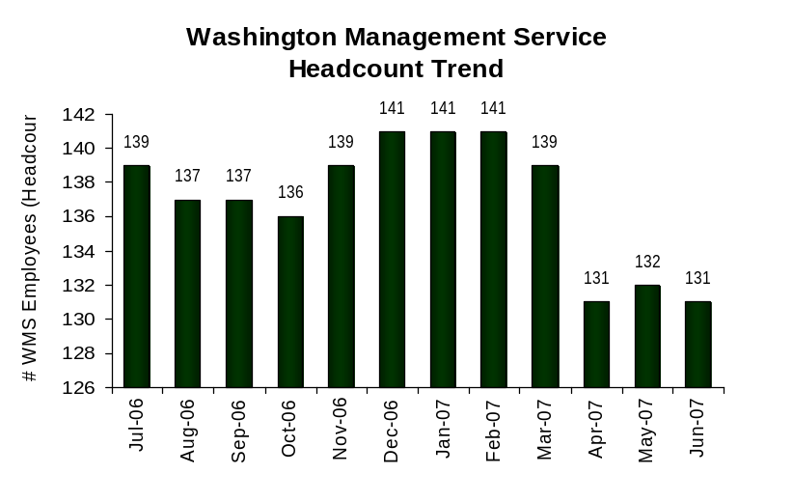
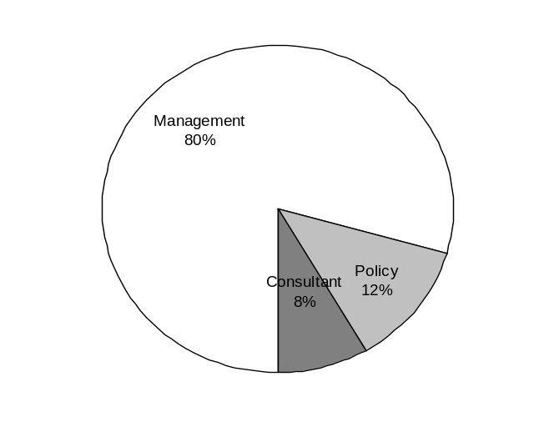
Plan & Align Workforce
Outcomes:
Managers understand workforce management accountabilities. Jobs and competencies are defined and aligned with business priorities. Overall foundation is in place to build & sustain a high performing workforce.
Performance Measures:
Percent supervisors with current performance expectations for workforce management
Management profile
Workforce Planning measure (TBD)
Percent employees with current position/ competency descriptions
Management Profile
WMS Employees Headcount = 131
Percent of agency workforce that is WMS = 7.4 %
Managers* Headcount = 121
Percent of agency workforce that is Managers* = 6.8%
* In positions coded as “Manager” (includes EMS, WMS, and GS)
Analysis:
Since the last report, we have reduced the number of WMS employees in the Department from 139 to 131 and reduced the percentage of WMS employees from 8.4% to 7.4%.
Over the last biennium, we reduced the number of WMS employees by 33. This has not come without cost to the Department.
The total number of managers at the Department of Fish and Wildlife is now 121, including EMS, WMS and classified employees. The size and scope of their areas of responsibility has grown to be barely manageable, diluting effectiveness and accountability.
Since the inception of WMS, we have worked hard to maintain a management level below 10% of the workforce. A ratio at, or near, 10% seems a more reasonable expectation for the ratio of management to employees.
Action Steps:
Maintain a workforce that is within the WMS baseline as established by the Department of Personnel.
Management 104
Consultant 11
Policy 16
Not Assigned 0
Data as of 9/27/2007
Source: Business Warehouse Portal

Slide 6
Plan & Align Workforce
Outcomes:
Managers understand workforce management accountabilities. Jobs and competencies are defined and aligned with business priorities. Overall foundation is in place to build & sustain a high performing workforce.
Performance Measures:
Percent supervisors with current performance expectations for workforce management
Management profile
Workforce Planning measure (TBD)
Percent employees with current position/ competency descriptions
Current Position/Competency Descriptions
Percent employees with current position/competency descriptions = 80%
Analysis:
In February of 2005 we began training all staff on determining competencies through job analysis, and continue to offer group classes and one-on-one instruction and assistance.
By June 6, 2007, 80% of all employees had completed new position descriptions with competencies.
A review of the position description and competencies is required with every position action.
The Assessment Manager has worked with employees to develop an extensive list of internal competencies to be used in developing position descriptions, recruitments and performance evaluations.
Action Steps:
Complete a review of all position descriptions by March 31, 2008. Update any remaining “classification questionnaires” to position descriptions with competencies.
On June 30, 2007, the Department had 1488 WMS or classified employees in permanent positions. This does not include seasonal employees or employees in non-permanent or acting appointments.
An additional 123 permanent positions were identified as vacant, filled with a non-permanent employee or undergoing recruitment, bringing the total to 1611 permanent positions.
1566 positions, or 97%, have either position descriptions or classification questionnaires on file in the HR Office. However, 282 of these positions are still described on the old “classification questionnaires” rather than the new position descriptions. This brings the total to 80%.
Data as of October 10, 2007
Source: Agency data

Slide 7
Hire Workforce
Outcomes:
Best candidates are hired and reviewed during appointment period. The right people are in the right job at the right time.
Performance Measures
Time-to-fill vacancies
Candidate quality
Hiring Balance (proportion of appointment types)
Separation during review period
Time-to-fill / Candidate Quality
Time-to-fill Funded Vacancies
Average number of days to fill*: 67
Number of vacancies filled: 157
*Equals # of days from receipt of the HR Action Form to job offer acceptance
Time Period: 07/01/2006 to 6/30/2007
Analysis:
From July 2006 to June 2007, the Department opened and closed 157 recruitments for permanent positions.
The starting date of the recruitment was the day the HR Action Form was received in the HR Office. The ending date was the day the candidate accepted a job offer. On average, it took 67 days from start to finish.
During the 67 days, the the HR Office reviews the position description, job analysis and allocation; determines the recruitment process; develops and posts the recruitment announcement; prepares scoring criteria; develops written and oral exams; screens and/or tests applicants; and prepares referrals.
The hiring supervisor reviews the candidates referred, works with HR to develop interviews, interviews candidates, completes reference checks, and prepares recommendations to hire.
Once an offer has been accepted, the recruitment is considered complete.
Action Steps:
Focus on candidate quality over length of time to fill vacancies, as many recruitments are lengthy by design and others are short by design.
The HR Office reorganized in October, 2007 in order to bring more focus and capacity to the recruitment process. One Human Resource Consultant has now been assigned to work on recruitment full-time with the Recruitment and Assessment Manager. This will enable us to focus on the quality of the candidates and the quality of the recruitment process.
Candidate Quality
Of the candidates interviewed for vacancies, how many had the competencies (knowledge, skills & abilities) needed to perform the job?
  100% The HR Office screens all candidates, so only those with competencies reach the interview process
  Of the candidates interviewed, were hiring managers satisfied with the selection?
  Hiring managers indicating “yes”:
  Number = 157 Percentage = 100%
  While all hiring managers were satisfied with the selection, the top candidate was not always the one hired. In several cases, the top candidate turned down the offer because the maximum salary allowed for the position was too low.
  According to our survey of hiring managers, the number of candidates available for consideration and the quality of candidates was rated “excellent” or “satisfactory,” no hiring supervisor rated the number or quality of candidates as “unsatisfactory.”
Time Period: 07/01/2006 to 6/30/2007
Data as of 10/04/2007
Source: Agency Database

Slide 8
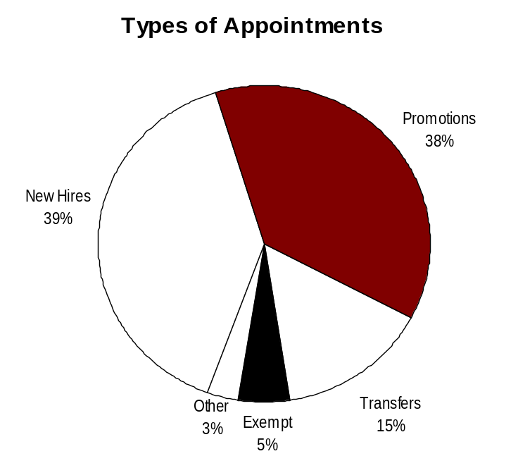
Hire Workforce
Outcomes:
Best candidates are hired and reviewed during appointment period. The right people are in the right job at the right time.
Performance Measures
Time-to-fill vacancies
Candidate quality
Hiring Balance (proportion of appointment types)
Separation during review period
Hiring Balance / Separations During Review Period
Analysis:
Our internal tracking system shows that 157 permanent vacant positions were filled by recruitment during this time frame.
Further drill down is required to determine if appointment types were excluded from this data, other than those listed on the chart to the left.
We had more new hires and fewer promotions and transfers than we had during the last reporting cycle, but we have not determined an appropriate proportion of appointment types.
Certain job classes are intentionally restricted to promotion–only. (Example: Fish and Wildlife Enforcement Officer 2 or 3).
Action Steps:
Out of 157 appointments, only 8 were separated during the review period. 5 of these separations were voluntary and 3 were involuntary.
This is almost exactly the same ratio as the last reporting cycle which showed 2 voluntary and 1 involuntary separation out of 56 hires.
Documentation does not show that there is a problem with the recruitment or appointment process, or that the wrong candidates are being appointed to positions, but we will continue to monitor this data.
Total number of appointments = 101*
Time period = 07/2006 – 6/2007
*Includes appointments to permanent vacant positions only; excludes reassignments
“Other” = Demotions, re-employment, reversion & RIF appointments
Separation During Review Period
Probationary separations - Voluntary 4
Probationary separations - Involuntary 3
  Total Probationary Separations 7
Trial Service separations - Voluntary 1
Trial Service separations - Involuntary
  Total Trial Service Separations 1
Total Separations During Review Period 8
Time period = 07/2007 through 06/2007
Data as of 09/27/2007
Source: Business Warehouse Portal and agency database

Slide 9
Deploy Workforce
Outcomes:
Staff know job expectations, how they’re doing, & are supported. Workplace is safe, gives capacity to perform, & fosters productive relations. Employee time and talent is used effectively. Employees are motivated.
Performance Measures
Percent employees with current performance expectations
Employee survey ratings on “productive workplace” questions
Overtime usage
Sick leave usage
Non-disciplinary grievances/appeals filed and disposition (outcomes)
Worker safety
Current Performance Expectations
Percent employees with current performance expectations = 96%
Analysis:
March 31, 2007 brought the close of the transition year for yearly evaluations, from the prior due date to the current due date.
Training classes were offered to all staff statewide during the year, but the majority of classes were completed during the December through February time frame prior to the due date.
All evaluations are reviewed by the Human Resource Consultants in the HR Office.
Additional training or consultation is offered when necessary or when requested.
Action Steps:
Increase the number of completed evaluations with performance expectations from 96% to 100% by March 31, 2008.
In 2006, the Department changed from Program-specific due dates based on work flow, to a single agency-wide date of March 31st for performance evaluations. Prior due dates based on Program work flow were:
Enforcement: January 31st
Business Services: April 30th
Wildlife: June 30th
Fish: August 31st
Habitat: November 30th
Director’s Office: December 31st
On February 28, 2007, at the beginning of the “performance evaluation month” the Department of Fish and Wildlife had 1340 active permanent employees on staff in WMS or classified positions.
1,288 completed evaluations were received by the required date of March 31, 2007.
96% of our employees have current evaluations with current performance expectations.
Data as of October 10, 2007
Source: Agency database

Slide 10
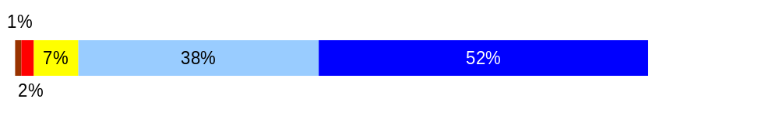
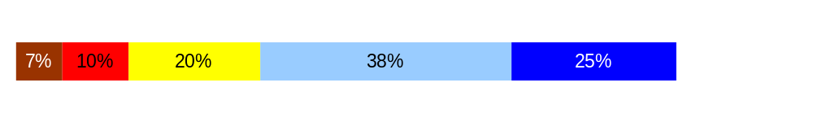
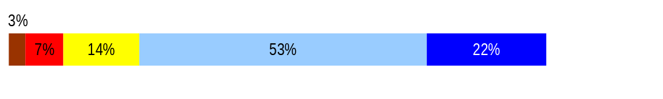
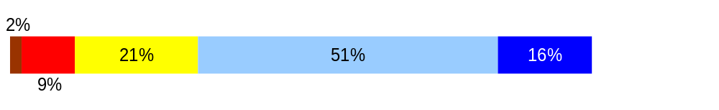
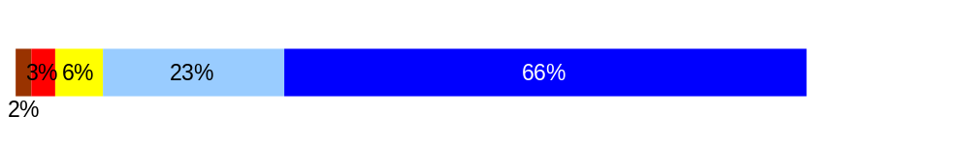
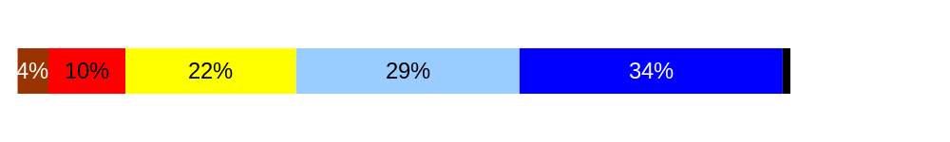
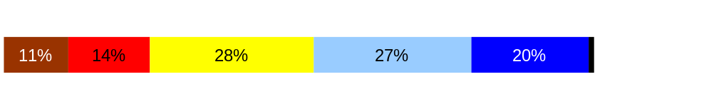
Deploy Workforce
Outcomes:
Staff know job expectations, how they’re doing, & are supported. Workplace is safe, gives capacity to perform, & fosters productive relations. Employee time and talent is used effectively. Employees are motivated.
Performance Measures
Percent employees with current performance expectations
Employee survey ratings on “productive workplace” questions
Overtime usage
Sick leave usage
Non-disciplinary grievances/appeals filed and disposition (outcomes)
Safety and Workers Compensation
Employee Survey “Productive Workplace” Ratings
Q4. I know what is expected of me at work.
Q1. I have opportunity to give input on decisions affecting my work.
Q2. I receive the information I need to do my job effectively.
Q6. I have the tools and resources I need to do my job effectively.
Q7. My supervisor treats me with dignity and respect.
Q8. My supervisor gives me ongoing feedback that helps me
improve my performance.
Q9. I receive recognition for a job well done.
Avg
Analysis:
The 2 highest ratings are: “I know what is expected of me at work.” and “My supervisor treats me with respect.”
The lowest rating is “I receive recognition for a job well done.”
Action Steps:
Improve on ways to recognize employees for good performance. Although we have a well defined Employee Recognition Program, it is primarily one formal event event during Public Service Recognition Week for the entire agency, and one formal event per year for each individual region during the annual Director visits.
Expand this effort to a year-round process, including but not limited to formal agency-wide, program-wide or region-wide awards.
4.3
3.6
3.8
3.7
4.4
3.7
3.3
Never
Seldom
Occasionally
Usually
Always
Overall average score for Productive Workplace Ratings: 3.88
Data as of 04/06
Source: DOP survey

Slide 11
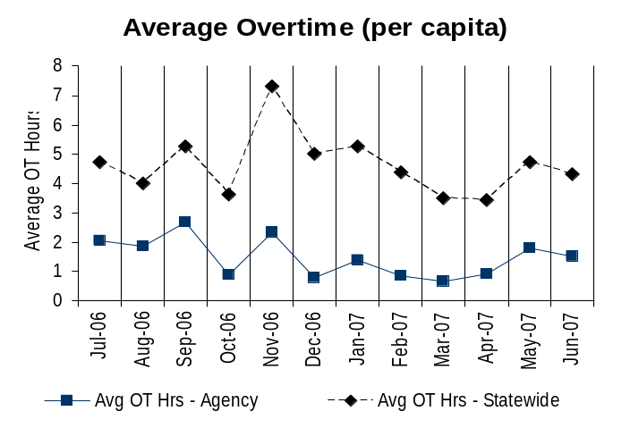
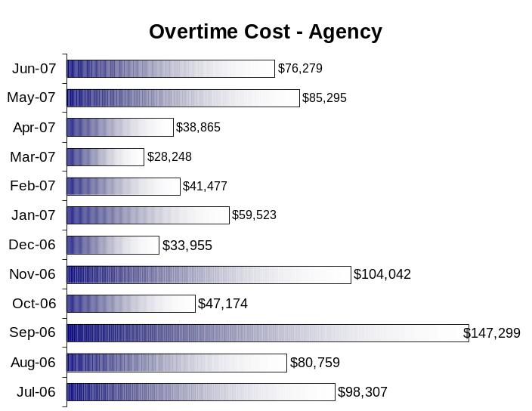
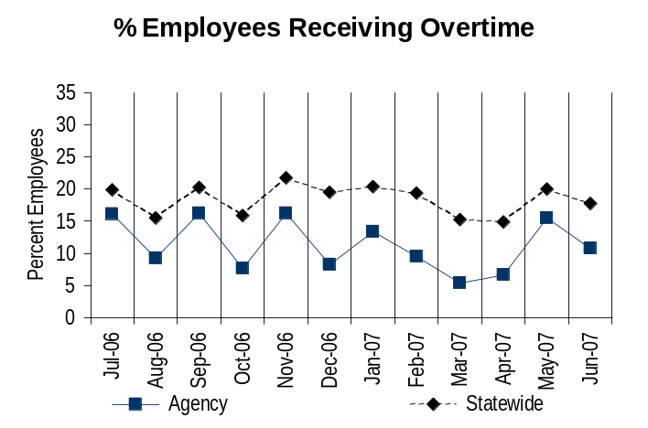
Deploy Workforce
Outcomes:
Staff know job expectations, how they’re doing, & are supported. Workplace is safe, gives capacity to perform, & fosters productive relations. Employee time and talent is used effectively. Employees are motivated.
Performance Measures
Percent employees with current performance expectations
Employee survey ratings on “productive workplace” questions
Overtime usage
Sick leave usage
Non-disciplinary grievances/appeals filed and disposition (outcomes)
Worker safety
Overtime Usage
Overall agency average OT usage is 1.5 hours per capita per month
Overall agency average OT usage – per capita, per month = sum of monthly OT averages divided by number of months
Analysis:
61% of WDFW employees are overtime eligible, and 48% of those work a 24/7 schedule. Our work does not stop on holidays. November has 3 holidays, and was the 2nd highest month for overtime costs. September includes a holiday, but more importantly: the Columbia Complex Fire, the opening of big game hunting season, waterfowl season, fish returning to the rivers from the ocean, and other business necessities made this the highest month for overtime expenses during the reporting period.
Responding to emergencies, maintaining healthy fish and wildlife populations throughout the year, and working when constituents are recreating are cornerstone business activities for the Department.
Action Steps:
Based on our analysis, there are no obvious concerns about overtime use at this time. We will continue to monitor overtime use with business necessity, and will watch for spikes or trends in use.
On average, 11% of WDFW employees receive OT each month.
Average employees receiving OT per month = sum of monthly OT percentages divided by number of months
Data as of 10/04/2007
Source: Business Warehouse Portal

Slide 12
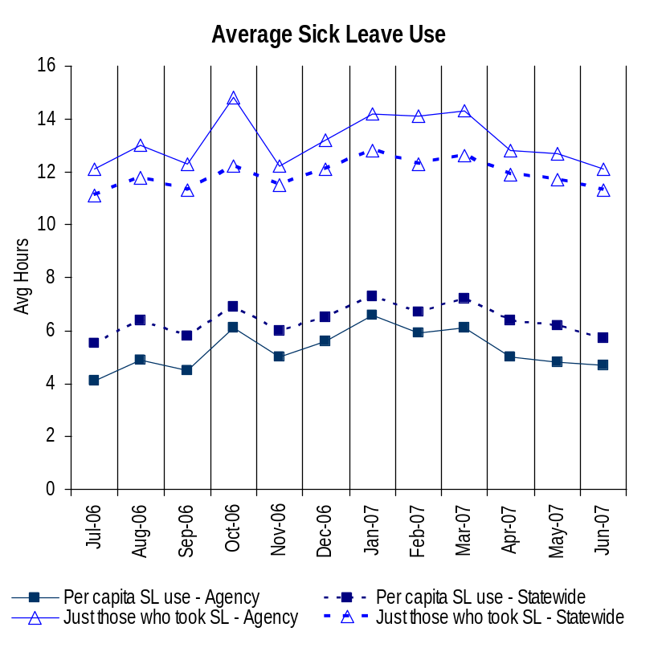
Deploy Workforce
Outcomes:
Staff know job expectations, how they’re doing, & are supported. Workplace is safe, gives capacity to perform, & fosters productive relations. Employee time and talent is used effectively. Employees are motivated.
Performance Measures
Percent employees with current performance expectations
Employee survey ratings on “productive workplace” questions
Overtime usage
Sick leave usage
Non-disciplinary grievances/appeals filed and disposition (outcomes)
Worker safety
Sick Leave Usage
Analysis:
WDFW continues to be below the state average for sick leave hours used per capita.
WDFW is slightly higher than the statewide average in average sick leave hours used for those employees who took sick leave. We are doing further analysis to determine if this indicates a problem.
We reviewed sick leave use in conjunction with high overtime accruals and found no consistent correlation.
We have analyzed sick leave use by program, by day of the week and by individual employee, and have not found indications of inappropriate use. We continue to analyze areas of high sick leave use to determine if there is a connection to workload.
Action Steps: WDFW will continue to:
Maintain a level of sick leave use that is below the per capita use statewide.
Monitor, review and analyze sick leave use and balances for any trends, patterns or problems.
Monitor sick leave used for on-the-job injuries to determine if there are safety concerns that need to be addressed.
Focus on health and wellness programs. In 2006 the Executive Management Team increased the budget, exposure and support of the Wellness Committee, and continues to support wellness activities.
Sick Leave Hrs Used / Earned (per capita)
Avg Hrs SL Used Agency | % of SL Hrs Earned Agency
5.3 Hrs | 66.8%
Avg Hrs SL Used Statewide* | % of SL Hrs Earned Statewide*
6.4 Hrs | 82.5%
Sick Leave Hrs Used / Earned (those who took SL)
Avg Hrs SL Used (those who took SL) - Agency | % SL Hrs Earned (those who took SL) - Agency
13.2 Hrs | 164.4%
Avg Hrs SL Used (those who took SL) – Statewide* | % SL Hrs Earned (those who took SL) – Statewide*
11.9 Hrs | 148.4%
Sick Leave time period = July 2006 through June 2007
* Statewide data does not include DOL, DOR, L&I, and LCB
Source: Information provided by DOP

Slide 13
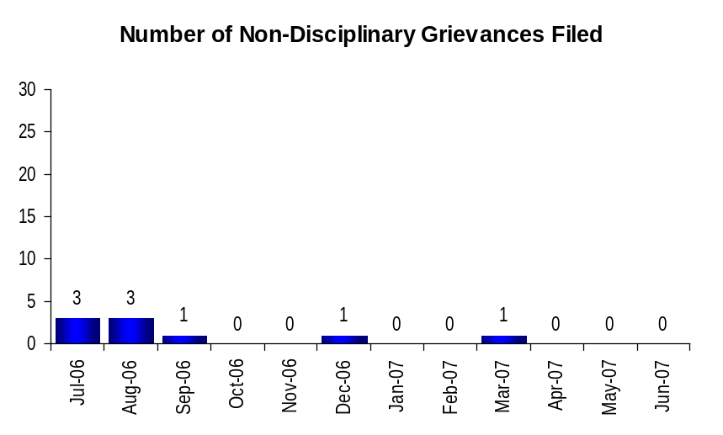
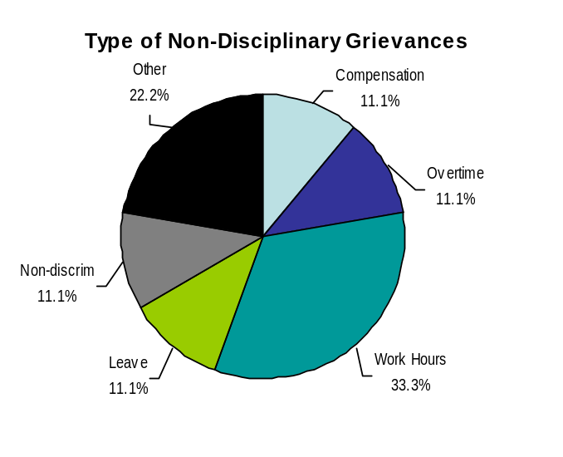
Deploy Workforce
Outcomes:
Staff know job expectations, how they’re doing, & are supported. Workplace is safe, gives capacity to perform, & fosters productive relations. Employee time and talent is used effectively. Employees are motivated.
Performance Measures
Percent employees with current performance expectations
Employee survey ratings on “productive workplace” questions
Overtime usage
Sick leave usage
Non-disciplinary grievances/appeals filed and disposition (outcomes)
Worker safety
Non-Disciplinary Grievances (represented employees)
Total Non-Disciplinary Grievances = 9
Analysis:
WDFW administers 3 Master Agreements which cover employees in 15 bargaining units, represented by 5 different employee organizations. Approximately 90% of our employees are represented.
We train all managers and supervisors on all 3 Agreements.
The low number of grievances filed in relation to the number of represented employees indicates good communication between employees and supervisors.
Action Steps:
Continue training on contract administration.
Increase clear communication in advance of actions and changes.
Work toward reducing the number of grievances filed.
Non-Disciplinary Grievance Disposition*
Outcomes of the 9 grievances determined during the one year period from July 2006 through June 2007
5 were withdrawn by the employee organization filing the grievance.
1 was resolved in favor of the employee.
3 were resolved via compromise.
* There may not be a one-to-one correlation between the number of grievances filed (shown top of page) and the outcomes determined during this time period. The time lag between filing date and when a decision is rendered can cross the time periods indicated.
Data as of June 30, 2007
Source: Agency database

Slide 14
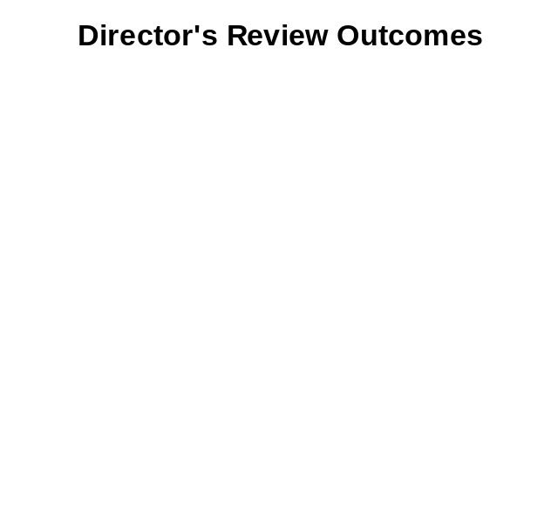
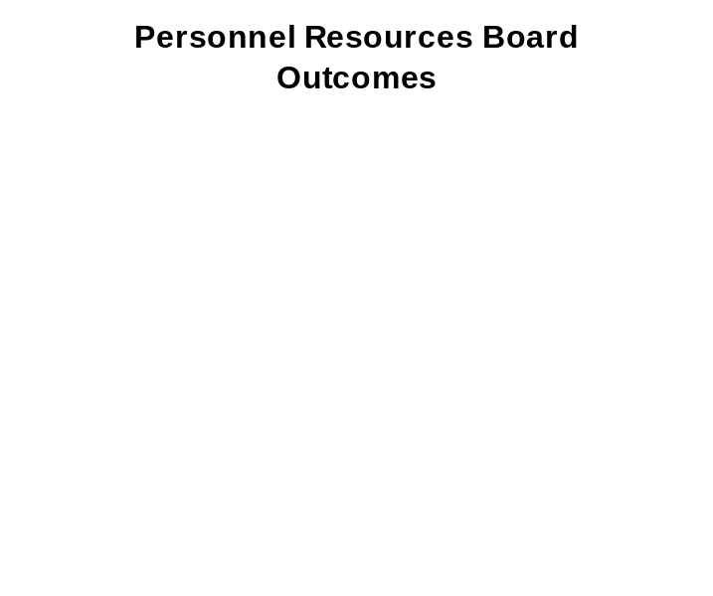
Deploy Workforce
Outcomes:
Staff know job expectations, how they’re doing, & are supported. Workplace is safe, gives capacity to perform, & fosters productive relations. Employee time and talent is used effectively. Employees are motivated.
Performance Measures
Percent employees with current performance expectations
Employee survey ratings on “productive workplace” questions
Overtime usage
Sick leave usage
Non-disciplinary grievances/appeals filed and disposition (outcomes)
Worker safety
Non-Disciplinary Appeals (mostly non-represented employees)
Filings for DOP Director’s Review
Time Period = July 2006 through June 2007
3 Job classification appeals filed with the Director of the Department of Personnel.
3 Total filings
Filings with Personnel Resources Board
Time Period = July 2006 through June 2007
0 Total filings
There is no one-to-one correlation between the filings shown above and the outcomes displayed in the charts below. The time lag between filing date and when a decision is rendered can cross the time periods indicated.
Time Period = July 2006 through June 2007
2 were withdrawn by the employee
1 outcome is pending
Based on our analysis, there are no obvious problems in this area.
Time Period = July 2006 through June 2007
No filings with the Personnel Resources Board
Source: Dept of Personnel

Slide 15
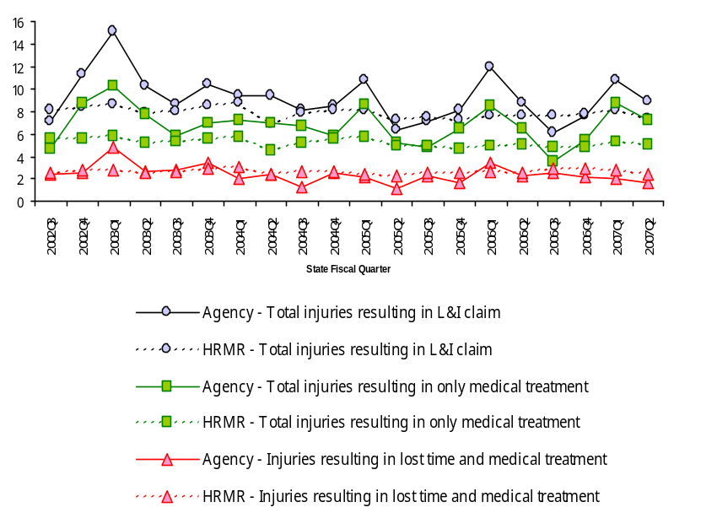
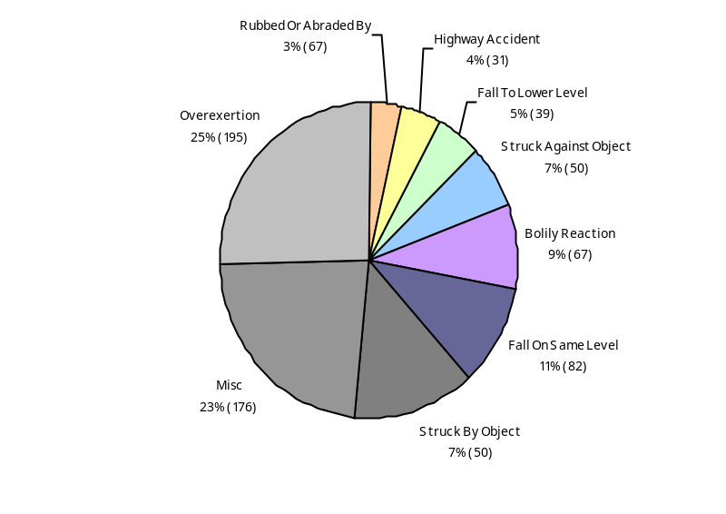
Deploy Workforce
Outcomes
Staff know job expectations, how they’re doing, & are supported. Workplace is safe, gives capacity to perform, & fosters productive relations. Employee time and talent is used effectively. Employees are motivated.
Performance Measures
Percent employees with current performance expectations
Employee survey ratings on 'productive workplace' questions
Overtime usage
Sick leave usage
Non-disciplinary grievances/appeals filed and disposition outcomes
Worker Safety
Worker Safety: Fish and Wildlife, Department of
Allowed Annual Claims Rate*^:
*Annual claims rate is # claims / 100 FTE 1 FTE = 2000 hours
^Due to natural lag in claim filing, rates are expected to increase significantly
over time
Analysis:
Although WDFW is above the statewide average in total injuries resulting in L&I claims and those resulting in only medical treatment, more than ½ of the reporting HRMR agencies don’t perform the fieldwork we do, and no other agency performs the full complement of field activities including law enforcement, construction, fish culture, and agriculture.
WDFW typically outperforms other agencies during non-field seasons. Spikes occur during heavy field seasons (Q1), when we have the most staff in the field and the highest number of temporary employees.
Percent of overexertion injuries is similar to other natural resource agencies. Most of our field staff work alone without assistance.
WDFW employees work outdoors where “Impact with” injuries are typically seen, as is true with all natural resource agencies.
WDFW rate for time-loss and medical treatment, the most expensive type of claim, is generally lower than HRMR reporting agencies except during our heaviest field season (Q1).
Action Plan:
Administer appropriate training for all staff, including temporary employees, to include proper personal protective equipment, lifting techniques, and outdoor field safety awareness.
Monitor training through the new employee supervisor checklist and the annual performance evaluation process.
Continue to apply early Return-to-Work concepts and increase modified duty opportunities to keep time loss costs at a minimum.
Injuries by Occupational Injury and Illness Classification (OIICS)
Source: Labor & Industries, Research and Data Services (data as of 09/03/2007 )

Slide 16
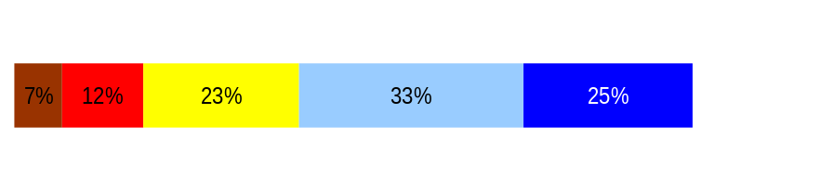
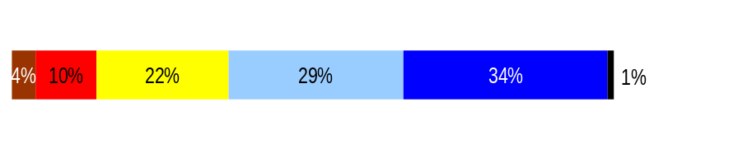
Develop Workforce
Outcomes:
A learning environment is created. Employees are engaged in professional development and seek to learn. Employees have competencies needed for present job and future advancement.
Performance Measures
Percent employees with current individual development plans
Employee survey ratings on “learning & development” questions
Competency gap analysis
Individual Development Plans
Percent employees with current individual development plans = 96%
Analysis:
March 31, 2007 brought the close of the transition year for yearly evaluations, with individual development plans, from the prior due date to the current due date. (See also slides 9 & 17)
Training classes were offered to all staff statewide during the year, but the majority of classes were completed during the December through February time frame prior to the due date.
Additional training or consultation is offered when necessary or when requested.
Action Steps:
Increase the number of completed evaluations with individual development plans from 96% to 100% by the next report.
Total # of employees with current individual development plans is1288. This includes active employees in permanent WMS or classified positions.
Employee Survey “Learning & Development” Ratings
Q5. I have opportunities at work to learn and grow.
Q8. My supervisor gives me ongoing feedback that helps me
improve my performance.
Avg
3.5
3.7
Never
Seldom
Occasionally
Usually
Always
Overall average score for Learning & Development Ratings: 3.65
Data as of 10/10/07
Source: Agency and DOP Employee Survey from 04/06

Slide 17
Reinforce Performance
Outcomes:
Employees know how their performance contributes to the goals of the organization. Strong performance is rewarded; poor performance is eliminated. Successful performance is differentiated and strengthened. Employees are held accountable.
Performance Measures
Percent employees with current performance evaluations
Employee survey ratings on “performance and accountability” questions
Disciplinary actions and reasons, disciplinary grievances/appeals filed and disposition (outcomes)
Reward and recognition practices (TBD)
Current Performance Evaluations
Percent employees with current performance evaluations = 96%*
Analysis:
March 31, 2007 brought the close of the transition year for yearly evaluations, from the prior due date to the current due date.
Training classes were offered to all staff statewide during the year, but the majority of classes were completed during the December through February time frame prior to the due date.
All evaluations are reviewed by the Human Resource Consultants in the HR Office.
Additional training or consultation is offered when necessary or when requested.
Action Steps:
Increase the number of completed evaluations with performance expectations from 96% to 100% by March 31, 2008.
In 2006, the Department changed from Program-specific due dates based on work flow, to a single agency-wide date of March 31st for performance evaluations. Prior due dates based on Program work flow were:
Enforcement: January 31st
Business Services: April 30th
Wildlife: June 30th
Fish: August 31st
Habitat: November 30th
Director’s Office: December 31st
On February 28, 2007, at the beginning of the “performance evaluation month” the Department of Fish and Wildlife had 1340 active permanent employees on staff in WMS or classified positions.
1,288 completed evaluations were received by the due date of March 31, 2007.
96% of our employees have current performance evaluations.
Data as of October 10, 2007
Source: Agency database

Slide 18
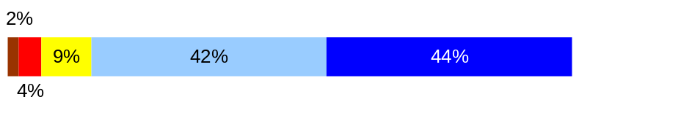
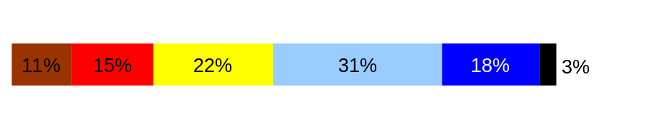
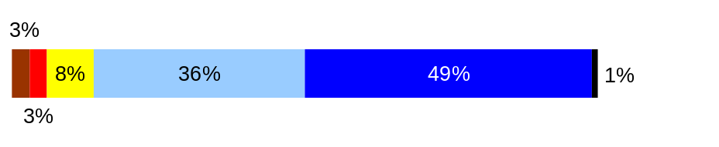
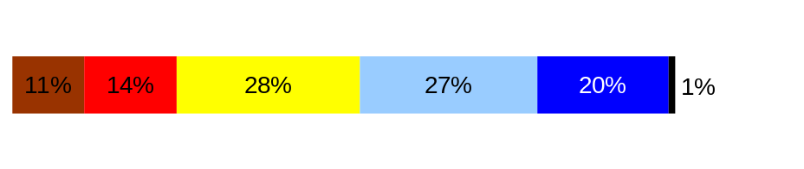
Reinforce Performance
Outcomes:
Employees know how their performance contributes to the goals of the organization. Strong performance is rewarded; poor performance is eliminated. Successful performance is differentiated and strengthened. Employees are held accountable.
Performance Measures
Percent employees with current performance evaluations
Employee survey ratings on “performance and accountability” questions
Disciplinary actions and reasons, disciplinary grievances/appeals filed and disposition (outcomes)
Reward and recognition practices
Employee Survey “Performance & Accountability” Ratings
Q3. I know how my work contributes to the goals of my agency.
Q10. My performance evaluation provides me with meaningful information about my performance.
Q11. My supervisor holds me and my co-workers accountable for performance.
Q9. I receive recognition for a job well done.
Avg
Analysis:
The 2 highest ratings are : “I know how my work contributes to the goals of my agency.” and “My superior holds me and my co-workers accountable for performance.”
We train supervisors and managers to link essential job functions with the strategic goals and objectives of the agency during performance evaluation training.
Employees feel that they are held accountable for performance, and yet are less satisfied that their performance evaluations are meaningful or that they are recognized for good performance.
Employees do not feel they are receiving recognition for good performance.
Action Steps:
Expand the ways we recognize employees. Continue our formal yearly recognition program and add an informal component that spans the entire year.
4.2
3.3
4.2
3.3
Never
Seldom
Occasionally
Usually
Always
Overall average score for “Performance & Accountability” ratings: 3.77
Data as of 04/06
Source: DOP

Slide 19
Reinforce Performance
Outcomes:
Employees know how their performance contributes to the goals of the organization. Strong performance is rewarded; poor performance is eliminated. Successful performance is differentiated and strengthened. Employees are held accountable.
Performance Measures
Percent employees with current performance evaluations
Employee survey ratings on “performance and accountability” questions
Disciplinary actions and reasons, disciplinary grievances/appeals filed and disposition (outcomes)
Reward and recognition practices (TBD)
Formal Disciplinary Actions
Disciplinary Action Taken
Time period = 7/1/06 to 6/30/07
Analysis:
There were 12 formal disciplinary actions in one year.
Formal disciplinary actions were taken on less than 1% of our employees.
The issues leading to disciplinary actions are varied.
The 12 actions crossed all Programs in the agency.
Action Steps:
Continue training on human resource management practices and accountability, Ethics in Public Service, and contract administration.
Conclude the hiring process to hire an HRC 4 to complete the revision of the supervisor training course and continue to offer training statewide throughout the year.
Dismissals | 4
Demotions | 2
Suspensions | 4
Reduction in Pay* | 2
Total Disciplinary Actions* | 12
* Reduction in Pay is not currently available in HRMS/BW.
Issues Leading to Disciplinary Action
“Misuse of State Resources” was part of two dismissals and one demotion, and one reduction in pay.
“Misconduct” was part of two dismissals, one demotion, all of the suspensions, and included such actions as: a DUI, falsifying information, aggressive behavior, unprofessional behavior, and violence in the workplace.
Data as of 9/28/07
Source: Business Warehouse

Slide 20
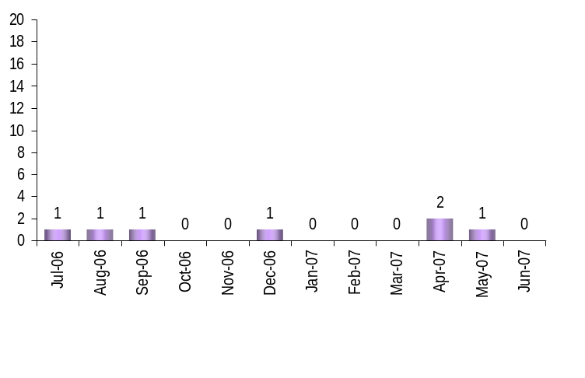
Reinforce Performance
Outcomes:
Employees know how their performance contributes to the goals of the organization. Strong performance is rewarded; poor performance is eliminated. Successful performance is differentiated and strengthened. Employees are held accountable.
Performance Measures
Percent employees with current performance evaluations
Employee survey ratings on “performance and accountability” questions
Disciplinary actions and reasons, disciplinary grievances/appeals filed and disposition (outcomes)
Reward and recognition practices (TBD)
Disciplinary Grievances and Appeals
Disciplinary Grievances
(Represented Employees)
Disciplinary Appeals
(Non-Represented Employees
filed with Personnel Resources Board)
Time Period = July 2006 through June 2007
2 Demotion appeals
2 Total Disciplinary Appeals Filed with PRB
Total # Disciplinary Grievances Filed: 7
There is no one-to-one correlation between the filings shown above and the outcomes displayed below. The time lag between filing date and when a decision is rendered can cross the time periods indicated.
Disposition (Outcomes) of Disciplinary Grievances
Time period =July 2006 to June 2007
Resolution:
3 withdrawn by the employee organizations filing the grievances
2 resolved in favor of employee, with conditions
2 upheld
Disposition (Outcomes) of Disciplinary Appeals*
Time period = July 2006 through June 2007
Outcomes issued by Personnel Resources Board are still pending
Data as of 10/4/07
Source: DOP data

Slide 21
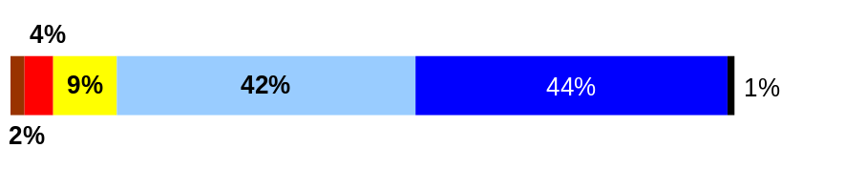
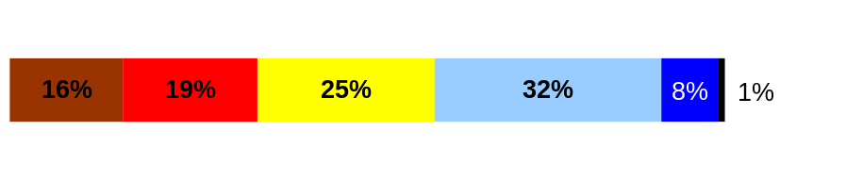
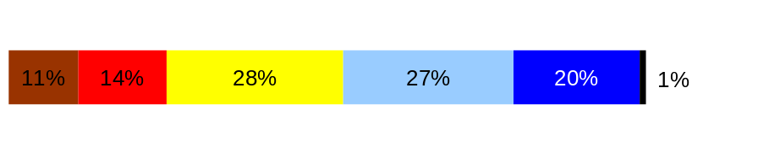
ULTIMATE OUTCOMES
Employees are committed to the work they do and the goals of the organization
Successful, productive employees are retained
The state has the workforce breadth and depth needed for present and future success
Performance Measures
Employee survey ratings on “commitment” questions
Turnover rates and types
Turnover rate: key occupational categories
Workforce diversity profile
Retention measure
Employee Survey “Employee Commitment” Ratings
Q3. I know how my work contributes to the goals of my agency.
Q12. I know how my agency measures its success.
Q9. I receive recognition for a job well done.
Avg
Analysis:
The highest rating is: “I know how my work contributes to the goals of my agency.”
We do a good job of training supervisors and managers to link essential job functions with the strategic goals and objectives of the agency during performance evaluation training. Employees are recognizing how their work contributes to those strategic goals and objectives, and have work plans that link to performance measures.
The lowest rating is: “I know how my agency measures its successes.”
Action Steps:
Expand the opportunities to involve employees in the strategic planning process and the development of performance measures.
4.2
2.9
3.3
Never
Seldom
Occasionally
Usually
Always
Overall average score for Employee Commitment ratings: 3.51
Data as of 04/06
Source: DOP

Slide 22
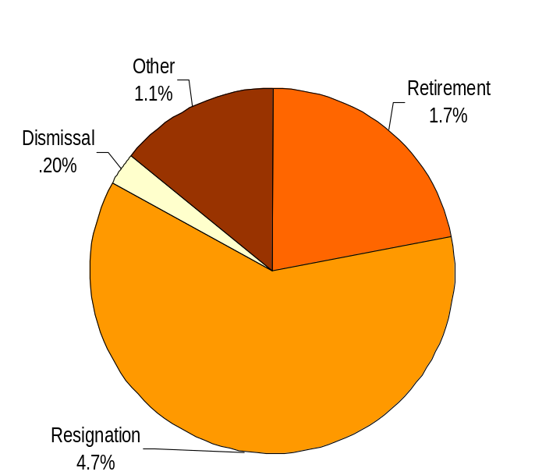
ULTIMATE OUTCOMES
Employees are committed to the work they do and the goals of the organization
Successful, productive employees are retained
The state has the workforce breadth and depth needed for present and future success
Performance Measures
Employee survey ratings on “commitment” questions
Turnover rates and types
Turnover rate: key occupational categories
Workforce diversity profile
Retention measure (TBD)
Turnover Rates
Analysis:
We traditionally have a very low turnover rate at the Department of Fish and Wildlife. Resource professionals are a very dedicated group of employees who are passionate about their work.
Over the past biennium, we have seen professionals leaving the Department for higher salaries elsewhere. For the first time in our history, lagging compensation coupled with more opportunities to work in natural resource management outside of state government, became a major factor in turnover.
Of those who left the agency for reasons other than retirement or dismissal, more than 50% were for higher salaries elsewhere.
Exit interviews reflected that management positions had become “impossible to manage”, “too broad”, “too immense”, as we continue to downsize the number of managers in our employment ranks.
Many employees leaving for positions elsewhere expressed finding positions in which they were “actually able to complete the responsibilities” they were assigned.
Action Steps:
Complete exit interviews with all employees leaving the Department, assess the need to act on information shared by employees, and make appropriate changes where possible.
Compensate employees with salaries and benefits that are competitive.
Analyze the scope and responsibilities of management positions to see if workloads can become more manageable.
Total % Turnover (leaving state)
Time Period: July 2006 through June2007
Total Turnover Actions: 108
Total % Turnover: 7.7 %
Note: Movement to another agency is currently not available in HRMS/BW
Data as of October 11, 2007
Source: Business Warehouse

Slide 23
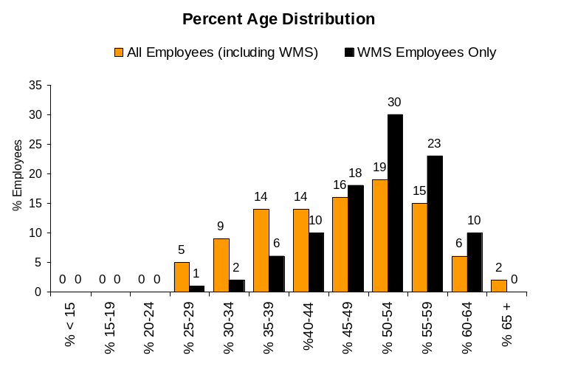
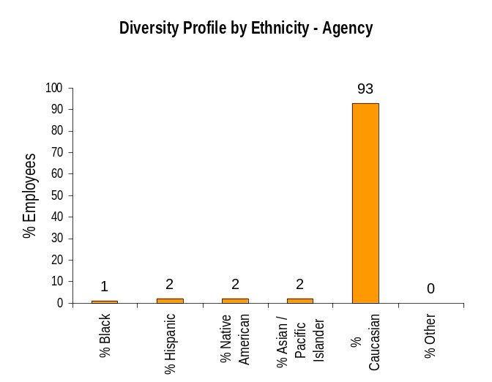
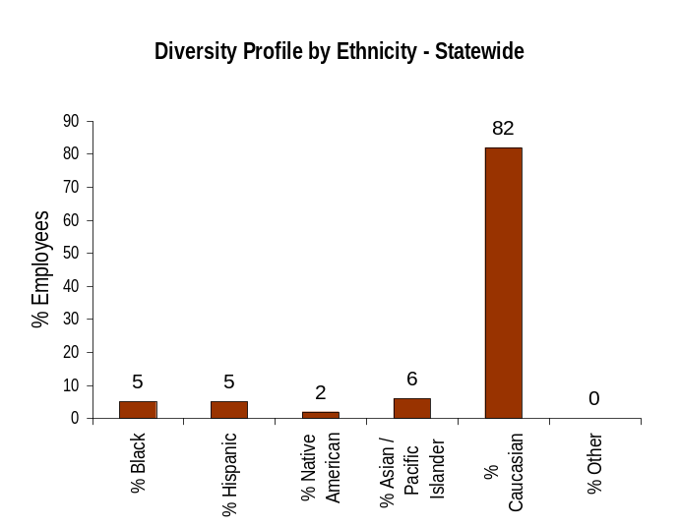
ULTIMATE OUTCOMES
Employees are committed to the work they do and the goals of the organization
Successful, productive employees are retained
The state has the workforce breadth and depth needed for present and future success
Performance Measures
Employee survey ratings on “commitment” questions
Turnover rates and types
Turnover rate: key occupational categories
Workforce diversity profile
Retention measure (TBD)
Workforce Diversity Profile
Agency State
Female 29% 53%
Disabled 2% 5%
Vietnam Vet 5% 7%
Disabled Vet 2% 2%
People of color 8% 18%
Persons over 40 71% 75%
Analysis: The Department has increased slightly in the percentage of women in the workforce, but has remained constant in all other areas.
Natural resource agencies have lagged behind the rest of the state in diversity. We recruit from colleges of fisheries, wildlife and environmental sciences for many of our entry positions as well as top scientists, and the recruitment pool is limited as student populations in these specific fields lack diversity.
Action Steps: Continue to emphasize diversity in recruitment and hiring, and increase target recruiting efforts.
The HR Office reorganized in October, 2007 in order to bring more focus and capacity to the recruitment process. One Human Resource Consultant has now been assigned to work on recruitment full-time with the Recruitment and Assessment Manager. This will enable us to focus on target recruitments.
Data as of 10/04/2007
Source: Business Warehouse

