Slide 1
Archived File
The file below has been archived for historical reference purposes only. The content and links are no longer maintained and may be outdated. See the OER Public Archive Home Page for more details about archived files.

Slide 2
Asynchronous
Electronic
Discussion
Dec 4, 2006
George Chacko
Center for Scientific Review
National Institutes of Health
Department of Health and Human Services

Slide 3
Asynchronous Electronic Discussion (AED)
    Web-based Review Method
    Threaded Message Board
    Reviewers separated by time and space
    Thoughtful discussions; more time to think and research
    Potentially less confrontational environment

Slide 4
Logistical Advantages
    Reviewers do not have to travel
    Otherwise unavailable reviewers can be recruited
    Transcript of discussions
    Improved management of conflicts of interest
    Time-zone advantage- international reviewers

Slide 5
Information Flow
Applications
Reviewers
Applicant
IAR
AED
Study
Section
Program

Slide 6
How Does it Work?
Reviewers submit critiques to IAR
The meeting occurs on the website and comprises 3 phases
  Streamline phase
  Discussion phase
  Final scoring phase
Reviewers revise critiques on IAR.

Slide 7
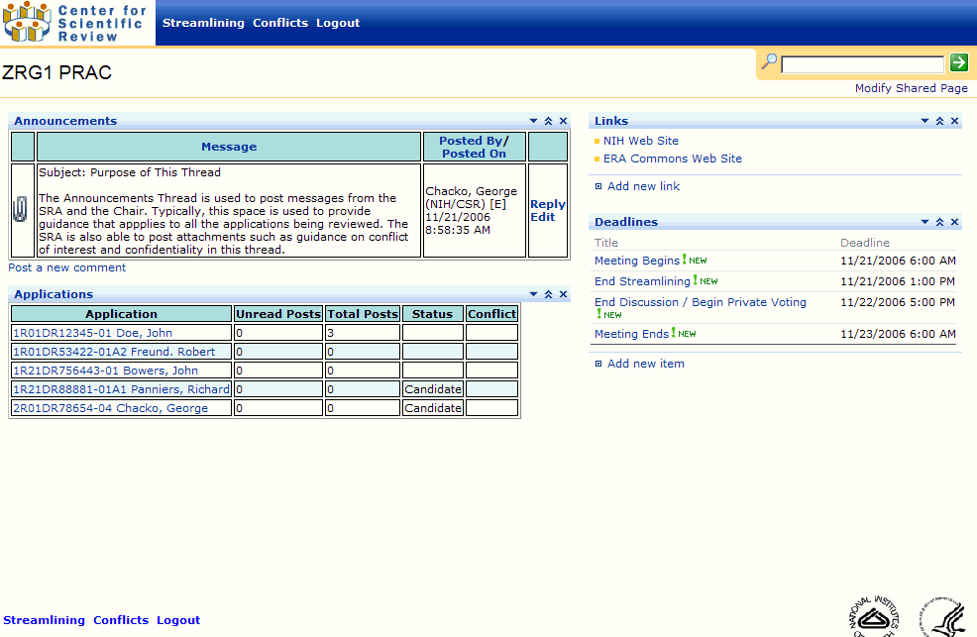

Slide 8
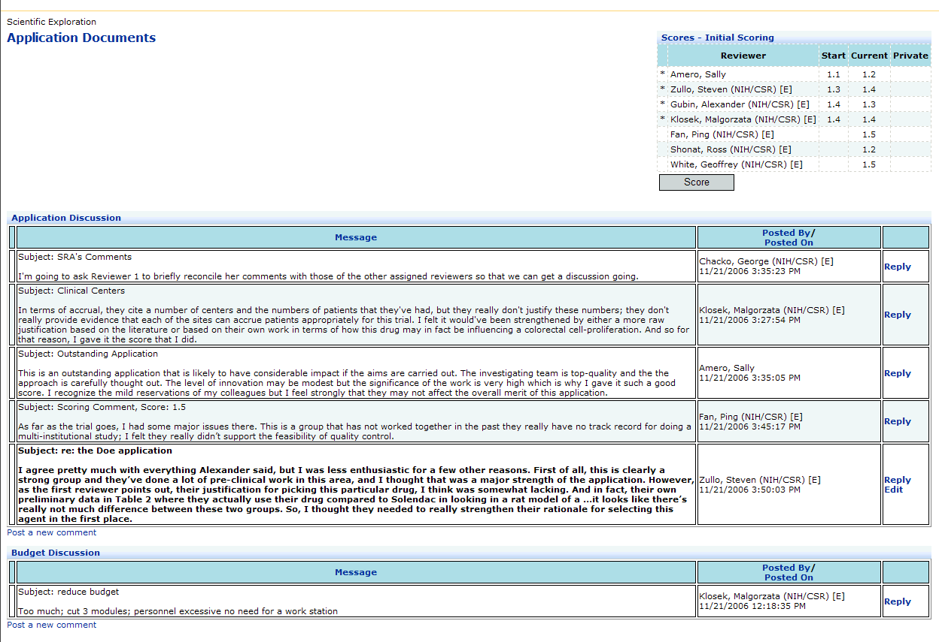

Slide 9
State of the Pilot
    July 2005- Jan 2006- 11 panels
    R21, R03, R15, R01
    Aug-Dec 2006- 38 SEPS
    R03, R21, R01, R15, P01, SBIRs
    Evaluation

Slide 10
Challenges
    Developing a culture of usage
    Less immersive than a face to face meeting
    Cognitive challenge & scalability
    Training
    Technical challenges, integration, usability

Slide 11
Future Directions
Scaling
  No of panels
  No of applications
  Different Mechanisms
Refining Protocols
Greater Automation
Integration
Wider Adoption

Slide 12
Acknowledgments
    Project Management Team
      McKay, Panniers, Srinivas, Blagaich, Chacko
    Developers
      Leo Wu, Sara Wu, Dipak Bhattacharyya, Yulia Shifrin,
    Reviewers
    CSR Staff
      Bob Freund, Participating SRAs, IRG Chiefs, Electronics Committee, CSR DDs, CSR RTAs
    NIH Staff
      Jack Jones, John Riston, Mikhail Gomon, Shawn Googins
    Executive Sponsors
      Toni Scarpa, Cheryl Kitt

