Slide 1
Integrated Simulation of DFS
Paul Lebrun
Fermilab CD/AMR

Slide 2
Overview
Goal: Steering in both Static and Dynamical cases (for the Main Linac, low-energy section)
  Can we use DFS in presence of beam jitter, as the machine moves ?
  Is the DFS solution “stable” and “local” ?
Related issues, static case:
    is the DFS solution unique for a given machine?
    What drives the emittance growth?
    What would it take to get < 0.5 nm emittance growth in ML ? (with “good, stable” BPMs ?)

Slide 3
On Acknowledgment & Integration..
While most of the studies were done in CHEF,
  “Borrowed” short range wakefield from Merlin
  “Took” the ATL Ground Motion code from V. Ivanov, who translated to C++ from Andrei S. previous work
  Studied the DFS codes from J. Smith and F. Poirier/N. Walker
Many thanks to those who directly, or indirectly contributed!
  Our studies are “mostly independent!”

Slide 4
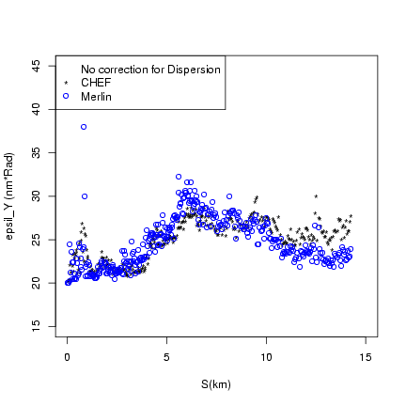
On Benchmarks/Checks
CHEF vs Merlin tracking,
on “Benchmark 2”
Quadrupoles kicks due to displacement
Short Range Wakes
Cavity tilts…
Spike at 800 m. in projected emittance has a bigger amplitude (other codes saw similar features).

Slide 5
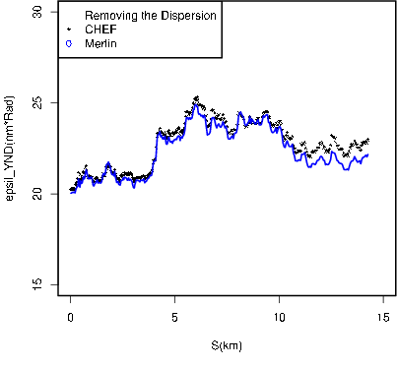
On Benchmarks/Checks
Local Dispersion can be slightly off, yet, once corrected for dispersion,
better agreement.
Detailed agreement, after empirically finding out the rotation axis intercept for cavities..

Slide 6
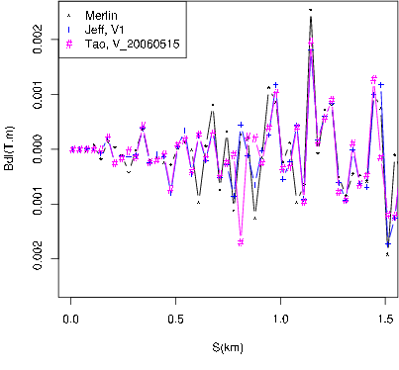
With a caveat!
As we did this benchmark, improvements were made to our DFS algorithms.
Different list of corrector settings were found, with occasional – but definite – improvement. Not factor of two, though.
These solutions at position of the emittance spikes were found markedly different!
Robustness of DFS?

Slide 7
DFS in CHEF
Although DFS has been implemented many times, it is still considered “sometimes tricky”
Usually running on the static case (albeit with beam jitter).
  What happens when ground motion is included? Do we have to run steering feedback loops upstream of the section being steered?
New implementation.
  Partly based on previous experience..
  Having in mind dynamical simulation

Slide 8
DFS in a feedback loop
Basic DFS, unchanged, but:
  Apply a gain factor at each correction cycle
  One correction cycle may take many pulses:
    to smooth out BPM resolution effects or beam jitter, or other (not yet implemented not thought off effects).
  Requires convergence.
    based an absolute relative changes to actuators
Other features..
  Response Matrices can be either:
    computed for the perfect machine, or at each iteration.
    Using pilot positron, or low emittance high intensity bunch (i.e., with wake field)

Slide 9
DFS more details..
  Arbitrary length/overlap of DFS sections
    with constraints on r.f. control ( changing the LLRF settings of klystrons, not r.f. gradient of individual cavities..)
  Capability of adding BPMs located downstream of the current DFS section, to refine trajectory measurement.
    ( found not that useful…Not sure why)
  Matched Dispersion Steering:
    Although results shown below have been obtained for a straight lattice, our DFS codes are really DMS, i.e., tune to Dispersion to the design value.

Slide 10
DFS “Advanced algorithms”
  “Steer” to a y, y’ that is independent of P prior to DFS through a given section (J. Smith/P. T.)
    Should improve the handling of the overlap.. Coded it up, but I did not had much success for the seed I studied so far.. Adjusting section overlap works as well, it seemed..
  Some support for missing/broken dipoles.
    BPM/Corrector can be marked “bad” and are not used in the fit… But no automated changes of DFS parameters take place.. Still shaky!
  Tilt correction of a set of cavities:
    Although cavities are fixed, it does make sense to explore improvements to LET if either movers are provide, or, conversely, if correctors are installed in each cryo-modules.. More on this later.

Slide 11
DFS “Multiple/Dynamical”
  Macro-iterations: once gone through the entire machine section, do it again
    support for multiple Beam Based alignments loops algorithm, done sequentially on overlapping sections is provided. Thus, it might make sense to check things out one more time, i.e., do the whole thing again.
  In presence of dynamical effects, need to do it again!
    Like Ground Motion…
    Thus, one must keep track of “real time”, “real pulse count”
      becomes a “control” simulation code, instead of beam physics.. But since the “real time” aspect is very simple, starting from a accelerator code make sense…

Slide 12
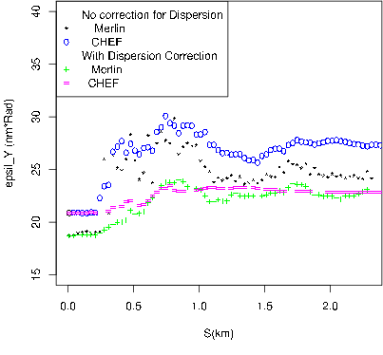
On DFS Check
DFS-CHEF started to be implemented as Freddy P. was polishing his Merlin version.
Based on his release code of April 06, Euro-TeV-2006-071, “re-adjusted” the CHEF code and ran Merlin and CHEF on the same lattice, same misalignment.
… Almost the same DFS algorithm..
Each package generates its
own bunches of ~ few 1000
particles.. ε₀ varies..

Slide 13
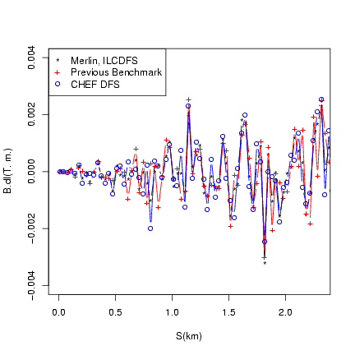
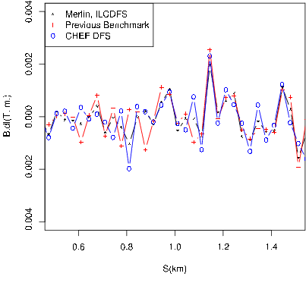
DFS Solution CHEF/Merlin
Solution can be locally different, (i.e., at s ~ 0.8), for this seed), without substantial difference in emittance growth, after correction for Dispersion !!

Slide 14
DFS Robustness
  Multiple solutions occur simply because parasitic dispersion occur from both cavity tilts and quadrupole displacement.
    And one can either “pre-correct” or “post-correct” the dispersion occurring in between dipole correctors.
    Solution depends on details of the DFS algorithm, such as the gain factor and the DFS section length/overlap.
  In presence of such multiple solutions and time dependent perturbations, can we still get a “relatively stable” solution?
    May be this is not a problem, each solution having its own region of stability?

Slide 15
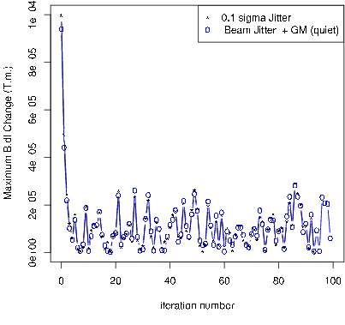
DFS dynamic, example
Consider the first DFS section, length of 40 dipoles, and let us DFS steer as 0.1 s in y and y’ beam jitter is applied, as we wll as a “relatively quiet” ground motion occurs.
Plotted is the largest of all 40 corrections, vs iteration number.
This sets an upper limit on the convergence criteria.
Beam jitter dominates over
quiet GM, on distance scale of hundreds of meter.

Slide 16
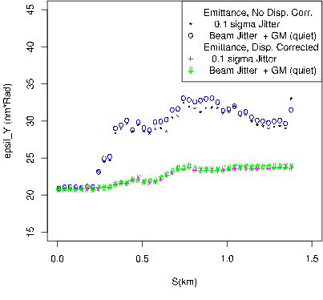
DFS dynamic, example, results.
Consider the previous run, and over only two DFS sections.
(Always same good old Tesla lattice and same seed.)
Projected emittance growth higher than the static case,
but not disastrously large

Slide 17
DFS & Cavitiy Tilts, static case
  DFS performance for the bunch compressor and the beginning of LINAC barely within specs..
    On paper… Static case..
    Perfectly alignment for first few modules…
    → Worth exploring what it would take to improve the performance (despite a likely – albeit modest – cost increase)!
  Easy to establish that, in the static case, with BPM not drifting, if no cavity rotation, there is DFS solution that give tiny ( < 0.5 nm) emittance growth.
    Only one source of dispersion (quadrupole offsets) and corrector is highly local!

Slide 18
DFS & Cavitiy Tilts, static case
  A variant of DFS: a tilted cavity will produce less dispersion if running at a lower voltage!
    Work one cryo-module at a time.
    Compensate the reduce gradient in that module with higher gradient with previous cryo-module (Overall, the LINAC runs at lower gradient during this operation).
    Tweak the tilt angle of the cavities such that the dispersion measured in 3 downstream BPM does not depend on the gradient distribution.
  Caveat:
    Can’t move cavity once cold and tuned! While piezo-movers are possible, a small dipole corrected in each cryo-module also could do the trick.
    More serious: Can’t change the gradient on a cryo-module, only an r.f. unit ( 3 cryo-modules, or one Quad)

Slide 19
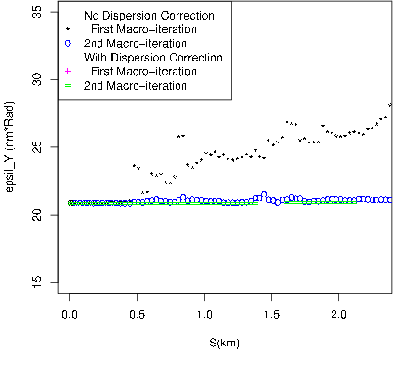
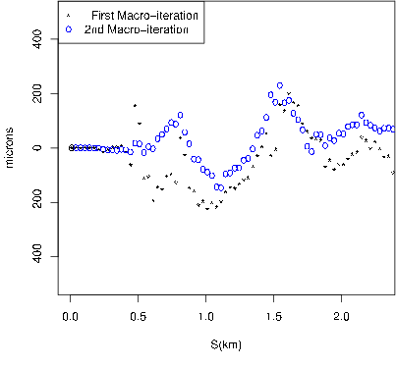
DFS-CavTilts, Prelim Results.
Static case : It seems to work..! The trajectory is not perfectly flat, because the dispersion can not be corrected exactly where it occurs (one actuator per 8 cavities)

Slide 20
Plans
Move to the recent version of the ILC lattice, Main Linac and (possibly) bunch compressor.
  Done, mostly, need to do quick check with Lucretia
More studies on dynamical steering issues
  More seeds! (evidently)
  Improved Ground motion models (We have data!)
  DFS along with simpler (~ 1-1) feedback loops in upstream sections
Steering Improvement:
  Cavity Tilt mitigation effort
    Study what it would take to control r.f. gradient one a per module basis.
    Additional dipole correctors.
  Quadrupole/BPM package

Slide 21
Backup Slides.
More details available in note at
http://beamdocs.fnal.gov/AD-public/DocDB/ShowDocument?docid=2589

Slide 22
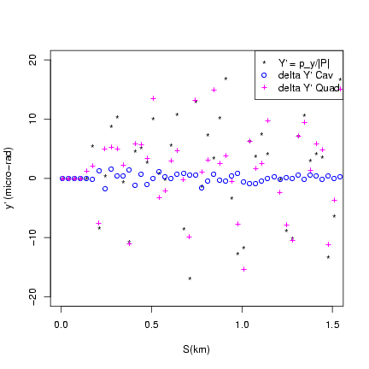
Why Cavity tilts..
Sources of y’
Quadrupoles kicks
Wakes
Cavity tilts.
Cavity tilts effect not negligible wrt quads.
Wake small if trajectory off set is small.

Slide 23
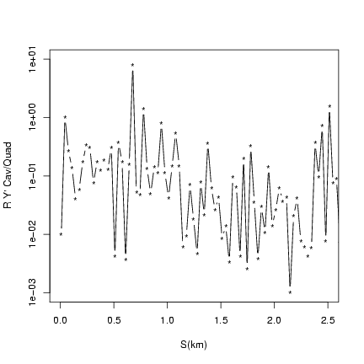
Why Cavity tilts.., 2nd
Ratio of Δy’, Cav/Quad, from 24 consecutive cavities to one quadrupole.
One dipole.. per 24 cavities! Distributed all along the LINAC…
=> No truly local solution!.

Slide 24
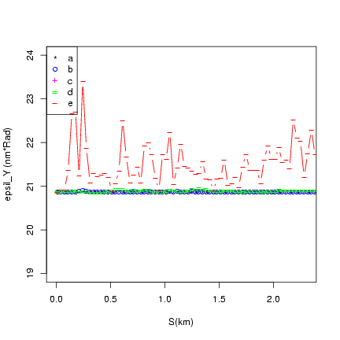
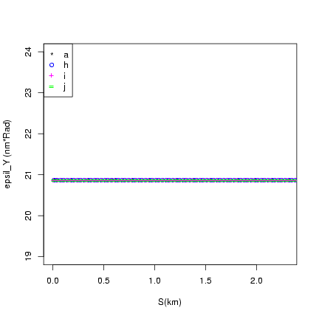
Perfectly aligned cryomodules.
For a wide range of DFS parameter, (DFS length, overlaps, Trajectory/Dispersion weight ratio,..)
Got a good solution:
No emittance growth.

Slide 25
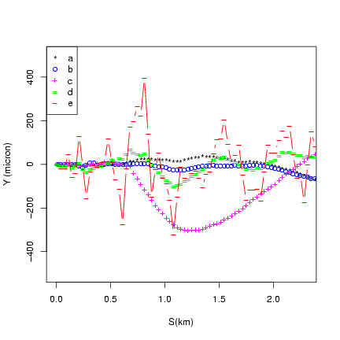
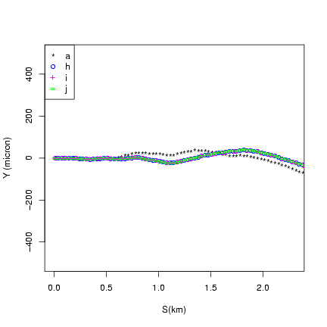
Perfectly aligned cryomodules.
For a wide range of DFS parameter, (DFS length, overlaps, Trajectory/Dispersion weight ratio,..)
Got a good solution:
Near straight trajectory.
(~ 100 micron offsets).

Slide 26
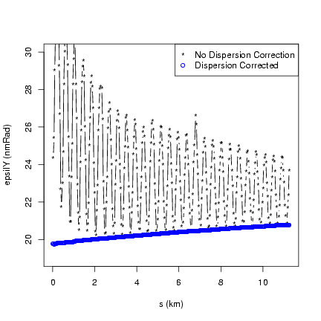
ILC-RDR, first checks.
CHEF version 2006_12_19 (Most recent release)
XSIF Lattice file: Unchanged from what we received from Alex V.
Matching Injection Twiss parameters found in the accompanying MAD file,
Injected bunch created by CHEF-User code.
After correction for Dispersion, emittance growth of ~1 nm.

Slide 27
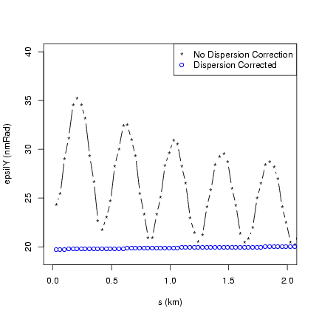
ILC-RDR, first checks.
Same run as previous slide,
Upstream part of the Linac.
Would be good to check the projected emittance growth in detail, perhaps..

Slide 28
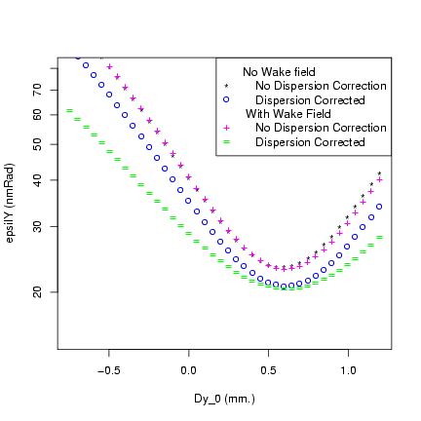
Verification of Dy at injection.
Emittance at the end of ML vs Dy at injection
Suggested value from Alex is ~ + 0.497 mm
Best performance a bit higher.. (10%)
Non-trivial dependence on Wake fields at the wrong initial Dy.

Slide 29
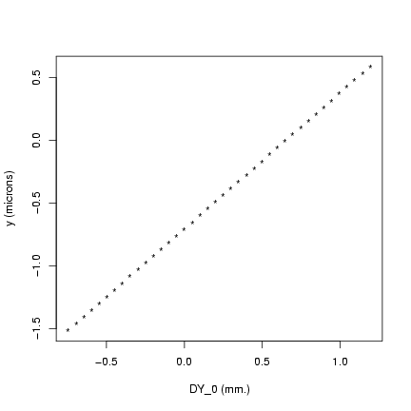
Verification of D at injection.
No Wake field…
Best performance when the average position is close to 0.
Non-trivial offset at the wrong initial Dy. Albeit very small offset…
More checks/comparison preferable before DFSing..

