Slide 1
State of Washington
Employment Security Department
Human Resource
Management Report
Plan & Align Workforce
Hire Workforce
Deploy Workforce
Reinforce Performance
Develop Workforce
October 2007

Slide 2
Managers’ Logic Model for Workforce Management
Outputs
Initial Outcomes
Intermediate Outcomes
Plan & Align Workforce
Articulation of managers HRM accountabilities. HR policies. Workforce planning. Job classes & salaries assigned.
Managers understand HRM accountabilities. Jobs, staffing levels, & competencies aligned with agency priorities.
Foundation is in place to build and sustain a productive, high performing workforce.
Hire
Workforce
Qualified candidate pools, interviews & reference checks. Job offers. Appts & per-
formance monitoring.
Best candidate hired & reviewed during appointment period. Successful performers retained.
The right people are in the right job at the right time.
Ultimate Outcomes
Employees are committed to the work they do & the goals of the organization
Productive, successful employees are retained
State has workforce depth & breadth needed for present and future success
Deploy
Workforce
Work assignments& requirements defined. Positive workplace environment created. Coaching, feedback, corrections.
Workplace is safe, gives capacity to perform, & fosters productive relations. Staff know job rqmts, how they’re doing, & are supported.
Time & talent is used effectively. Employees are motivated & productive.
Develop Workforce
Individual development plans. Time/ resources for training. Continuous learning environment created.
Learning environment created. Employees are engaged in develop-
ment opportunities & seek to learn.
Employees have competencies for present job & career advancement
Agencies are better enabled to successfully carry out their mission. The citizens receive efficient government services.
Reinforce Performance
Clear performance expectations linked to orgn’al goals & measures. Regular performance appraisals. Recognition. Discipline.
Employees know how performance contributes to success of orgn. Strong performance rewarded; poor performance eliminated
Successful perf is differentiated & strengthened. Employees are held accountable.

Slide 3
Standard Performance Measures
Plan & Align Workforce
Percent supervisors with current performance expectations for workforce management
Management profile
Workforce planning measure (TBD)
Percent employees with current position/competencies descriptions
Time-to-fill funded vacancies
Candidate quality
Hiring Balance (Proportion of appointment types)
Separation during review period
Percent employees with current performance expectations
Employee survey ratings on “productive workplace” questions
Overtime usage
Sick leave usage
Non-disciplinary grievances/appeals filed and disposition (outcomes)
Worker safety
Percent employees with current individual development plans
Employee survey ratings on “learning & development” questions
Competency gap analysis (TBD)
Percent employees with current performance evaluations
Employee survey ratings on “performance & accountability” questions
Disciplinary actions and reasons, disciplinary grievances/appeals filed and disposition (outcomes)
Reward and recognition practices (TBD)
Ultimate Outcomes
Hire
Workforce
Employee survey ratings on “commitment” questions
Turnover rates and types
Turnover rate: key occupational categories
Workforce diversity profile
Retention measure (TBD)
Deploy
Workforce
Develop Workforce
Reinforce Performance

Slide 4
Plan & Align Workforce
Outcomes:
Managers understand workforce management accountabilities. Jobs and competencies are defined and aligned with business priorities. Overall foundation is in place to build & sustain a high performing workforce.
Performance Measures:
Percent supervisors with current performance expectations for workforce management
Management profile
Workforce Planning measure (TBD)
Percent employees with current position/ competency descriptions
Workforce Management Expectations
Percent supervisors with current performance expectations for workforce management = 100%*
Analysis:
Agency has placed an emphasis on all employees having clear, measurable written performance expectations.
Although supervisors have written performance expectations, there needs to be efforts concentrated on the outcome of the expectations.
Expectations need to become part of the agency culture. Maintaining a 100% rating is important but treating expectations as a living document is the bigger goal.
Action Steps:
The Human Resource Services Division will continue to provide consultation and training for managers and supervisors in the area of writing and using performance expectations.
The Human Resource Services Division will monitor outcomes of agency efforts as reflected in quality of performance evaluations and outcomes of disciplinary actions.
Managers will be held accountable for timely, high quality performance evaluations.
*Based on 387 of 387 reported number of supervisors – Includes Exempt, WMS and Classified Supervisors
Data as of 9/17/2007
Source: Internal Tracking

Slide 5
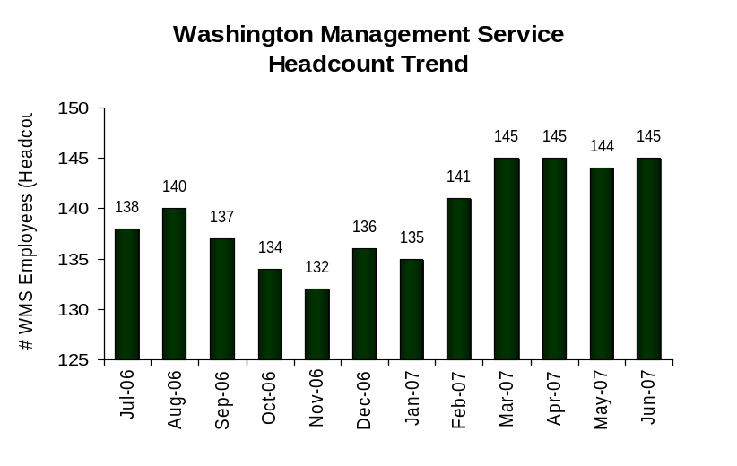
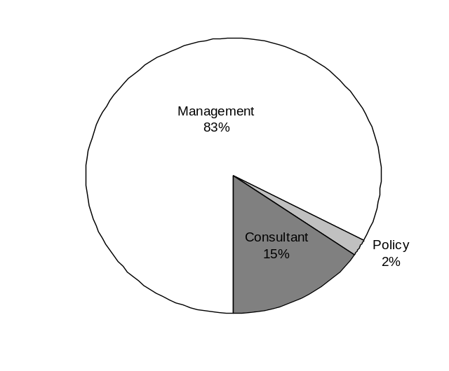
Plan & Align Workforce
Outcomes:
Managers understand workforce management accountabilities. Jobs and competencies are defined and aligned with business priorities. Overall foundation is in place to build & sustain a high performing workforce.
Performance Measures:
Percent supervisors with current performance expectations for workforce management
Management profile
Workforce Planning measure (TBD)
Percent employees with current position/ competency descriptions
Management Profile
WMS Employees Headcount = 145
Percent of agency workforce that is WMS = 7.4%
Managers* Headcount = 146
Percent of agency workforce that is Managers* = 7.4%
* In positions coded as “Manager” (includes EMS, WMS, and GS)
Analysis:
ESD completed mid-management reductions at the end of 2006. The agency surpassed the number of WMS reductions required by OFM. Since that time the agency has continued reorganization efforts and filled WMS positions that were previously vacant.
ESD is below state average 8.2% WMS and 9.2% percentage of positions that are managers.
Statistical information is for headcount only and does not take into consideration vacant positions during any point in the reporting period for either management or agency total.
Action Steps:
The Human Resource Services Division has ensured that all management positions are properly categorized.
Agency will continue to monitor number of management positions in an effort to maintain a balance of management to non-management positions..
[Use of this chart is optional]
Management 120
Consultant 22
Policy 3
Data as of 9/6/2007
Source: HRMS Business Warehouse

Slide 6
Plan & Align Workforce
Outcomes:
Managers understand workforce management accountabilities. Jobs and competencies are defined and aligned with business priorities. Overall foundation is in place to build & sustain a high performing workforce.
Performance Measures:
Percent supervisors with current performance expectations for workforce management
Management profile
Workforce Planning measure (TBD)
Percent employees with current position/ competency descriptions
Current Position/Competency Descriptions
Percent employees with current position/competency descriptions = 100%*
Analysis:
The Human Resource Services Division and agency management has made a concerted effort to ensure that position descriptions are kept up to date.
Action Steps:
The Human Resource Services Division will focus additional effort on the quality of the position description and competencies.
The Human Resource Services Division will continue to offer training to management and supervisors on completion of position descriptions.
Additional HRSD work is planned to begin job analysis for all positions by June 30, 2008.
*Based on of reported employee count
1614 of 1614. Applies to employees in permanent positions, both WMS & GS
Data as of 6/30/07
Source: Internal Tracking

Slide 7
Hire Workforce
Outcomes:
Best candidates are hired and reviewed during appointment period. The right people are in the right job at the right time.
Performance Measures
Time-to-fill vacancies
Candidate quality
Hiring Balance (proportion of appointment types)
Separation during review period
Time-to-fill / Candidate Quality
Time-to-fill Funded Vacancies
Average number of days to fill*: 74.7
Number of vacancies filled: 37
*Equals # of days from creation of the requisition to job offer acceptance
Time Period: December 2006 – June 30, 2007
Analysis:
ESD began using E-Recruitment in December 2006 for specific classifications on a limited basis.
Currently certifications/referrals and appointments are completed utilizing position specific recruitment efforts, including but not limited to; ESD Listserv, Intranet and Internet postings, Go2 WorkSource, and WAStateJobsListservs, advertising and sourcing. A small percentage of recruitments are still done in E-recruiting.
Tracking of Time-to-Fill Vacancies is currently being done using an Access Database. The totals include E-recruiting numbers.
Action Steps:
Due to managers/supervisors’ needs, job seeker feedback, and the agency unique job classes recruited for, utilizing E-recruiting will not be the primary means of recruitment.
Candidate Quality Reporting – We will be capturing this information by directly sending the Candidate Quality survey to managers along with the certifications. This will be available for the next reporting cycle.
Candidate Quality
Of the candidates interviewed for vacancies, how many had the competencies (knowledge, skills & abilities) needed to perform the job?
  No data to report at this time.
Data as of 9/27/07
Source: DOP E-Recruitment Detail

Slide 8
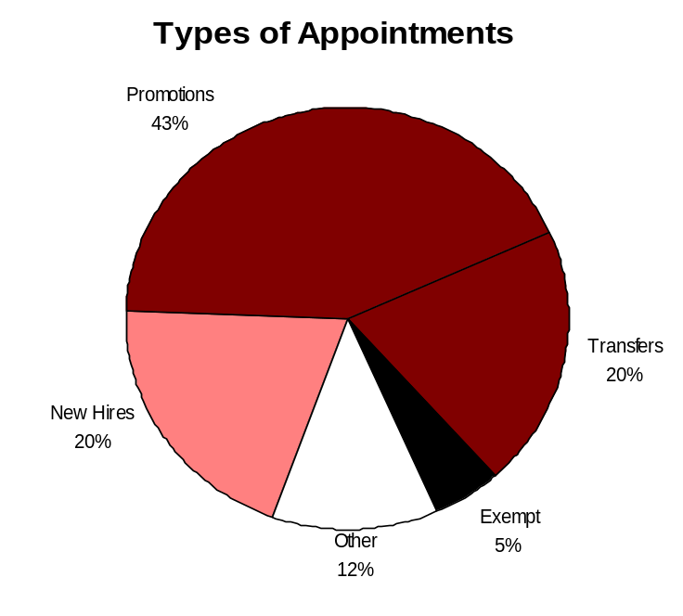
Hire Workforce
Outcomes:
Best candidates are hired and reviewed during appointment period. The right people are in the right job at the right time.
Performance Measures
Time-to-fill vacancies
Candidate quality
Hiring Balance (proportion of appointment types)
Separation during review period
Hiring Balance / Separations During Review Period
Analysis:
Majority of Transfer and Other actions stemmed from layoff action effective 10/15/06. Most impacted employees selected options to Transfer or Demote in Lieu of Layoff.
One third of involuntary probationary separation caused by Layoff action.
Majority of hiring was in the Unemployment Insurance Program with the most significant number of hires in UI Tax Central Office & Field. Also includes most significant amount of positions filled during the Layoff process.
The Human Resource Services Division saw the most significant activity with the loss of eight staff (26%) and the filling of 13 positions during this period of time.
Action Steps:
Continue to monitor hiring balance and separation information to determine trends
Total number of appointments = 256*
Time period = July 2006 through June 2007
Includes appointments to permanent vacant positions only; excludes reassignments
“Other” = Demotions, re-employment, reversion & RIF appointments
Separation During Review Period
Probationary separations - Voluntary 3
Probationary separations - Involuntary 3
  Total Probationary Separations 6
Trial Service separations - Voluntary 2
Trial Service separations - Involuntary 0
  Total Trial Service Separations 2
Total Separations During Review Period 8
Time period = July 2006 through June 2007
Data as of 9/1/2007
Source: HRMS Business Warehouse

Slide 9
Deploy Workforce
Outcomes:
Staff know job expectations, how they’re doing, & are supported. Workplace is safe, gives capacity to perform, & fosters productive relations. Employee time and talent is used effectively. Employees are motivated.
Performance Measures
Percent employees with current performance expectations
Employee survey ratings on “productive workplace” questions
Overtime usage
Sick leave usage
Non-disciplinary grievances/appeals filed and disposition (outcomes)
Worker safety
Current Performance Expectations
Percent employees with current performance expectations = 100%*
Analysis:
The agency has placed an emphasis on all employees having clear, measurable written performance expectations.
Although employees have written performance expectations, there needs to be efforts concentrated on the outcome of the expectations.
Expectations need to become part of the agency culture. Maintaining a 100% rating is important but treating expectations as a living document is the bigger goal.
Action Steps:
The Human Resource Services Division will continue to provide consultation and training for managers and supervisors in the area of writing and using performance expectations.
The Human Resource Services Division will monitor outcomes of agency efforts as reflected in quality of performance evaluations and outcomes of disciplinary actions.
*Based on 1614 of 1614 reported employee count
Applies to employees in permanent positions, both WMS & GS
Data as of 6/30/07
Source: Internal Tracking

Slide 10
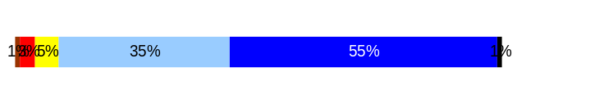
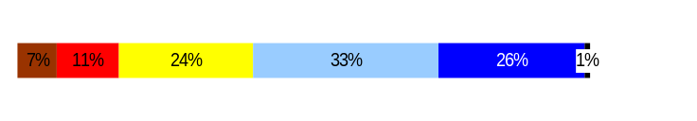
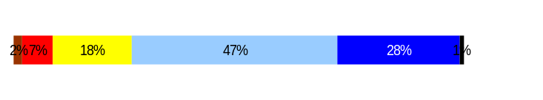
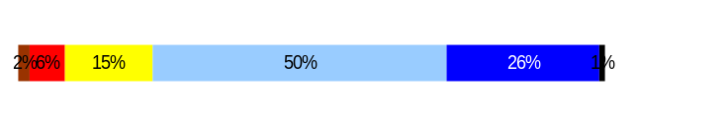
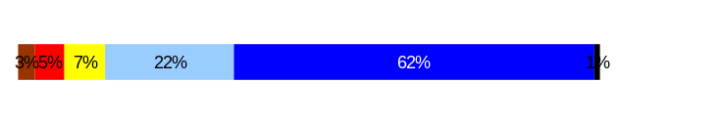
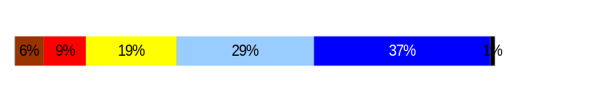
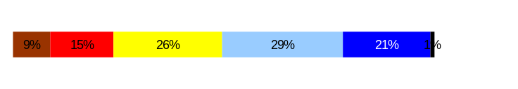
Deploy Workforce
Outcomes:
Staff know job expectations, how they’re doing, & are supported. Workplace is safe, gives capacity to perform, & fosters productive relations. Employee time and talent is used effectively. Employees are motivated.
Performance Measures
Percent employees with current performance expectations
Employee survey ratings on “productive workplace” questions
Overtime usage
Sick leave usage
Non-disciplinary grievances/appeals filed and disposition (outcomes)
Safety and Workers Compensation (TBD)
Employee Survey “Productive Workplace” Ratings
Avg
Q4. I know what is expected of me at work.
Q1. I have opportunity to give input on decisions affecting my work.
Q2. I receive the information I need to do my job effectively.
Q6. I have the tools and resources I need to do my job effectively.
Q7. My supervisor treats me with dignity and respect.
Q8. My supervisor gives me ongoing feedback that helps me
improve my performance.
Q9. I receive recognition for a job well done.
Analysis:
Survey data indicates that ESD employees are only slightly higher than the statewide average for productive workplace survey questions.
ESD collected data from additional questions during this survey with several having a productive workplace theme.
Responses that were closely related to the productive workplace theme suggested employees; feel that they provide a service or product that made a difference for the customer; have a desire for more communication from and with management; and, are interested in clear performance measures that are not constantly changing.
Action Steps:
Agency management participates in reverse GMAP sessions where staff can question leadership.
Commissioner Lee has scheduled brown bag sessions with staff to hear and talk about program issues and agency actions.
The Human Resource Services Division is developing options to address the agency recognition program.
Agency leadership has placed greater emphasis on all employees having clear, written job expectations.
4.4
3.6
3.9
3.9
4.4
3.8
3.4
Never
Seldom
Occasionally
Usually
Always
Overall average score for Productive Workplace Ratings: 3.9
This data is from the April 2006 Employee Survey and the agency has already implemented action steps in response to survey information. The next survey will occur at the end of 2007.
Data as of April 2007
Source: Dept of Personnel 2006 Employee Survey

Slide 11
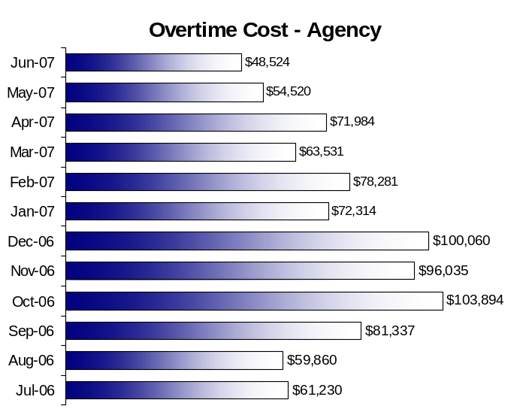
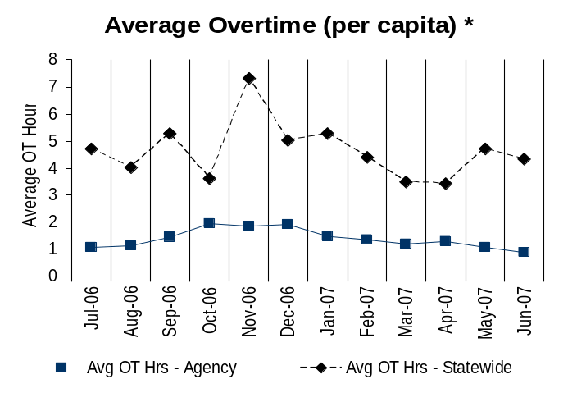
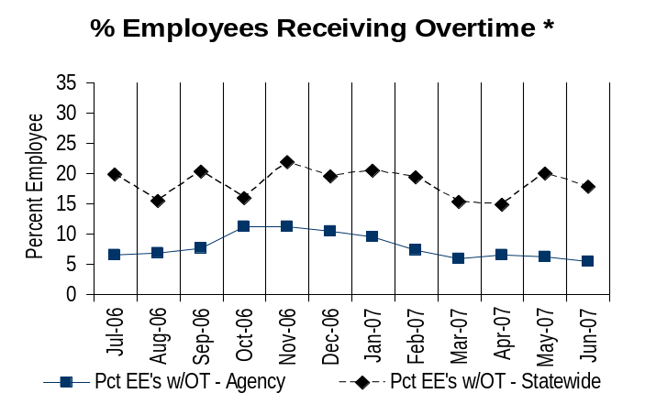
Deploy Workforce
Outcomes:
Staff know job expectations, how they’re doing, & are supported. Workplace is safe, gives capacity to perform, & fosters productive relations. Employee time and talent is used effectively. Employees are motivated.
Performance Measures
Percent employees with current performance expectations
Employee survey ratings on “productive workplace” questions
Overtime usage
Sick leave usage
Non-disciplinary grievances/appeals filed and disposition (outcomes)
Worker safety
Overtime Usage
Overall agency avg overtime usage – per capita, per month: 1.38**
*Statewide overtime values do not include DNR
**Overall agency avg overtime usage – per capita, per month = sum of monthly OT averages divided by number of months
Total Overtime Cost for Agency FY07 $891,570.
Analysis:
Most overtime occurs in the winter months due to traditionally higher unemployment claim load during that time of year.
Overtime that occurs in the summer months is in areas of Office Services and IT Support and is caused by office moves/agency reorganization.
There was a notable increase in overtime for the Human Resource Services Division for the period which was due to the implementation and operation of HRMS and Total time issues.
The available overtime data does not include compensatory time earned and taken nor does it average based on only those positions that are overtime eligible.
Action Steps:
The Human Resource Service Division will involve division management in future analysis of overtime data once the data has been stabilized.
Overall agency avg employees receiving overtime per month: 7.93%**
*Statewide overtime values do not include DNR
**Overall agency avg employees receiving overtime per month = sum of monthly OT percentages divided by number of months
Data as of 9/20/2007 Source: HRMS Business Warehouse

Slide 12
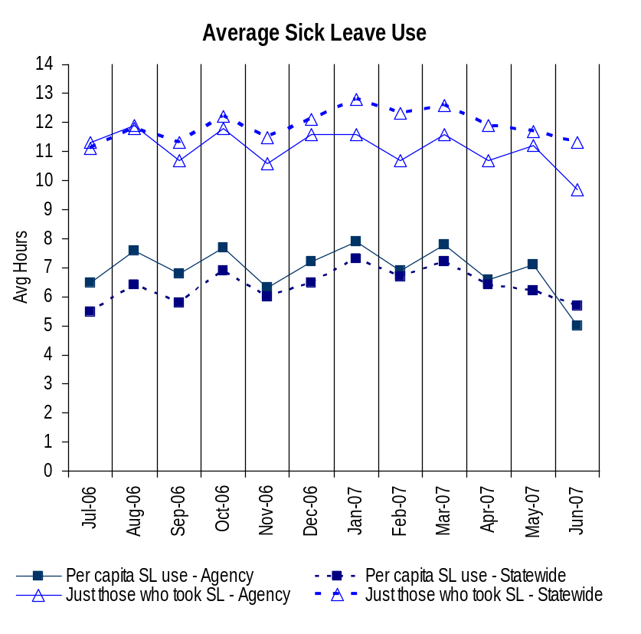
Deploy Workforce
Outcomes:
Staff know job expectations, how they’re doing, & are supported. Workplace is safe, gives capacity to perform, & fosters productive relations. Employee time and talent is used effectively. Employees are motivated.
Performance Measures
Percent employees with current performance expectations
Employee survey ratings on “productive workplace” questions
Overtime usage
Sick leave usage
Non-disciplinary grievances/appeals filed and disposition (outcomes)
Worker safety
Sick Leave Usage
Analysis:
ESD has a higher average of sick leave hours earned per capita than the statewide average and a lower average of sick leave hours used than the statewide average.
ESD has a slightly higher number of sick leave hours used per capita than the statewide average, but the average number of hours used by those who took sick leave is less than the statewide average.
The highest percentage of permanent employee sick leave use occurred in October of 2006 while the agency was conducting a layoff action.
Action Steps:
The Agency will develop a health and productivity program with components to education managers and staff concerning issues of safety, health and wellness with a focus towards the reduction of personal sick leave usage.
The Agency will continue to work with similar agencies to refine best practices and strategies to reduce sick leave usage.
The Agency will refine current systems to allow for better sick leave data collection to assist in monitoring, determining trends and measuring the success of the Health and Productivity program.
Sick Leave Hrs Used / Earned (per capita)
Avg Hrs SL Used (per capita) - Agency | % of SL Hrs Earned (per capita) - Agency
6.9 Hrs | 89.0%
Avg Hrs SL Used (per capita) – Statewide* | % of SL Hrs Earned (per capita) – Statewide*
6.4 Hrs | 82.5%
Sick Leave Hrs Used / Earned (those who took SL)
Avg Hrs SL Used (those who took SL) - Agency | % SL Hrs Earned (those who took SL) - Agency
11.1 Hrs | 139.0%
Avg Hrs SL Used (those who took SL) – Statewide* | % SL Hrs Earned (those who took SL) – Statewide*
11.9 Hrs | 148.4%
Sick Leave time period = July 2006 through June 2007
* Statewide data does not include DOL, DOR, L&I, and LCB
Source: HRMS Business Warehouse

Slide 13
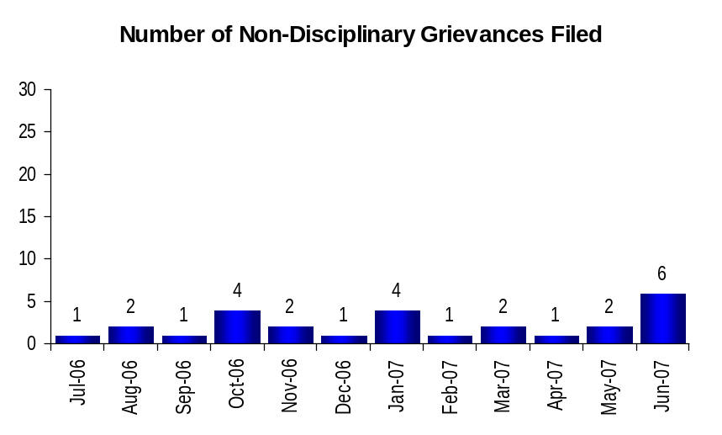
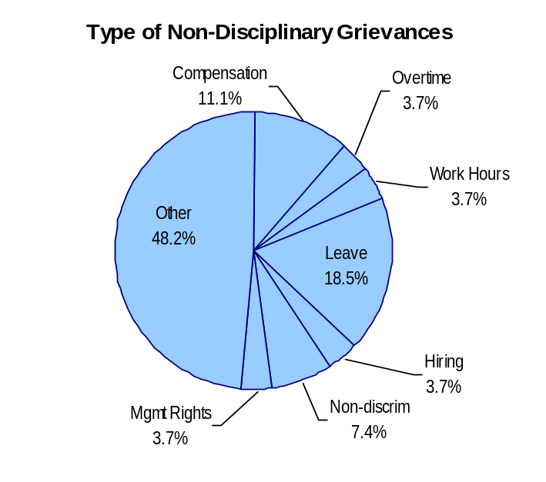
Deploy Workforce
Outcomes:
Staff know job expectations, how they’re doing, & are supported. Workplace is safe, gives capacity to perform, & fosters productive relations. Employee time and talent is used effectively. Employees are motivated.
Performance Measures
Percent employees with current performance expectations
Employee survey ratings on “productive workplace” questions
Overtime usage
Sick leave usage
Non-disciplinary grievances/appeals filed and disposition (outcomes)
Worker safety
Non-Disciplinary Grievances (represented employees)
Total Non-Disciplinary Grievances = 27
There may not be a one-to-one correlation between the number of grievances filed (shown top of page) and the outcomes determined during this time period. The time lag between filing date and when a decision is rendered can cross the time periods indicated.
Analysis:
92% of non-disciplinary grievances during this period of time have been withdrawn or settled without Arbitration.
Compensation Issues are currently the only issue that is being moved to Arbitration.
The majority of non-disciplinary grievances were in the “other” category which included evaluation, classification, job share and union dues issues.
Action Steps:
The Human Resource Services Division will continue to monitor the type and outcome of future grievances to identify specific patterns.
Non-Disciplinary Grievance Disposition*
(Outcomes determined during July 2006 through June 2007)
Withdraw - 9
Settled without Arbitration - 15
Scheduled for Pre-Arbitration - 1
Schedule for Arbitration - 1
Data as of 6/30/07
Source: Internal Tracking

Slide 14
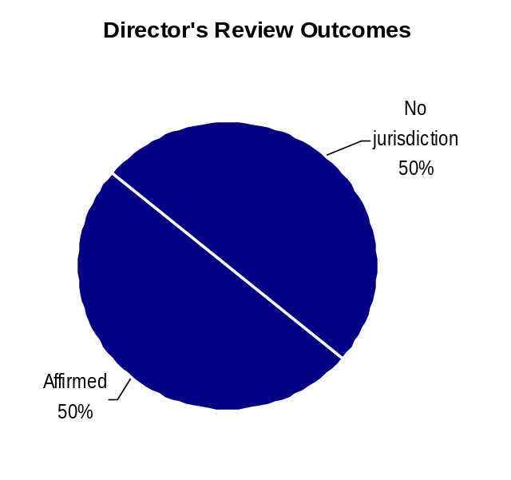
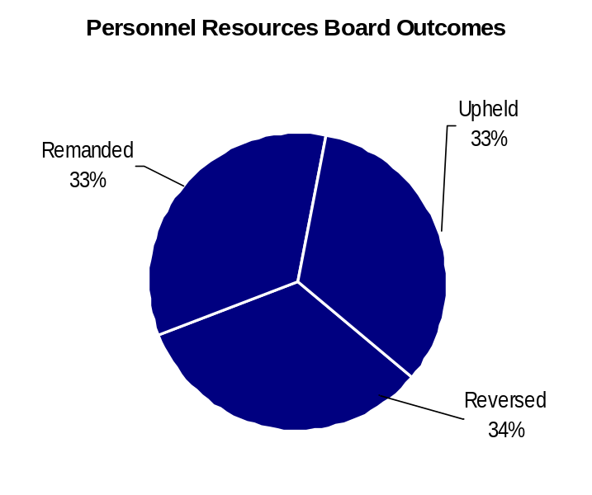
Deploy Workforce
Outcomes:
Staff know job expectations, how they’re doing, & are supported. Workplace is safe, gives capacity to perform, & fosters productive relations. Employee time and talent is used effectively. Employees are motivated.
Performance Measures
Percent employees with current performance expectations
Employee survey ratings on “productive workplace” questions
Overtime usage
Sick leave usage
Non-disciplinary grievances/appeals filed and disposition (outcomes)
Worker safety
Non-Disciplinary Appeals (mostly non-represented employees)
Filings for DOP Director’s Review
Time Period = July 2006 through June 2007
6 Job classification
0 Rule violation
0 Name removal from register
0 Rejection of job application
0 Remedial action
6 Total filings
Filings with Personnel Resources Board
Time Period = July 2006 through June 2007
1 Job classification
0 Other exceptions to Director Review
0 Layoff
0 Disability separation
0 Non-disciplinary separation
1 Total filings
Non-Disciplinary appeals only are shown above.
There is no one-to-one correlation between the filings shown above and the outcomes displayed in the charts below. The time lag between filing date and when a decision is rendered can cross the time periods indicated.
Total outcomes = 2
Time Period = July 2006 through June 2007
Total outcomes = 3
Time Period = July 2006 through June2007
*Outcome “Upheld” was not on PRB spreadsheet
Source: Dept of Personnel

Slide 15
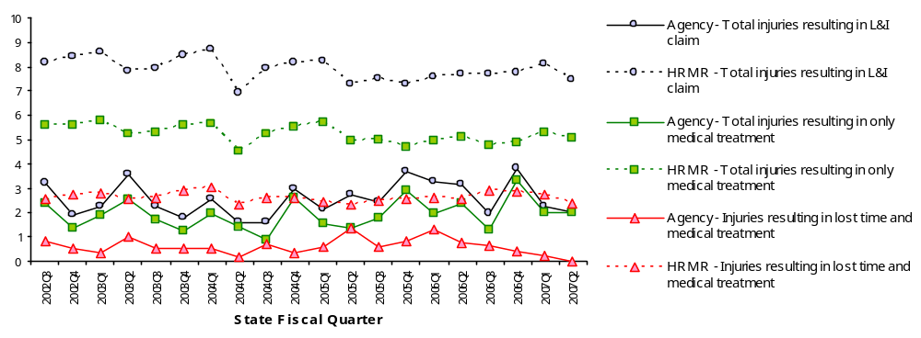
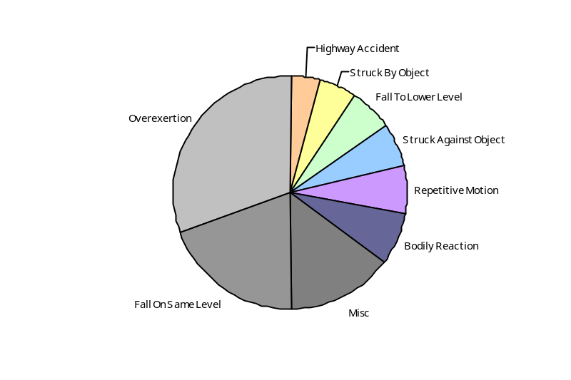
Deploy Workforce
Outcomes
Staff know job expectations, how they’re doing, & are supported. Workplace is safe, gives capacity to perform, & fosters productive relations. Employee time and talent is used effectively. Employees are motivated.
Performance Measures
Percent employees with current performance expectations
Employee survey ratings on 'productive workplace' questions
Overtime usage
Sick leave usage
Non-disciplinary grievances/appeals filed and disposition outcomes
Worker Safety
Worker Safety: Employment Security, Department of
Analysis:
Employment Security Department claim rates for total claims, lost time claims and medical treatment claims remain well below the average for all state agencies.
Although the medical treatment claim rate leveled between 2007Q1 and Q2, the lost time rate continued down and is now 0.
Action Plan:
Maintain this trend by actively implementing the state agency workplace safety initiative directed by the Governor.
  The workplace safety survey, gap analysis and action plan have been completed.
  The ESD Safety Action Plan was introduced at a department-wide safety symposium on September 24th.
  Milestones for completing action plan sub-projects have been established and will be tracked by internal GMAP.
Allowed Annual
Claims Rate*^:
Agency vs. All HR
Management Report
(HRMR) agencies
*Annual claims rate
is # claims / 100 FTE
1 FTE = 2000 hours
^Due to natural lag
in claim filing, rates
are expected to
increase significantly
over time
Injuries by Occupational
Injury and Illness
Classification (OIICS)
event:
For fiscal period 2002Q3
through 2007Q2
(categories under 3% or not
adequately coded are grouped
into 'misc.')
Oiics Code | Oiics Description | Percent | Number
21 | Bodily Reaction | 7% | 19
13 | Fall On Same Level | 20% | 51
11 | Fall To Lower Level | 6% | 15
41 | Highway Accident | 4% | 10
- | Misc | 15% | 39
22 | Overexertion | 30% | 79
23 | Repetitive Motion | 7% | 17
01 | Struck Against Object | 6% | 16
02 | Struck By Object | 5% | 14
Source: Labor & Industries, Research and Data Services (data as of 09/03/2007 )
Notes:
HRMR Safety Report Overview
The HRMR Safety Reports are:
- PowerPoint slides created by the Department of Labor and Industries
- Created for each state agency that is reporting their employee safety program results bi-
annually as part of their Human Resources Management Report (HRMR).
- Snapshots of five years of worker’s compensation claim data specific to that agency, as
well as a comparison to the combined data for agencies completing HRMR reports.
- There is a two quarter lag at the end of the five years.
This allows each agency’s payroll data to be entered into L&I’s computer system. This
payroll data is used to compute the number of workers per agency and quarter.
Definitions
Claim – When a covered worker sustains an occupational injury or illness, that worker files a
'claim’ for benefits. A 'claim number' is assigned, and all wage replacement payments, medical
provider bills, etc, for that worker and injury, are associated with that claim number.
Report Detail
'Allowed Annual Claim Rate'
This chart shows your agency's rate of injuries resulting in allowed
claims, by injury quarter, for on-the-job injuries and occupational illnesses. The rate for all
reporting agencies is shown for comparison.
- The rate is the number accepted claims per 200,000 annual worker hours (100 workers)
Three rates are included in this chart:
A)The total rate for all injuries resulting in a claim; the two groups listed below are
exclusive of each other.
B)The rate of injuries which required medical care, but no compensation for lost
time.
C)The rate of injuries which resulted in compensation for lost time in addition to
medical care.
'Injuries by Occupational Injury and Illness Classification (OIICS) Event’
This section contains a pie chart which shows your agency's injuries by type* and a table which
shows the percent and number of accepted claims by OIICS Event description and code.
This information is useful in identifying what causes injuries so prevention can occur. Prevention
might include root cause analysis, education, and hazard mitigation.
* Injury Type is based on the 2 digit Major Group code of the Event or Exposure section of the Occupational
Injury and Illness Classification System (OIICS). Groups with less than 3% of the
total injuries are combined into the 'Misc' category.
How to get this report for your agency:
All worker compensation reports will be available on the L&I website by the 20th of September or
the 20th of March of each year. The data will be provided in a PowerPoint slide to which you will
add your own analyses and action plans.

Slide 16
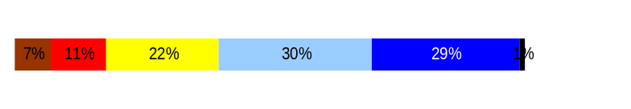
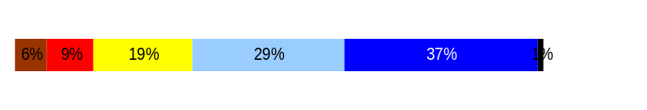
Develop Workforce
Outcomes:
A learning environment is created. Employees are engaged in professional development and seek to learn. Employees have competencies needed for present job and future advancement.
Performance Measures
Percent employees with current individual development plans
Employee survey ratings on “learning & development” questions
Competency gap analysis (TBD)
Individual Development Plans
Percent employees with current individual development plans = 100%
Analysis:
Survey data indicates that ESD employees rating are almost identical to the statewide average for Learning & Development survey questions.
ESD collected data from additional questions during this survey with several that had a Learning & Development theme.
Responses that were close to this theme suggested employee; have a desire for more communication from and with management; and, are interested in clear performance measures that are not constantly changing.
Action Steps:
The Human Resource Services Division, Training unit is looking at the issue of agency training and exploring options for alternative learning experiences.
Agency leadership has placed greater emphasis on all employees having clear, written job expectations.
The Human Resource Services Division will continue to provide consultation and training for managers and supervisors in the area determining appropriate training plans for employees.
Total # of employees with current IDPs* = 1617
Total # of employees* = 1617
*Applies to employees in permanent positions, both WMS & GS
Employee Survey “Learning & Development” Ratings
Q5. I have opportunities at work to learn and grow.
Q8. My supervisor gives me ongoing feedback that helps me
improve my performance.
Avg
3.6
3.8
Overall average score for Learning & Development Ratings: 3.7
This data is from the April 2006 Employee Survey and the agency has already implemented action steps in response to survey information. The next survey will occur at the end of 2007.
Data as of April 2007
Source: Dept of Personnel 2006 Employee Survey

Slide 17
Reinforce Performance
Outcomes:
Employees know how their performance contributes to the goals of the organization. Strong performance is rewarded; poor performance is eliminated. Successful performance is differentiated and strengthened. Employees are held accountable.
Performance Measures
Percent employees with current performance evaluations
Employee survey ratings on “performance and accountability” questions
Disciplinary actions and reasons, disciplinary grievances/appeals filed and disposition (outcomes)
Reward and recognition practices (TBD)
Current Performance Evaluations
Percent employees with current performance evaluations = 99%*
Analysis:
ESD measures timely completion of evaluations on a monthly basis
There were 26 performance evaluations that were not done in a timely fashion in 2006. All 26 were completed at a later date.
Reasons for untimely evaluations were: Employee on mission critical deadline; Management scheduling problem; Employee and/or supervisor out on medical leave; Supervisor failed to meet deadline; Error on due date; Disciplinary action in progress;
Action Steps:
The Human Resource Services Division is working with IT to bring new evaluation notification and tracking system on-line by the end of 2007.
The Human Resource Services Division Consultants are reviewing performance evaluation for content and quality.
The Human Resource Services Division will continue to advise and train managers and supervisors in the area of conducting meaningful evaluations.
*Based on 1795 of 1821 reported employee count
Applies to all employees
ESD monitors completion of evaluations for all employees. The statistics above are based on the total count of evaluations due between July 2006 and June 2007 and the number of evaluations completed in a timely manner during this period of time.
Data as of 9/17/07
Source: Internal Tracking System

Slide 18
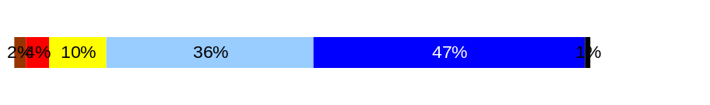
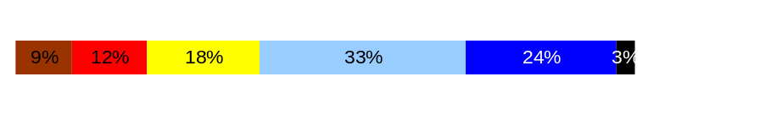
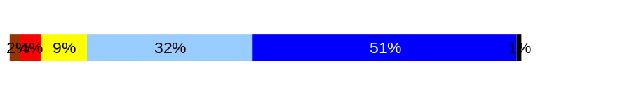
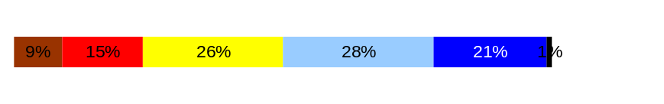
Reinforce Performance
Outcomes:
Employees know how their performance contributes to the goals of the organization. Strong performance is rewarded; poor performance is eliminated. Successful performance is differentiated and strengthened. Employees are held accountable.
Performance Measures
Percent employees with current performance evaluations
Employee survey ratings on “performance and accountability” questions
Disciplinary actions and reasons, disciplinary grievances/appeals filed and disposition (outcomes)
Reward and recognition practices (TBD)
Employee Survey “Performance & Accountability” Ratings
Avg
Analysis:
Survey data indicates that ESD employee responses are only slightly higher than the statewide average for performance & accountability survey questions.
ESD collected data from additional questions during this survey. Question #11 dealing with holding employee and co-workers accountable were split.
Employee responses suggested that while they felt that their supervisor held them accountable, they felt less sure that the supervisor held their co-workers accountable.
Action Steps:
The agency has outlined a strategic plan which tasks management to fully integrate performance measures into employee job descriptions and performance agreements. This is an ongoing process.
The Human Resource Service Division has been tasked with providing additional support to managers to address performance issues.
Agency leadership has placed a greater emphasis on all employees having clear, written job expectations.
GMAP will continue to review performance measures of programs and units.
Q3. I know how my work contributes to the goals of my agency.
Q10. My performance evaluation provides me with meaningful information about my performance.
Q11. My supervisor holds me and my co-workers accountable for performance.
Q9. I receive recognition for a job well done.
4.2
3.4
3.6
4.3
Never
Seldom
Occasionally
Usually
Always
Overall average score for “Performance & Accountability” ratings: 3.9
This data is from the April 2006 Employee Survey and the agency has already implemented action steps in response to survey information. The next survey will occur at the end of 2007.
Data as of April 2007
Source: Dept of Personnel 2006 Employee Survey

Slide 19
Reinforce Performance
Outcomes:
Employees know how their performance contributes to the goals of the organization. Strong performance is rewarded; poor performance is eliminated. Successful performance is differentiated and strengthened. Employees are held accountable.
Performance Measures
Percent employees with current performance evaluations
Employee survey ratings on “performance and accountability” questions
Disciplinary actions and reasons, disciplinary grievances/appeals filed and disposition (outcomes)
Reward and recognition practices (TBD)
Formal Disciplinary Actions
Disciplinary Action Taken
Time period = July 2006 through June 2007
Analysis:
Few formal disciplinary actions were taken during this FY07.
Agency applies consequences that are appropriate for the level of misconduct.
Although a small amount of formal disciplinary actions took place, the number of pre-disciplinary investigations has increased. Thorough investigations lead to better determination of course of action and does not always lead to formal discipline.
There does not appear to be a significant correlation between disciplinary actions and grievances.
Action Steps:
The Human Resource Services Division has given training in this area in the past but is looking at ways to give refresher training and constant reinforcement to managers to ensure that misconduct is addressed efficiently and effectively.
Dismissals | 0
Demotions | 5
Suspensions | 1
Reduction in Pay* | 1
Total Disciplinary Actions* | 7
* Reduction in Pay is not currently available in HRMS/BW.
Issues Leading to Disciplinary Action
Inappropriate behavior towards other staff
Inappropriate use of computer
Inaccurate time reporting and travel reimbursement reporting
Insubordination, undermining and threatening supervisor
Accessing information without permission, undermining supervisor and inappropriate behavior
Inappropriate behavior with program participants
Failure to comply with management directives
Data as of 9/7/2007
Source: HRMS Business Warehouse & Internal Tracking

Slide 20
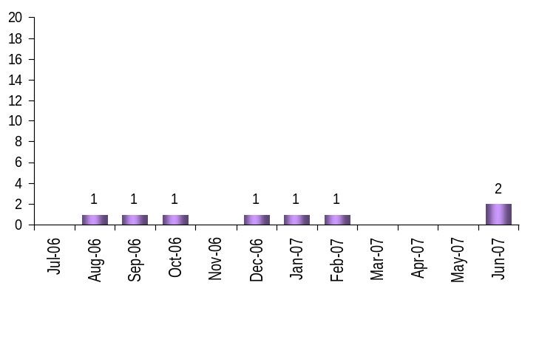
Reinforce Performance
Outcomes:
Employees know how their performance contributes to the goals of the organization. Strong performance is rewarded; poor performance is eliminated. Successful performance is differentiated and strengthened. Employees are held accountable.
Performance Measures
Percent employees with current performance evaluations
Employee survey ratings on “performance and accountability” questions
Disciplinary actions and reasons, disciplinary grievances/appeals filed and disposition (outcomes)
Reward and recognition practices (TBD)
Disciplinary Grievances and Appeals
Disciplinary Grievances
(Represented Employees)
Disciplinary Appeals
(Non-Represented Employees
filed with Personnel Resources Board)
Time Period = July 2006 through June 2007
0 Dismissal
0 Demotion
0 Suspension
0 Reduction in salary
0 Total Disciplinary Appeals Filed with PRB
Total # Disciplinary Grievances Filed: 8
There is no one-to-one correlation between the filings shown above and the outcomes displayed in the charts below. The time lag between filing date and when a decision is rendered can cross the time periods indicated.
Disposition (Outcomes) of Disciplinary Grievances
Time period = July 2006 through June 2007
1 Arbitration Outcome Denied & Dismissed
3 Settled without Arbitration
1 Withdrawn
3 In Process
  1 Going to Arbitration
  1 Going to Pre-Arbitration
  1 At Agency Level
Disposition (Outcomes) of Disciplinary Appeals*
Time period = July 2006 through June 2007
There were no Disciplinary Appeal outcomes in the period from July 2006 through June 2007
*Outcomes issued by Personnel Resources Board
Data as of 9/21/2007
Source: Internal Tracking

Slide 21
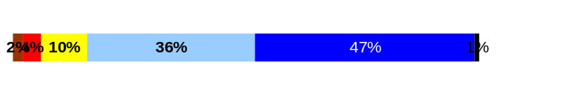
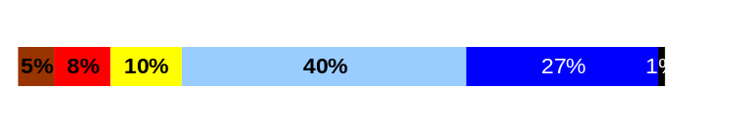
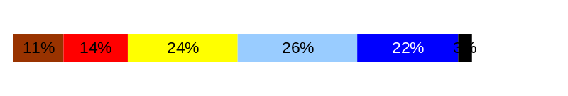
ULTIMATE OUTCOMES
Employees are committed to the work they do and the goals of the organization
Successful, productive employees are retained
The state has the workforce breadth and depth needed for present and future success
Performance Measures
Employee survey ratings on “commitment” questions
Turnover rates and types
Turnover rate: key occupational categories
Workforce diversity profile
Retention measure (TBD)
Employee Survey “Employee Commitment” Ratings
Avg
Analysis:
Survey data indicates that ESD employees rate higher than the statewide average in the category of Employee Commitment.
ESD collected data from additional questions during this survey with several having a employee commitment theme.
Employee responses that were closely related to employee commitment suggested that employees; feel that they provide a service or product that made a difference for the customer but were unsure of the value of GMAP. They also felt that they were not rewarded for merit.
Action Steps:
Agency Senior Leaders were tasked to identify specific actions that will communicate processes and clarify the operational linkages to the strategic plan by July 2007.
Agency management participates in reverse GMAP sessions where staff can question leadership.
The Human Resource Service Division is developing options to address the agency recognition program.
Q3. I know how my work contributes to the goals of my agency.
Q12. I know how my agency measures its success.
Q9. I receive recognition for a job well done.
3.8
4.2
3.4
Never
Seldom
Occasionally
Usually
Always
Overall average score for Employee Commitment ratings: 3.8
This data is from the April 2006 Employee Survey and the agency has already implemented action steps in response to survey information. The next survey will occur at the end of 2007
.
Data as of April 2007
Source: Dept of Personnel 2006 Employee Survey

Slide 22
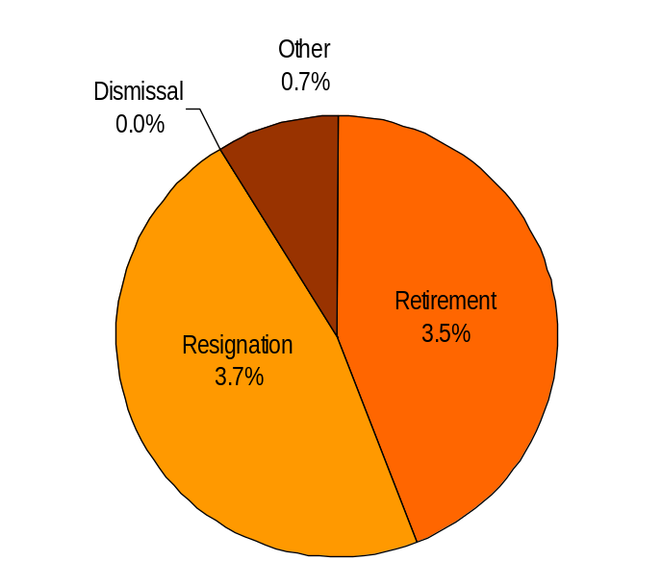
ULTIMATE OUTCOMES
Employees are committed to the work they do and the goals of the organization
Successful, productive employees are retained
The state has the workforce breadth and depth needed for present and future success
Performance Measures
Employee survey ratings on “commitment” questions
Turnover rates and types
Turnover rate: key occupational categories
Workforce diversity profile
Retention measure (TBD)
Turnover Rates
Total % Turnover (leaving state)
Time Period: July 2006 through June 2007
Analysis:
Long time ESD employees are retiring at a faster rate with the bulk of retirements occurring in June and December of every year. Most significant number of retirements in FY07 occurred in December 2006. 12 of 15 separations were due to retirement.
Agency implemented a layoff action in October of 2006, Many of the resignations that occurred from July through September were a result of the impending layoff action. Frequent layoff actions have an impact on the agency’s ability to recruit and retain staff.
Action Steps:
The Budget, Policy and Communications Division is piloting efforts to improve efficiencies and programmatic focus to alleviate effects of reduced funding.
The Human Resource Services Division is focusing on recruitment issues to address recruitment and retention of qualified workers.
Total Turnover Actions: 128
Total % Turnover: 7.8%
Note: Movement to another agency is currently not available in HRMS/BW
In addition to the turnover information listed above:
49 employees left ESD to go to other State Agencies. This changes the turnover figures as follows:
Total Turnover Actions: 177
Total % Turnover: 10.8%
Data as of 9/25/2007
Source: HRMS Business Warehouse

Slide 23
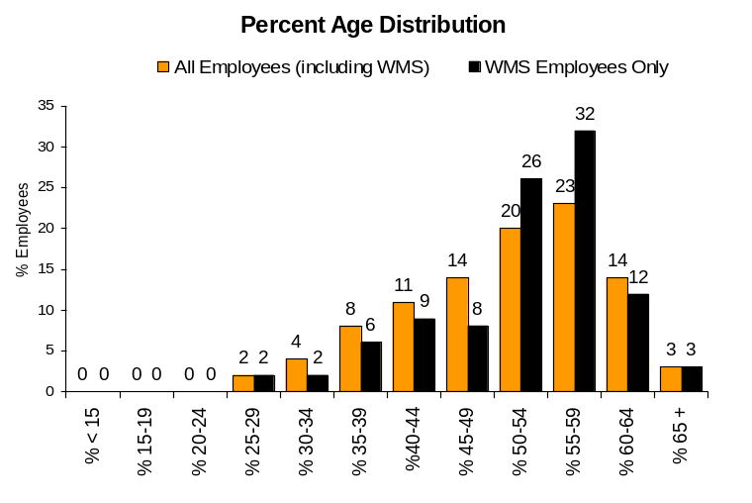
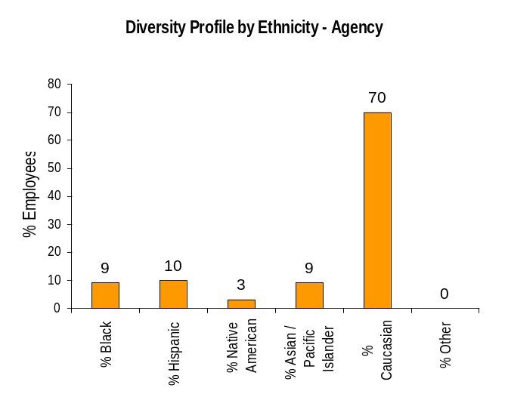
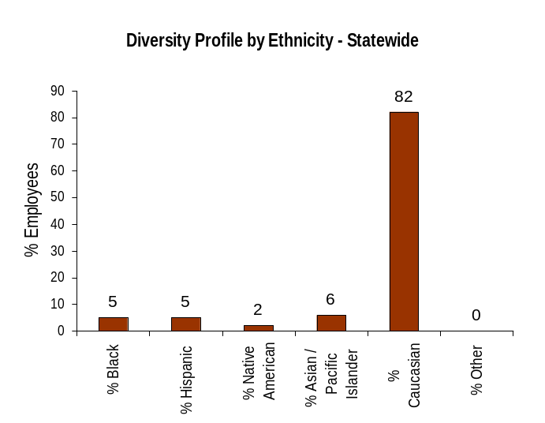
ULTIMATE OUTCOMES
Employees are committed to the work they do and the goals of the organization
Successful, productive employees are retained
The state has the workforce breadth and depth needed for present and future success
Performance Measures
Employee survey ratings on “commitment” questions
Turnover rates and types
Turnover rate: key occupational categories
Workforce diversity profile
Retention measure (TBD)
Workforce Diversity Profile
Agency State
Female 64% 53%
Disabled 6% 5%
Vietnam Vet 11% 7%
Disabled Vet 6% 2%
People of color 30% 18%
Persons over 40 86% 75%
Analysis:
Agency continues to reflect a diverse workforce that is above the statewide profile. The same levels of diversity have been reflected in the agency permanent workforce for over ten years.
Age distribution data reflects the depth of the aging problem that ESD will face in the future. This data is also reflective of the number of retirements shown in the turnover statistics.
Action Steps:
Maintain diversity through management awareness and continued program monitoring.
Agency management will need to determine agency capacity for succession planning.
Data as of 9/5/07
Source: HRMS Business Warehouse

