Slide 1
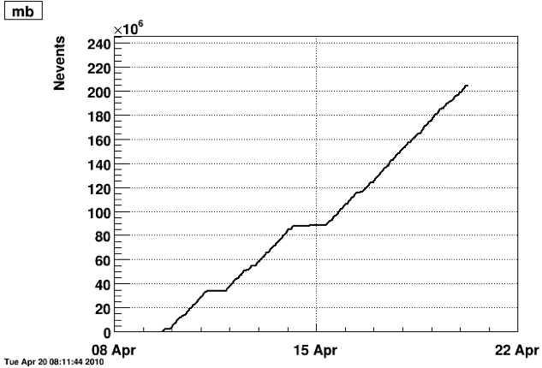
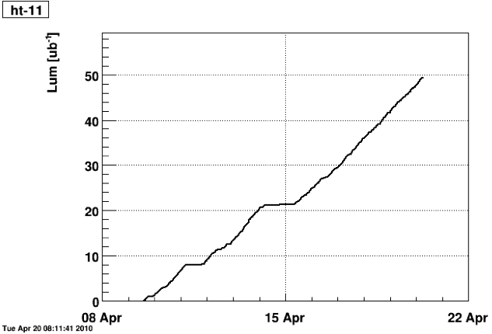
STAR Run 10 - Au+Au 39 GeV Status: As of 8am April 20th
Minimum bias
Bare HT trigger
E_{T}>2.6 GeV
205M
49 μb⁻¹
April 12-18: 100 hrs of production DAQ running!
Subsystems are running smoothly (Issue: Magnet trip yesterday)
Getting ready for energy change on Thursday. Testing triggers and configurations now in preparation for upcoming 7.7 GeV run.

