Slide 1
State of Washington
Office of the Attorney General
Human Resource
Management Report
Plan & Align Workforce
Hire Workforce
Deploy Workforce
Reinforce Performance
Develop Workforce
Prepared for:
Honorable Rob McKenna
Attorney General
By:
Reneé Zirkle
Human Resources Operations Manager
October 2007

Slide 2
Managers’ Logic Model for Workforce Management
Office of the Attorney General
Outputs
Initial Outcomes
Intermediate Outcomes
Plan & Align Workforce
Articulation of managers HRM accountabilities. HR policies. Workforce planning. Job classes & salaries assigned.
Managers understand HRM accountabilities. Jobs, staffing levels, & competencies aligned with agency priorities.
Foundation is in place to build and sustain a productive, high performing workforce.
Hire
Workforce
Qualified candidate pools, interviews & reference checks. Job offers. Appts & per-
formance monitoring.
Best candidate hired & reviewed during appointment period. Successful performers retained.
The right people are in the right job at the right time.
Ultimate Outcomes
Employees are committed to the work they do & the goals of the organization
Productive, successful employees are retained
State has workforce depth & breadth needed for present and future success
Deploy
Workforce
Work assignments& requirements defined. Positive workplace environment created. Coaching, feedback, corrections.
Workplace is safe, gives capacity to perform, & fosters productive relations. Staff know job rqmts, how they’re doing, & are supported.
Time & talent is used effectively. Employees are motivated & productive.
Develop Workforce
Individual development plans. Time/ resources for training. Continuous learning environment created.
Learning environment created. Employees are engaged in develop-
ment opportunities & seek to learn.
Employees have competencies for present job & career advancement
Agencies are better enabled to successfully carry out their mission. The citizens receive efficient government services.
Reinforce Performance
Clear performance expectations linked to orgn’al goals & measures. Regular performance appraisals. Recognition. Discipline.
Employees know how performance contributes to success of orgn. Strong performance rewarded; poor performance eliminated
Successful perf is differentiated & strengthened. Employees are held accountable.

Slide 3
Standard Performance Measures
Office of the Attorney General
Plan & Align Workforce
Percent supervisors with current performance expectations for workforce management
Management profile
Workforce planning measure (TBD)
Percent employees with current position/competencies descriptions
Time-to-fill funded vacancies
Candidate quality
Hiring Balance (Proportion of appointment types)
Separation during review period
Percent employees with current performance expectations
Employee survey ratings on “productive workplace” questions
Overtime usage
Sick leave usage
Non-disciplinary grievances/appeals filed and disposition (outcomes)
Worker safety
Percent employees with current individual development plans
Employee survey ratings on “learning & development” questions
Competency gap analysis (TBD)
Percent employees with current performance evaluations
Employee survey ratings on “performance & accountability” questions
Disciplinary actions and reasons, disciplinary grievances/appeals filed and disposition (outcomes)
Reward and recognition practices (TBD)
Ultimate Outcomes
Hire
Workforce
Employee survey ratings on “commitment” questions
Turnover rates and types
Turnover rate: key occupational categories
Workforce diversity profile
Retention measure (TBD)
Deploy
Workforce
Develop Workforce
Reinforce Performance

Slide 4
Plan & Align Workforce
Outcomes:
Managers understand workforce management accountabilities. Jobs and competencies are defined and aligned with business priorities. Overall foundation is in place to build & sustain a high performing workforce.
Performance Measures:
Percent supervisors with current performance expectations for workforce management
Management profile
Workforce Planning measure (TBD)
Percent employees with current position/ competency descriptions
Office of the Attorney General
Workforce Management Expectations
Percent supervisors with current performance expectations for workforce management = 100%
Analysis:
Number of supervisory positions increased by 50 due to the implementation for processing the entry of these relationships into HRMS.
All supervisors were trained in the PDP process.
All Division Management receive quarterly Affirmative Action Goal Updates.
All supervisor’s PDPs incorporate good management practices and evaluation expectations.
The AGO provides opportunities for all new supervisors to attend supervisory training and provides mid management training for all managers.
Action Steps:
Continue providing targeted management training.
Ensure new supervisors attend required supervisory training.
Total # of supervisors with current performance expectations for workforce management = 274
Total # of supervisors = 274
Data as of December 2007
Source: HRMS Business Warehouse

Slide 5
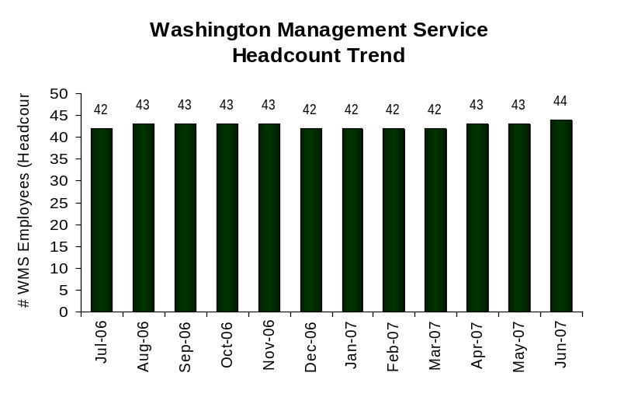
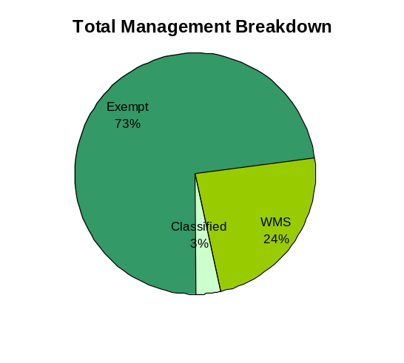
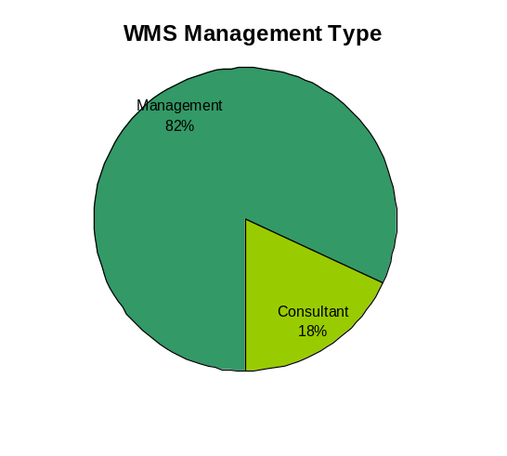
Plan & Align Workforce
Outcomes:
Managers understand workforce management accountabilities. Jobs and competencies are defined and aligned with business priorities. Overall foundation is in place to build & sustain a high performing workforce.
Performance Measures:
Percent supervisors with current performance expectations for workforce management
Management profile
Workforce Planning measure (TBD)
Percent employees with current position/ competency descriptions
Office of the Attorney General
Management Profile
WMS Employees Headcount = 44
Percent of agency workforce that is WMS = 3.3%
Managers* Headcount = 150
Percent of agency workforce that is Managers* = 11.4%
* In positions coded as “Manager” (includes EMS, WMS, and GS)
Analysis:
Our manager count has been reduced by 3 since last reporting period.
In addition to WMS managers, the AGO has exempt mid-level managers (Section Chiefs and Team Leaders) who manage the various regional offices or teams and programs within divisions.
Given that the AGO has 65 divisions in 13 geographic locations, the number of managers is appropriate.
Action Steps:
Continue looking at mid-manager positions that could be cut or moved into non-manager positions.
Exempt 109
WMS 36
Classified 5
Manager 36
Consultant 8
Data as of June 2007
Source: HRMS Business Warehouse

Slide 6
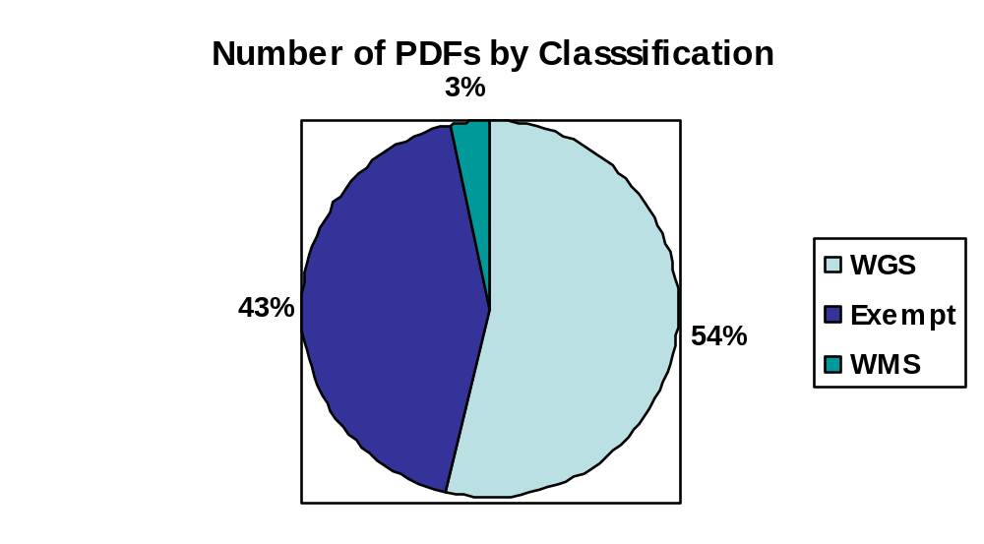
Plan & Align Workforce
Outcomes:
Managers understand workforce management accountabilities. Jobs and competencies are defined and aligned with business priorities. Overall foundation is in place to build & sustain a high performing workforce.
Performance Measures:
Percent supervisors with current performance expectations for workforce management
Management profile
Workforce Planning measure (TBD)
Percent employees with current position/ competency descriptions
Office of the Attorney General
Current Position/Competency Descriptions
Percent employees with current position/competency descriptions = 99%
Analysis:
Since the last reporting period, we have received 31 of the 46 outstanding PDFs.
Action Steps:
We will continue to monitor outstanding PDFs and encourage completion and or update during performance reviews.
All PDFs are being reviewed annually during the evaluation process or when filling a vacancy.
Total # of positions with current position/competency descriptions* = 1288
Total # of positions* = 1303
*Applies to employees in permanent positions.
Data as of June 2007
Source: Internal Log

Slide 7
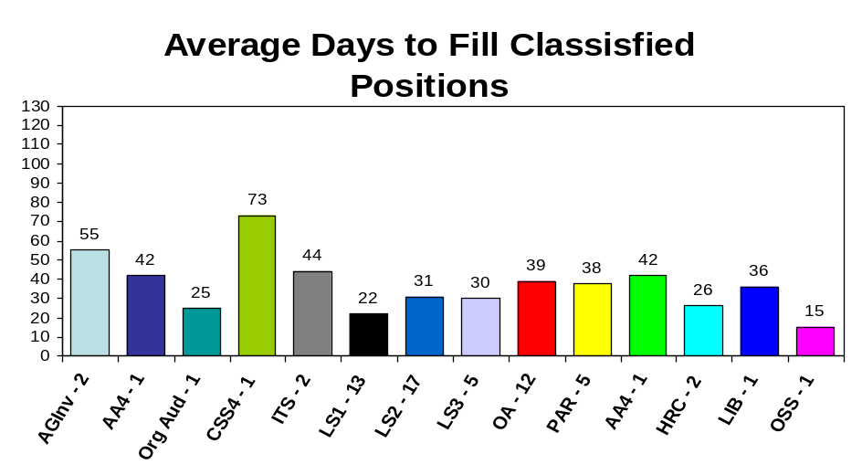
Hire Workforce
Outcomes:
Best candidates are hired and reviewed during appointment period. The right people are in the right job at the right time.
Performance Measures
Time-to-fill vacancies
Candidate quality
Hiring Balance (proportion of appointment types)
Separation during review period
Office of the Attorney General
Time-to-fill / Candidate Quality
Time-to-fill Funded Vacancies
Average number of days to fill*: 34
Number of vacancies filled: 64
*Equals # of days from creation of the requisition to job offer acceptance
Time Period: 01/2007 – 06/2007
Analysis:
The average time to fill our vacancies is appropriate for the variety of classifications we hire.
Our longest recruitment period was 73 days for a CSS4 in our Regional Services Division in Vancouver. We don’t find adequate candidate pools in E-Recruiting and have to do additional outsourcing.
Candidate quality information was taken from an in-house survey after positions were filled and is not 100% reflective of all positions filled.
Action Steps:
Continue to get applicant names to hiring supervisors as soon as possible.
Update survey instrument for supervisor feedback on the quality of interviewed candidates to get better data.
Attending more job fairs
Implemented a List Serve for applicants who were interested in position with the Office of the Attorney General.
Updated our external website
Posting jobs on relevant job boards
Candidate Quality
Percent Number
Candidates interviewed who had competencies needed for job
Hiring managers who indicated they could hire best candidate 96.9% 31
Data as of June 2007
Source: DOP Time to Fill Data Report/ Survey Monkey

Slide 8
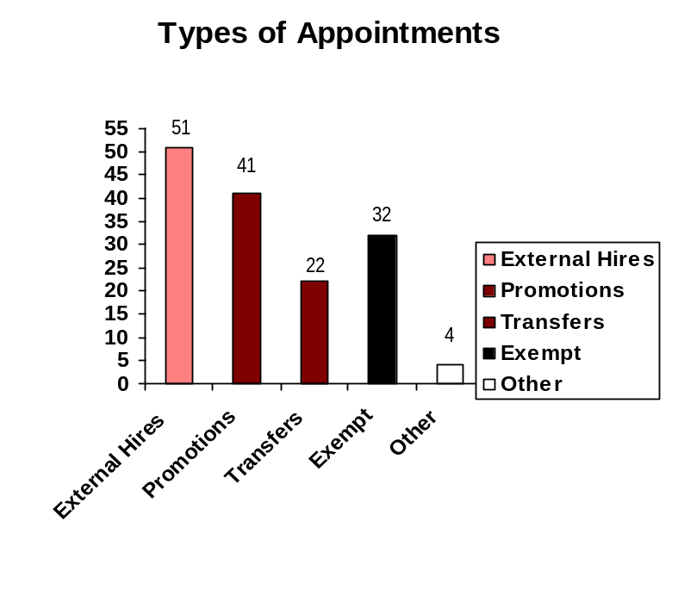
Hire Workforce
Outcomes:
Best candidates are hired and reviewed during appointment period. The right people are in the right job at the right time.
Performance Measures
Time-to-fill vacancies
Candidate quality
Hiring Balance (proportion of appointment types)
Separation during review period
Office of the Attorney General
Hiring Balance / Separations During Review Period
Analysis:
These numbers are significantly higher than last reporting period due to the ability within HRMS to capture Non Permanent to Probationary appointments and the hiring freeze at Go Live in July 2006. Our agency is also able to capture data more consistently since conversion to HRMS.
External Hires – This number includes employees who went from non-permanent status to probationary and employees who transferred or promoted into our agency.
Promotions – Current employees in trial service, including WMS. i.e. completion of in-training, promotion, in-training and reallocation. The AGO requires at least three agency promotional candidates be considered for vacancies. Does not include employees who promoted into our agency.
Transfers – These are AGO staff who transfer from one position to another position with the same salary range.
Exempt – This includes all exempt hires and appointment changes except internal transfers or interns.
The AGO highly encourages transfer between divisions of both exempt and classified staff.
Action Steps:
Continue to develop succession planning.
Continue to encourage promotional and interdivisional transfer opportunities to staff.
Total number of appointments = 150*
Time period = January 2007 through June 2007
Includes appointments to permanent vacant positions only; excludes reassignments
“Other” = Demotions, re-employment, reversion & RIF appointments
Separation During Review Period
Probationary separations – Voluntary 3
Probationary separations – Involuntary 3
  Total Probationary Separations 6
Trial Service separations – Voluntary 1
Trial Service separations – Involuntary 0
  Total Trial Service Separations 1
Total Separations During Review Period 7
Time period = January 2007 through June 2007
Data as of June 2007
Source: HRMS Business Warehouse

Slide 9
Deploy Workforce
Outcomes:
Staff know job expectations, how they’re doing, & are supported. Workplace is safe, gives capacity to perform, & fosters productive relations. Employee time and talent is used effectively. Employees are motivated.
Performance Measures
Percent employees with current performance expectations
Employee survey ratings on “productive workplace” questions
Overtime usage
Sick leave usage
Non-disciplinary grievances/appeals filed and disposition (outcomes)
Worker safety
Office of the Attorney General
Current Performance Expectations
Percent employees with current performance expectations = 100%*
Analysis:
It has always been a high priority of this agency for every employee to have an annual performance review and a performance plan. With the agency receiving Performance Confirmation from the Department of Personnel, it was even more important that we have 100% participation for all staff. Because it has been such a high priority, the agency has reached it’s goal of 100% participation and the agency has received Performance Confirmation from DOP.
These number are from our last PDP cycle, which were due 12/01/06. We will not have new numbers until the next reporting cycle.
Action Steps:
Continue to stress the importance and benefits of a high performance expectation system.
Continue to promote the performance recognition program.
Continue to provide training for management and employees on the PDP process.
Ensure all new employees have a performance plan within 30 days of hire.
Total # of employees with current performance expectations = 1067
Total # of employees = 1290 (This number includes non-permanent employees who are not eligible for performance awards)
Data as of December 2006
Source: Agency evaluation tracking system

Slide 10
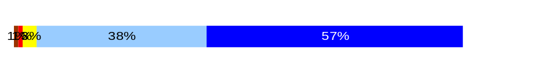
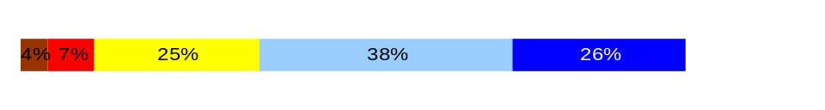
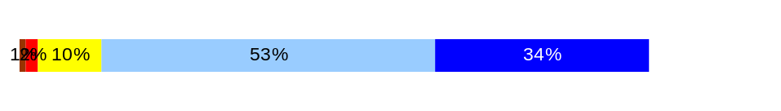
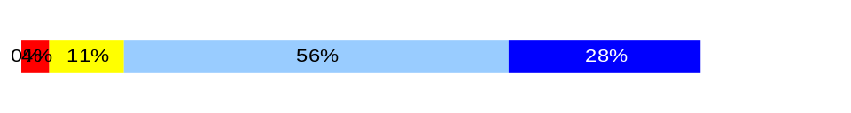
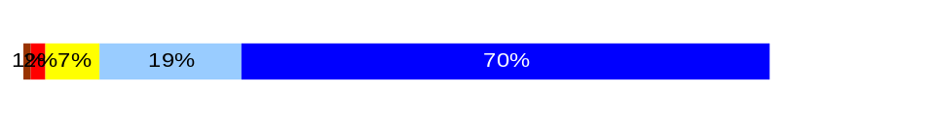
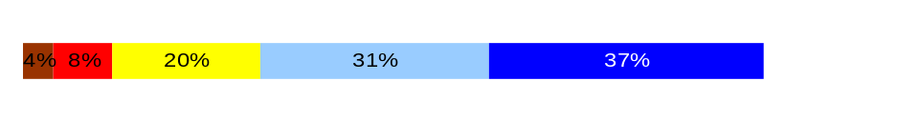
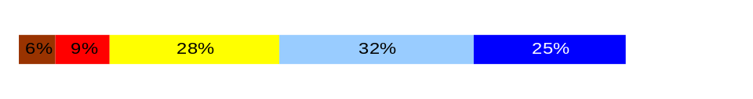
Deploy Workforce
Outcomes:
Staff know job expectations, how they’re doing, & are supported. Workplace is safe, gives capacity to perform, & fosters productive relations. Employee time and talent is used effectively. Employees are motivated.
Performance Measures
Percent employees with current performance expectations
Employee survey ratings on “productive workplace” questions
Overtime usage
Sick leave usage
Non-disciplinary grievances/appeals filed and disposition (outcomes)
Safety and Workers Compensation (TBD)
Office of the Attorney General
Employee Survey “Productive Workplace” Ratings
Q4. I know what is expected of me at work.
Q1. I have opportunity to give input on decisions affecting my work.
Q2. I receive the information I need to do my job effectively.
Q6. I have the tools and resources I need to do my job effectively.
Q7. My supervisor treats me with dignity and respect.
Q8. My supervisor gives me ongoing feedback that helps me
improve my performance.
Q9. I receive recognition for a job well done.
Avg
Analysis:
The AGO will be participating in the 2007 employee survey through the Department of Personnel at the request of the Governor’s Office. The finding will be reported during the next reporting period.
This information is from a survey done by the agency through DOP in Spring of 2006. Another survey will be done before the Fall 2007 HR Management Report.
811 staff, approximately 76% of our employees responded to the survey.
We feel that our staff know what is expected of them because of our emphasis on performance expectations and management.
Through our performance management program, we feel that we will find these numbers going up.
Action Steps:
Continue to emphasize good management practices by encouraging interim reviews during evaluation period and open communication with staff.
Continue use of 360 degree feedback in the evaluation process.
Continue to improve our performance recognition program.
4.5
3.7
4.2
4.1
4.5
3.9
3.6
Never
Seldom
Occasionally
Usually
Always
On a scale from 1-5 our overall average score for Productive Workplace Ratings: 4.1
Data as of Spring 2006
Source: DOP Survey

Slide 11
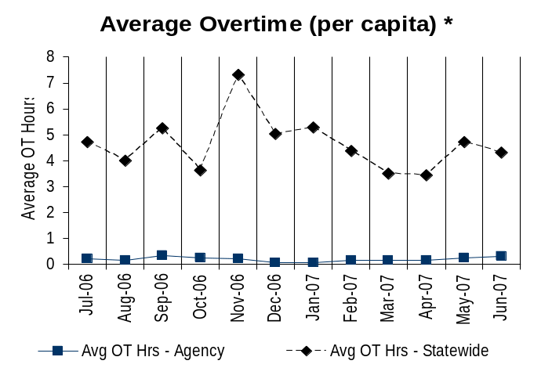
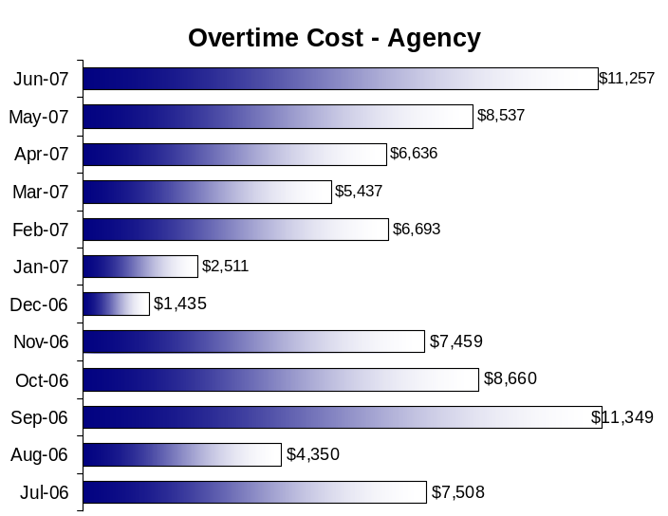
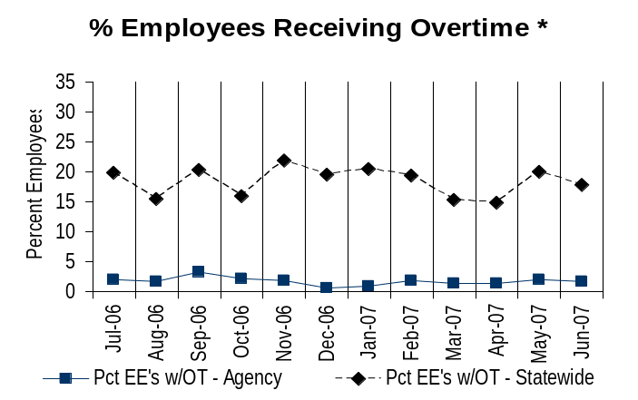
Deploy Workforce
Outcomes:
Staff know job expectations, how they’re doing, & are supported. Workplace is safe, gives capacity to perform, & fosters productive relations. Employee time and talent is used effectively. Employees are motivated.
Performance Measures
Percent employees with current performance expectations
Employee survey ratings on “productive workplace” questions
Overtime usage
Sick leave usage
Non-disciplinary grievances/appeals filed and disposition (outcomes)
Worker safety
Office of the Attorney General
Overtime Usage
Overall agency avg overtime usage – per capita, per month: [XXX]**
*Statewide overtime values do not include DNR
**Overall agency avg overtime usage – per capita, per month = sum of monthly OT averages divided by number of months
Analysis:
We feel our overtime costs are well within the acceptable range.
More than 50% of our staff are exempt and not eligible for overtime.
The Office of the Attorney General is far below the Statewide Average for overtime.
Action Steps:
Continue to monitor use of overtime.
Overall agency avg employees receiving overtime per month: [XXX]%**
*Statewide overtime values do not include DNR
**Overall agency avg employees receiving overtime per month = sum of monthly OT percentages divided by number of months
Data as of June 2007
Source: HRMS Business Warehouse

Slide 12
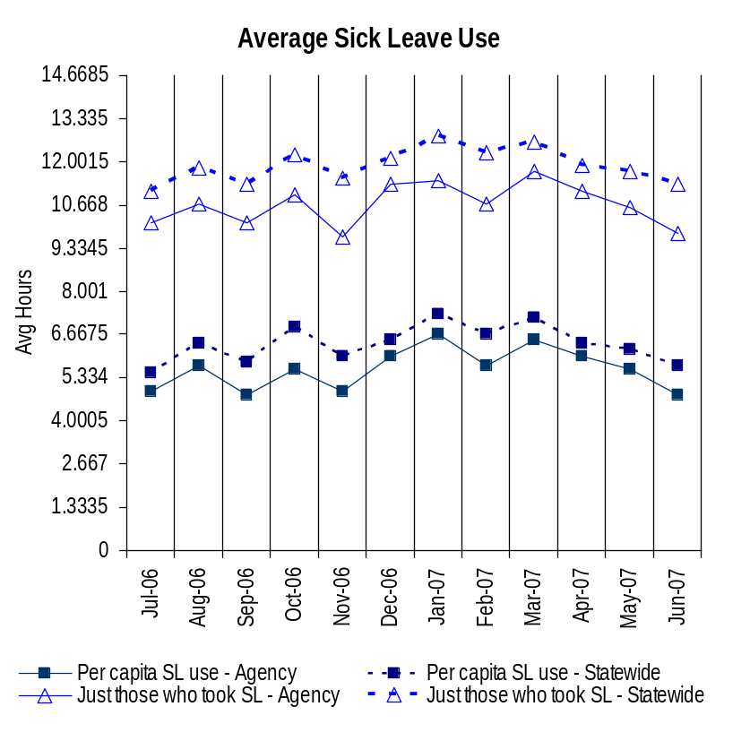
Deploy Workforce
Outcomes:
Staff know job expectations, how they’re doing, & are supported. Workplace is safe, gives capacity to perform, & fosters productive relations. Employee time and talent is used effectively. Employees are motivated.
Performance Measures
Percent employees with current performance expectations
Employee survey ratings on “productive workplace” questions
Overtime usage
Sick leave usage
Non-disciplinary grievances/appeals filed and disposition (outcomes)
Worker safety
Office of the Attorney General
Sick Leave Usage
Analysis:
On average the AGO sick leave usage is 10% below the Statewide average.
Action Steps:
Will continue utilizing Flexible Work Schedules to keep the use of Sick Leave down.
Continue to encourage individual and group wellness activities throughout the office.
Sick Leave Hrs Used / Earned (per capita)
Avg Hrs SL Used (per capita) - Agency | % of SL Hrs Earned (per capita) - Agency
5.6 Hrs | 72.3%
Avg Hrs SL Used (per capita) – Statewide* | % of SL Hrs Earned (per capita) – Statewide*
6.4 Hrs | 82.5%
Sick Leave Hrs Used / Earned (those who took SL)
Avg Hrs SL Used (those who took SL) - Agency | % SL Hrs Earned (those who took SL) - Agency
10.7 Hrs | 133.6%
Avg Hrs SL Used (those who took SL) – Statewide* | % SL Hrs Earned (those who took SL) – Statewide*
11.9 Hrs | 148.4%
Sick Leave time period = January 2007 through June 2007
* Statewide data does not include DOL, DOR, L&I, and LCB
* Statewide data does not include DOL, DOR. L&I, and LCB
Data Source: DOP Pivot Table

Slide 13
Deploy Workforce
Outcomes:
Staff know job expectations, how they’re doing, & are supported. Workplace is safe, gives capacity to perform, & fosters productive relations. Employee time and talent is used effectively. Employees are motivated.
Performance Measures
Percent employees with current performance expectations
Employee survey ratings on “productive workplace” questions
Overtime usage
Sick leave usage
Non-disciplinary grievances/appeals filed and disposition (outcomes)
Worker safety
Office of the Attorney General
Non-Disciplinary Appeals (mostly non-represented employees)
Filings for DOP Director’s Review
Time Period = January 2007 through June 2007
0 Job classification
0 Rule violation
0 Name removal from register
0 Rejection of job application
0 Remedial action
0 Total filings
Filings with Personnel Resources Board
Time Period = January 2007 through June 2007
0 Job classification
0 Other exceptions to Director Review
0 Layoff
0 Disability separation
0 Non-Disciplinary separation
0 Total filings
Job classification appeal from last reporting period has been resolved internally.
Source: Data as of June 2007
Source: Agency tracked data

Slide 14
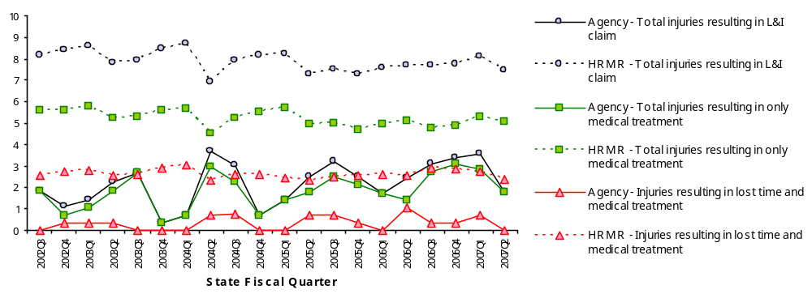
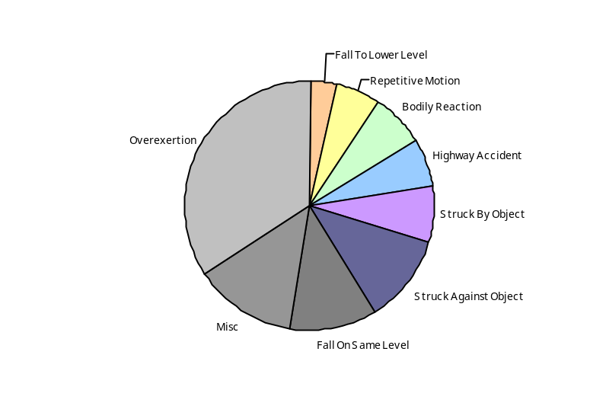
Deploy Workforce
Outcomes
Staff know job expectations, how they’re doing, & are supported. Workplace is safe, gives capacity to perform, & fosters productive relations. Employee time and talent is used effectively. Employees are motivated.
Performance Measures
Percent employees with current performance expectations
Employee survey ratings on 'productive workplace' questions
Overtime usage
Sick leave usage
Non-disciplinary grievances/appeals filed and disposition outcomes
Worker Safety
Worker Safety: Attorney General, Office of the
Analysis:
Agency below statewide average for injuries/illnesses
First Quarter reflects repetitive trauma & unsafe actions of staff when moving items w/o using available equipment to assist them. All instances involve loss days and medical treatment.
Second Quarter less days lost reported.
Action Plan:
Agency online ergo education initial self assessment awareness.
Active agency Wellness Program.
Mandatory agency defensive driving education. Anyone with two vehicle accidents must repeat training.
Lifting standards identified.
Allowed Annual
Claims Rate*^:
Agency vs. All HR
Management Report
(HRMR) agencies
*Annual claims rate
is # claims / 100 FTE
1 FTE = 2000 hours
^Due to natural lag
in claim filing, rates
are expected to
increase significantly
over time
Injuries by Occupational
Injury and Illness
Classification (OIICS)
event:
For fiscal period 2002Q3
through 2007Q2
(categories under 3% or not
adequately coded are grouped
into 'misc.')
Oiics Code | Oiics Description | Percent | Number
21 | Bodily Reaction | 7% | 8
13 | Fall On Same Level | 12% | 14
11 | Fall To Lower Level | 3% | 4
41 | Highway Accident | 7% | 8
- | Misc | 13% | 16
22 | Overexertion | 34% | 41
23 | Repetitive Motion | 6% | 7
01 | Struck Against Object | 12% | 14
02 | Struck By Object | 7% | 9
Source: Labor & Industries, Research and Data Services (data as of 09/03/2007 )
Notes:
HRMR Safety Report Overview
The HRMR Safety Reports are:
- PowerPoint slides created by the Department of Labor and Industries
- Created for each state agency that is reporting their employee safety program results bi-
annually as part of their Human Resources Management Report (HRMR).
- Snapshots of five years of worker’s compensation claim data specific to that agency, as
well as a comparison to the combined data for agencies completing HRMR reports.
- There is a two quarter lag at the end of the five years.
This allows each agency’s payroll data to be entered into L&I’s computer system. This
payroll data is used to compute the number of workers per agency and quarter.
Definitions
Claim – When a covered worker sustains an occupational injury or illness, that worker files a
'claim’ for benefits. A 'claim number' is assigned, and all wage replacement payments, medical
provider bills, etc, for that worker and injury, are associated with that claim number.
Report Detail
'Allowed Annual Claim Rate'
This chart shows your agency's rate of injuries resulting in allowed
claims, by injury quarter, for on-the-job injuries and occupational illnesses. The rate for all
reporting agencies is shown for comparison.
- The rate is the number accepted claims per 200,000 annual worker hours (100 workers)
Three rates are included in this chart:
A)The total rate for all injuries resulting in a claim; the two groups listed below are
exclusive of each other.
B)The rate of injuries which required medical care, but no compensation for lost
time.
C)The rate of injuries which resulted in compensation for lost time in addition to
medical care.
'Injuries by Occupational Injury and Illness Classification (OIICS) Event’
This section contains a pie chart which shows your agency's injuries by type* and a table which
shows the percent and number of accepted claims by OIICS Event description and code.
This information is useful in identifying what causes injuries so prevention can occur. Prevention
might include root cause analysis, education, and hazard mitigation.
* Injury Type is based on the 2 digit Major Group code of the Event or Exposure section of the Occupational
Injury and Illness Classification System (OIICS). Groups with less than 3% of the
total injuries are combined into the 'Misc' category.
How to get this report for your agency:
All worker compensation reports will be available on the L&I website by the 20th of September or
the 20th of March of each year. The data will be provided in a PowerPoint slide to which you will
add your own analyses and action plans.

Slide 15
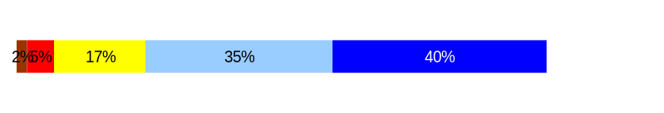
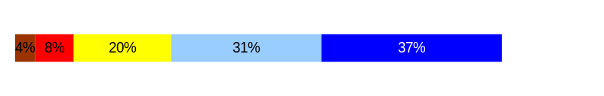
Develop Workforce
Outcomes:
A learning environment is created. Employees are engaged in professional development and seek to learn. Employees have competencies needed for present job and future advancement.
Performance Measures
Percent employees with current individual development plans
Employee survey ratings on “learning & development” questions
Competency gap analysis (TBD)
Office of the Attorney General
Individual Development Plans
Percent employees with current individual development plans = 100%
Analysis:
The AGO will be participating in the 2007 employee survey through the Department of Personnel at the request of the Governor’s Office. The finding will be reported during the next reporting period.
Individual training plans are found in many different places including the following:
  Part 2 of the PDP
  New Employee Orientation
  In-Training Plans
  corrective action / counseling
  Mandatory agency trainings – attendance is tracked.
  These number are from our last PDP cycle, which were due 12/01/06. We will not have new numbers until the next reporting cycle.
Action Steps:
Continue to make PDP training mandatory for supervisors and managers and emphasize importance of completing part 2 of plan.
Encourage supervisors to create individual development plans for employees when there are deficiencies.
Total # of employees with current IDPs = 1067
(This includes all permanent WMS, GS and exempt staff)
Total # of employees = 1290
(This includes all permanent WMS, GS, exempt and non-permanent staff)
Employee Survey “Learning & Development” Ratings
Q5. I have opportunities at work to learn and grow.
Q8. My supervisor gives me ongoing feedback that helps me
improve my performance.
Avg
4.1
3.9
Overall avg score for Learning & Development Ratings: 4.0
Data as of Spring 2006
Source: DOP Survey

Slide 16
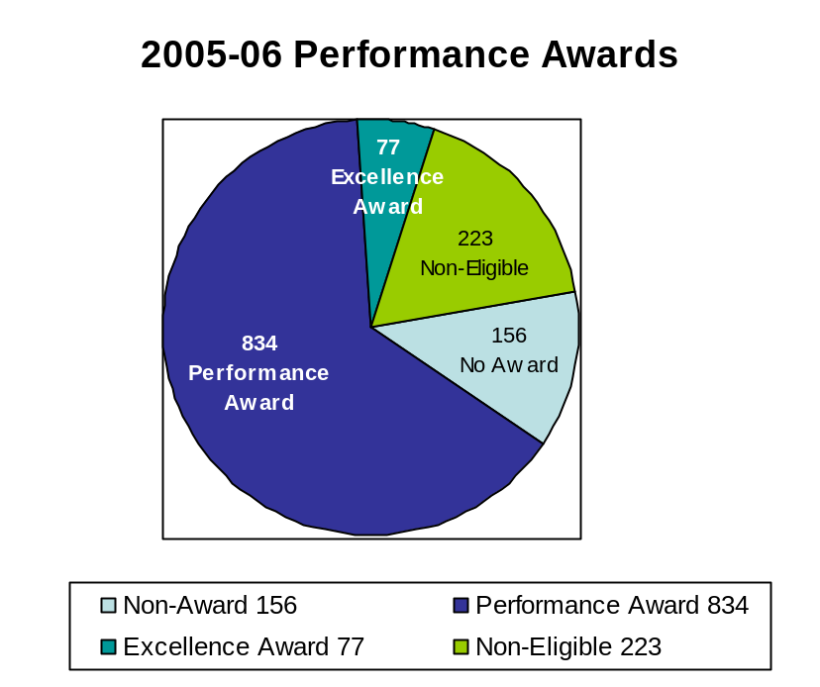
Reinforce Performance
Outcomes:
Employees know how their performance contributes to the goals of the organization. Strong performance is rewarded; poor performance is eliminated. Successful performance is differentiated and strengthened. Employees are held accountable.
Performance Measures
Percent employees with current performance evaluations
Employee survey ratings on “performance and accountability” questions
Disciplinary actions and reasons, disciplinary grievances/appeals filed and disposition (outcomes)
Reward and recognition practices (TBD)
Office of the Attorney General
Current Performance Evaluations
Percent employees with current performance evaluations = 100%
Analysis:
Supervisors are encouraged to have regular and on-going reviews with staff about their progress toward their goals.
Approximately 70% of AGO employees received some form of performance recognition award. We believe that this is an indication that the AGO is a high- performing organization.
These number are from our last PDP cycle, which were due 12/01/06. We will not have new numbers until the next reporting cycle.
Action Steps:
Continue to promote the PDP process within the agency.
Ensure all new employees have a performance plan within 30 days of hire.
Survey all employees regarding performance recognition program and consider suggestions for program improvement.
Total # of employees with current performance evaluations* = 1067
Total # of employees* = 1290
*Applies to employees in permanent positions, both WMS & GS
Data as of December 2006
Source: Agency evaluation tracking system

Slide 17
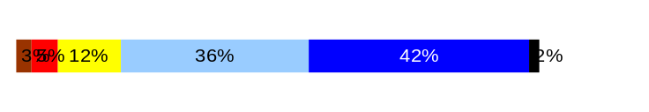
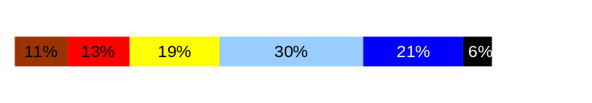
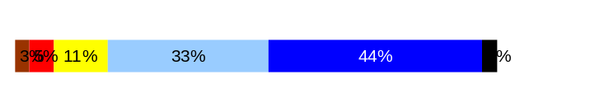
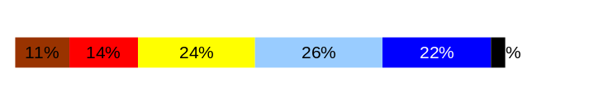
Reinforce Performance
Outcomes:
Employees know how their performance contributes to the goals of the organization. Strong performance is rewarded; poor performance is eliminated. Successful performance is differentiated and strengthened. Employees are held accountable.
Performance Measures
Percent employees with current performance evaluations
Employee survey ratings on “performance and accountability” questions
Disciplinary actions and reasons, disciplinary grievances/appeals filed and disposition (outcomes)
Reward and recognition practices (TBD)
Office of the Attorney General
Employee Survey “Performance & Accountability” Ratings
Avg
Analysis:
The AGO will be participating in the 2007 employee survey through the Department of Personnel at the request of the Governor’s Office. The finding will be reported during the next reporting period.
We feel our performance management program has been a success. We expect that our ratings on these questions will go up over time as we continue to foster a performance-based culture.
Action Steps:
Continue AGO’s peer driven Employee Recognition Program.
Continue to develop creative recognition strategies on a divisional basis.
Continue performance recognition program recognizing staff for a job well done.
Expand the performance management program by raising the reward amount.
Q3. I know how my work contributes to the goals of my agency.
Q10. My performance evaluation provides me with meaningful information about my performance.
Q11. My supervisor holds me and my co-workers accountable for performance.
Q9. I receive recognition for a job well done.
4.4
3.6
4.2
3.6
Never
Seldom
Occasionally
Usually
Always
Overall average score for “Performance & Accountability” ratings: 4
Data as of Spring 2006
Source: DOP Survey

Slide 18
Reinforce Performance
Outcomes:
Employees know how their performance contributes to the goals of the organization. Strong performance is rewarded; poor performance is eliminated. Successful performance is differentiated and strengthened. Employees are held accountable.
Performance Measures
Percent employees with current performance evaluations
Employee survey ratings on “performance and accountability” questions
Disciplinary actions and reasons, disciplinary grievances/appeals filed and disposition (outcomes)
Reward and recognition practices (TBD)
Office of the Attorney General
Formal Disciplinary Actions
Disciplinary Action Taken
Time period = January 2007 through June 2007
Analysis:
We only had four formal disciplinary actions during this time period, which we feel is an acceptable amount given the size of our agency.
Action Steps:
Continue to train our managers and supervisors in the just cause corrective and disciplinary process so hopefully behavior or performance can be turned around before we reach discipline.
Dismissals | 2
Demotions | 0
Suspensions | 0
Reduction in Pay* | 2
Total Disciplinary Actions* | 4
* Reduction in Pay is not currently available in HRMS/BW.
Issues Leading to Disciplinary Action
Work performance deficiencies
Inappropriate behavior
Disciplinary Appeals
(Non-Represented Employees
filed with Personnel Resources Board)
Time Period = January 2007 through June 2007
None at this time
Data as of June 2007
Source: HRMS Business Warehouse and Agency Tracked

Slide 19
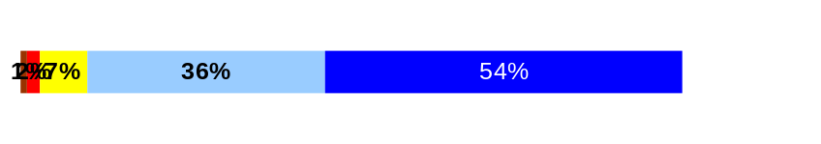
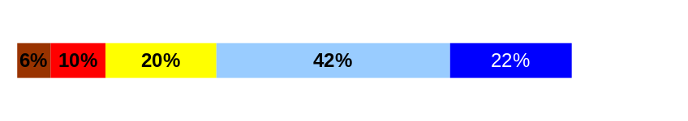
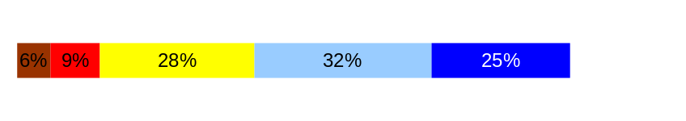
ULTIMATE OUTCOMES
Employees are committed to the work they do and the goals of the organization
Successful, productive employees are retained
The state has the workforce breadth and depth needed for present and future success
Performance Measures
Employee survey ratings on “commitment” questions
Turnover rates and types
Turnover rate: key occupational categories
Workforce diversity profile
Retention measure (TBD)
Office of the Attorney General
Employee Survey “Employee Commitment” Ratings
Avg
Analysis:
The AGO will be participating in the 2007 employee survey through the Department of Personnel at the request of the Governor’s Office. The finding will be reported during the next reporting period.
For several years the AGO has directed managers to provide a link between the work of their employees to the agency or division strategic plan.
Action Steps:
Will develop suggestions for managers in terms of measuring success.
Continue all efforts in recognizing employees on an ongoing basis.
Q3. I know how my work contributes to the goals of my agency.
Q12. I know how my agency measures its success.
Q9. I receive recognition for a job well done.
4.4
3.6
3.6
Never
Seldom
Occasionally
Usually
Always
Overall average score for Employee Commitment ratings: 3.9
Data as of Spring 2006
Source: DOP Survey

Slide 20
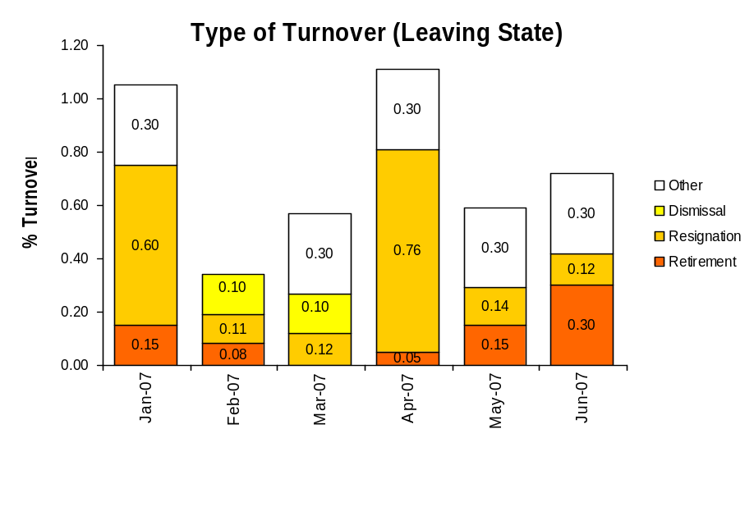
ULTIMATE OUTCOMES
Employees are committed to the work they do and the goals of the organization
Successful, productive employees are retained
The state has the workforce breadth and depth needed for present and future success
Performance Measures
Employee survey ratings on “commitment” questions
Turnover rates and types
Turnover rate: key occupational categories
Workforce diversity profile
Retention measure (TBD)
Office of the Attorney General
Turnover Rates
Analysis:
We believe that our high turnover rate is due in part to our inability to compete with the higher wages that the private sector is able to pay along with shorter work weeks and bonus packages.
This chart does not capture Permanent Employees who left while in a Non- Permanent position or interns.
Action Steps:
We will continue to advocate for higher salaries for our staff.
We will continue to monitor staff morale surveys for ways to increase job satisfaction.
We will continue and expand our performance recognition program.
Employees leaving state service: 65
Employees transferring to another state agency: 12
Total Turnover Actions: 78
Average number of Permanent employees January - June: 1229
Total Percent of Turnover January – June 2007: 5.3%
Total Percent of Turnover with Transfer Out January – June 2007 = 6.3%
Data as of June 2007
Source: HRMS Business Warehouse and Agency Tracking

Slide 21
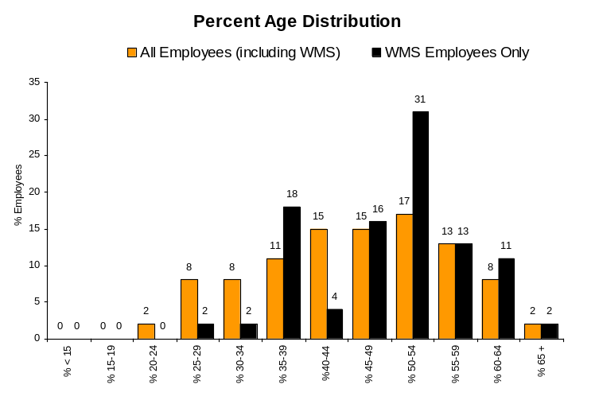
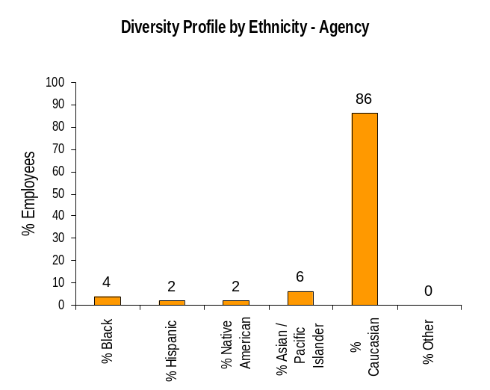
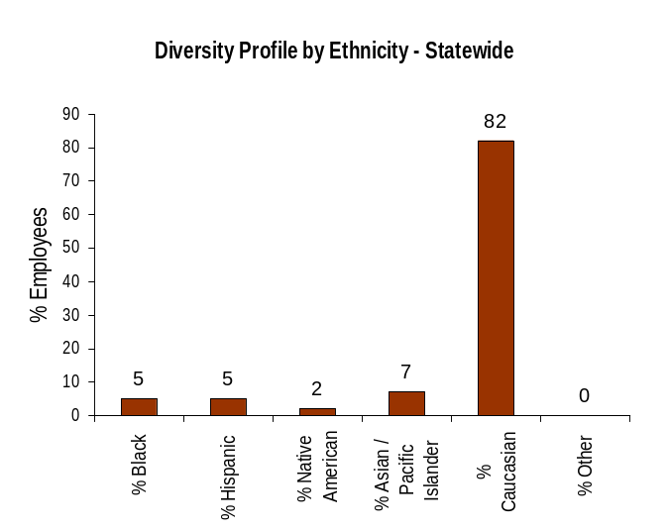
ULTIMATE OUTCOMES
Employees are committed to the work they do and the goals of the organization
Successful, productive employees are retained
The state has the workforce breadth and depth needed for present and future success
Performance Measures
Employee survey ratings on “commitment” questions
Turnover rates and types
Turnover rate: key occupational categories
Workforce diversity profile
Retention measure (TBD)
Office of the Attorney General
Workforce Diversity Profile
Agency State
Female 80% 53%
Disabled 6% 5%
Vietnam Vet 5% 7%
Disabled Vet 2% 2%
People of color 14% 18%
Persons over 40 70% 75%
Analysis:
We believe our numbers are consistent with statewide levels however, we continue to strive to increase our diversity.
Action Steps:
Continue efforts to diversify the Professional job group.
Continue to emphasize employment of persons with disabilities in the Attorney, and Officials and Managers job groups.
Continue in-house training programs.
Continue checking Affirmative Action Update for underrepresented groups when hiring for positions.
Attend more job fairs that focus on the areas of diversity in which we are low.
Continue going to law schools where more diverse candidates are and continue attending diversity fairs.
Data as of June 2007
Source: HRMS Business Warehouse

