Slide 1
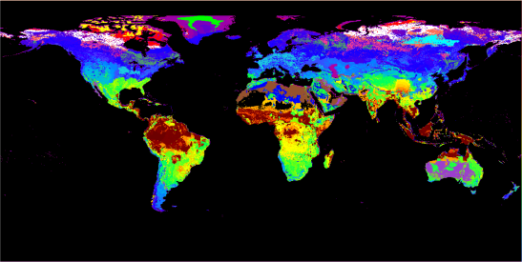
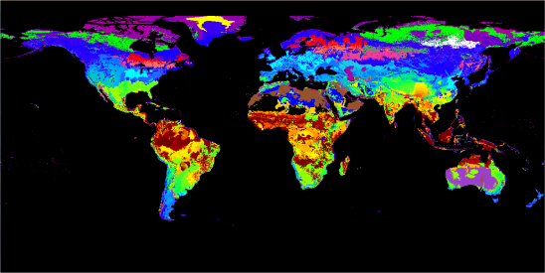
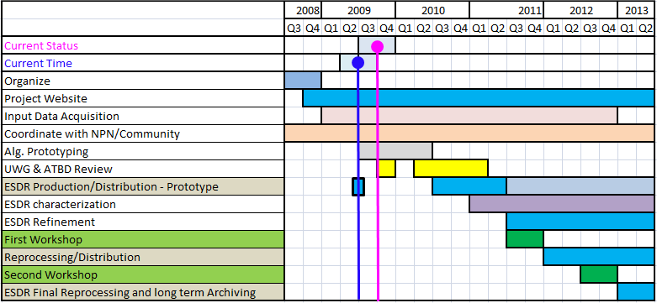
Vegetation Phenology and Vegetation Index Products from Multiple Long Term Satellite Data Records
Kamel Didan/The University of Arizona
August 2009
Goal: Generate a global long term multi sensor Vegetation Index and Land Surface Phenology ESDR measures.
Objectives: Develop science and production algorithms to merge datasets from different global Earth imagers into a well characterized, seamless, and platform independent long term ESDR of Vegetation status and seasonality in support of global change research.
Key Innovations:
  A methodology to address platform dependency of earth datasets, and a solution for data continuity across different platforms & sensors.
  A Vegetation Index continuity algorithm
  Provide the Earth Science Community with the first consistent, long term (30+ yrs) and properly characterized data record of vegetation status and seasonality.
Accomplishments to date:
  2 refereed journal papers, 13 conference abstracts, 2 papers in prep.
  First global cluster maps, similar to the Köppen-Geiger climate classifications.
1992 AVHRR LC based cluster map. Different
colors correspond to the homogeneous areas.
2003 MODIS LC based cluster map. Different
Colors correspond to the homogeneous areas.
Cluster maps are used to drive the Surface Reflectance and VI continuity work. Homogeneous clusters correspond to phenologically identical areas.
NASA Relevance:
Advance our understanding of the Earth's terrestrial biomes, their functioning and sustainability in the face of increasing human and natural pressures
These ESDRs are very relevant to NASA’s Carbon Cycle and Ecosystems roadmap, in particular:
  How are global ecosystems changing?
  What changes are occurring in global land cover and land use, and what are their causes?
  How do ecosystems, land cover and biogeochemical cycles respond to and affect global environmental change?
  What are the consequences of land cover and land use change for human societies and the sustainability of ecosystems?
  Improved understanding of the land-atmosphere interactions.
Schedule:
Notes:
1
Publications/Presentations (team members’ names are bold)
Peer reviewed
Davison, Jennifer E., David D. Breshears, Willem J. D. van Leeuwen, Grant M. Casady, 2009. Remotely sensed vegetation dynamics along an elevation gradient: woody plant cover as a functional intermediary of bioclimatic interactions. Global Ecology and Biogeography ( Submitted).
van Leeuwen, Willem J. D., G. M. Casady, D. G. Neary, S. Bautista, J. A. Alloza, Y. Carmel, L. Wittenberg, D. Malkinson, B. J. Orr, 2009. Monitoring post-wildfire vegetation response with remotely sensed time-series data in Spain, USA and Israel. International Journal of Wildland Fire, (Accepted).
J. Zhangyan, A.R. Huete, K. Didan, T. Miura, Development of a two-band enhanced vegetation index without a blue band, Remote Sensing of Environment 112 (2008), pp. 3833-3845. doi:10.1016/j.rse.2008.06.006.
White, Michael A., Kirsten M. de Beurs, Kamel Didan, David W. Inouye, Andrew D. Richardson, Olaf P. Jensen, John Magnuson, John O’Keefe, Gong Zhang, Ramakrishna R. Nemani, Willem J.D. van Leeuwen, Jesslyn F. Brown, Allard de Wit, Michael Schaepman, Xioamao Lin, Michael Dettinger, Amey Bailey, John Kimball, Mark D. Schwartz, Dennis D. Baldocchi, John T. Lee, William K. Lauenroth, 2009. Intercomparison, interpretation, and assessment of spring phenology in North America estimated from remote sensing for 1982 to 2006. Global Change Biology. DOI: 10.1111/j.1365-2486.2009.01910.x
Conference presentations
Armando Barreto, Kamel Didan, Tomoaki Miura (2009). Limitations of Global Synoptic Remote Sensing Data Sources. Long term global monitoring of vegetation variables using moderate resolution satellites, Missoula, MT. June 15-20, 2009.
Kamel Didan (2009). Towards a Sensor Independent Long Term Earth Science Date Records of Vegetation Index and Phenology In Support of Global Change Research. Long term global monitoring of vegetation variables using moderate resolution satellites, Missoula, MT. June 15-20, 2009.
van Leeuwen, Willem J.D. and Jahan Kariyeva, 2009. “An Assessment of Remotely Sensed Land Surface Phenology for Detecting Spatio-Temporal Landscape Change Patterns: Arizona and its National Parks”, International Symposium for Remote Sensing of Environment (ISRSE) - May 4-8, 2009, Stresa, Italy.
Alfredo Huete, Yosio Shimabukuro, Youngwook Kim, Piyachat Ratana, Tomoaki Miura, Kamel Didan, (2008), Shifts in Amazon Seasonality and functioning with Climate and Disturbance, LBA Conference, Manaus, Nov. 17-20, 2009.
Armando Barreto, Kamel Didan, Tomoaki Miura (2008), Sources of divergence in remote sensing of vegetation phenology from multiple long term satellite data, Eos Trans. AGU 89(53), Fall Meet. Suppl., Abstract B54C-06
Didan, K., Van Leeuwen, W., Miura, T., Friedl, M., Zhang, X., Czapla-Myers, J., Jenkerson, C B., Maiersperger, T K., (2008), Vegetation Phenology and Vegetation Index Products from Multiple Long Term Satellite Data Records, Eos Trans. AGU 89(53), Fall Meet. Suppl., Abstract IN54A-04.
Friedl, M A., Ganguly, S., Tan, B., Verma, M., (2008), 500-m Estimates Of Land Surface Phenology For 2001-2008 From MODIS, Eos Trans. AGU 89(53), Fall Meet. Suppl., Abstract B51B-0378.
Glenn, E., Morino, K., Didan, K., Jordan, F., Carroll, K., Nagler, P L., Hultine, K., Waugh, J., Sheader, L., (2008), Scaling Sap Flux Measurements of Shrub communities with Fine and Coarse-Resolution Remote Sensing, Eos Trans. AGU 89(53), Fall Meet. Suppl., Abstract B43C-0442 (invited).
Saleska, S., Goncalves, L G., Baker, I., Costa, M., Poulter, B., Christoffersen, B., da Rocha, H R., Didan, K., Huete, A., Imbuziero, H., Kruijt, B., Manzi, A., von Randow, C., Restrepo-Coupe, N., Silva, R., Tota, J., Denning, S., Gulden, L., Rosero, E., Zeng, X., (2008), Effects of seasonality and land-use change on carbon and water fluxes across the Amazon basin: synthesizing results from satellite-based remote sensing, towers, and models, Eos Trans. AGU 89(53), Fall Meet. Suppl., Abstract B54A-07 (Invited).
van Leeuwen, Willem J.D., Kariyeva, J., Romo Leon, J. R., “Phenology of National Parks in Arizona: a Multi-Sensor Approach to Land Surface Characterization and Assessments”, National Phenology Network (NPN) and Southwest US Region, American Society of Photogrammetry & Remote Sensing (ASPRS), Tucson, Arizona, October 10, 2008.
Villarreal, M.L., Willem J.D. van Leeuwen, and Romo, R., “Integrating Phenology into Satellite-based Classifications for Landscape Dynamics Monitoring”. At Characterizing the Phenology of Southwest Landscapes. U.S.A. National Phenology Network (NPN) & Southwest U.S. Region, American Society of Photogrammetry and Remote Sensing (ASPRS). Tucson, Arizona. October 10, 2008.
White, M., de Beurs, K., Didan, K., Inouye, D., Richardson, A., Jensen, O., O'Keefe, J., Zhang, G., Nemani, R., van Leeuwen, W., Schwartz, M., Brown, J., de Wit, A., Schaepman, M., Baldocchi, D., Lin, X., Dettinger, M., Bailey, A., Kimball, J., Lee, J., Lauenroth, W., (2008), Intercomparison, interpretation, and assessment of spring phenology in North America estimated from remote sensing for 1982 to 2006, Eos Trans. AGU 89(53), Fall Meet. Suppl., Abstract B54C-05 (invited).
Conference Posters
Didan, K., Van Leeuwen, W., Miura, T., Friedl, M., Zhang, X., Czapla-Myers, J., Jenkerson, C B., Maiersperger, T K., (2008), Vegetation Phenology and Vegetation Index Products from Multiple Long Term Satellite Data Records. NASA ECC Workshop, Adelphi, MD, April 28-May 2, 2008.
Didan, K., Van Leeuwen, W., Miura, T., Friedl, M., Zhang, X., Czapla-Myers, J., Jenkerson, C B., Maiersperger, T K. (2008), Vegetation Phenology and Vegetation Index Products from Multiple Long Term Satellite Data Records, NASA Seventh Earth Science Data Systems Working Group (ESDSWG) Meeting, October 21st - October 23rd, 2008, Philadelphia, PA
Davison, J.E., Willem J. D. van Leeuwen, D. D. Breshears, “Remotely sensed vegetation dynamics along Sky Island woody plant gradients: barometers of climate change and variability”. Southwest US Region, American Society for Photogrammetry and Remote Sensing / USA-NPN annual meeting, Tucson, AZ, October 10, 2008.
van Leeuwen, Willem J.D., Jahan Kariyeva, Jesslyn F. Brown, Multi-sensor characterization of land surface phenology for selected rangeland sites and latitudinal gradients. AAG meetings in Las Vegas – March 22-29, 2009.
Kariyeva, Jahan and Willem J.D. van Leeuwen, 2009. Land Surface Phenological Responses to Changes in Land Use, Climate and Socio-Economics: Central Asia before and after the USSR Collapse. AAG meetings in Las Vegas – March 22-29, 2009.
van Leeuwen, Willem J.D. and Jahan Kariyeva, An Assessment of Remotely Sensed Land Surface Phenology for Detecting Spatio-Temporal Landscape Change Patterns: Arizona and its National parks, International Remote Sensing of Environment conference - May 4-8, 2009, Stresa, Italy.
Thomas, A., M. Crimmins, Willem J.D. van Leeuwen, S.E. Marsh, “Exploring NDVI-Climate Relationships in Support of Drought Monitoring in Arizona”. Southwest US Region, American Society for Photogrammetry and Remote Sensing / USA-NPN annual meeting, Tucson, AZ, October 10, 2008.

