Slide 1
DAY 0
P0 Setup & Logistics Review
P1 Welcome & Workshop Preview
P2 Work Breakdown Structure - Review & Prep!
P3 Parallel Sessions - Birds of A Feather (Program Managers, System Architects, Administrators/ Facilitators and CSAs)
P4 Study of States Pre-Work
Day 0, P4
Study of States Pre-Work
Notes:
The Workshop Manager leads this session.
If a state gives a demo, this will go in at about this time. But it can not interfere with this session. This needs to be closely coordinated.
PC
Projection

Slide 2
Session Guidelines
Review Pre-Work Status Summary:
  Identify any work still to be completed,
  Identify potential problems/issues (especially COACH Part 2 items the state disagrees with).
Identify/address open questions.
Define plan of attack for completing open pre-work items.
Make paper copy of Pre-Work Status Summary
Deliver summary to FMCSA or APL Workshop Leader by 5:00 PM.
Notes:
We don’t need to have everyone back together for this.
At least one person per state needs to come back with the summary form filled in
If all “Done” columns are checked (or if the state reports their pre-work is complete), they’re done!
If a state still has some pre-work to complete (“Done” columns unchecked), they should discuss what needs to be done with FMCSA/APL. - Most items are critical for a state to proceed with the workshop. Work with the state(s) to develop a plan to complete their pre-work.
The Workshop Manager will stay in the meeting room awaiting the return of each state.
PC
Projection

Slide 3
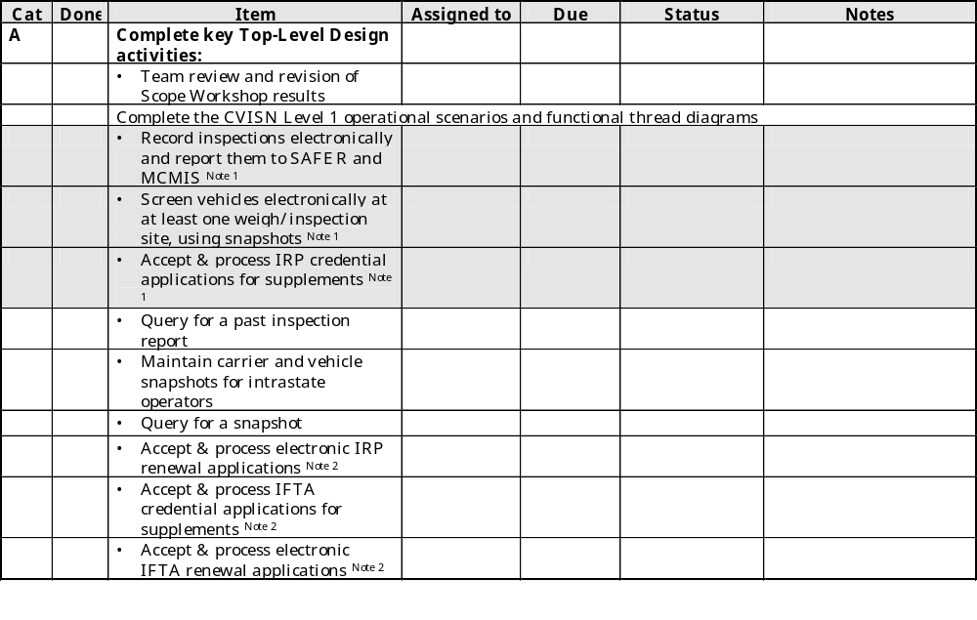
[State Name] Pre-Work Status Summary (1 of 3)
Note 1 – Prepared during Scope Workshop
Note 2 – See Note 2 on Page 4 of Pre-Work Introduction
Notes:
Shaded items were done in the scope workshop
Un-shaded items should have been done between workshops.
PC
Projection

Slide 4
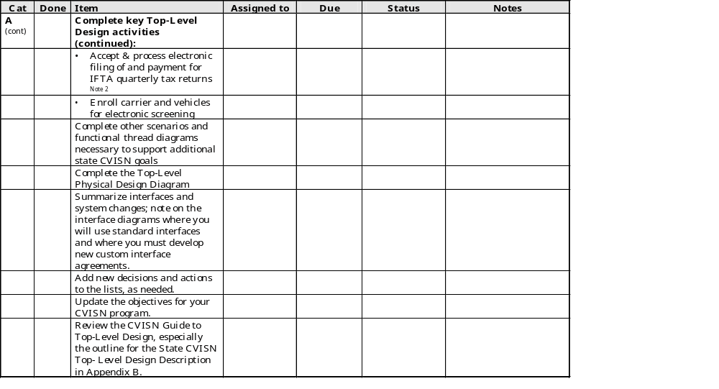
[State Name] Pre-Work Status Summary (2 of 3)
Notes:
PC
Projection

Slide 5
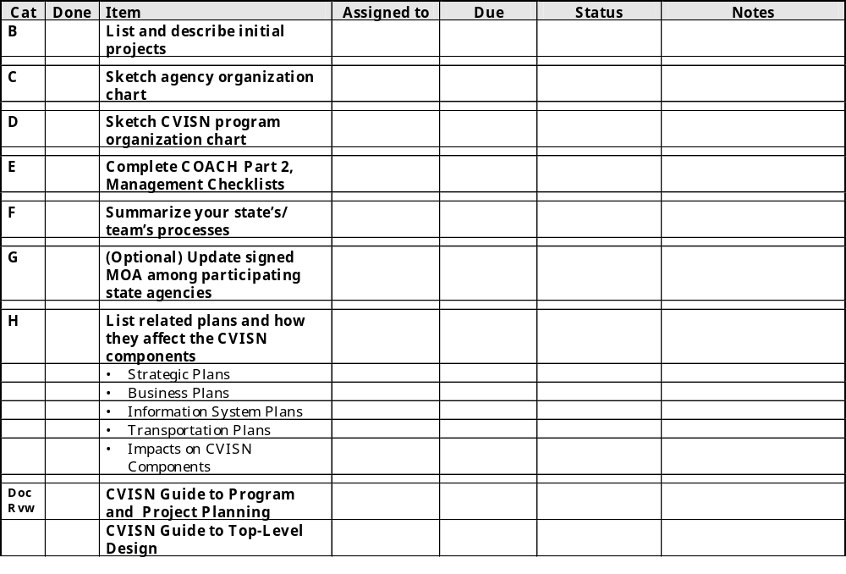
[State Name] Pre-Work Status Summary (3 of 3)
Notes:
PC
Projection

Slide 6
This Page Intentionally Blank

