Slide 1
State of Washington
Department of Agriculture
Human Resource
Management Report
Plan & Align Workforce
Hire Workforce
Deploy Workforce
Reinforce Performance
Develop Workforce
October 2007

Slide 2
Managers’ Logic Model for Workforce Management
Outputs
Initial Outcomes
Intermediate Outcomes
Plan & Align Workforce
Articulation of managers HRM accountabilities. HR policies. Workforce planning. Job classes & salaries assigned.
Managers understand HRM accountabilities. Jobs, staffing levels, & competencies aligned with agency priorities.
Foundation is in place to build and sustain a productive, high performing workforce.
Hire
Workforce
Qualified candidate pools, interviews & reference checks. Job offers. Appts & per-
formance monitoring.
Best candidate hired & reviewed during appointment period. Successful performers retained.
The right people are in the right job at the right time.
Ultimate Outcomes
Employees are committed to the work they do & the goals of the organization
Productive, successful employees are retained
State has workforce depth & breadth needed for present and future success
Deploy
Workforce
Work assignments& requirements defined. Positive workplace environment created. Coaching, feedback, corrections.
Workplace is safe, gives capacity to perform, & fosters productive relations. Staff know job rqmts, how they’re doing, & are supported.
Time & talent is used effectively. Employees are motivated & productive.
Develop Workforce
Individual development plans. Time/ resources for training. Continuous learning environment created.
Learning environment created. Employees are engaged in develop-
ment opportunities & seek to learn.
Employees have competencies for present job & career advancement
Agencies are better enabled to successfully carry out their mission. The citizens receive efficient government services.
Reinforce Performance
Clear performance expectations linked to orgn’al goals & measures. Regular performance appraisals. Recognition. Discipline.
Employees know how performance contributes to success of orgn. Strong performance rewarded; poor performance eliminated
Successful perf is differentiated & strengthened. Employees are held accountable.

Slide 3
Standard Performance Measures
Plan & Align Workforce
Percent supervisors with current performance expectations for workforce management
Management profile
Workforce planning measure (TBD)
Percent employees with current position/competencies descriptions
Time-to-fill funded vacancies
Candidate quality
Hiring Balance (Proportion of appointment types)
Separation during review period
Percent employees with current performance expectations
Employee survey ratings on “productive workplace” questions
Overtime usage
Sick leave usage
Non-disciplinary grievances/appeals filed and disposition (outcomes)
Worker safety
Percent employees with current individual development plans
Employee survey ratings on “learning & development” questions
Competency gap analysis (TBD)
Percent employees with current performance evaluations
Employee survey ratings on “performance & accountability” questions
Disciplinary actions and reasons, disciplinary grievances/appeals filed and disposition (outcomes)
Reward and recognition practices (TBD)
Ultimate Outcomes
Hire
Workforce
Employee survey ratings on “commitment” questions
Turnover rates and types
Turnover rate: key occupational categories
Workforce diversity profile
Retention measure (TBD)
Deploy
Workforce
Develop Workforce
Reinforce Performance

Slide 4
Plan & Align Workforce
Outcomes:
Managers understand workforce management accountabilities. Jobs and competencies are defined and aligned with business priorities. Overall foundation is in place to build & sustain a high performing workforce.
Performance Measures:
Percent supervisors with current performance expectations for workforce management
Management profile
Workforce Planning measure (TBD)
Percent employees with current position/ competency descriptions
Workforce Management Expectations
Percent supervisors with current performance expectations for workforce management = 100%*
Analysis:
Director Loveland sent out a memorandum in April 2007 to all managers and supervisors communicating her expectations for human resource management.
Action Steps:
The Director will reinforce her expectations on a yearly basis.
*Based on 120 of 120 reported number of supervisors
Data as of 6/30/07
Source: BW and Agency

Slide 5
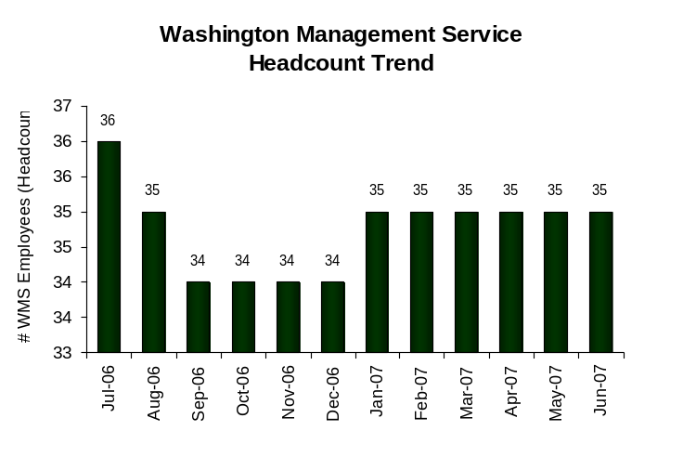
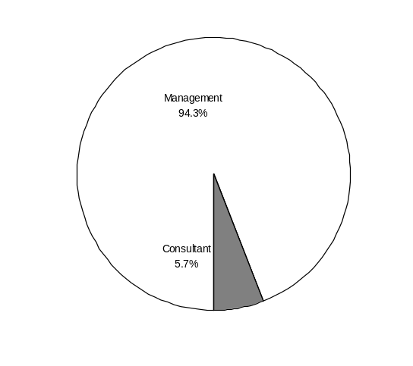
Plan & Align Workforce
Outcomes:
Managers understand workforce management accountabilities. Jobs and competencies are defined and aligned with business priorities. Overall foundation is in place to build & sustain a high performing workforce.
Performance Measures:
Percent supervisors with current performance expectations for workforce management
Management profile
Workforce Planning measure (TBD)
Percent employees with current position/ competency descriptions
Management Profile
WMS Employees Headcount = 35
Percent of agency workforce that is WMS = 4.4%
Managers* Headcount = 43
Percent of agency workforce that is Managers* = 5.4%
* In positions coded as “Manager” (includes EMS, WMS, and GS)
The figures at left are based on a headcount of 794 which would be an absolute peak time including nonpermanent employees.
Our permanent staff count at the time was 520. Using this figure, our WMS percentage was 6.7% and Managers were 8.3% of the workforce.
Analysis:
One WMS Organizational Performance Manager was added as a result of an outside assessment done of Agency needs.
Action Steps:
Continue to monitor to ensure WMS positions are used appropriately.
Management 33
Consultant 2
Policy 0
Not Assigned 0
Data as of 6/30/07
Source: BW
Notes:
Consultant – Budget Officer
Perf and Account. Mgr
New WMS: Bartusch

Slide 6
Plan & Align Workforce
Outcomes:
Managers understand workforce management accountabilities. Jobs and competencies are defined and aligned with business priorities. Overall foundation is in place to build & sustain a high performing workforce.
Performance Measures:
Percent supervisors with current performance expectations for workforce management
Management profile
Workforce Planning measure (TBD)
Percent employees with current position/ competency descriptions
Current Position/Competency Descriptions
Percent employees with current position/competency descriptions = 47.5%*
Analysis:
This is up from 18.9% last reporting period.
In September of this year, WSDA implemented an action plan for timely completion of evaluations. That plan included updating position descriptions.
Our goal is to have 100% updated position descriptions by January 2008.
Action Steps:
In September of 2007, Director Loveland distributed the action plan to all of WSDA, reinforcing her commitment to 100% timely evaluations.
WSDA’s Executive Management Team (EMT) will be tracking progress.
*Based on 240 of 505 reported employee count
Applies to employees in permanent positions, both WMS & GS
Data as of 7/31/07
Source: Agency

Slide 7
Hire Workforce
Outcomes:
Best candidates are hired and reviewed during appointment period. The right people are in the right job at the right time.
Performance Measures
Time-to-fill vacancies
Candidate quality
Hiring Balance (proportion of appointment types)
Separation during review period
Time-to-fill / Candidate Quality
Time-to-fill Funded Vacancies
Average number of days to fill*: [XXX]
Number of vacancies filled: [XXX]
*Equals # of days from creation of the requisition to job offer acceptance
Time Period: [mm/dd/yyyy – mm/dd/yyyy]
Analysis:
[XXX]
[XXX]
[XXX]
[XXX]
[XXX]
[XXX]
[XXX]
Action Steps:
[XXX]
[XXX]
[XXX]
Candidate Quality
Of the candidates interviewed for vacancies, how many had the competencies (knowledge, skills & abilities) needed to perform the job?
  Number = [XXX] Percentage = [XXX]
Of the candidates interviewed, were hiring managers able to hire the best candidate for the job?
  Hiring managers indicating “yes”:
  Number = [XXX] Percentage = [XXX]
  Hiring managers indicating “no”:
  Number = [XXX] Percentage = [XXX]
Time Period: [mm/dd/yyyy – mm/dd/yyyy]
THIS INFORMATION UNAVAILABLE
Data as of [Enter Date]
Source: [Enter Data Source]

Slide 8
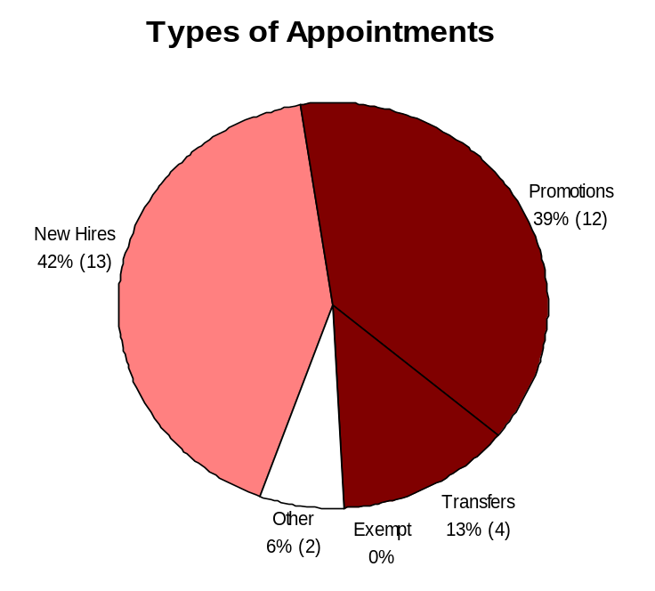
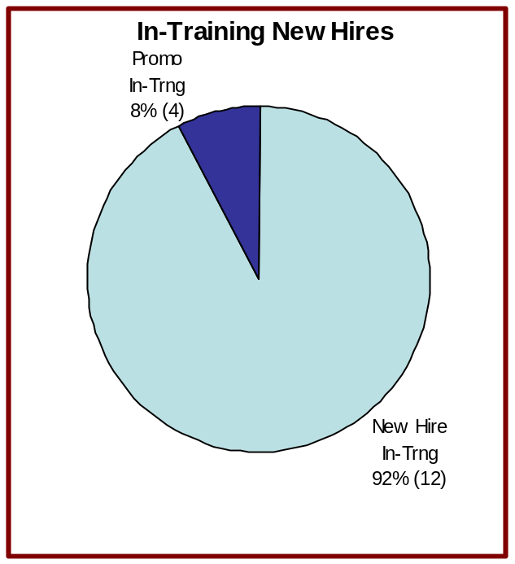
Hire Workforce
Outcomes:
Best candidates are hired and reviewed during appointment period. The right people are in the right job at the right time.
Performance Measures
Time-to-fill vacancies
Candidate quality
Hiring Balance (proportion of appointment types)
Separation during review period
Hiring Balance / Separations During Review Period
Analysis:
The majority of hires were new hires.
Separations during the review period are down from 6 last reporting period.
Total number of appointments = 31*
Time period = 1/07 through 6/07
Includes appointments to permanent vacant positions only; excludes reassignments
“Other” = Demotions, re-employment, reversion & RIF appointments
Separation During Review Period
Probationary separations - Voluntary 2
Probationary separations - Involuntary 1
  Total Probationary Separations 3
Trial Service separations - Voluntary 0
Trial Service separations - Involuntary 1
  Total Trial Service Separations 1
Total Separations During Review Period 4
Time period = 1/2007 through 6/2007
Data as of 6/30/07
Source: BW and Agency
Notes:
Vol. Prob. Sep.: Grain–Johnny Pierce
Grain–Rhonda Perozzo
Invol. Prob. Sep.: Grain–Guy Williams
Involuntary Trial Srvc. Sep.: Grain–Cichocki
New Hires' programs: Small Farms – 1
Animal Health office – 1
F&V Yakima office – 1
Seed office – 1
Food Safety office – 2
Organic – 2
Pest.Mngt Registration– 1
Plant Protection Admin – 1
Chem Lab – 1
Entomology – 1
Nursery - 1

Slide 9
Deploy Workforce
Outcomes:
Staff know job expectations, how they’re doing, & are supported. Workplace is safe, gives capacity to perform, & fosters productive relations. Employee time and talent is used effectively. Employees are motivated.
Performance Measures
Percent employees with current performance expectations
Employee survey ratings on “productive workplace” questions
Overtime usage
Sick leave usage
Non-disciplinary grievances/appeals filed and disposition (outcomes)
Worker safety
Current Performance Expectations
Percent employees with current performance expectations = 58.6%*
Analysis:
This is up from 56.9% last reporting period.
In September of this year, WSDA implemented an action plan for timely completion of evaluations. That plan included performance expectations.
Our goal is to have 100% updated expectations by January 2008.
Action Steps:
In September of 2007, Director Loveland distributed the action plan to all of WSDA, reinforcing her commitment to 100% timely evaluations.
WSDA’s Executive Management Team (EMT) will be tracking progress.
*Based on 296 of 505 reported employee count
with Expectations due. Applies to employees in permanent positions, both WMS & GS
Data as of 7/31/07
Source: Agency

Slide 10
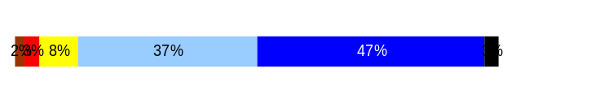
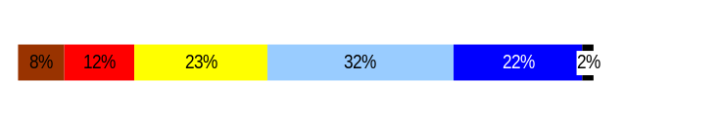
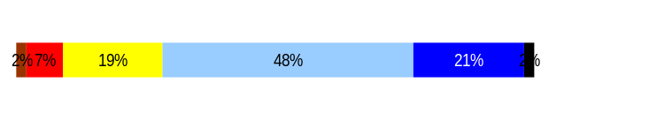
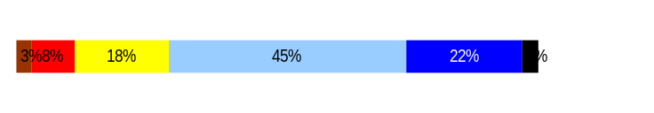
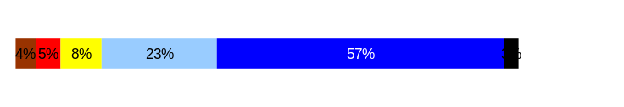
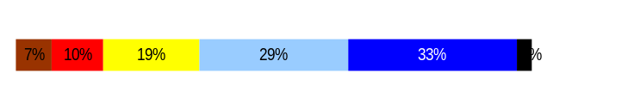
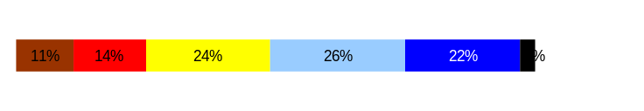
Deploy Workforce
Outcomes:
Staff know job expectations, how they’re doing, & are supported. Workplace is safe, gives capacity to perform, & fosters productive relations. Employee time and talent is used effectively. Employees are motivated.
Performance Measures
Percent employees with current performance expectations
Employee survey ratings on “productive workplace” questions
Overtime usage
Sick leave usage
Non-disciplinary grievances/appeals filed and disposition (outcomes)
Worker safety
Employee Survey “Productive Workplace” Ratings
Avg
Q4. I know what is expected of me at work.
Q1. I have opportunity to give input on decisions affecting my work.
Q2. I receive the information I need to do my job effectively.
Q6. I have the tools and resources I need to do my job effectively.
Q7. My supervisor treats me with dignity and respect.
Q8. My supervisor gives me ongoing feedback that helps me
improve my performance.
Q9. I receive recognition for a job well done.
Analysis:
84% of staff taking the survey usually or always feel they know what is expected of them at work.
80% usually or always feel their supervisor treats them with dignity and respect.
As the percentage of timely evaluations rises, the assumption is that the responses to Q6 and Q9 will increase.
4.3
3.5
3.8
3.8
4.3
3.7
3.3
Never
Seldom
Occasionally
Usually
Always
Overall average score for Productive Workplace Ratings: 3.9
Data as of March 2006 Survey
Source: DOP

Slide 11
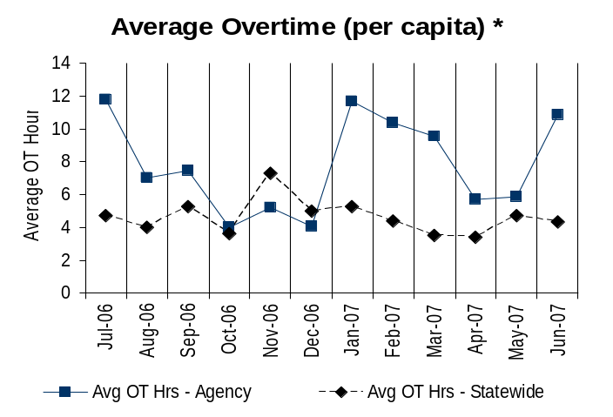
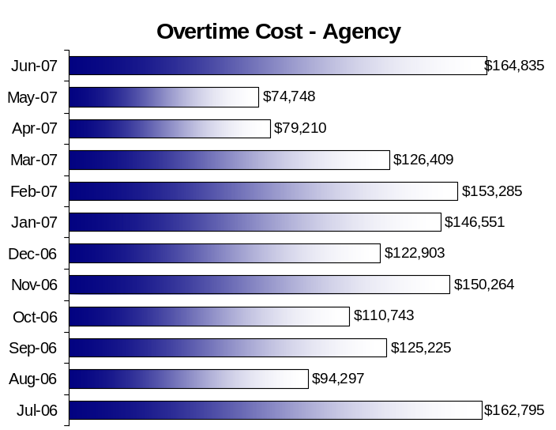
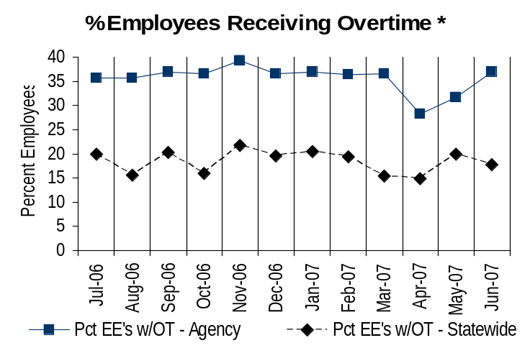
Deploy Workforce
Outcomes:
Staff know job expectations, how they’re doing, & are supported. Workplace is safe, gives capacity to perform, & fosters productive relations. Employee time and talent is used effectively. Employees are motivated.
Performance Measures
Percent employees with current performance expectations
Employee survey ratings on “productive workplace” questions
Overtime usage
Sick leave usage
Non-disciplinary grievances/appeals filed and disposition (outcomes)
Worker safety
Overtime Usage
Overall agency avg overtime usage – per capita, per month: 7.8**
* Statewide overtime values do not include DNR
**Overall agency avg overtime usage – per capita, per month =
sum of monthly OT averages divided by number of months
Analysis:
WSDA overtime (OT) increases on a cyclical basis to meet industry demand, particularly during harvests.
94% of WSDA’s OT occurs in the Commodity Inspection Division (From 1/1/07 to 6/30/07 WSDA had 36,087.6 hours of OT. 33,985.5 of those hours were in the Commodity Inspection Division.) OT in the Commodity Inspection Division is driven by industry demand. These OT costs are covered by inspection fee revenue.
Industry-driven OT is essential to support the economic vitality of the industry. It supports commerce in domestic and export markets.
OT is an effective and efficient way to provide adequate staffing during times of peak activity.
Action Steps:
Assistant Directors will continue to effectively manage OT to ensure it stays at acceptable levels.
Overall agency avg employees receiving overtime per month: 35.6%**
* Statewide overtime values do not include DNR
**Overall agency avg employees receiving overtime per month =
sum of monthly OT percentages divided by number of months
Data as of 6/30/07
Source: BW

Slide 12
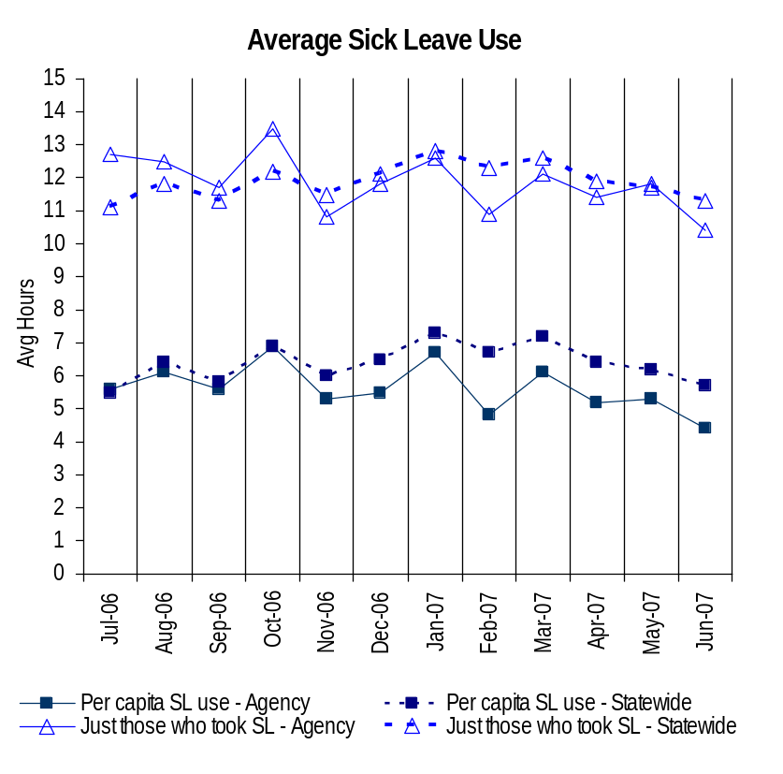
Deploy Workforce
Outcomes:
Staff know job expectations, how they’re doing, & are supported. Workplace is safe, gives capacity to perform, & fosters productive relations. Employee time and talent is used effectively. Employees are motivated.
Performance Measures
Percent employees with current performance expectations
Employee survey ratings on “productive workplace” questions
Overtime usage
Sick leave usage
Non-disciplinary grievances/appeals filed and disposition (outcomes)
Worker safety
Sick Leave Usage
Analysis:
From the last reporting period (12/06) to this reporting period (6/07) WSDA continues to remain at or below the statewide average in the use of sick leave.
Action Steps:
Assistant Directors will continue to manage sick leave in each division.
HR will work with managers and supervisors on strategies to identify and mitigate sick leave abuse.
WSDA will continue to publicize and encourage participation in workplace wellness activities.
Sick Leave Hrs Used / Earned (per capita)
Avg Hrs SL Used (per capita) - Agency | % of SL Hrs Earned (per capita) - Agency
5.6 Hrs | 72.3%
Avg Hrs SL Used (per capita) – Statewide* | % of SL Hrs Earned (per capita) – Statewide*
6.4 Hrs | 82.5%
Sick Leave Hrs Used / Earned (those who took SL)
Avg Hrs SL Used (those who took SL) - Agency | % SL Hrs Earned (those who took SL) - Agency
11.8 Hrs | 147.9%
Avg Hrs SL Used (those who took SL) – Statewide* | % SL Hrs Earned (those who took SL) – Statewide*
11.9 Hrs | 148.4%
Sick Leave time period = 07/06 through 06/07
* Statewide data does not include DOL, DOR, L&I, and LCB
Source: DOP

Slide 13
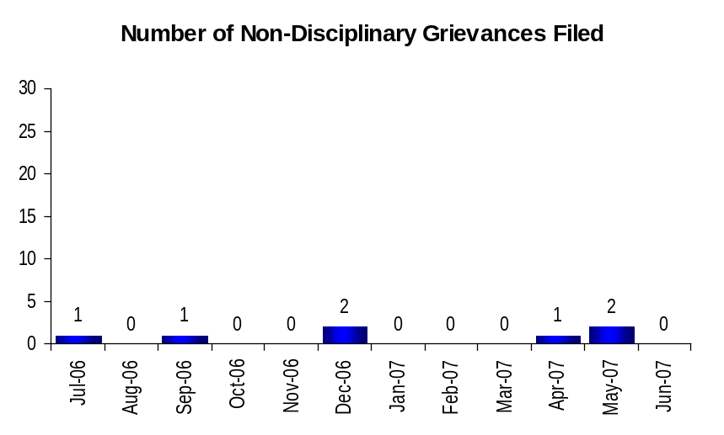
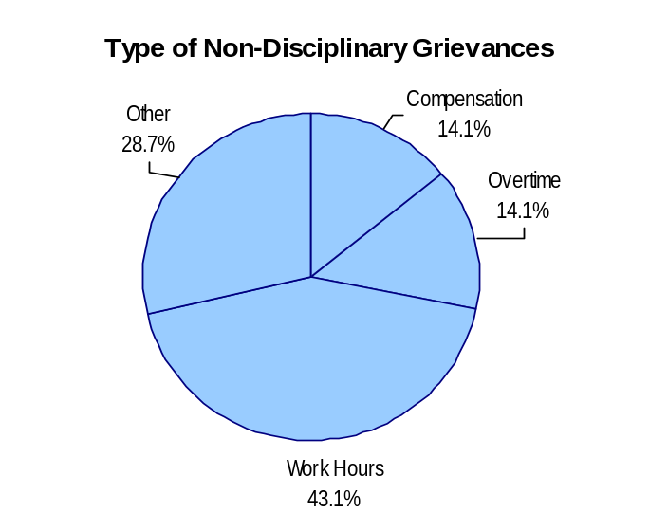
Deploy Workforce
Outcomes:
Staff know job expectations, how they’re doing, & are supported. Workplace is safe, gives capacity to perform, & fosters productive relations. Employee time and talent is used effectively. Employees are motivated.
Performance Measures
Percent employees with current performance expectations
Employee survey ratings on “productive workplace” questions
Overtime usage
Sick leave usage
Non-disciplinary grievances/appeals filed and disposition (outcomes)
Worker safety
Non-Disciplinary Grievances (represented employees)
Total Non-Disciplinary Grievances = 7
Non-Disciplinary Grievance Disposition*
(Outcomes determined during1/2007 through 6/30/2007
Compensation grievance at impasse
Overtime grievance withdrawn after 3rd step hearing
1 Other (seniority) grievance settled at 2nd level
1 Other (evaluation process) grievance settled at 1st level
1 Work Hours grievance withdrawn prior to arbitration
2 Work Hours grievances settled at 1st level
Analysis:
3 grievances were filed during this reporting period.
7 grievances have been filed since July 2006.
Managers and supervisors continue to resolve issues at the lowest level, resulting in the low number of grievances filed.
* There may not be a one-to-one correlation between the number of grievances filed (shown top of page) and the outcomes determined during this time period. The time lag between filing date and when a decision is rendered can cross the time periods indicated.
Data as of 6/30/07
Source: Agency
Notes:
OT: F&V - Rushing
Comp: F&V – Bultena, et al
Other, Seniority: F&V – Godinez
Other, Eval.Process: Grain – Pierce
Work Hours: F&V – Newell
Myers
Dionne

Slide 14
Deploy Workforce
Outcomes:
Staff know job expectations, how they’re doing, & are supported. Workplace is safe, gives capacity to perform, & fosters productive relations. Employee time and talent is used effectively. Employees are motivated.
Performance Measures
Percent employees with current performance expectations
Employee survey ratings on “productive workplace” questions
Overtime usage
Sick leave usage
Non-disciplinary grievances/appeals filed and disposition (outcomes)
Worker safety
Non-Disciplinary Appeals (mostly non-represented employees)
Filings for DOP Director’s Review
Time Period = 01/07 through 06/07
0 Job classification
0 Rule violation
0 Name removal from register
0 Rejection of job application
0 Remedial action
0 Total filings
Filings with Personnel Resources Board
Time Period = 01/07 through 06/07
0 Job classification
0 Other exceptions to Director Review
0 Layoff
0 Disability separation
0 Non-disciplinary separation
0 Total filings
Non-Disciplinary appeals only are shown above.
There is no one-to-one correlation between the filings shown above and the outcomes displayed in the charts below. The time lag between filing date and when a decision is rendered can cross the time periods indicated.
Director's Review Outcomes
Personnel Resources Board Outcomes
Total outcomes = 0
Time Period = 01/07 through 06/07
Total outcomes = 0
Time Period = 01/07 through 06/07
Source: Dept of Personnel

Slide 15
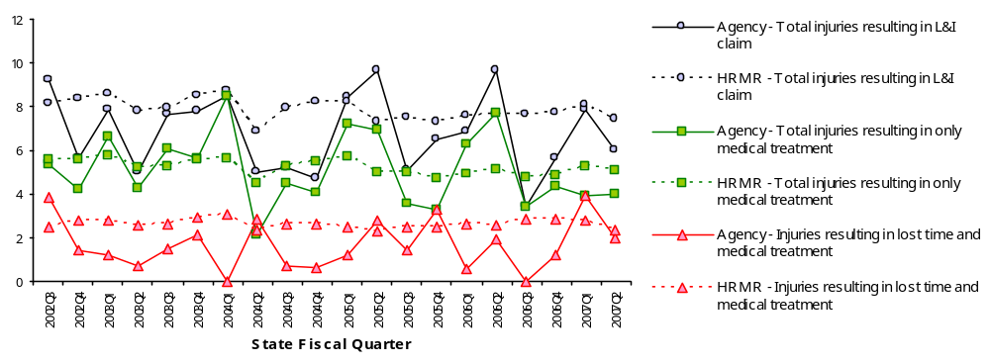
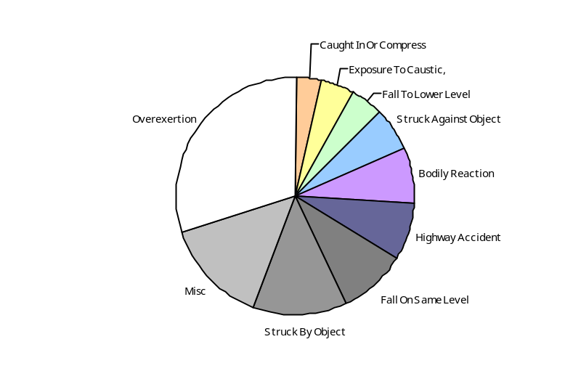
Deploy Workforce
Outcomes
Staff know job expectations, how they’re doing, & are supported. Workplace is safe, gives capacity to perform, & fosters productive relations. Employee time and talent is used effectively. Employees are motivated.
Performance Measures
Percent employees with current performance expectations
Employee survey ratings on 'productive workplace' questions
Overtime usage
Sick leave usage
Non-disciplinary grievances/appeals filed and disposition outcomes
Worker Safety
Worker Safety: Agriculture, Department of
Analysis:
Many WSDA job functions are in the field and are physical in nature.
Typically, WSDA is at or below HR MR agencies
Due to the nature of the work, most injuries occur in the Commodity Inspection Division
Action Plan:
Along with other cabinet-level agencies, WSDA has created an action plan for the reduction of reportable claims.
The plan includes active participation from top management down through the organization.
WSDA is in the process of hiring a risk/safety manager position.
Allowed Annual
Claims Rate*^:
Agency vs. All HR
Management Report
(HRMR) agencies
*Annual claims rate
is # claims / 100 FTE
1 FTE = 2000 hours
^Due to natural lag
in claim filing, rates
are expected to
increase significantly
over time
Injuries by Occupational
Injury and Illness
Classification (OIICS)
event:
For fiscal period 2002Q3
through 2007Q2
(categories under 3% or not
adequately coded are grouped
into 'misc.')
Oiics Code | Oiics Description | Percent | Number
21 | Bodily Reaction | 8% | 16
03 | Caught In Or Compress | 3% | 7
34 | Exposure To Caustic, | 4% | 9
13 | Fall On Same Level | 9% | 19
11 | Fall To Lower Level | 4% | 9
41 | Highway Accident | 8% | 16
- | Misc | 14% | 29
22 | Overexertion | 30% | 61
01 | Struck Against Object | 6% | 12
02 | Struck By Object | 13% | 27
Source: Labor & Industries, Research and Data Services (data as of 09/03/2007 )
Notes:
HRMR Safety Report Overview
The HRMR Safety Reports are:
- PowerPoint slides created by the Department of Labor and Industries
- Created for each state agency that is reporting their employee safety program results bi-
annually as part of their Human Resources Management Report (HRMR).
- Snapshots of five years of worker’s compensation claim data specific to that agency, as
well as a comparison to the combined data for agencies completing HRMR reports.
- There is a two quarter lag at the end of the five years.
This allows each agency’s payroll data to be entered into L&I’s computer system. This
payroll data is used to compute the number of workers per agency and quarter.
Definitions
Claim – When a covered worker sustains an occupational injury or illness, that worker files a
'claim’ for benefits. A 'claim number' is assigned, and all wage replacement payments, medical
provider bills, etc, for that worker and injury, are associated with that claim number.
Report Detail
'Allowed Annual Claim Rate'
This chart shows your agency's rate of injuries resulting in allowed
claims, by injury quarter, for on-the-job injuries and occupational illnesses. The rate for all
reporting agencies is shown for comparison.
- The rate is the number accepted claims per 200,000 annual worker hours (100 workers)
Three rates are included in this chart:
A)The total rate for all injuries resulting in a claim; the two groups listed below are
exclusive of each other.
B)The rate of injuries which required medical care, but no compensation for lost
time.
C)The rate of injuries which resulted in compensation for lost time in addition to
medical care.
'Injuries by Occupational Injury and Illness Classification (OIICS) Event’
This section contains a pie chart which shows your agency's injuries by type* and a table which
shows the percent and number of accepted claims by OIICS Event description and code.
This information is useful in identifying what causes injuries so prevention can occur. Prevention
might include root cause analysis, education, and hazard mitigation.
* Injury Type is based on the 2 digit Major Group code of the Event or Exposure section of the Occupational
Injury and Illness Classification System (OIICS). Groups with less than 3% of the
total injuries are combined into the 'Misc' category.
How to get this report for your agency:
All worker compensation reports will be available on the L&I website by the 20th of September or
the 20th of March of each year. The data will be provided in a PowerPoint slide to which you will
add your own analyses and action plans.

Slide 16
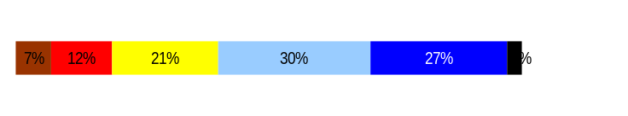
Develop Workforce
Outcomes:
A learning environment is created. Employees are engaged in professional development and seek to learn. Employees have competencies needed for present job and future advancement.
Performance Measures
Percent employees with current individual development plans
Employee survey ratings on “learning & development” questions
Competency gap analysis (TBD)
Individual Development Plans
Percent employees with current individual development plans = 58.6%*
Analysis:
WSDA is up from 50% last reporting period.
As the timely completion of evaluations increases, so should the rate of individual performance plans.
WSDA anticipates that timely evaluations will positively impact the “Learning and Development” ratings.
Action Steps:
In September of 2007, Director Loveland distributed the action plan to all of WSDA, reinforcing her commitment to 100% timely evaluations, to include individual development plans.
WSDA’s Executive Management Team (EMT) will be tracking progress.
*Based on 296 of 505 reported employee count.
Applies to employees in permanent positions, both WMS & GS
Employee Survey “Learning & Development” Ratings
Q5. I have opportunities at work to learn and grow.
Q8. My supervisor gives me ongoing feedback that helps me
improve my performance.
Avg
3.6
3.7
Overall avg score for Learning & Development Ratings: 3.7
Data as of March 2006 Survey
Source: DOP

Slide 17
Reinforce Performance
Outcomes:
Employees know how their performance contributes to the goals of the organization. Strong performance is rewarded; poor performance is eliminated. Successful performance is differentiated and strengthened. Employees are held accountable.
Performance Measures
Percent employees with current performance evaluations
Employee survey ratings on “performance and accountability” questions
Disciplinary actions and reasons, disciplinary grievances/appeals filed and disposition (outcomes)
Reward and recognition practices (TBD)
Current Performance Evaluations
Percent employees with current performance evaluations = 62%*
Analysis:
This us up from 57.1 last reporting period
In September of this year, WSDA implemented an action plan for timely completion of evaluations.
Our goal is to have 100% current evaluations by January 2008.
Action Steps:
In September of 2007, Director Loveland distributed the action plan to all of WSDA, reinforcing her commitment to 100% timely evaluations.
WSDA’s Executive Management Team (EMT) will be tracking progress.
*Based on 296 of 477 reported employee count
of those whose PDP is due. Applies to employees in permanent positions, both WMS & GS
Data as of 7/31/07
Source: Agency

Slide 18
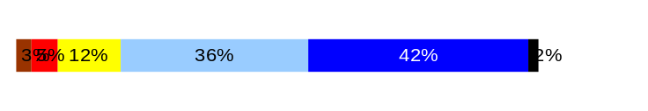
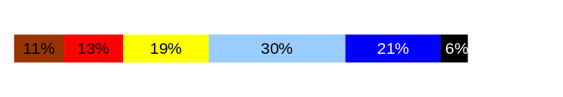
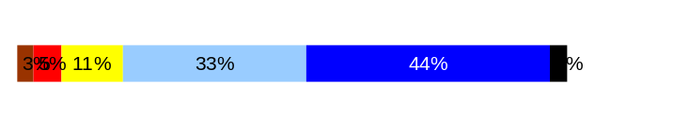
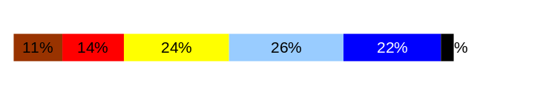
Reinforce Performance
Outcomes:
Employees know how their performance contributes to the goals of the organization. Strong performance is rewarded; poor performance is eliminated. Successful performance is differentiated and strengthened. Employees are held accountable.
Performance Measures
Percent employees with current performance evaluations
Employee survey ratings on “performance and accountability” questions
Disciplinary actions and reasons, disciplinary grievances/appeals filed and disposition (outcomes)
Reward and recognition practices (TBD)
Employee Survey “Performance & Accountability” Ratings
Avg
Q3. I know how my work contributes to the goals of my agency.
Q10. My performance evaluation provides me with meaningful information about my performance.
Q11. My supervisor holds me and my co-workers accountable for performance.
Q9. I receive recognition for a job well done.
Analysis:
78% of staff usually or always know how their work contributes to the goals of the WSDA.
As evaluations are done timely, these ratings should improve.
4.1
3.4
4.1
3.3
Never
Seldom
Occasionally
Usually
Always
Overall average score for “Performance & Accountability” ratings: 3.7
Data as of March 2006 Survey
Source: DOP

Slide 19
Reinforce Performance
Outcomes:
Employees know how their performance contributes to the goals of the organization. Strong performance is rewarded; poor performance is eliminated. Successful performance is differentiated and strengthened. Employees are held accountable.
Performance Measures
Percent employees with current performance evaluations
Employee survey ratings on “performance and accountability” questions
Disciplinary actions and reasons, disciplinary grievances/appeals filed and disposition (outcomes)
Reward and recognition practices (TBD)
Formal Disciplinary Actions
Disciplinary Action Taken
Time period = 01/07 through 06/07
Analysis:
There were no formal disciplinary actions taken during this reporting period.
Action Steps:
WSDA HR will continue to work with managers and supervisors to address workplace performance appropriately.
Dismissals | 0
Demotions | 0
Suspensions | 0
Reduction in Pay* | 0
Total Disciplinary Actions* | 0
* Reduction in Pay is not currently available in HRMS/BW.
Data as of 6/30/07
Source: Agency

Slide 20
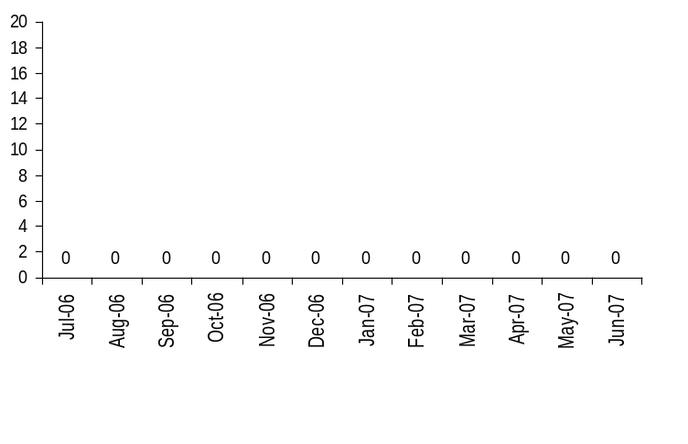
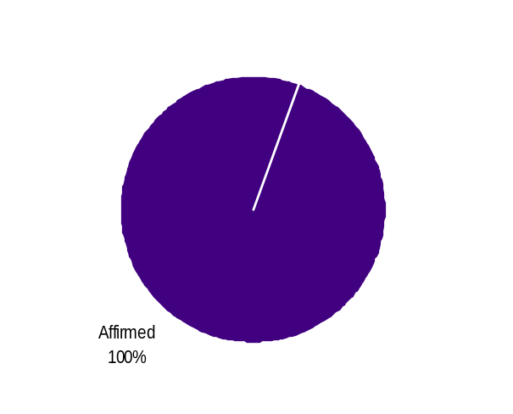
Reinforce Performance
Outcomes:
Employees know how their performance contributes to the goals of the organization. Strong performance is rewarded; poor performance is eliminated. Successful performance is differentiated and strengthened. Employees are held accountable.
Performance Measures
Percent employees with current performance evaluations
Employee survey ratings on “performance and accountability” questions
Disciplinary actions and reasons, disciplinary grievances/appeals filed and disposition (outcomes)
Reward and recognition practices (TBD)
Disciplinary Grievances and Appeals
Disciplinary Grievances
(Represented Employees)
Disciplinary Appeals
(Non-Represented Employees
filed with Personnel Resources Board)
Time Period = 07/06 through 06/07
1 Dismissal
0 Demotion
0 Suspension
0 Reduction in salary
1 Total Disciplinary Appeals Filed with PRB
Total # Disciplinary Grievances Filed: 0
There is no one-to-one correlation between the filings shown above and the outcomes displayed in the charts below. The time lag between filing date and when a decision is rendered can cross the time periods indicated.
Disposition (Outcomes) of Disciplinary Grievances
Time period = 07/06 through 06/07
0
0
0
0
0
0
0
Disposition (Outcomes) of Disciplinary Appeals*
Time period = 07/06 through 06/07
Data as of 6/30/07
Source: Agency

Slide 21

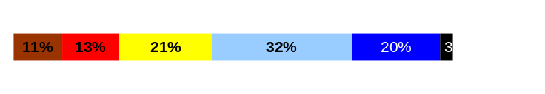
ULTIMATE OUTCOMES
Employees are committed to the work they do and the goals of the organization
Successful, productive employees are retained
The state has the workforce breadth and depth needed for present and future success
Performance Measures
Employee survey ratings on “commitment” questions
Turnover rates and types
Turnover rate: key occupational categories
Workforce diversity profile
Retention measure (TBD)
Employee Survey “Employee Commitment” Ratings
Avg
Analysis:
78% of staff usually or always know how their work contributes to the goals of the WSDA.
Timely completion of evaluations should positively impact these ratings.
Q3. I know how my work contributes to the goals of my agency.
Q12. I know how my agency measures its success.
Q9. I receive recognition for a job well done.
4.1
3.4
3.3
Never
Seldom
Occasionally
Usually
Always
Overall average score for Employee Commitment ratings: 3.5
Data as of March 2006 Survey
Source: DOP

Slide 22
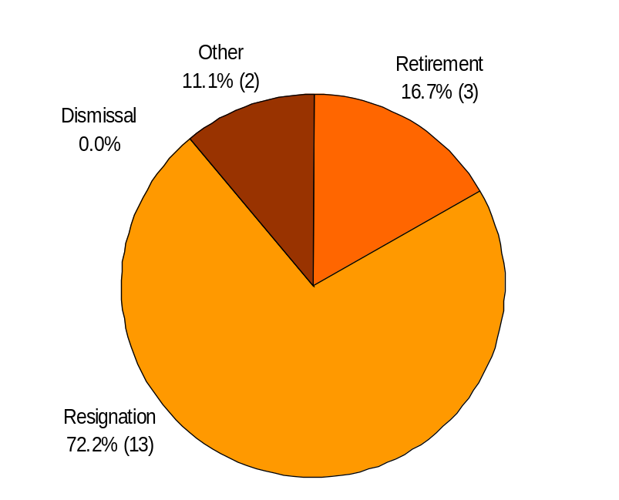
ULTIMATE OUTCOMES
Employees are committed to the work they do and the goals of the organization
Successful, productive employees are retained
The state has the workforce breadth and depth needed for present and future success
Performance Measures
Employee survey ratings on “commitment” questions
Turnover rates and types
Turnover rate: key occupational categories
Workforce diversity profile
Retention measure (TBD)
Turnover Rates
Total % Turnover (leaving state)
Time Period: 01/07 through 06/07
Analysis:
The reasons for 13 resignations varied from moving out of state to promoting. There was no discernable pattern.
Exit Interviews are not done regularly
Exit interviews that are done, are done in person
Action Steps:
WSDA has begun the process of developing a standard exit interview format to be given to all exiting employees, along with a process to track the information collected.
The Executive Management Team will discuss succession planning and begin that process.
Total Turnover Actions: 18
Total % Turnover: 3.6%
Note: Movement to another agency is currently not available in HRMS/BW
Data as of 6/30/07
Source: BW
Notes:
Resignations: 2 Food Safety 1 Animal ID
4 F&V 1 HR
2 Grain 1 Director's Office (Bio-Fuel)
1 Financial Srvcs 1 Pest Program
Retirements: 1 Pesticide Mngt 1 Livestock ID
1 Wts & Measures
Other: 2 Grain
No one thing. I listed the programs in the comments for the slide, but here's the reasons:
1 – moving out of state
2 – illness
1 – go back to school
3 – avoid discipline/dismissal
2 – to stay at home
1 – take better paying job
1 – needed a change
1 – x
1 – x

Slide 23
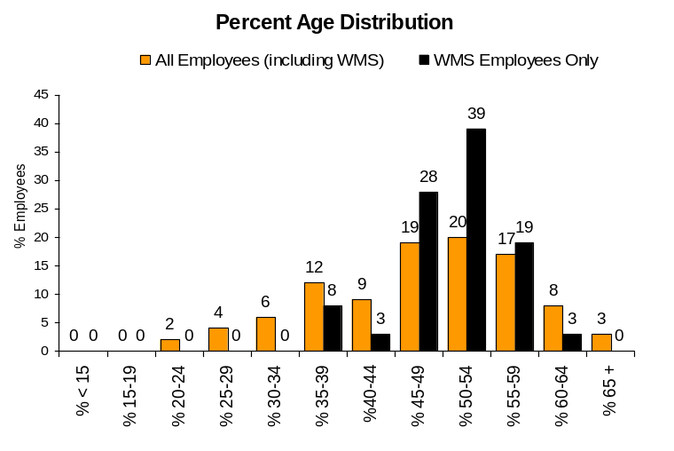
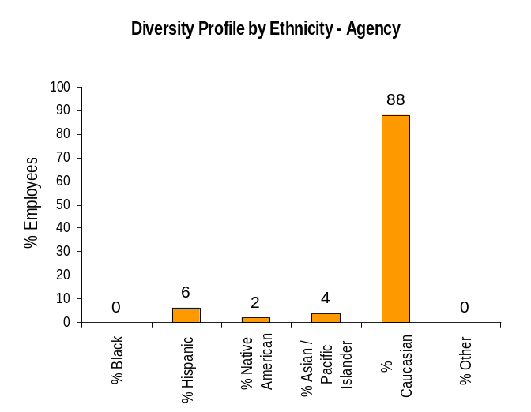
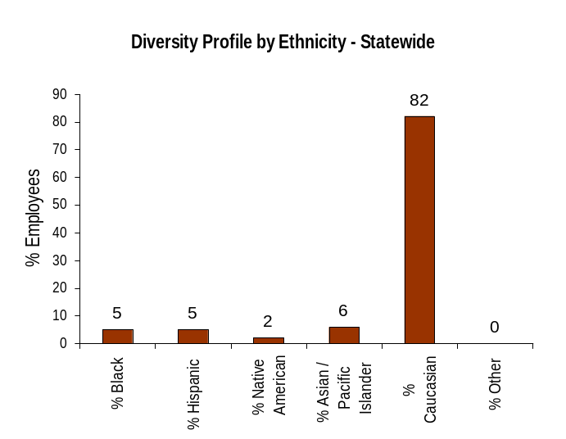
ULTIMATE OUTCOMES
Employees are committed to the work they do and the goals of the organization
Successful, productive employees are retained
The state has the workforce breadth and depth needed for present and future success
Performance Measures
Employee survey ratings on “commitment” questions
Turnover rates and types
Turnover rate: key occupational categories
Workforce diversity profile
Retention measure (TBD)
Workforce Diversity Profile
Agency State
Female 39% 53%
Disabled 2% 5%
Vietnam Vet 6% 7%
Disabled Vet 1% 2%
People of color 13% 18%
Persons over 40 76% 75%
Analysis:
WSDA continues to closely mirror the statewide diversity profile with the exception of African Americans
Action Steps:
WSDA will continue to focus on recruiting candidates that reflect the diversity of the State of Washington.
Data as of 6/30/07
Source: BW

