Slide 1
Run IIb Schedule Status
  Schedule Status
  Update on near-term equipment expenditures
  Budgeting Update
  Summary

Slide 2
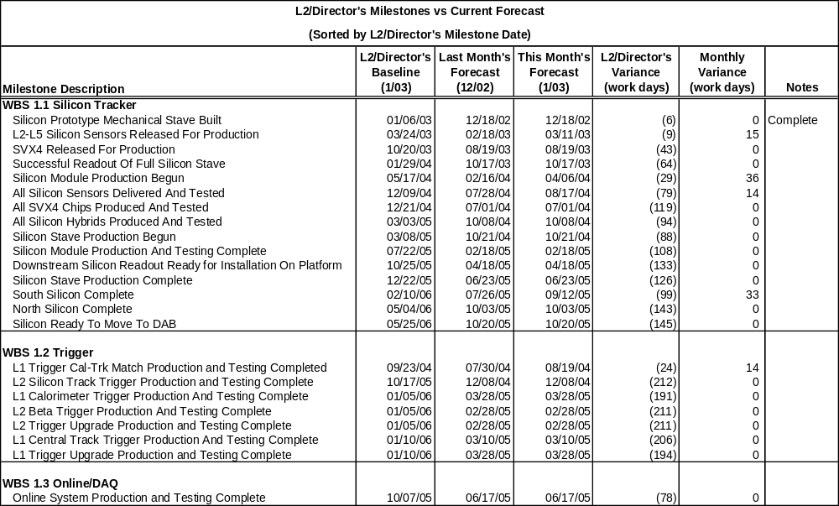
Overview of Director’s Milestones
Status Date: Jan 31,2003

Slide 3
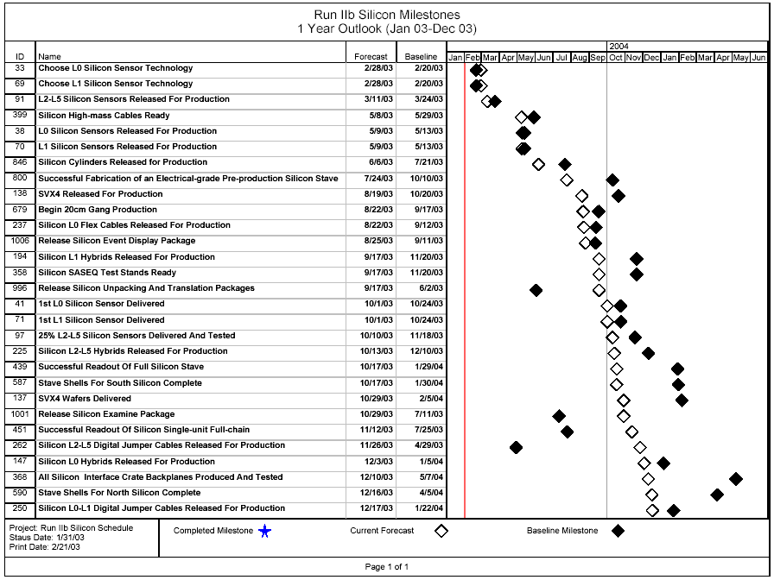
All Silicon Milestones -
1 Year Outlook
DOE Baseline
Forecast

Slide 4
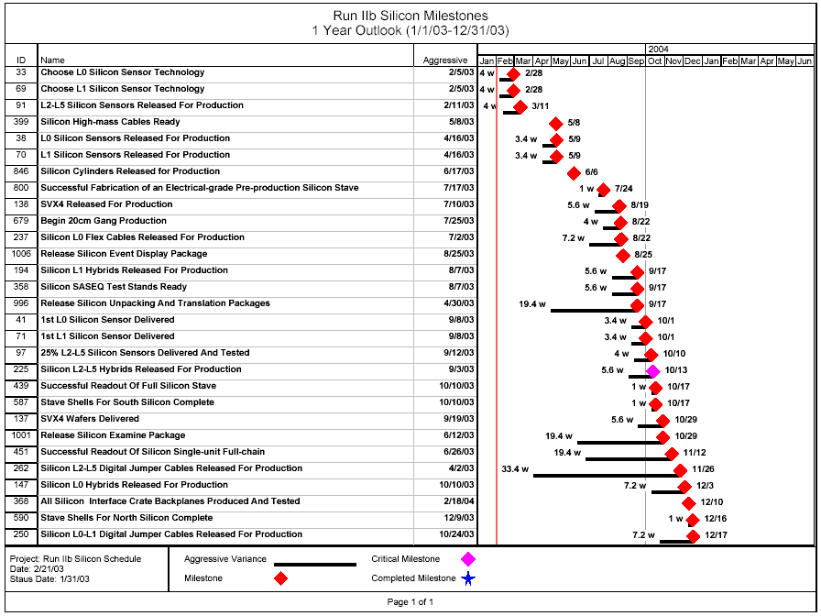
All Silicon Milestones -
1 Year Outlook
Forecast
Variance from Aggressive Milestone
L2-L5 Sensors
4w
3w change since last month; delay in completion of analysis of irradiation tests and probing; PRR now scheduled for 3/6/03.

Slide 5
All Silicon Milestones -
1 Year Outlook
Forecast
Variance from Aggressive Milestone
L0-L1 Sensors
3.4w
Technology choice delayed, but procurement dates remain unchanged.

Slide 6
All Silicon Milestones -
1 Year Outlook
Forecast
Variance from Aggressive Milestone
SVX4
5.6w
No change since last month; critical path

Slide 7
All Silicon Milestones -
1 Year Outlook
Forecast
Variance from Aggressive Milestone
L0/L1 Cables/Hybrids
7.2w
Delay in completion of L0 analog cable prototype testing
L2-L5
Digital Cables
33.4w
Baseline schedule required prod. cables for test stands; no longer true

Slide 8
All Silicon Milestones -
1 Year Outlook
Forecast
Variance from Aggressive Milestone
Staves
1w
Slight delay in completion of probing sensor prototypes

Slide 9
All Silicon Milestones -
1 Year Outlook
Forecast
Variance from Aggressive Milestone
Software
19.4w
Expected start of software tasks March, 2003

Slide 10
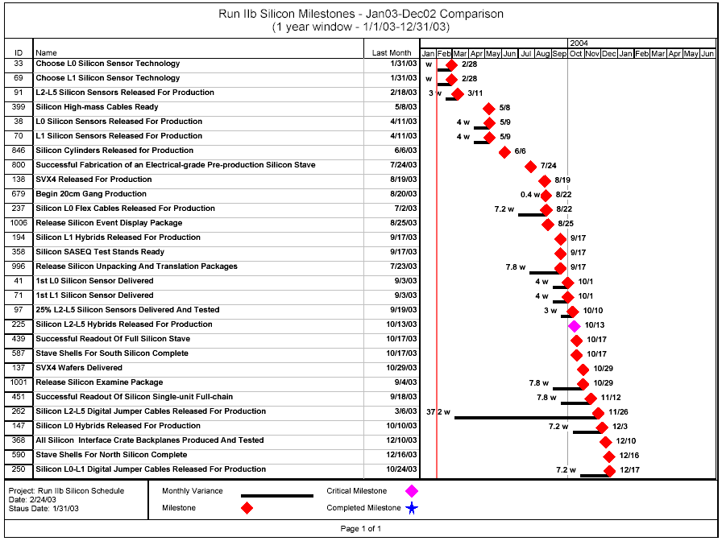
Last Month/This Month -
Silicon Forecasts
Forecast
Variance from last month
Critical path remains unchanged;
Project end date remains unchanged (10/20/05)

Slide 11
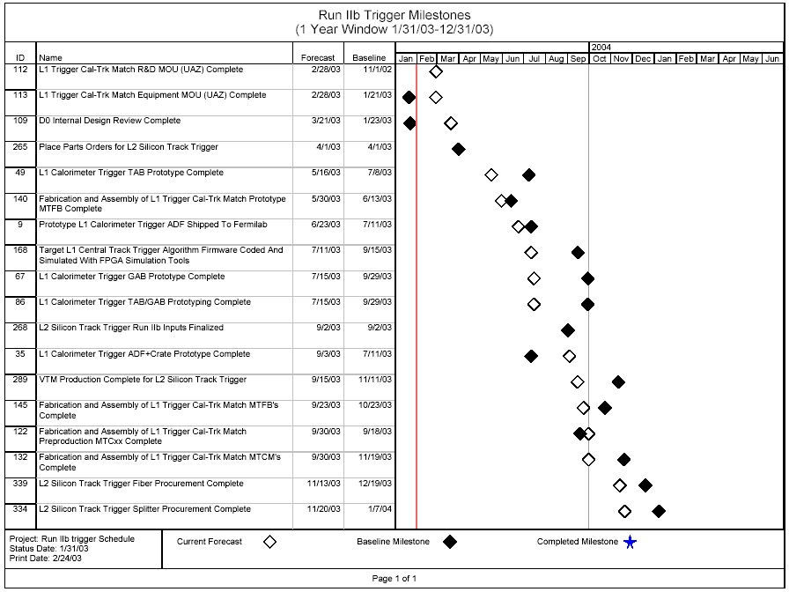
All Trigger Milestones -
1 Year Outlook
DOE Baseline
Forecast

Slide 12
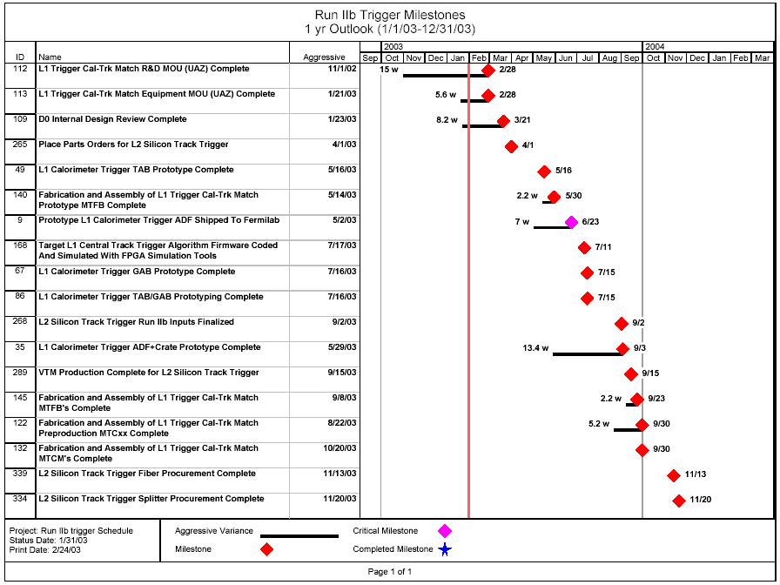
All Trigger Milestones -
1 Year Outlook
Forecast
Variance from Aggressive Milestone
Cal Track Match
MOU needs to be established. (Soon)
Use of pre-qualified vendors may allow recovery of some slippage.

Slide 13
All Trigger Milestones -
1 Year Outlook
Forecast
Variance from Aggressive Milestone
Cal Trigger ADF
Prototype ADF kept at Saclay for additional testing, rather than shipped early to FNAL
Custom backplane may not be needed, commercial crate and patch panel sufficient

Slide 14
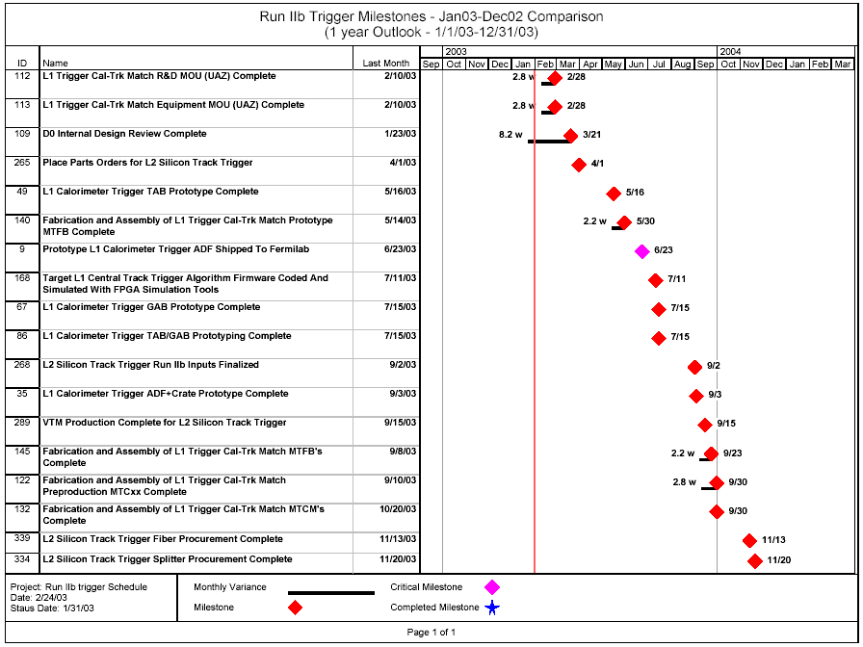
Last Month/This Month -
Trigger Forecasts
Forecast
Variance from last month
Critical path/project end date remains unchanged since last month (3/28/05)

Slide 15
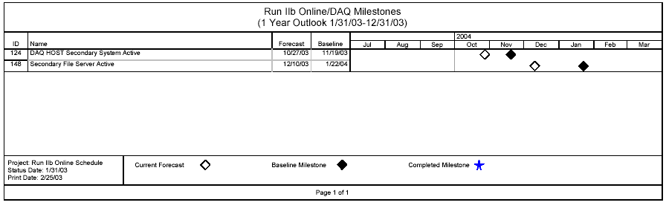
All Online Milestones -
1 Year Outlook
DOE Baseline
Forecast
No changes since last month
No variance from aggressive schedule

Slide 16
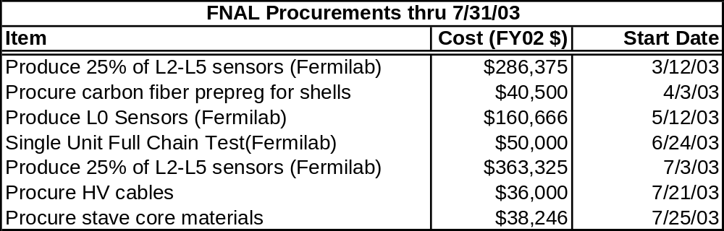
Silicon: Upcoming Equipment Purchases over $30k
Upcoming FNAL equipment purchases
over $30k through July ’03
Total L2-L5 Sensor obligation:$1376k
Costs do not include contingency, G&A, or escalation.
Labor not included..

Slide 17
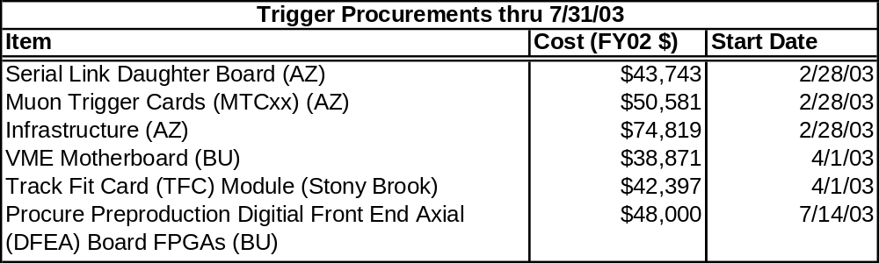
Trigger Upcoming Equipment Purchases over $30k
Upcoming equipment purchases over $30k through July ’03
Costs do not include contingency, G&A, or escalation.
Labor not included.

Slide 18
Budgeting Activities
    COBRA consultant was here last week to assist in loading schedules,establishing baselines, etc.
    Equipment budget codes were established for near-term procurements (~April 2003) following DOE approval to spend.
      Silicon (18), Trigger (11), Online (1)
    Next hurdle - Implementation of project accounting
Project | Cost Accounts
Silicon | 271
Trigger | 99
Online/DAQ | 23
Project Admin | 4

Slide 19
Summary
  Continuing to manage to the “aggressive” schedule
    Forecast completion date remains unchanged since last month at October 20, 2005; EIR/DOE schedule finish May 25, 2006
    Regularly reviewing schedule to optimize the plan
      Looking at variances from aggressive schedule
      Month-to-month differences in forecasts
      Variance wrt DOE baseline dates
    Not yet in danger of missing any DOE/Director’s milestones
  Loaded schedule into COBRA
    Established cost account/work packages
    Established baseline log, loaded actuals
    Produced reports (CPR, CPI/SPI)
  Established equipment budget codes for near-term needs

