Slide 1
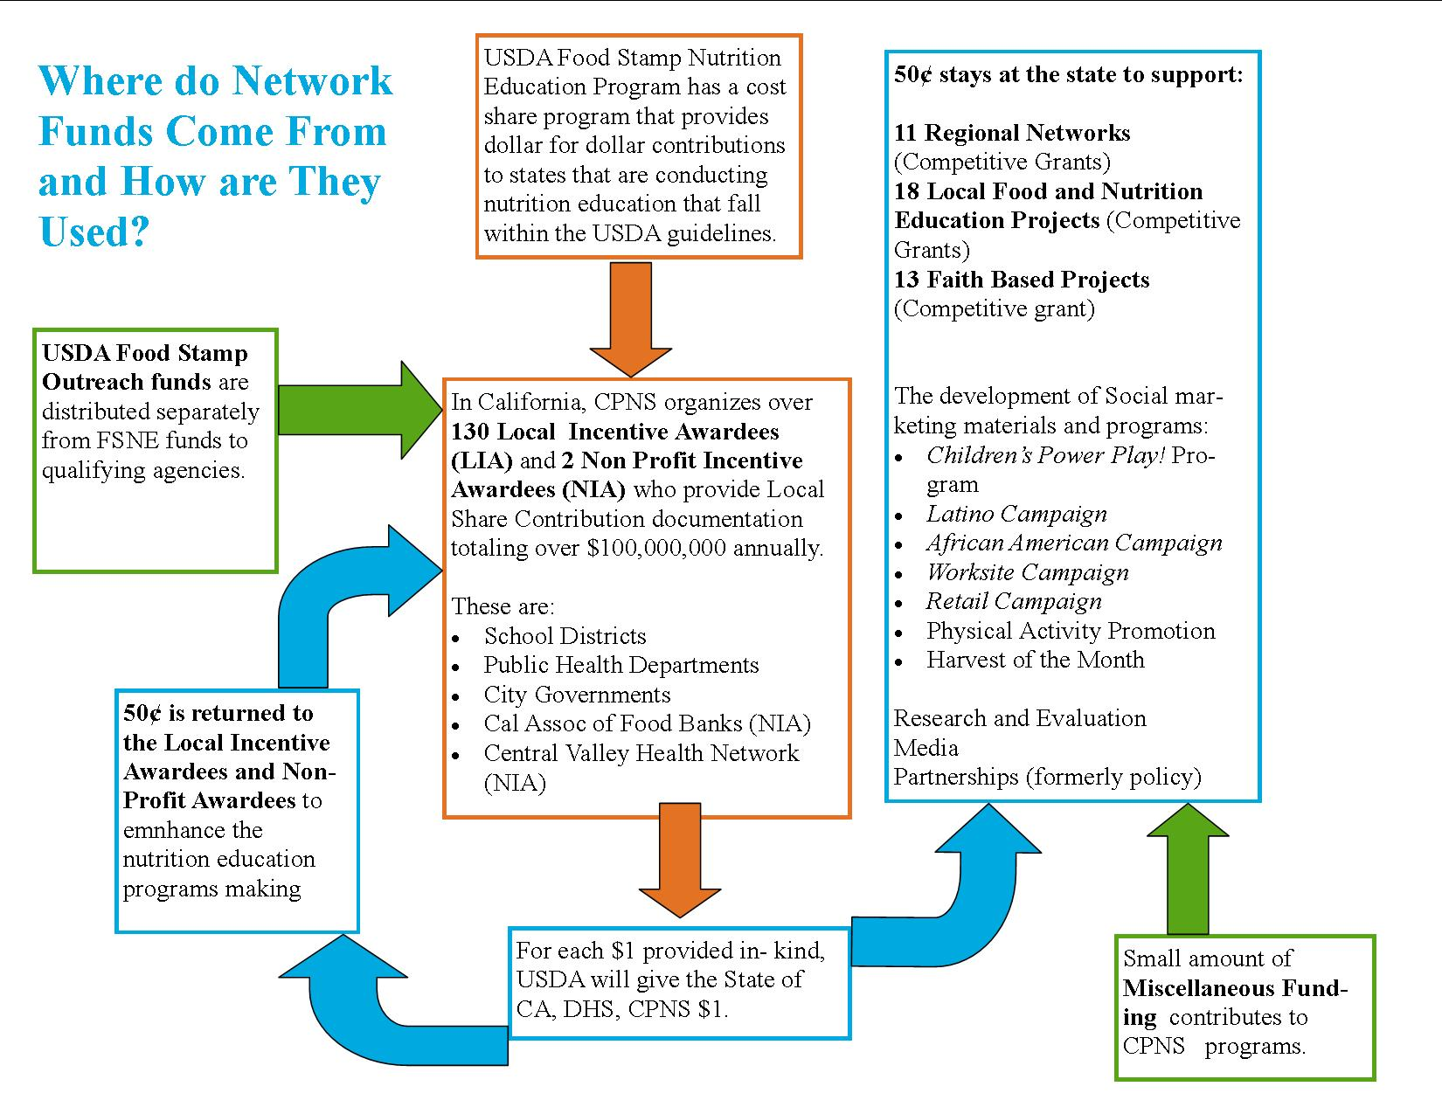
Notes:
LIA and NIAs document the amount they spend in nutrition education activities for FSNE eligible populations and submit that information to CPNS. CPNS compiles all of the information and budgets into one statewide budget. Then the USDA matches the funds being spent on Nutrition Education dollar for dollar. That match goes to the state who returns $.50 for each $1 provided inkind back to the LIAs and NIAs.
They use the remaining $.50 for various programs and activities lead by CPNS as listed here.

