Slide 1
Max Zolotorev
CBP AFRD LBNL
Radiation & Acceleration
Tutorial

Slide 2
Optics
Diffraction
Formation Length
Volume of coherence
Weizsäcker-Williams method of equivalent photons
Spectrum
a. Synchrotron radiation
b. Cherenkov radiation
c. Transition radiation
Fluctuations
Linear Acceleration / deceleration
Nonlinear interaction
a. Ponderomotive acceleration in vacuum
b. FEL small signal small gain

Slide 3







Light Optics
Charge Particle Optics
Prism
Bend magnet
x
x
k
k
p
p
Deflection angle = (n -1) α
Deflection angle = eBL/cp
n , α
B , L
Lens
Quadrupole lens
x
y
x
y
k
p
n , R
G , L

Slide 4

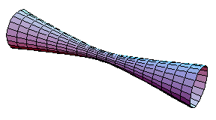




E
E
d
k
B
B
Transverse coherence
Longitudinal coherence
Volume of coherence
Degeneracy parameter = number of photons per mode =
= number of photons in volume of coherence

Slide 5
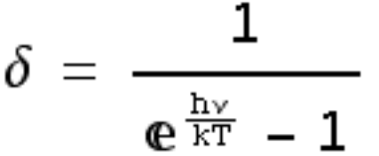
Degeneracy parameter = number of particle per mode =
= number of particle in volume of coherence
Spin 1 (photons)
< <1
for thermal sources of radiation in visible range
δ ~ α N_{e} ω τ_{b} ~ 10³
for synchrotron sources of radiation in visible range
δ~ N_{ph} ~ 3 10¹⁸
for 1 J laser in visible range
Spin 1/2 (electrons)
δ = 2
for electrons in Cu (maximum possible
for unpolarized electrons)
3
N_{e}
λc
δ~ ~ 2 10⁻¹¹
for electrons from RF photo guns
ε_{x} ε_{y} ε_{z}
δ ~ 10⁻⁶
for electrons from needle cathode

Slide 6


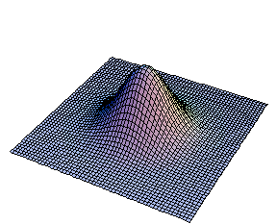

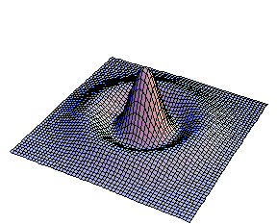

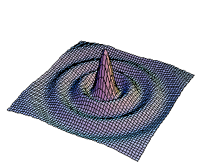
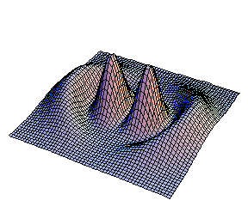
d ~ Θ_{dif} Z_{R}
for the high order (m) of optical beam emittance
Liouville’s Theorem
Conservation of emittance

Slide 7
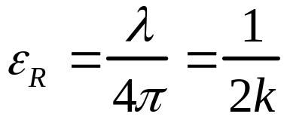
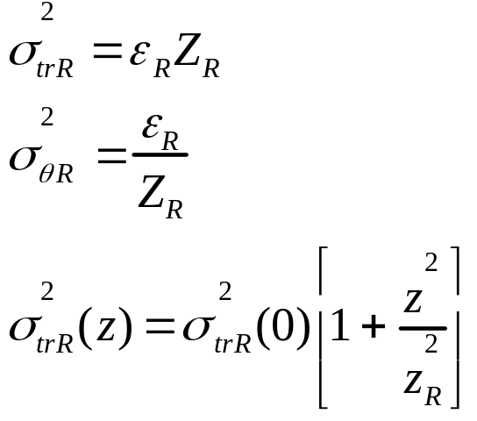
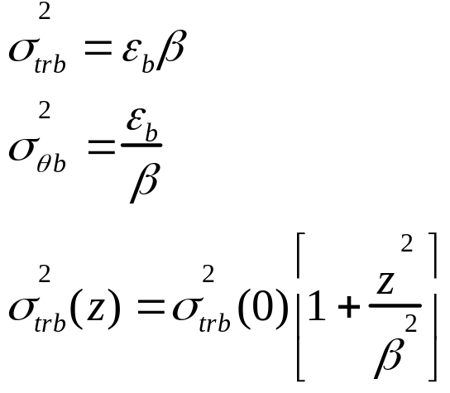
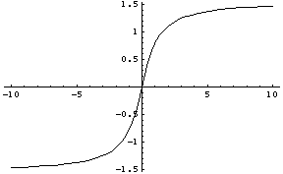
Gaussian beam approximation
Light optics
Accelerator optics
ε_{b} >> λ_{c}
Guoy phase
Betatron phase

Slide 8




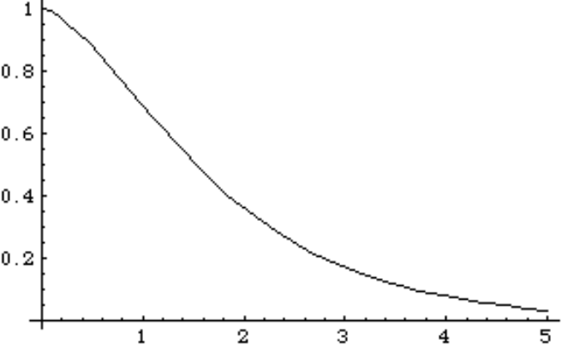

Weizsäcker-Williams method of equivalent photons
E
In the rest frame
V ≈ C
d
Transverse field
B
In Lab. frame
θ ≈1/γ
ω e^{-ω /ω}c
ωc = 2 γ c /d
^{ω /ω}c

Slide 9
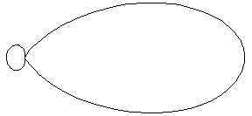
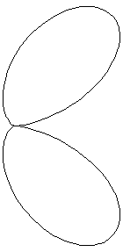
Virtual photons became a real:
1. If charge particle receive a kick to delay from virtual photons of its cloud
In vacuum in a case γ >>1 the only practical way it is a transverse kick
V
2. In medium if V > c/n Cherenkov radiation
V
3. Transition radiation (non homogenous medium)
V

Slide 10



Formation length and Transfers coherence
Radiation of charge particles
Formation length
Rayleigh range
Transfers coherence size
Waist
1. Synchrotron radiation
θ
ρ
for Θ >> 1/γ
Θ ~ (1/kρ)^{1/3}

Slide 11



Formation length
2. Transition radiation
3. Cherenkov radiation
k
θ
l_{f}
V

Slide 12





Spectral Intensity
On formation length virtual photons became real !
In one transfers mode
and
Estimation
Exact solution
1. Synchrotron radiation
2. Cerenkov radiation

Slide 13






3. Transition radiation
d
In a limit d -> 0
we still have a hole
Total radiated energy in forward direction

Slide 14
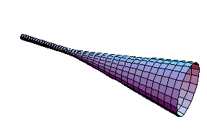

Superposition and radiation of beam
p_{i}
k
p_{f}
If
Incoherent radiation ω τ_{b} >> 1
amplitude
E_{s}(ω ,θ) ~ N^{1/2}
intensity
~
Es(ω ,θ)
2
~
N
Coherent radiation ω τ_{b} << 1
amplitude
E_{s}(ω ,θ) ~ N
intensity
~
Es(ω ,θ)
2
~
N²

Slide 15
Fluctuation Properties of Electromagnetic Field

Slide 16
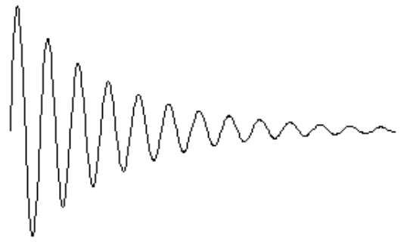
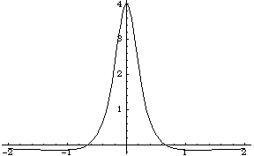
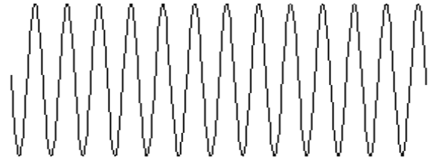
Examples of radiated field
E
Electric field of spontaneous radiation of a single atom or
electric field excited by single electron passing through
resonator cavity or response of an oscillator to a kick and…
ω_{o} t
E_{max} ~ β e/R λ₀
Electric field of spontaneous radiation of a single electron
passing through bend magnet (synchrotron radiation)
ω_{c}t
E_{max} = 4 e γ⁴ / Rρ ~ γβ e/R λ_{c}
E
Electric field of spontaneous radiation of a single electron
passing through a wiggler
ω_{o}t
1
(1+K²)²
E_{max} = 4 e γ⁴ / Rρ ~ γβ e/R λ₀

Slide 17
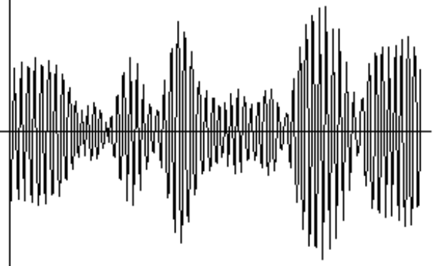
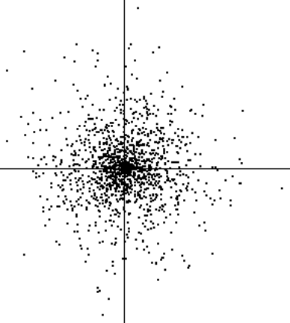
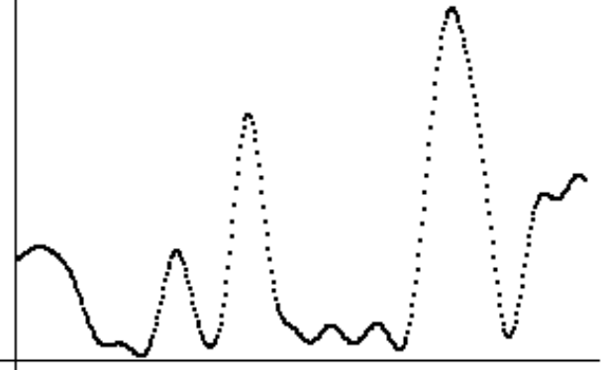
Chaotic Electromagnetic Field
Excitation time of atoms
or electrons’ time of entrance
into wiggler
t
E
E Cos[ωt]
t
I
E Sin[ωt]
t

Slide 18
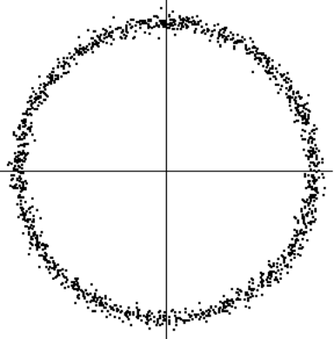
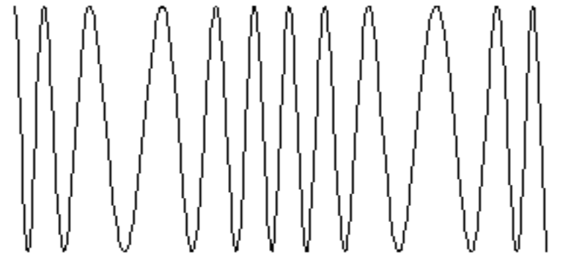
Coherent Electromagnetic Field
E Cos[ωt]
E
E Sin[ωt]
t
Media with inverse population (atomic or electron beam in wiggler)
can amplify signal (and + positive feedback = generator)

Slide 19


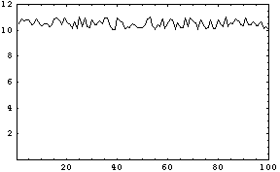
Max, you are telling lies !
If you are right, why do we not observe 100% fluctuations in the signal
from fluorescent lamp on time scale 10-20 ns (life time of transitions)?
Photo detector and oscilloscope have right time resolution.
Light radiated from area >> d² (d ~ transverse coherence size ~λ/θ , λ - wave length and θ - observation angle) is incoherent, thus intensities add and therefore observer will see very small fluctuations.
We can observe 100% fluctuations, but we need to install diaphragms that will transmit light only from area of coherence.
I
When we try to observe 100% fluctuations,
we are force to go to small solid angle
and thus small intensity and gives rise to the question
t
When do quantum phenomena become important ?

Slide 20
Fields can be treated classically if degeneracy parameter δ >>1
Degeneracy parameter
Transverse coherence size d ~ λ/θ
Longitudinal coherence size l ~ c / Δω
Volume of coherence d² l
Degeneracy parameter δ
δ = number of photons in volume of coherence
δ = number of photons per mode
δ =
1
Sunlight
1. Thermal source
≈ 10⁻²
Exp[hν/kT] -1
2. Synchrotron radiation
δ ≈ α N λ/ (cτ F) ≈ 10⁴/F
F = number of
transverse coherence
modes in beam area
3. Wiggler radiation
δ ≈ 2 M_{W} α N λ/ (cτ F) for K_{W} > 1
4. Laser ~1 mJ visible light
≈ 10¹⁵

Slide 21
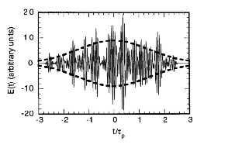
Can information about longitudinal charge distribution
be extracted from incoherent radiation ?
In time domain
Time domain picture of incoherent radiation produced by Gaussian longitudinal charge distribution
and filtered with ω/Δω =10
and τ ≈10/Δω
Pulse-to-pulse fluctuations in intensity under these conditions
will be ~ 1/√M, where M is the number of groups. In this
case M ≈10 and fluctuations ~ 30%. This does not depend
on the number of electrons if the degeneracy parameter is large.
Pulse length can be recovered from known filter bandwidth and
measured fluctuations

Slide 22
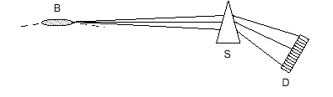
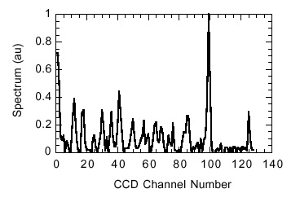
Frequency Domain
Spectral fluctuations: narrow spikes with width 1/τ_{b.}

Slide 23
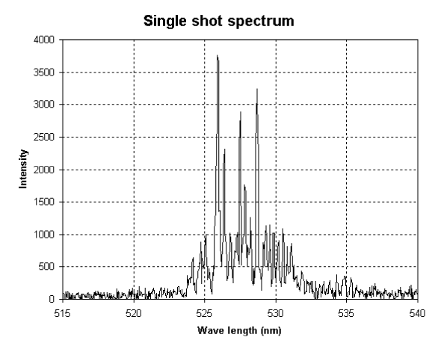
Experimental data taken at Argon National Lab (V. Sajaev)

Slide 24
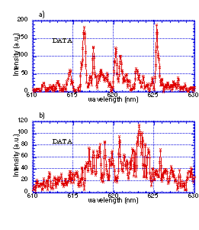
Probability distribution for spikes
for beam size smaller than transverse coherence size and/or resolution of spectrometer Δω < 1/τ_{b}, follows the
Poisson distribution
for beam size larger than transverse coherence size and/or resolution of spectrometer Δω >1/τ_{b}, follows the
Gamma distribution
Experimental data taken at Brookhaven National Lab (P. Catravs)

Slide 25
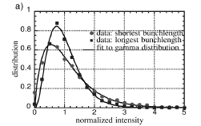
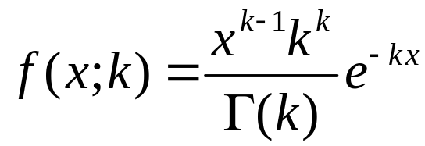
Surviving in case of poor resolution
Average spike width gives information about time duration
of radiation when resolution of spectrometer is much better
than inverse length of radiation pulse. In the opposite case,
it is still possible to extract information about time duration
of radiation. Signal obtained in the frequency band equal
to resolution of the spectrometer will be the sum of several
independent events (spikes in frequency domain and from
different transverse coherence regions) each distributed
according Poisson statistic. Resulting distribution will follow
Gamma distribution.
Measured distribution of spectral intensity
fluctuations for 1.5 ps and 4.5 ps bunch
lengths are plotted along with gamma
distribution fit.
where x = I/<I> , and k is number of independent unresolved spikes
The same information can be extracted from the measurement of fluctuations relative to the base.
For example if k =10, it will be 30% of relative fluctuations and, otherwise, if 30% fluctuations are
measured then there were 10 independent spikes in spectrometer resolution width. One can find the
number of spikes in frequency domain and time duration of radiation by using spatial transverse mode filter.

Slide 26
Can it be used at LCLS for measurement of X ray pulse duration?
degeneracy parameter δ ≈ 2 M_{g} α N λ/ (cτ F) and F~ area of the beam / λ²
for fixed linear density and size of the electron beam δ ~ λ³
but if beam emittance ~ λ/4π; F~1 and δ ~ λ
for LCLS (M_{g}~200 ) λ ≈ .15 nm; δ ≈ gain x10⁴ are good enough even for
gain ≈ 1. Fluctuation signal can be used for tuning LCLS.
One can measure in time domain, then number of spikes ~ 10³ - 10⁴ and fluctuations are ~ 1 - 3%
(this can be used for rough estimation of x-ray pulse length)
Or, for a one-shot measurement, can use x ray spectrometer with width
Δω/ω ~ 10⁻³ and resolution
δω/ω ~ 10⁻⁶
spectrometer resolution
X ray frequency
It looks possible !

Slide 27
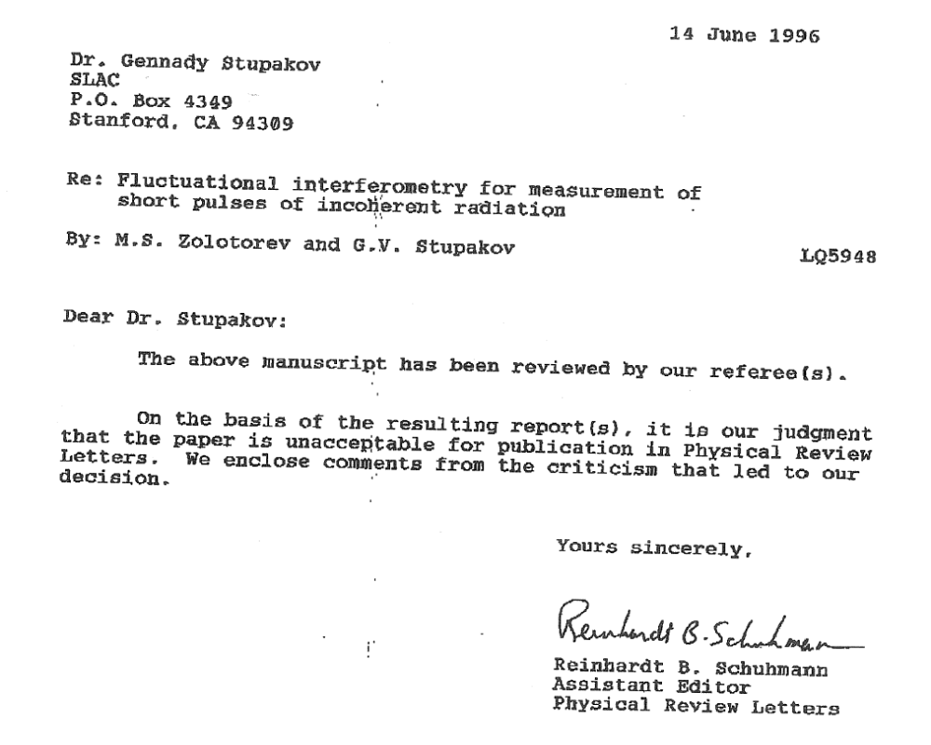

Slide 28
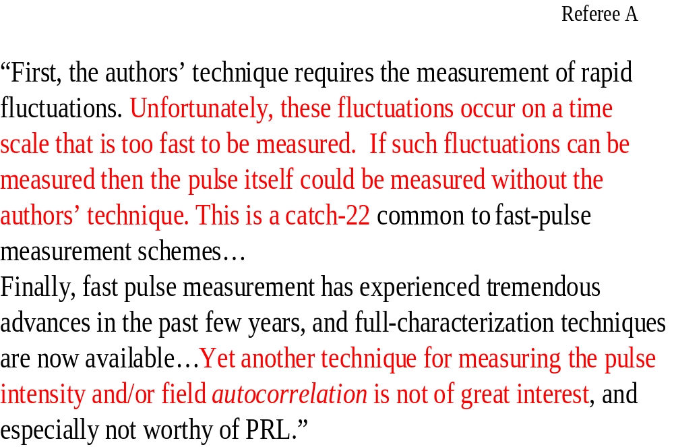

Slide 29
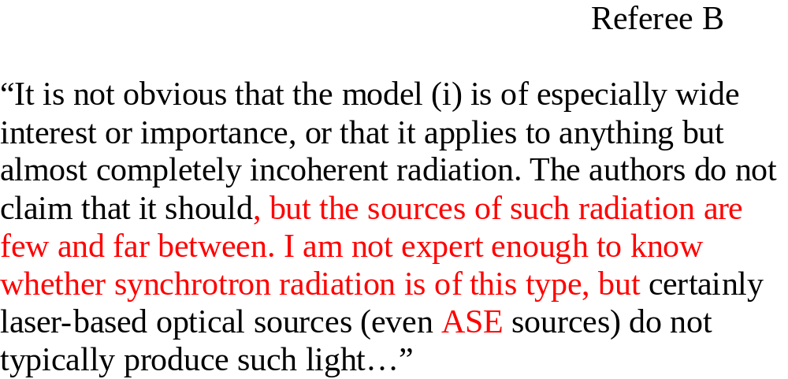
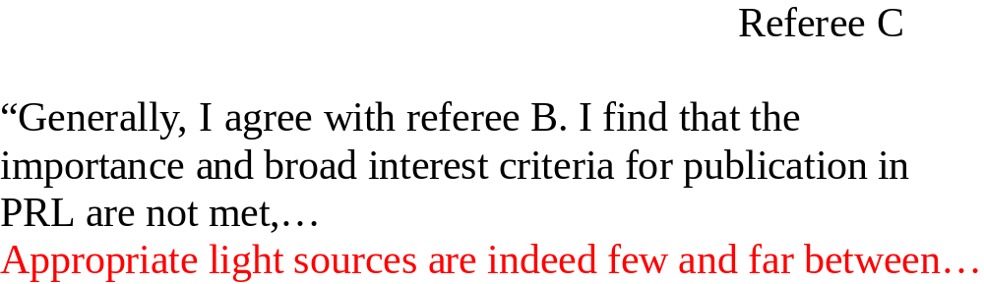

Slide 30

Linear acceleration/ deceleration
If in the far field region one has fields from an external source
and fields from spontaneous emission from particles
E = E_{ex}(ω,θ) +e_{s} (ω,θ)
Were η is the overlap of external and spontaneous fields
Acceleration/ deceleration linear with external field always is interference
of spontaneous radiation with external field. In vacuum, far away from
matter (in far field region L>>Z_{R}) no spontaneous radiation from particles and
No acceleration linear with external field .

Slide 31
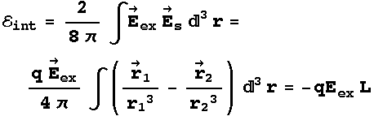


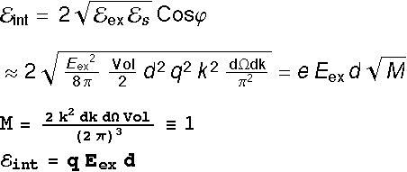
Electrostatic accelerator
r₂
r₁
L
q
-q
E_{ex}
RF accelerator
d

Slide 32
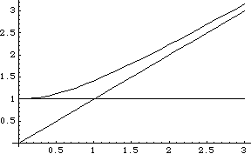
Plasma acceleration
ω / ω_{p}
Moving charged particle in plasma
radiate longitudinal Cherenkov wave
k / k_{p}
Interference of this radiation with plasma
wave exited by external source result in
acceleration of charge particle in plasma

Slide 33




Nonlinear acceleration in vacuum (ponderomotive)
Primary wave forced particle oscillate in transverse direction and as a result, secondary wave are radiated. Interference of this waves result in energy exchange between particle and wave (ponderomotive acceleration).
1. In a plane wave electron moved with velocity:
and
2. Radiated power in one special mode on frequency ω , Δω are
=
3. Energy gain

Slide 34





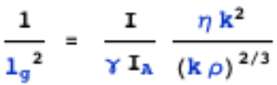
Microbunch instability
Very close to exact solution by G. Stupakov and S. Heifets

Slide 35
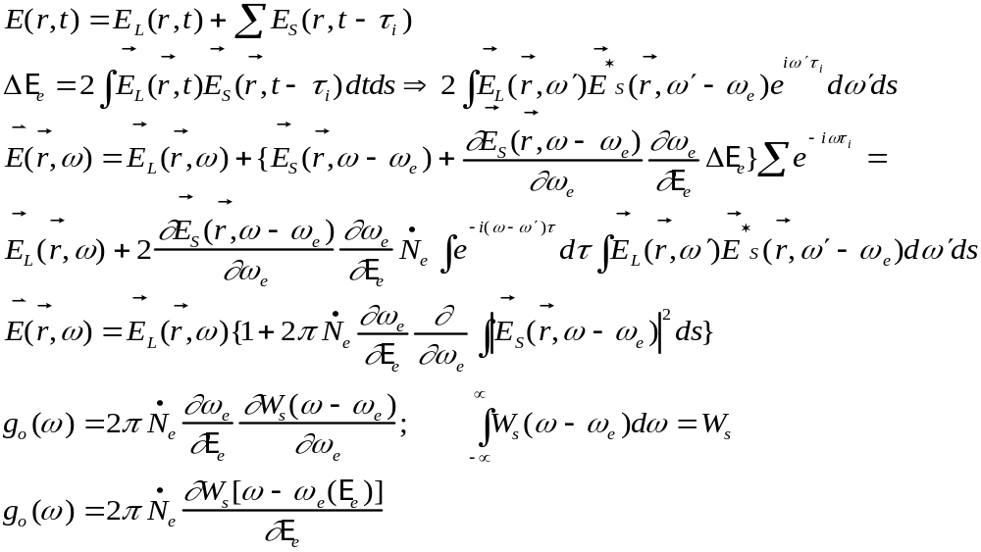
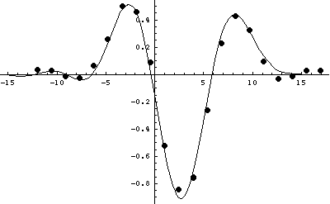
FEL small signal and small gain
If in the far field region one has fields from an external source
and fields from spontaneous emission from particles

