Slide 1
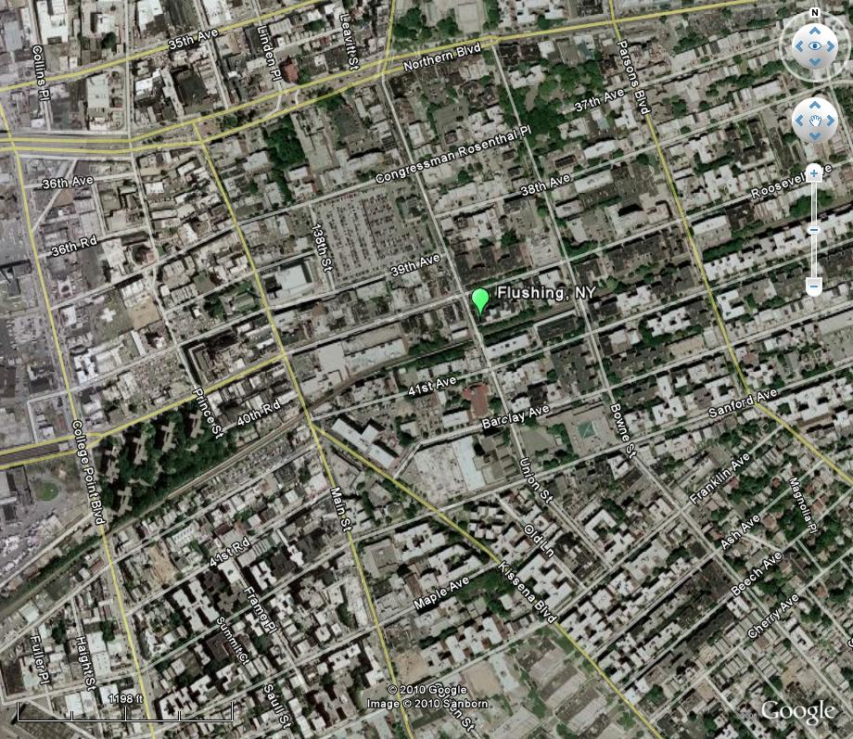

Flushing NY New Lease
Delineated Area:
Northern Boundary: Northern Blvd
Southern Boundary: Sanford Ave
Eastern Boundary: Parsons Blvd
Western Boundary: College Point Blvd

