Slide 1
Climate Change, Sustainability and Massachusetts
EPP Vendor Fair
October 26, 2004
Worcester, MA
Eric Friedman, EOEA
MA Climate Protection Plan
State Government Sustainability Guide
Agency Planning
Waste/Climate Case Study

Slide 2
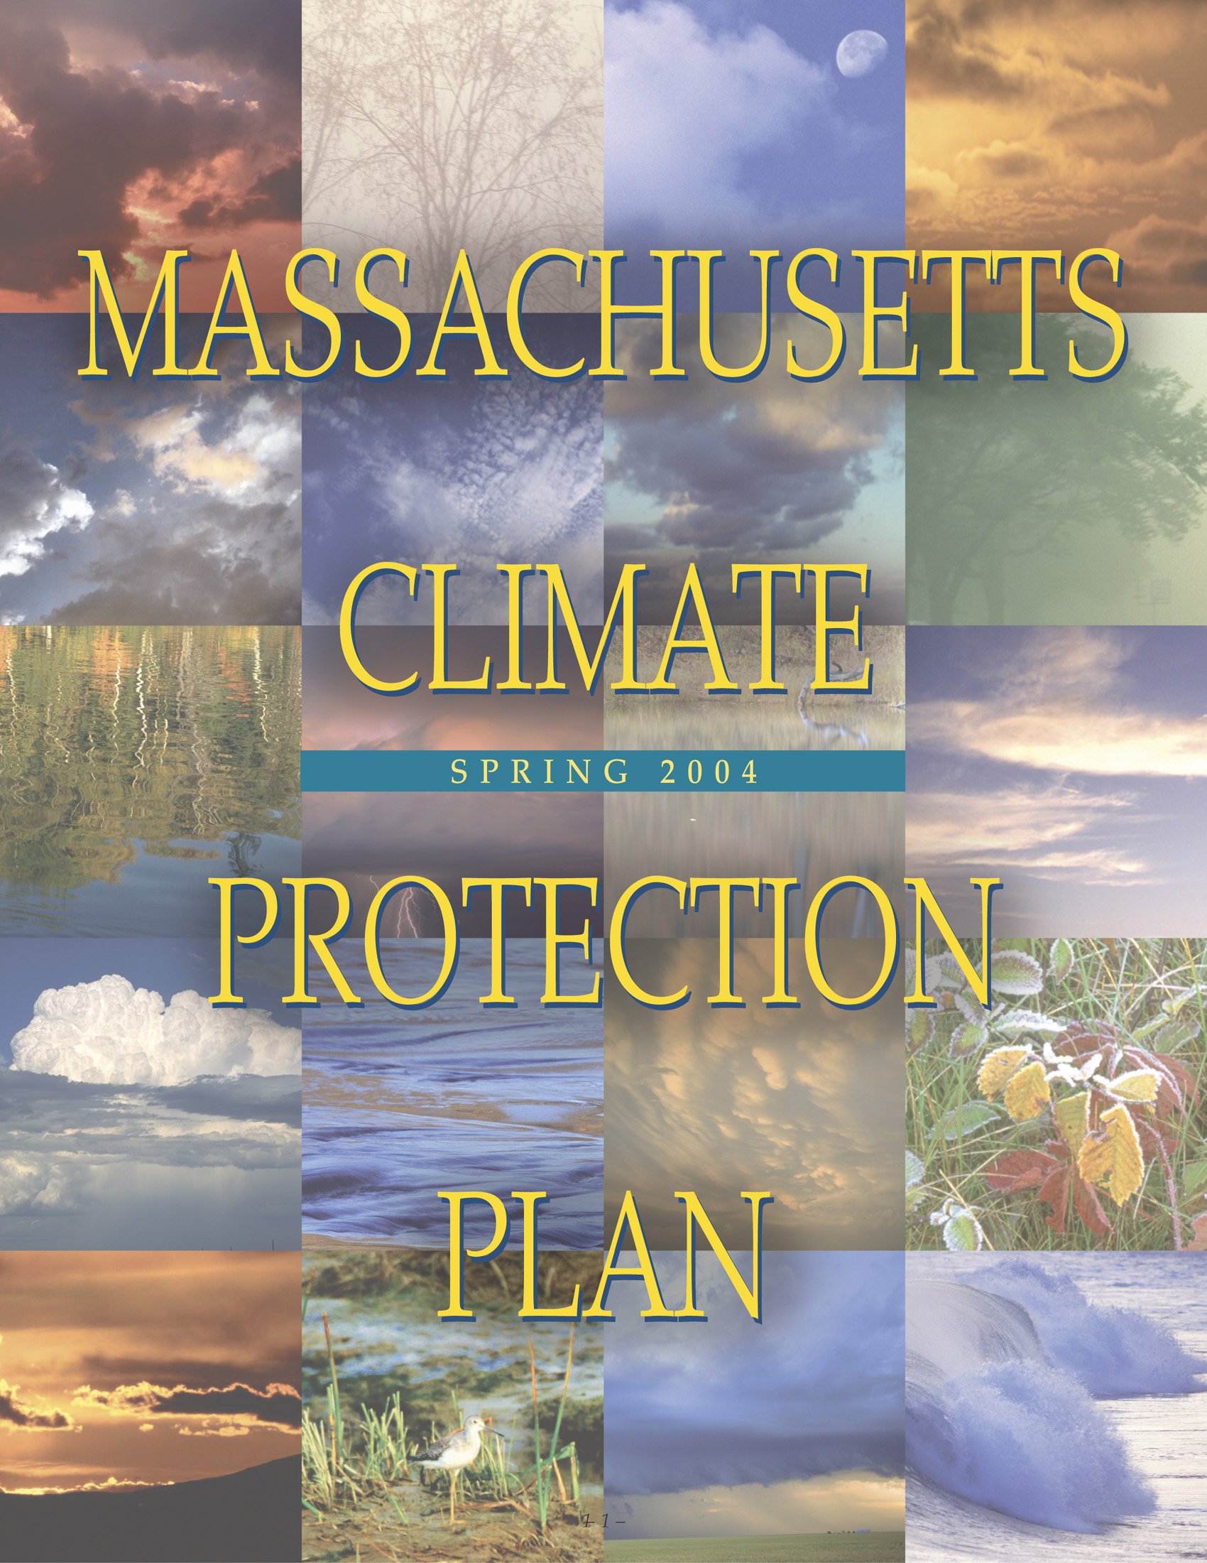
MA Climate Protection
Plan
Released May 6th by Governor Romney
Sets long-range targets and includes 72 measures
  “These are actions we can and must take now; if we are to have “no regrets” when we transfer our temporary stewardship of this earth to the next generation.” Gov. Romney

Slide 3
The Rationale Behind the Plan
Most Scientists Agree:
Glacial melting, forest fires, more severe storm patterns and heavy rainfall events, and then periods of drought will result from global warming
Global temperatures are up 0.7 – 1.4 degrees F, New England coastal areas are showing an average increase of 1.9 degrees
The 5 warmest years on record are, starting with the hottest, 1998, 2002, 2003, 2001, and 1997 (the 10 hottest years ever recorded all occurred since 1990).
Notes:
Weather extremes: Already a New England feature, are likely to become more frequent and cause more damage under all climate change scenarios:
The winter of 1999/2000 was the warmest recorded (replacing the winter of 1998/1999 as the warmest previously, which in turn had replaced 1997/1998)
Severe ice storm hits northern New England, New York and Eastern Canada (January 1998)
Longest snow-free period ever recorded at Logan Airport (304 days 1999/2000)
And in the rest of globe, extreme weather events have started occurring with regularity.
Public Health: Hotter weather and more frequent and severe heat waves pose multiple risks: heat-related deaths, increase in tropical and insect borne diseases such as West Nile, Hanta virus, and Lyme disease, more frequent air pollution episodes, raised pollen counts, for example.
Fisheries: Warming ocean and changing coastal current are significantly altering coastal and marine ecosystems, affecting the distribution, growth rate and survival of species such as the Atlantic cod, lobster and yellowtail flounder. Reduction in species and quantities of landings (also from wetlands losses).

Slide 4
Our Own Impacts
MA state-wide emissions are comparable to the total emissions of whole countries (i.e. Portugal, Egypt, Austria, or Greece).
If the New England/ Eastern Canadian Region was classified as a country, it would be the 12th largest emitter of GHG in the world.
Add NY and NJ = 5th largest.
MA emits 1.9% of the total U.S. inventory with 2.4% of the population
19.2 tons per person in MA compared to 26.3 tons per capita in the US and 3.3 tons globally

Slide 5
Plan Priority Areas
Inventory and Registry of GHG emissions
Modernize Energy and Transmission Systems
Promote Energy Efficiency and Renewables
Promote Efficient Transportation Technology, and Better Planning for Communities and Transportation Systems
Lead by example in State Government
Natural Resources: Adaptation and Impacts
Public Outreach and Education

Slide 6
Plan’s 10 Chapters
Tough but Realistic Targets
Assessing & Communicating Emissions Trends
State Sustainability – Leadership by Example
Cities and Towns and Climate Protection Partners
Business, Industry, and Institutions as Climate Protection Partners
Clean and Reliable Energy
More Efficient Buildings: Reducing Pollution through Sustainable Design & Construction
Transportation & Sustainable Development: Increasing Choices, Reducing Emissions
Vehicles: Supporting Clean, Efficient New Technologies
Natural Resource Protection as a Climate Strategy

Slide 7
1. Tough but Realistic Targets
Short-Term
Reduce GHG emissions to 1990 levels by 2010
Medium-Term
Reduce GHG emissions 10% below 1990 levels by 2020
Long-Term
Reduce GHG emissions to eliminate threat – 75-85% below current levels

Slide 8
2. Assess and Communicate Trends
Develop statewide GHG inventory
Enhance tracking of CO2 sources
Require CO2 impacts in MEPA projects
Education public about impacts of electricity generation

Slide 9
3. State Sustainability
Promote GHG reductions across state government – 25% reduction by 2012
Establish GHG inventory and track progress
Promote sustainable design for state buildings
Purchase more fuel efficient cars
Promote recycling and water conservation
Stimulate markets for EPPs
Purchase renewable electricity for state gov’t.

Slide 10
4. Cities and Towns
Create climate change roundtable
Encourage purchase of renewable energy
Promote recycling and energy efficiency
Target tree planting and efficient traffic and street lighting

Slide 11
5. Partnering with Business, Industry and Institutions
Create a CO2 registry with other states
Create an emissions and trading program
Facilitate business leaders roundtable
Initiate a Governors Climate Change Challenge
Provide T/A and promote distributed generation at businesses

Slide 12
6. Clean and Reliable Energy
Provide incentives for renewable energy and support meeting the RPS (4% renewables by 2009)
Support the Regional Greenhouse Gas Initiative (RGGI)
Encourage regulations that promote small-scale distributed generation
Implement new appliance energy-efficiency standards
Reduce barriers to renewable energy
Target increase in efficiency of residential oil systems use through incentives

Slide 13
7. More Efficient Buildings
Continue work on Sustainable Design efforts for state buildings
Initiate a SD roundtable and promote SD among design professionals
Incorporate SD approaches into MEPA projects
Support existing green schools program

Slide 14
8. Transportation and Sustainable Development
Favor transit oriented development
Include GHG emissions as criteria in transportation decisions
Increase parking at train stations
Reduce emissions at Logan Airport
Develop new pedestrian and bicycle policies, programs and facilities

Slide 15
9. Support Clean, Efficient Vehicle Technologies
Provide consumer incentives to purchase fuel-efficient vehicles
Promote cleaner vehicles and fuels in public transit fleets
Use cleaner train engine technology to reduce soot
Adopt GHG emissions standards for new light-duty vehicles
Eliminate unnecessary idling of buses
Support HOV lane access for clean/efficient vehicles

Slide 16
10. Natural Resources
Promote strategies that preserve trees
Develop comprehensive biomass policy
Make farms part of protection and mitigation strategies
Integrate carbon resource management with other natural resource goals
Continue aggressive open space and wetlands protection

Slide 17
Plan Implementation
Executive committee coordinated by Office of Commonwealth Development (Doug Foy)
Implementation partners include EOEA, DEP, DOER, DTE, MassHighway, MBTA, OSD, DCAM, etc.
7 implementation committees established to develop action plans for dozens of items

Slide 18
Resources
OCD & Climate Plan: www.mass.gov/ocd
State Sustainability: www.mass.gov/envir/Sustainable
DOER efficiency and renewables info: www.mass.gov/doer
Mass Technology Collaborative: www.mtpc.org
Eric Friedman, Director of State Sustainability
EOEA, 100 Cambridge St. 9th Floor, Boston, MA 02114
Eric.friedman@state.ma.us / 617-626-1034

