Slide 1
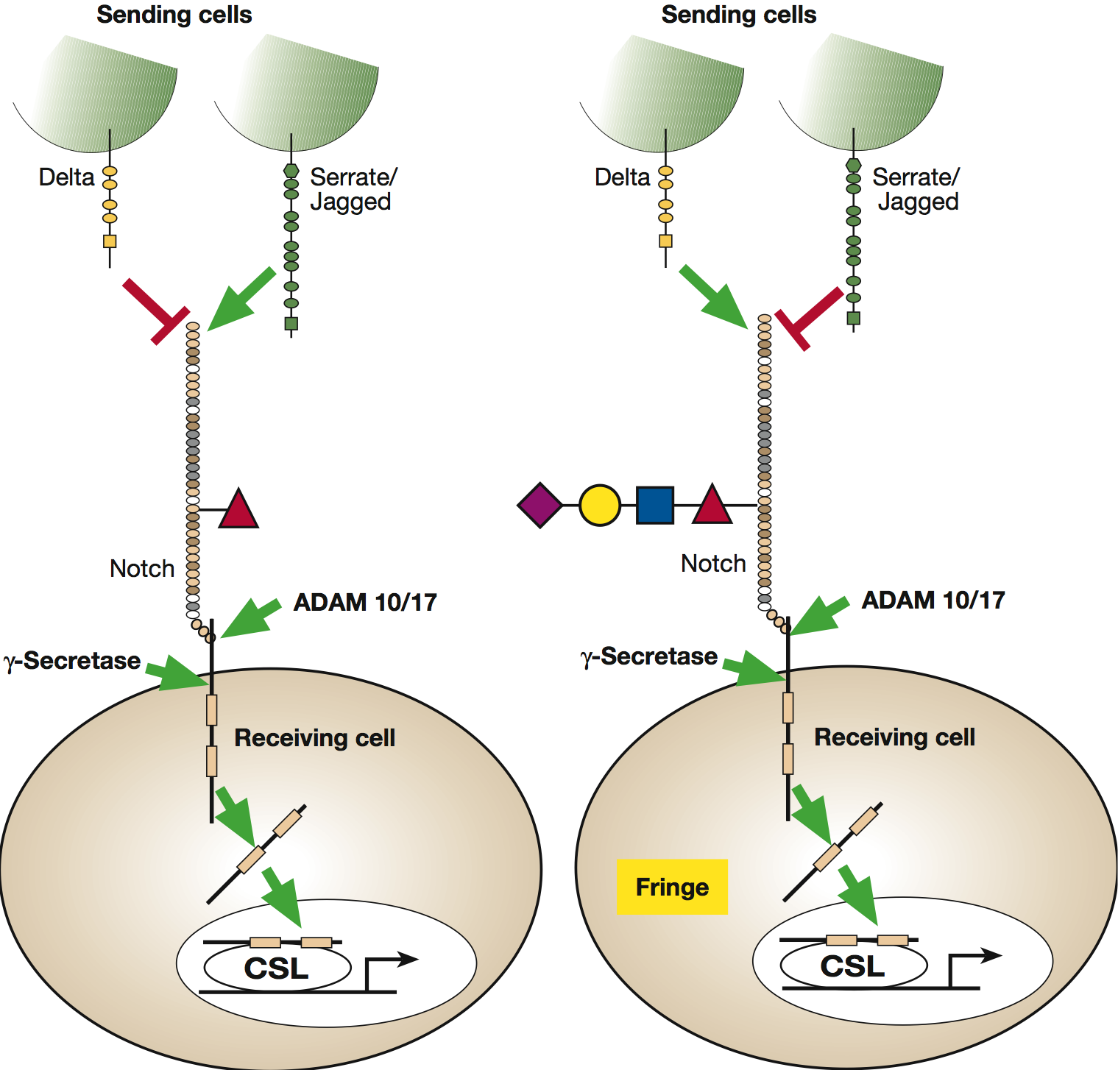


Notch signaling pathway
Essentials of Glycobiology
Chapter 12, Figure 3
Second Edition
Notes:
FIGURE 12.3. Notch signaling pathway. Notch exists on the cell surface as a heterodimer where the extracellular domain is tethered to the transmembrane/intracellular domain by noncovalent, calcium-dependent interactions. Notch is activated by ligand (members of either the Delta or Serrate/Jagged families) expressed on the surface of a “sending cell.” Both ligands are shown, but typically the sending cell would express one or the other. Binding of ligand induces a conformational change in the Notch receptor, exposing a protease site for a cell-surface protease (either ADAM 10 or 17). This extracellular cleavage is followed by a second cleavage, catalyzed by γ-secretase, which results in release of the Notch intracellular domain as a soluble protein in the cytoplasm of the “receiving cell.” The Notch intracellular domain translocates to the nucleus where it interacts with members of the CSL family of transcriptional regulators and activates transcription of a number of downstream gene products. (Left panel) Notch expressed in cells without Fringe; (right panel) with Fringe. The presence of Fringe results in elongation of O-fucose to a tetrasaccharide and alters the ability of Notch to respond to ligands on the sending cell. (Modified, with permission of the Annual Review of Biochemistry, from Haltiwanger R.S. and Lowe J.B. 2004. Annu. Rev. Biochem. 73: 491–537, ©Annual Reviews.)

