Slide 1
EIC@JLab (more general: EIC Project)
– Plans, Politics and Beyond
Rolf Ent
Nuclear Chromo-Dynamic Studies with a Future EIC
Workshop at Argonne National Laboratory
April 07-09, 2010

Slide 2
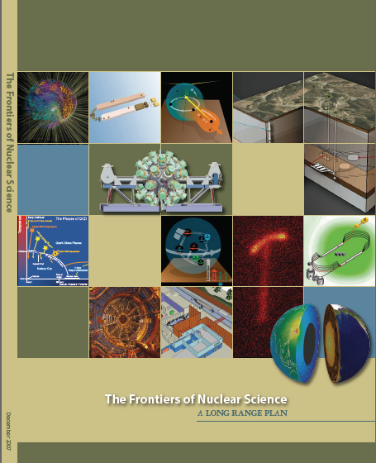
EIC Project - Status
NSAC 2007 Long-Range Plan:
“An Electron-Ion Collider (EIC) with polarized beams has been embraced by the U.S. nuclear science community as embodying the vision for reaching the next QCD frontier. EIC would provide unique capabilities for the study of QCD well beyond those available at existing facilities worldwide and complementary to those planned for the next generation of accelerators in Europe and Asia.”
MEIC/ELIC = a 3-11 GeV on 20-60 GeV ep/eA collider
    fully-polarized, longitudinal and transverse
    luminosity: about 10³⁴ e-nucleons cm⁻² s⁻¹
    Almost all parameters “defendable”?
    upgradable to higher energies (250 GeV protons)

Slide 3
(M)EIC@JLab: Basic Considerations
Optimize for nucleon/nuclear structure in QCD
    - access to sea quarks/gluons (x > 0.01 or so)
    - deep exclusive scattering at Q² > 10
    - any QCD machine needs range in Q²
→ s = 1000 or so to reach decade in Q²
→ high luminosity, 10³⁴ or so essential
→ lower, more symmetric energies for resolution & PID
Not driven by gluon saturation (small-x physics) …
    … avoid fundamental conflict of “classical” EIC
“Sweet spot” for
    - electron energies from 3 to 5 GeV (minimize synchrotron)
    proton energies ranging from 20 to 60 GeV
    but larger range of s accessible (E_{e} = 11 GeV, E_{p} = 12 GeV)
Decrease R&D needs, while maintaining high luminosities
    Potential future upgrade to high-energy collider,
    but no compromising of nucleon structure capabilities

Slide 4
Current Ideas for a Collider
Design Goals for Colliders Under Consideration World-wide
 | Energies | s | luminosity
MEIC@JLab | Up to 11 x 60 | 240-2650 | Close to 10³⁴
Future ELIC@JLab | Up to 11(22?) x 250 | 11000 (22000?) | Close to 10³⁵
Staged MeRHIC@BNL | Up to 4 x 250 | 800-4000 | Close to 10³³
eRHIC@BNL | Up to 20 x 325 | 26000 | Few x 10³³
ENC@GSI | Up to 3 x 15 | 180 | Few x 10³²
LHeC@CERN | Up to 70 x 7000 | 1960000 | 10³³
Present focus of interest (in the US) are the (M)EIC and Staged MeRHIC versions, with s up to 2650 and 4000, resp.

Slide 5
The “Base EIC”
This is my personal and temporal judgment, and may not agree with what a base EIC will turn out to be.
Range in energy from s = few 100 (COMPASS = 350) to s = few 1000
Variability in energy without major changes
Ion species up to A = 200
Both longitudinal and transverse (light) ion polarization, > 70%
Longitudinal electron polarization, > 70%
Preference for (at least) two independent interaction regions
Clear upgradeable path towards higher energy
For such a “Base EIC”, the various energy-luminosity profile(s) need to be balanced against the science output, the dollar costs, and the technical viability.
Ongoing process: refine the science requirements in terms of energy and luminosity, validate the pre-conceptual designs and (early) cost range estimates

Slide 6
Both laboratories are working together to get advice on the best steps towards a US Electron-Ion Collider.
Sam Aronson and Christoph Lehmann/Hugh Montgomery have named an international EIC Advisory Committee:
Joachim Bartels Allen Caldwell
Albert De Roeck Walter Henning (chair)
David Hertzog Xiangdong Ji
Robert Klanner Alfred Mueller
Katsunobu Oide Naohito Saito
Uli Wienands
1st meeting Feb. 16, 2009 at SURA headquarters, D.C.
2nd meeting Nov. 2&3, 2009 at Jefferson Lab
3rd meeting around September???, 2010 At BNL???
Concrete design for EIC@Jlab requested by this meeting
Internal reviewed cost estimate requested by this meeting

Slide 7
(M)EIC@JLab: Plan and Deliverables
Accelerator Design “Contract”
  Medium energy with scaled down parameters (ELIC version M.1)
  “Contract” revision (end of 2010), after user workshops and the next EIC AC meeting
“Design Manual”
  A 20 to 30 page document, archived in web
  Explanation of high level design choices
  Main and secondary parameters, schemes
  Major components, and interfaces between them
Action items
  Finish in a week per action item(?)
  Work scope
    Collecting information/references
    Performing estimations/calculations if applicable
    Formulate a solution/recommendation
    Present in ELIC R&D meeting
    Write a (minimum) half page on each item for the “design manual”
Similar Action Item: Detector/IR document

Slide 8
EIC Project - Roadmap
Year | CEBAF Upgrade | Electron-Ion Colldier
1994 | 1st CEBAF at Higher Energies Workshop
1996 (LRP) | CEBAF Upgrade an Initiative
~2000 | Energy choice settled, “Golden Experiments” | 1st workshops on US Electron-Ion Collider
2002 (LRP) | JLab 12-GeV Upgrade 4th recommendation | Electron-Ion Collider an Initiative
2007 (LRP) | JLab 12-GeV Upgrade highest recommendation | Electron-Ion Collider “half-recommendation”
2010 |  | EIC “Golden Experiments”???
2013? (LRP) | JLab 12-GeV & FRIB construction highest recommendation? | EIC a formal (numbered) recommendation?
2015 | JLab 12-GeV Upgrade construction complete | EIC Mission Need, formal R&D ongoing?
2025? |  | EIC construction complete?

Slide 9
Electron-Ion Collider – JLab User Meetings Roadmap
March 12 + 13 @Rutgers: Electron-Nucleon Exclusive Reactions
March 14 + 15 @Duke: Partonic Transverse Momentum in Hadrons:
        Quark Spin-Orbit Correlations and Quark-Gluon Interactions
April 07, 08, 09 @ANL: Nuclear Chromo-Dynamic Studies
May 17 +18 @W&M: Electroweak Studies
June 03 + 04? @JLab: MEIC Detector Workshop
June 07,08,09 2010 JLab Users Group Meeting
(with session dedicated to a summary of users workshops,
held in Spring 2010, that explored physics motivations of
an Electron-Ion Collider, entitled
“Beyond the 12 GeV Upgrade: an EIC at JLab?”)

Slide 10

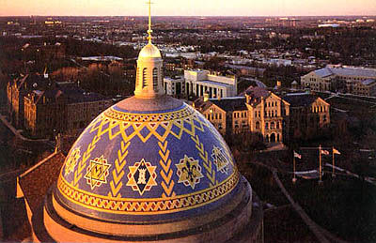

Electron-Ion Collider – Roadmap
EIC (eRHIC/ELIC) webpage: http://web.mit.edu/eicc/
Last meeting: January 10-12, 2010 @ Stony Brook
Next meeting: July 29-31, 2010
@ Catholic University, DC
Long INT10-03 program @ Institute for Nuclear Theory, Seattle,
centered around spin, small-x, imaging, electroweak
September 10 – November 19, 2010
Weekly meetings at both BNL and JLab
Wiki pages at http://eic.jlab.org/ & https://wiki.bnl.gov/eic
(see also https://wiki.bnl.gov/eic/index.php/Luminosity)

Slide 11
EIC Project - Science
General EIC @ INT Science Focus Areas:
    Origin of Nucleon Spin
    Strong Color Fields
    Imaging
    EW physics
Or, my own personal Elevator-Talk EIC science goals:
Map the spin and 3D quark-gluon structure of protons
(show the nucleon structure picture of the day…)
Discover the role of gluons in atomic nuclei
(without gluons there are no protons, no neutrons, no atomic nuclei)
Understand the creation of the quark-gluon matter around us
(how does E = Mc² work to create pions and nucleons?)
( add electroweak…)
Not there yet, but lots of progress

