Slide 1
Gonorrhea
Sexually Transmitted Disease Surveillance 2001
Division of STD Prevention

Slide 2

Gonorrhea — Reported rates: United States, 1970–2001 and the Healthy People year 2010 objective
Note: The Healthy People 2010 (HP2010) objective for gonorrhea is 19.0 cases per 100,000 population.

Slide 3
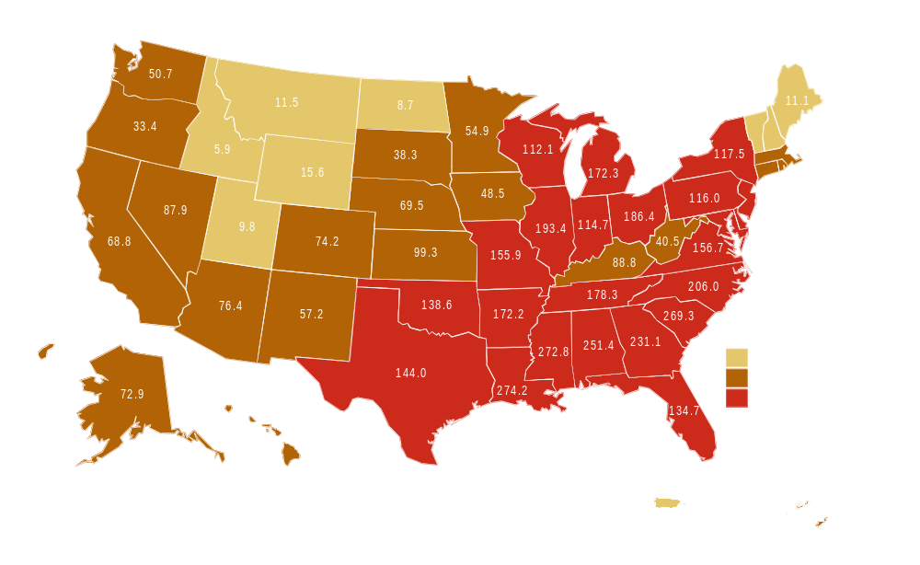
Gonorrhea — Rates by state: United States and outlying areas, 2001
Note: The total rate of gonorrhea for the United States and outlying areas (including Guam, Puerto Rico and Virgin Islands) was 126.9 per 100,000 population. The Healthy People year 2010 objective is 19.0 per 100,000 population.

Slide 4
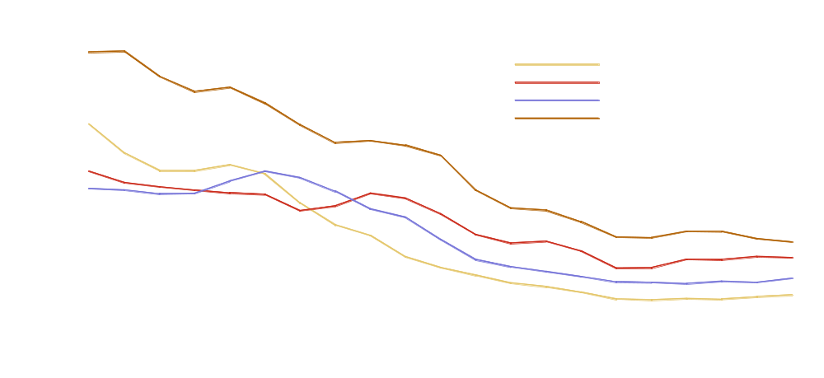
Gonorrhea — Rates by region: United States, 1981–2001 and the Healthy People year 2010 objective

Slide 5
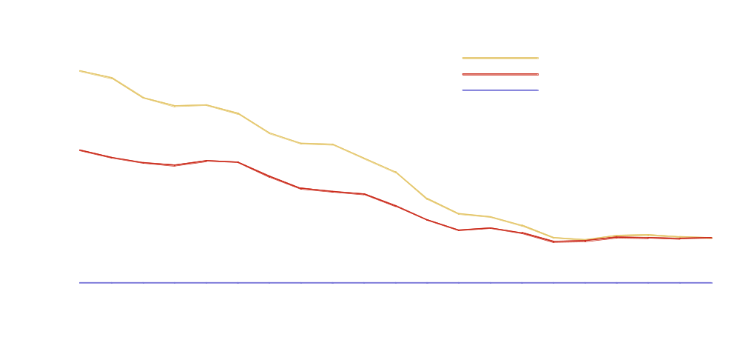
Gonorrhea — Rates by sex: United States, 1981–2001 and the Healthy People year 2010 objective

Slide 6
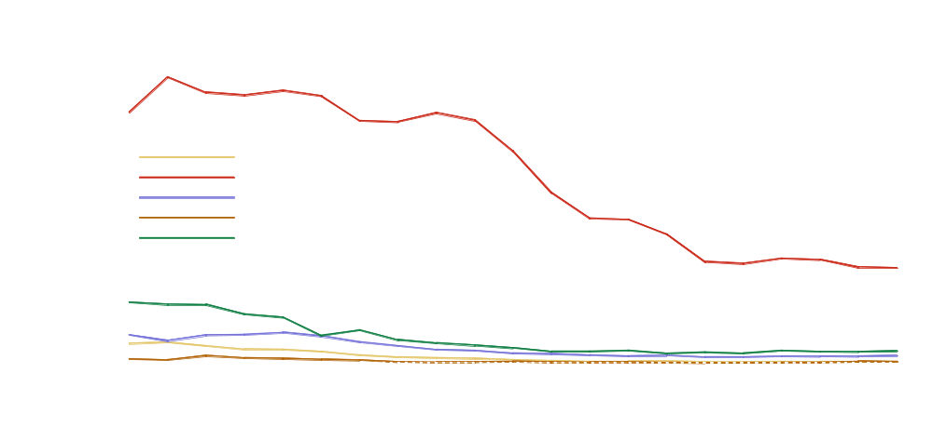
Gonorrhea — Rates by race and ethnicity: United States, 1981–2001 and the Healthy People year 2010 objective

Slide 7

Gonorrhea — Age- and sex-specific rates: United States, 2001

Slide 8
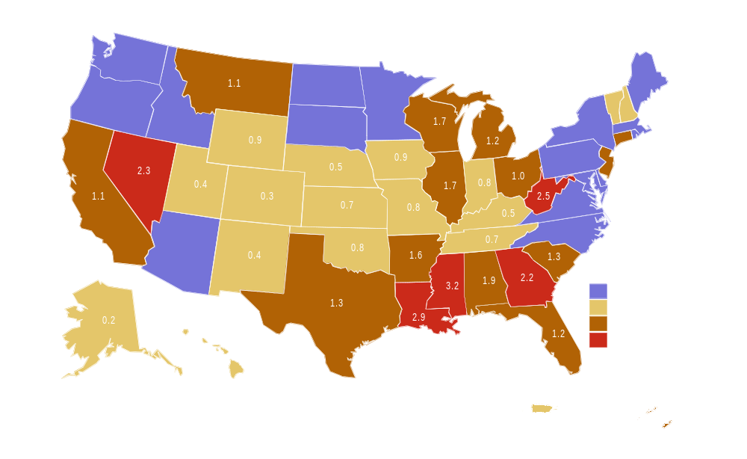
Gonorrhea — Positivity among 15-24 year old women tested in family planning clinics by state: United States and outlying areas, 2001
*States reported gonorrhea positivity data on less than 500 women aged 15-24 years during 2001.
SOURCE: Regional Infertility Prevention Program; Office of Population Affairs; Local and State STD Control Programs; Centers for Disease Control and Prevention

Slide 9
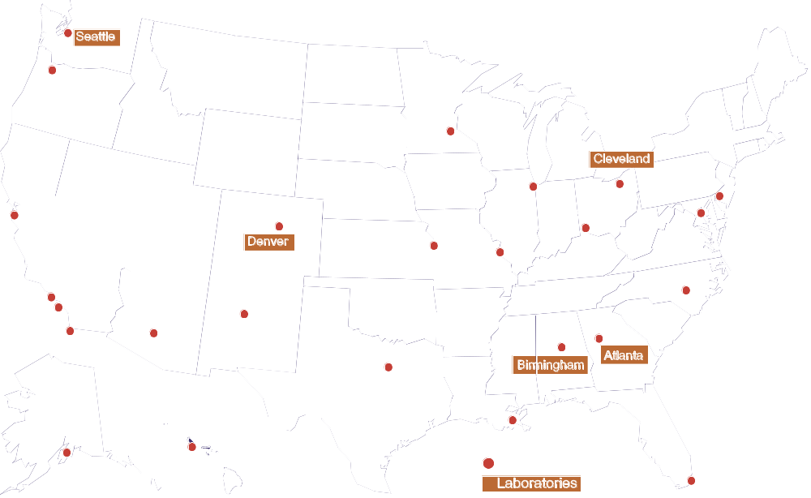
Gonococcal Isolate Surveillance Project (GISP) — Location of participating clinics and regional laboratories: United States, 2001
Tripler AMC

Slide 10
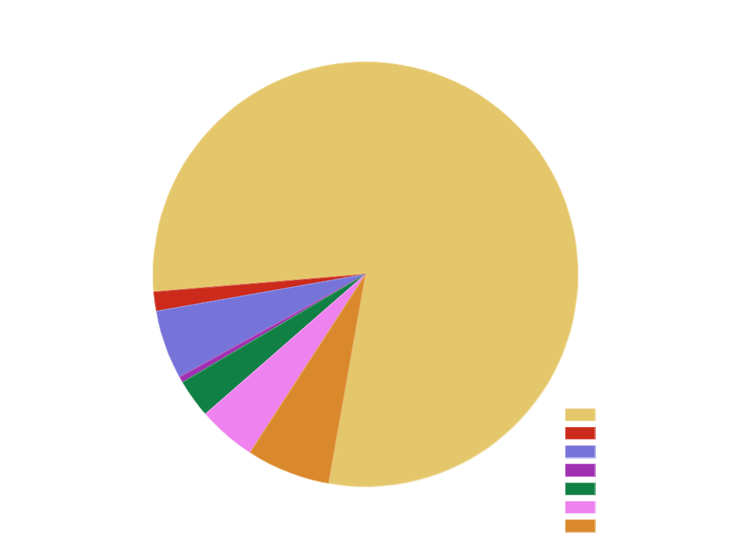
Gonococcal Isolate Surveillance Project (GISP) — Penicillin and tetracycline resistance among GISP isolates, 2001
Note: PPNG=penicillinase-producing N. gonorrhoeae; TRNG=plasmid-mediated tetracycline resistant N. gonorrhoeae; PPNG-TRNG=plasmid-mediated penicillin and tetracycline resistant
N. gonorrhoeae; PenR=chromosomally mediated penicillin resistant N. gonorrhoeae; TetR=chromosomally mediated tetracycline resistant N. gonorrhoeae; CMRNG=chromosomally mediated penicillin and tetracycline resistant N. gonorrhoeae.

Slide 11
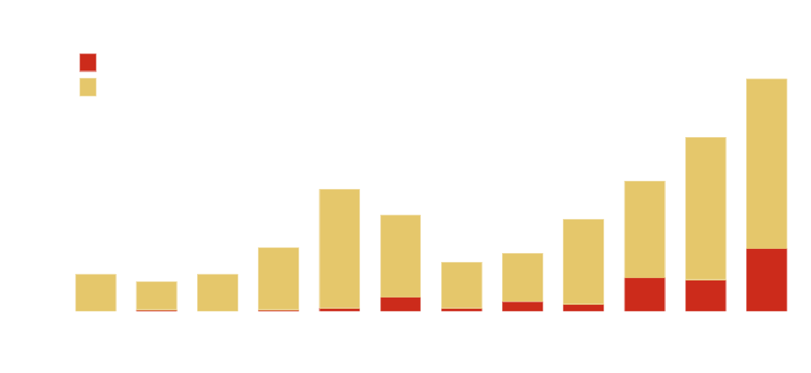
Gonococcal Isolate Surveillance Project (GISP) — Percent of Neisseria gonorrhoeae isolates with resistance or intermediate resistance to ciprofloxacin, 1990–2001
Note: Resistant isolates have ciprofloxacin MICs >1 μg/mL. Isolates with intermediate resistance have ciprofloxacin MICs of 0.125 - 0.5 μg/mL. Susceptibility to ciprofloxacin was first measured in GISP in 1990.

Slide 12
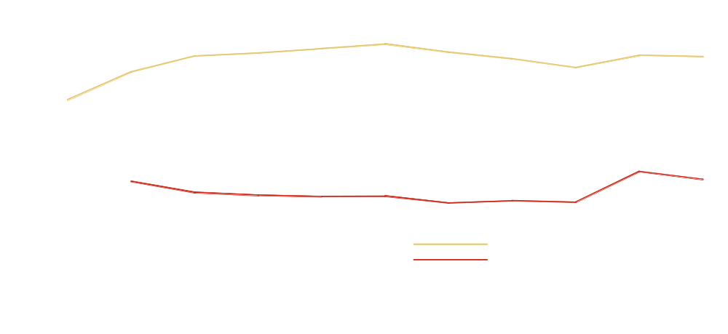
Gonococcal Isolate Surveillance Project (GISP) — Percent of men with gonorrhea who had a previous gonorrhea infection, 1991–2001
*Data first collected in 1991.
**Data first collected in 1992.

