Slide 1
RACT- CAIR- BART
Stakeholder Meeting
January 31, 2006
Massachusetts Department of Environmental Protection
Bureau of Waste Prevention

Slide 2
Purpose of Meeting
Over the next 1-3 years, states must revise
their State Implementation Plans (SIPS) to
address requirements of 3 EPA rules:
8-hour Ozone Standard
Clean Air Interstate Rule (CAIR)
Regional Haze/Best Available Retrofit Technology (BART) rules

Slide 3
Purpose of Meeting
Provide background on upcoming SIP requirements;
Provide an overview of ongoing planning to meet these SIP requirements;
Preview potential strategies to meet 3 EPA rules that may affect MA stakeholders.
Identify questions and issues.

Slide 4
Purpose of Meeting
Today’s invited stakeholders:
Industrial, commercial or institutional boilers (ICI boilers) with capacity >100mmBtu/hr;
Electric Generating Units (EGUs);
MA NOx Budget Program participants (310 CMR 7.28);
“BART eligible” sources under the Regional Haze program.

Slide 5
8-Hour Ozone – MA Status
MA is non-attainment statewide with a classification of “moderate.”
MA ozone SIP revisions required:
    September 2006 – Reasonably Available Control Technology (RACT) SIP
    September 2007 - Attainment Demonstration SIP showing how Eastern and Western MA non-attainment areas will meet 8-hour standard by 2010

Slide 6
8-Hour Ozone – OTC Planning
What are we doing to meet ozone SIP requirements?
MassDEP is participating in Ozone Transport Commission (OTC) regional planning process (12 states and D.C.).
OTC process is looking at 2 questions:
  What amount of additional emission reductions will be needed to bring OTC states into attainment?
  What regional control strategies should be adopted to achieve additional reductions?

Slide 7
8-Hour Ozone – OTC Planning
1. What amount of additional emission reductions will be needed for attainment within OTC region?
Multi-state emissions inventory and modeling effort.
Modeling to assess status of each OTC state by 2009 accounting for growth as well as emission reductions expected by then (“on-the books/on-the way” measures).
Results will show whether reductions beyond those already expected will be needed to attain ozone standard.
Modeling not completed but expectation is that further reductions will be needed in some states.

Slide 8
8-Hour Ozone – OTC Planning
2. What regional control strategies should be adopted to achieve the additional reductions?
Reviewing all sources – mobile, point and area – to see what additional reductions are feasible.
Includes review of reductions from EGUs that go beyond EPA’s rule to reduce EGU emissions (CAIR).
Includes review of RACT for sources of NOx and VOC emissions.

Slide 9
8-Hour Ozone - RACT
What is RACT (Reasonably Available Control Technology)?
Required on existing stationary emission sources in non-attainment areas.
Defined as the lowest emission level a facility is capable of meeting through the application of control technology, considering both technical and economic feasibility.
Section 183(c) of the CAA requires EPA to “revise and update…[RACT] as the Administrator determines necessary.”

Slide 10
8-Hour Ozone - RACT
1995 NOx RACT (under 1-hour ozone standard):
RACT required for facilities major for NOx emissions
MA 1995 RACT Categories:
Reciprocating Engines
Combustion Turbines
Municipal Waste Incinerators
Glass Furnaces
Boilers (>20 mmBtu/hr)

Slide 11
8-Hour Ozone - RACT
1995 Boiler RACT based on:
Energy input capacity
Fuel type
Combustion approach (stoker-fired, face-fired, etc…)
Heat release rate
Potential Emissions
Examples:
Small boilers with nameplate capacity 20-50 mmBtu/hr
        NOx RACT = DEP-approved annual tune-up
Tangential fired coal burning dry bottom boilers with nameplate capacity > or = 100mmBtu/hr
        NOx RACT = 0.38 lbs NOx/mmBtu

Slide 12
8-Hour Ozone - RACT
Now looking at RACT again - two purposes:
States must review RACT controls to meet EPA’s 8-hour ozone RACT SIP requirement.
OTC is reviewing RACT categories to assess potential for tighter RACT controls within OTC as regional attainment measure.

Slide 13
8-Hour Ozone – RACT
State RACT SIP Requirement:
MA and other states that adopted RACT under 1-hour ozone standard may not need to adopt new controls.
But - must review whether what was considered RACT when previously adopted is still RACT –are there new technologies, less costly controls, other factors?
May decide to adopt new state RACT limits or that nothing more is needed to satisfy RACT.
Submit our determination to EPA as a RACT SIP.

Slide 14
8-Hour Ozone – OTC Planning
OTC Review of RACT in OTC Region:
reviewing multiple RACT categories as possible candidates for tighter NOx and VOC limits
OTC Control Strategies Committee stakeholder meeting 1/24/06 discussed a number of categories and controls (www.otcair.org).
Categories include: metal production facilities; lime and cement kilns; glass furnaces; printing, etc.
Boilers are under consideration; may recommend tighter emission rates for some boiler sizes and types.

Slide 15
8-Hour Ozone – Timeline
Late Feb. 2006 - OTC Commissioners initial recommendations for regional control strategies, including RACT.
June 2006 – OTC Commissioners final recommendations for regional control strategies. May include ICI RACT measures – or not.
Jan. – July 2006 - MA review of state RACT controls adopted under 1-hour ozone standard.
September 2006 - RACT SIP due.

Slide 16
8-hour Ozone – Next Steps
After OTC Commissioners make initial recommendations for RACT measures (Feb.), MassDEP will follow-up with ICI boiler facilities (and other source categories) to discuss OTC recommendations.
MassDEP may propose regulations taking into account OTC recommendations and our in-state assessment of current MA RACT requirements.

Slide 17
CAIR – Background
5/12/05 final Clean Air Interstate Rule (CAIR) published.
EPA found that 28 states “contribute significantly” to non-attainment of 8-hour ozone and/or PM_{2.5} standards in downwind states.

Slide 18
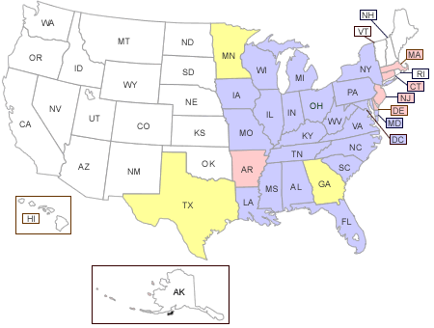
States Covered by CAIR
= Ozone and PM_{2.5} – Annual caps for SO₂ & NOx; ozone season cap for NOx
= Ozone only – Ozone season cap for NOx; = PM_{2.5} only – Annual caps for SO₂ & NOx

Slide 19
CAIR – Background
EPA determined the amount of emission reductions that each contributing state must achieve.
Based on the level of reductions that can be achieved with “highly cost-effective” controls on EGUs.
But does not require that states achieve the reductions from EGUs.

Slide 20
CAIR – Background
CAIR sets a cap for NOx and SO2 annual emissions from EGUs in states that contribute to PM 2.5 non-attainment.
2-phase declining annual emission caps:
    Phase 1 NOx cap – 2009 - 2014
    Phase 2 NOx cap – 2015 and thereafter
    Phase 1 SO2 cap – 2010 –2014
    Phase 2 SO2 cap – 2015 and thereafter

Slide 21
CAIR – Background
CAIR sets a cap for NOx seasonal emissions from EGUs in states that contribute to ozone non-attainment.
2-phase declining seasonal emission caps:
  Phase 1 2009 – 2014
  Phase 2 2015 and thereafter

Slide 22
CAIR – MA Status
MA found to contribute only to ozone non-attainment in other states. Subject to CAIR cap on ozone season emissions.
EPA used a fuel-adjusted heat input methodology to set caps: 1999-2002 heat input multiplied by fuel-adjustment factors of: 1.0 for coal, 0.6 for oil and 0.4 for gas.
Many states including MA not happy with use of fuel-adjustment factors.

Slide 23
CAIR – MA Status
MA CAIR Ozone Season NOx Budgets (tons):
  2009 – 2014: 7,551
  2015 and beyond: 6,293
MA NOx SIP Call Budget: 12,861
For 2009, 5,310 fewer NOx allowances for MA sources under CAIR ozone-season program than under NOx budget program.

Slide 24
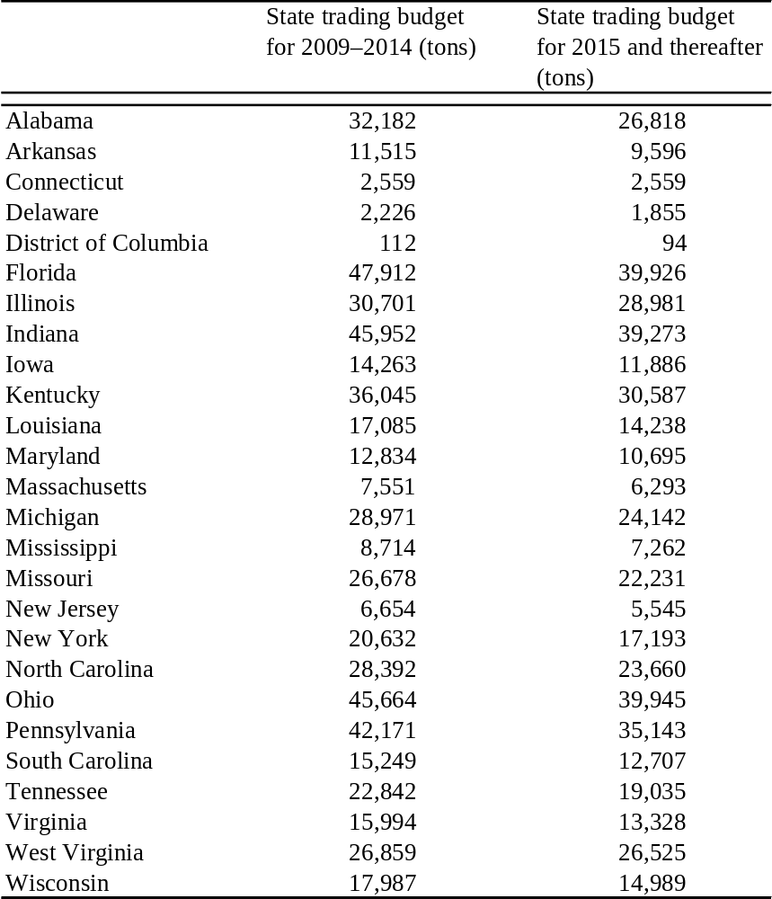
CAIR BUDGET
CAIR BUDGET

Slide 25
CAIR – Sources
CAIR Sources:
EGU = fossil-fuel fired boiler or turbine serving a generator > 25 MW nameplate capacity producing electricity for sale.
Municipal waste combustors included but EPA is proposing to exempt them.
Cogeneration units, as defined, are exempt.

Slide 26
CAIR – SIP Requirements
Other units affected:
NOx Budget (SIP Call) Program Sources –
  EPA’s CAIR trading program will replace the NOx Budget Program (310 CMR 7.28)
  State option whether to include all NOx Budget Program participants in CAIR program
Potential opt-in for sources that do not meet EGU definition if: vent through a stack and meet Part 75 monitoring and recordkeeping requirements.

Slide 27
CAIR – SIP Requirements
State must submit a SIP showing how it will achieve CAIR-required reductions.
States can achieve the reductions however they choose – control EGUs or control other sources.
If state controls only EGUs, it must adopt the state cap/budget set in CAIR.
If a state chooses to achieve reductions from other than EGUs, CAIR says how to set state CAIR budget.

Slide 28
CAIR – SIP Requirements
EPA has provided a model cap and trade rule for states to adopt to achieve EGU emissions
If a state wants its EGUs to participate in the CAIR cap and trade program, it must adopt EPA’s model rule in its CAIR SIP.
Model rule sets out most program parameters: accounts, permits, monitoring, reporting, etc.

Slide 29
CAIR – SIP Requirements
States have flexibility to revise EPA’s model rule for certain program elements:
Whether to include NOx SIP Call sources that do not meet CAIR EGU definition in the CAIR ozone season NOx program.
Whether to allow sources that do not meet CAIR EGU definition to opt-in to the CAIR trading program.
Allocation method for state allowances (input vs. output, set-asides for renewables, etc.)

Slide 30
CAIR – SIP Timing
Final CAIR rule (3/05) requires state CAIR SIPS be filed by September 2006
However, in April 2005 EPA proposed a Federal Implementation Plan (FIP) incorporating CAIR provisions.
Legal rationale for FIP: states failed to submit SIPs to address interstate transport following adoption of PM2.5 standard in 1997.

Slide 31
CAIR – SIP Timing
March 2006 – EPA will promulgate final FIP rule.
FIP will impose federal CAIR program in states until EPA has approved a state’s CAIR SIP.
FIP will set state CAIR caps/budgets for 2009 and subsequent allocation years.
But EPA will not record 2009 allowances to facility accounts until December 2007 – giving states time to get their SIPs approved before then, including state preferences for allocations.

Slide 32
CAIR – SIP Options
With FIP, states now have SIP options:
Full CAIR SIP – per CAIR Final Rule.
State adopts state rule establishing CAIR trading program that includes all provisions in EPA’s model rule (but may include state preferences for allocation.)
Abbreviated CAIR SIP – per proposed CAIR FIP and final FIP to be issued 3/06.
EPA model rule goes into effect covering all provisions for state cap and trade program. By 3/07 state may submit CAIR SIP with state rule covering only state allocation preferences.

Slide 33
CAIR – SIP Options
MA anticipated CAIR SIP approach:
Not planning to file full CAIR SIP by 9/06.
Will do a rulemaking to adopt CAIR Ozone Season NOx trading program.
Will file abbreviated CAIR SIP by March 2007
Expect to propose a state-defined output-based NOx allowance allocation methodology with set-asides (as in 310 CMR 7.28).
Will sunset MA NOx Budget Program - 310 CMR 7.28.

Slide 34
CAIR – SIP Issues
MA CAIR SIP issues:
Should MA CAIR trading program include all NOx Budget Program sources (310 CMR 7.28)? (There are a number of small units (< 25MW) in current program.)
Should MA allow sources not meeting EGU definition to opt-in to CAIR?
Allocation details and timing

Slide 35
CAIR – OTC Issues
CAIR SIP Issues related to OTC planning:
OTC reviewing potential for EGUs reductions greater than and/or sooner then CAIR to address non-attainment in OTC states after CAIR.
Straw proposal under consideration (handout).
OTC also reviewing inclusion of non-EGU large boilers in trading program (and as part of RACT review).
Initial recommendation at Feb. 2006 OTC meeting.
Final recommendation at June 2006 OTC meeting.

Slide 36
CAIR – OTC Planning
Issues under consideration in OTC process:
Do OTC states need additional reductions to attain by 2010?
If so, are additional EGU reductions needed or might local (non-transport related) measures be enough?
Waiting for modeling results and review of other potential control measures as part of 8-hour ozone planning.

Slide 37
Summary
Planning is ongoing through OTC and MANE-VU and within Mass DEP.
www.otcair.org www.manevu.org
www.nescaum.org www.ladco.org
More specific preliminary recommendations will be made at Feb. 22-23 OTC meeting.
MassDEP will hold additional stakeholder meetings prior to June OTC meeting to discuss OTC preliminary recommendations.

Slide 38
Summary
If your facility received notice of this meeting by hard copy, please provide us with an e-mail address.
To get on MassDEP’s stakeholder e-mail list: nicholas.m.bianco@state.ma.us
Today’s presentations will be posted at:
www.mass.gov.dep/air under
“Massachusetts Clean Air Framework”

