Slide 1
Cataloging Education: A New Emphasis for the LIS Curriculum
ALCTS / CETRC Preconference
Catholic University of America
Washington, DC
June 22, 2007

Slide 2
When we think of LIS education…
ALA Committee on Accreditation (COA)
Accredited master’s degree
ALA-accredited schools in North America
  55 public and private institutions
  Undergraduate, master’s, and doctoral degrees
Curricular requirements
  Hours (36 semester = 58 quarter)
  Required “core” courses
  ALA guidelines

Slide 3
LIS education & higher education
Accreditation
  Regional for the institution
  Programmatic (external = ALA)
Faculty
  Sweezey decision (354 U.S. 234 (1957))
  Tenure track and contingent (part-time)
  Boyer model
    Teaching / Research / Service
    Integration / Engagement

Slide 4
LIS education & higher education
Student cycle of recruitment, admissions, matriculation, graduation, placement
Decentralized budgeting
Curricular development in response to
  Mission, vision, and goals
  Accreditation
  Professional competencies
  Learning outcomes (programmatic and course)
  Employer expectations

Slide 5
Involves adult learners
Andragogy v. Pedagogy
Life span development
New passages
Generations

Slide 6
Adult learners
Characteristics
  Individual and groups
  Dynamic
  Interactive
  Mediated
  Peer-to-peer
  Outcome-oriented
  Competency-driven
Lenses
  Life cycle development
  Learning styles
  Multiple intelligences
  Emotional intelligence
  Moral, aesthetic development
  Ethnicity and race
  Gender

Slide 7
Cataloging education
Required at 9 schools
  Clarion
  Hawaii
  Denver
  Missouri – Columbia
  North Carolina – Greensboro
  Southern Mississippi
  SUNY Buffalo
  Toronto
  Wisconsin – Madison
Faculty
  Full-time = 26
  Vacancies = 4
  Part-time = 29
Courses
  Beginning (3 hours)
  Concentration (15 hours)
  Average = 2 courses

Slide 8
Challenges to cataloging education
Tensions of competing masters
Evolution of cataloging
Recognition of integration with reference, archives, and special collections
Convergence of technologies
Responsiveness to employers

Slide 9
Challenge 1: Tensions
Institutional demands and mandates
External accrediting body
Alumni
Employers (actual and potential)
Students
  Current
  Potential

Slide 10
Challenge 2: Cataloging evolution
Organization and description of resources
Types pf resources
  Print (multi-format and multilingual)
  Digital (“born” and made)
  Media (DVD, VHS, download, etc.)
  Sound (CD, vinyl, older formats, download)
  Cartographic (paper, electronic, digital)
  Cultural heritage (archives, records, and assets)

Slide 11
Challenge 3: Integration
Cross-training of staff
Outsourcing
  Acquisitions, standing orders, approval plans
  Cataloging, processing, “shelf ready”
Staffing
  Collapsing of full-time professional positions
  Increasing paraprofessional positions to technical and public services

Slide 12
Challenge 4: Convergence
Technologies
  Supporting public and technical services
  Requiring technical skills and competencies
  Maintaining and repairing equipment
Search strategies
  Approximating Google, Yahoo, etc.
  Visualization of library catalogs
  Impending arrival of RDA

Slide 13
Challenge 5: Employers’ expectations
Theoretical knowledge
Technical skills (hardware and software)
Cataloging competencies
  Bibliographic description, authority work
  Classifying
  Subject access
Workplace competencies
  Communication (written, oral, and multilingual)
  Flexibility (work independently and collaboratively)

Slide 14
Solutions and partnerships
Communication
Mentorships
Students
Research
Next steps

Slide 15

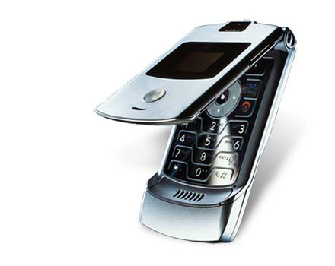
Solution 1: Communication
Professional groups
  National
  Regional
  State
Community of catalogers
LIS educators

Slide 16
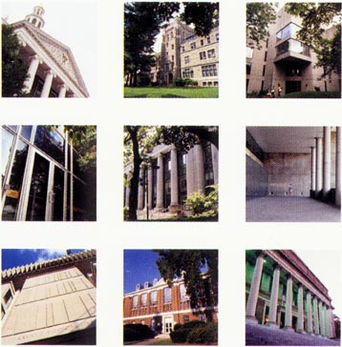
Solution 2: Mentorships
Internships
  Paid
  Unpaid
Practica
Mentorships
Service learning

Slide 17

Solution 3: Students
Support education for cataloging staff
Work with sponsors and hosts
Serve on boards / groups
Seek out learners
  Paraprofessionals
  Library school students
  Professional development

Slide 18

Solution 4: Research
Reflects shared questions
Involves using problem-solving in the “real world”
Informs practice and teaching
Involves all of us

Slide 19

Next steps

Slide 20
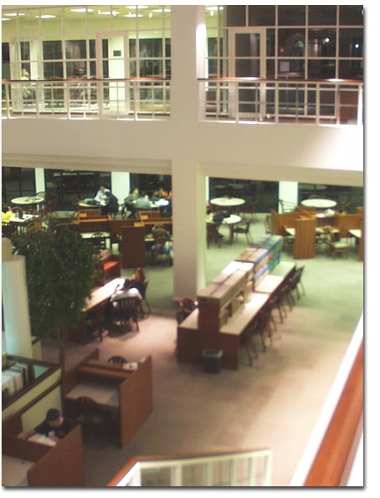
Step 1: Contact your library school
Get to know the cataloging faculty
Offer to collaborate
  Internship / practicum
  Mentor students
  Visit classes
  Work with faculty and alumni
  Serve as an advisor

Slide 21


Step 2: Volunteer
Join ALCTS
Volunteer for project and committees
Contribute training and educational materials to clearinghouses

Slide 22
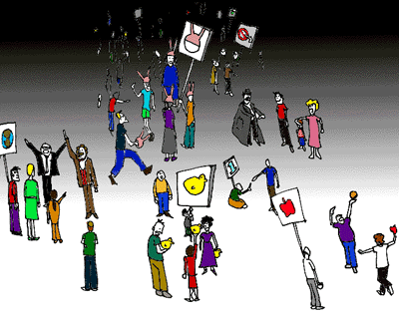
Step 3: Participate
Participate in conversations
Join listserv
  Speak up!
  AUTOCAT
  OCLC-CAT

Slide 23

Step 4: Contribute
Contribute your best ideas
Work with us
  Preparing catalogers
  Recruiting potential LIS students
  Educating the community of catalogers

Slide 24

Questions?
Sylvia D. Hall-Ellis, Ph.D.
Library & Information Science Program
Morgridge College of Education
University of Denver
1901 E. Iliff Ave., #122
Denver, Colorado 80208

