Slide 1
Exchange 2007 Pilot at LANL
Anil Karmel
Technical Staff Member
akarmel@lanl.gov
Notes:
Presentation Title Slide Notes
“UNCLASSIFIED” marking of slides is not a security requirement and may be deleted from the Slide Master (View › Master › Slide Master). In general, slides should be marked “UNCLASSIFIED” if there is potential for confusion or misinterpretation of something that could be deemed classified. For guidance on marking slides containing classified and unclassified controlled information, see the Protecting Information Web site at http://int.lanl.gov/security/protectinfo/.

Slide 2
Outline
Exchange 2007 Overview
Existing Infrastructure
Where Are We Today?
Project Key Milestones
Project Deployment Schedule
Exchange Architecture
Blackberry Pilot
Questions
Slide <number>

Slide 3
Exchange 2007 Overview
Exchange Pilot
Five distinct server roles
  Mailbox: for user mail storage
  Client Access: provides client connectivity for non-Outlook users
  Hub Transport: mail routing and policy management
  Unified Messaging: voicemail integration and inbox/calendar management via telephony interface
  Edge: Anti-virus/spam protection and policy management
64-bit only platform
  New requirement with Exchange 2007
Slide <number>
Notes:
Content Slide Notes
“UNCLASSIFIED” marking of slides is not a security requirement and may be deleted from the Slide Master (View › Master › Slide Master). In general, slides should be marked “UNCLASSIFIED” if there is potential for confusion or misinterpretation of something that could be deemed classified. For guidance on marking slides containing classified and unclassified controlled information, see the Protecting Information Web site at http://int.lanl.gov/security/protectinfo/.

Slide 4
Exchange 2007 Overview
Exchange Pilot
Exchange Features
  Outlook 2007 Client
    Integrated email and calendaring suite
    LANL Global Address List
  Outlook Web Access
    Full featured web client
  Native integration with Microsoft SharePoint and Project
Things to Note
  1GB Mailbox limit
  5000 item limit per folder
  Message recall
Slide <number>
Notes:
Content Slide Notes
“UNCLASSIFIED” marking of slides is not a security requirement and may be deleted from the Slide Master (View › Master › Slide Master). In general, slides should be marked “UNCLASSIFIED” if there is potential for confusion or misinterpretation of something that could be deemed classified. For guidance on marking slides containing classified and unclassified controlled information, see the Protecting Information Web site at http://int.lanl.gov/security/protectinfo/.

Slide 5
Existing Infrastructure
Exchange Pilot
Mail Server Infrastructure
  Cyrus Mail (IMAP)
  Clients consist of:
    Eudora
    Lotus Notes
    Mozilla Thunderbird
    Microsoft Outlook
    Apple Mail
    Others…
  Serves majority of laboratory
Calendar Infrastructure
  Meeting Maker
    Calendar system of record
Slide <number>

Slide 6
Where Are We Today?
Exchange Pilot
Alpha, Beta & Production Exchange 2007 Infrastructure implemented
Tool Evaluation Complete
  Backups: Tivoli Storage Manager for Exchange
  Monitoring: Microsoft System Center Operations Manager 2007
  Antivirus: Sunbelt Messaging Ninja
Outlook 2007 client required for connectivity to Exchange
  Required rollout of Office 2007 Professional client to IS&T users
  Conducting Beta testing of Microsoft Entourage 2008 for Macs
  Conducting Beta testing of Evolution w/ Brutus Plug-in for Linux
Slide <number>
Notes:
Content Slide Notes
“UNCLASSIFIED” marking of slides is not a security requirement and may be deleted from the Slide Master (View › Master › Slide Master). In general, slides should be marked “UNCLASSIFIED” if there is potential for confusion or misinterpretation of something that could be deemed classified. For guidance on marking slides containing classified and unclassified controlled information, see the Protecting Information Web site at http://int.lanl.gov/security/protectinfo/.

Slide 7
Project Key Milestones
Exchange Pilot
Stand up CTN Exchange 2007 HT/CA servers
  10/1/07 – 11/1/07
Stand up IS&T Exchange 2007 Mailbox servers
  11/1/07 – 11/15/07
Functionality & Load Testing
  11/15/07 – 1/15/08
Rollout Office 2007 to IS&T Users
  10/31/07 – 11/15/07
Rollout Exchange 2007 to IS&T Users
  1/15/08 – 4/15/08
Slide <number>
Notes:
Content Slide Notes
“UNCLASSIFIED” marking of slides is not a security requirement and may be deleted from the Slide Master (View › Master › Slide Master). In general, slides should be marked “UNCLASSIFIED” if there is potential for confusion or misinterpretation of something that could be deemed classified. For guidance on marking slides containing classified and unclassified controlled information, see the Protecting Information Web site at http://int.lanl.gov/security/protectinfo/.

Slide 8
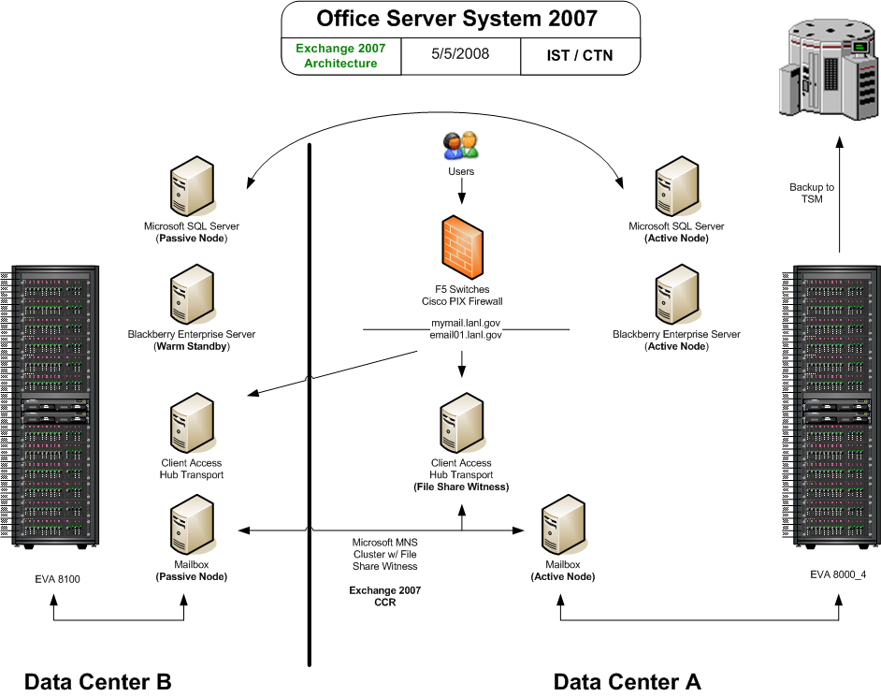

Slide <number>

Slide 9
Key Features
Blackberry Pilot
Secure access to Email & Corporate Data via Blackberry Enterprise Server 4.1 SP5
Security
  End-to-End Triple DES encryption (FIPS 140-2 compliant)
  Over-the-air wireless IT policy enforcement
  Secured with DISA/DoD Secure Technical Implementation Guide
Devices
  Blackberry 8830 World Edition (Verizon Wireless)
Slide <number>

Slide 10
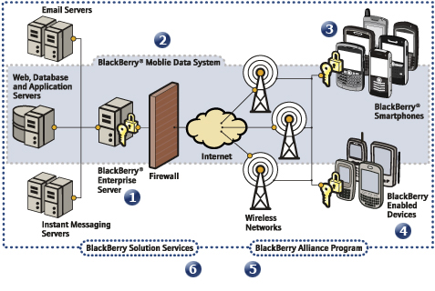
Blackberry Architecture
Blackberry Pilot
Slide <number>

Slide 11
Project Key Milestones
Blackberry Pilot
Identify & Migrate Technical Pilot Users to Exchange 2007
  4/15/08 - 5/15/08
Implement & Test BETA Blackberry Enterprise Server
  5/1/08 - 6/1/08
Identify & Migrate Customer Pilot Users to Exchange 2007
  5/15/08 – 7/15/08
Implement & Test PROD Blackberry Enterprise Server
  6/2/08 - 7/31/08
Slide <number>
Notes:
Content Slide Notes
“UNCLASSIFIED” marking of slides is not a security requirement and may be deleted from the Slide Master (View › Master › Slide Master). In general, slides should be marked “UNCLASSIFIED” if there is potential for confusion or misinterpretation of something that could be deemed classified. For guidance on marking slides containing classified and unclassified controlled information, see the Protecting Information Web site at http://int.lanl.gov/security/protectinfo/.

Slide 12
Q/A
Exchange Pilot
Questions?
Slide <number>
Notes:
Content Slide Notes
“UNCLASSIFIED” marking of slides is not a security requirement and may be deleted from the Slide Master (View › Master › Slide Master). In general, slides should be marked “UNCLASSIFIED” if there is potential for confusion or misinterpretation of something that could be deemed classified. For guidance on marking slides containing classified and unclassified controlled information, see the Protecting Information Web site at http://int.lanl.gov/security/protectinfo/.

