Slide 1
An Evolving Portrait of Head Start Families
Robert W. O’Brien, Ph.D., Mary Ann D’Elio, M.S.,
Michael J. Keane, Dr.P.H.
The CDM Group, Inc.

Slide 2
Introduction
There has been a great degree of societal change brought on by events of recent years, such as welfare reform and the diversification of the population served by Head Start. This has been reflected in the changing population that is taking advantage of Federal services for families. With these changes has come increased scrutiny of Federal programs providing services, including those designed for low-income families. If the programs that serve low-income children and their families are to be responsive to the evolving portrait of the people they serve, new data are needed on a regular basis. One goal of the Head Start Family and Child Experiences Survey (FACES) is to follow a national sample of Head Start families, to learn about the characteristics of these families, and to understand the challenges they face. The value of this information is in helping Head Start adapt policies and procedures to better fulfill its mission of assisting families in their own development as the primary nurturers of their children.

Slide 3
The Respondents
All respondents reported that they were a primary caregiver -- responsible for the daily care of the child
87.8% were the mother of the Head Start child
5.1% were the father of the Head Start child
4.2% were the grandmother of the Head Start child
2.9% were other relatives or foster parents

Slide 4
The Interview
Face-to-Face, individual interviews were completed with 3,156 families in the fall of 1997; 2,688 follow-up interviews were completed in the spring of 1998. Findings presented here are from the fall 1997 data, unless otherwise noted.
Most interviews were completed at the local Head Start centers (79.6%) or the child’s home (14.4%); 16.9% of the families were interviewed in Spanish, and 0.5% in some other language.
Most interviews lasted about one hour; respondents received $15.00 upon completion of the interview.

Slide 5
The Instrument
The FACES Parent Interview was designed to collect basic, descriptive information about the respondent, the child, and each child’s household. In addition to demographics, information was collected on the following topics:
  Satisfaction and Activities With Head Start
  Family Activities With the Child
  Disabilities
  The Primary Caregiver’s Assessment of Child Skills and Social Behavior
  Household Rules
  Employment, Income, and Housing
  Use of Community Services
  Child Care
  Family Health Care
  Home Safety Practices
  Home and Neighborhood Characteristics
  Ratings of Social Support
  Feelings of the Primary Caregiver About Herself/Himself

Slide 6
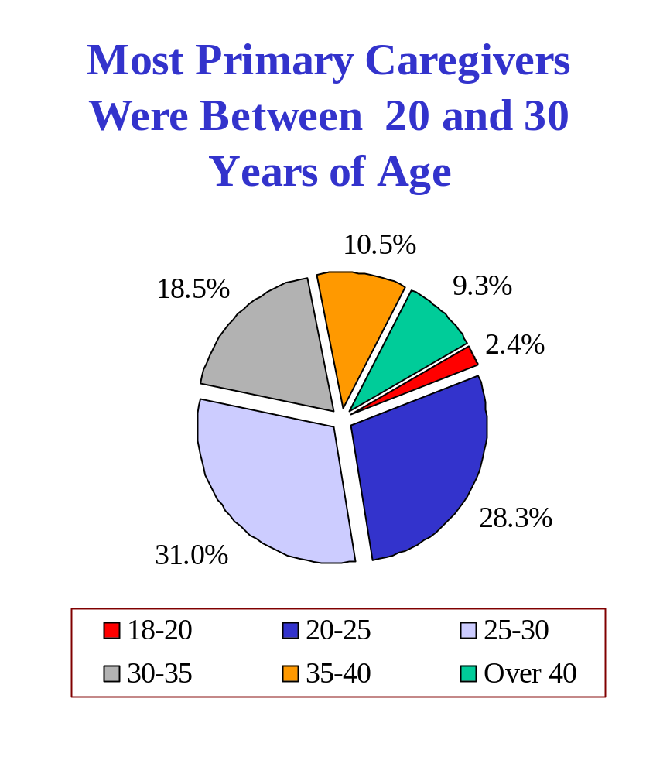

Slide 7
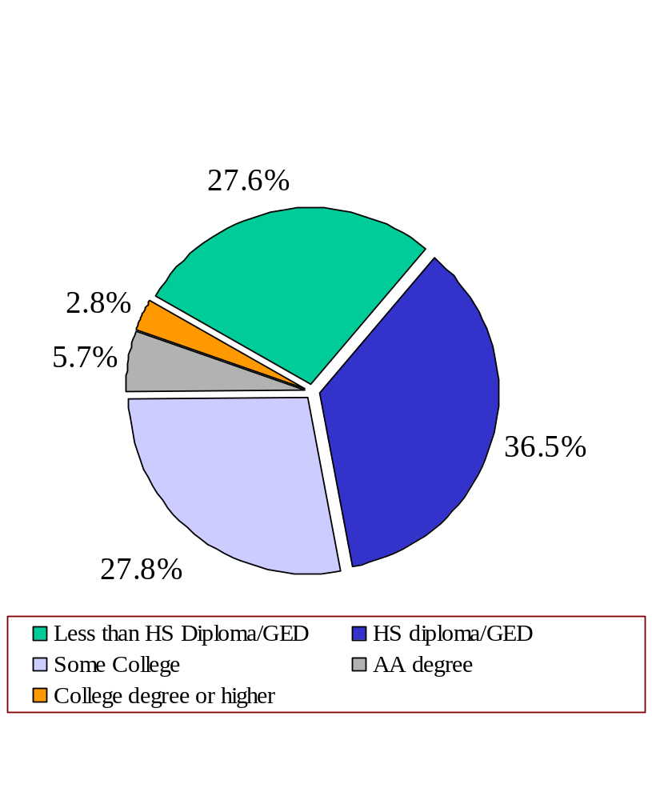
Most Primary Caregivers Had at Least
a High School Diploma or a GED
8.6% of the Primary Caregivers reported having completed a license, certificate, or degree between fall 1997 and spring 1998

Slide 8
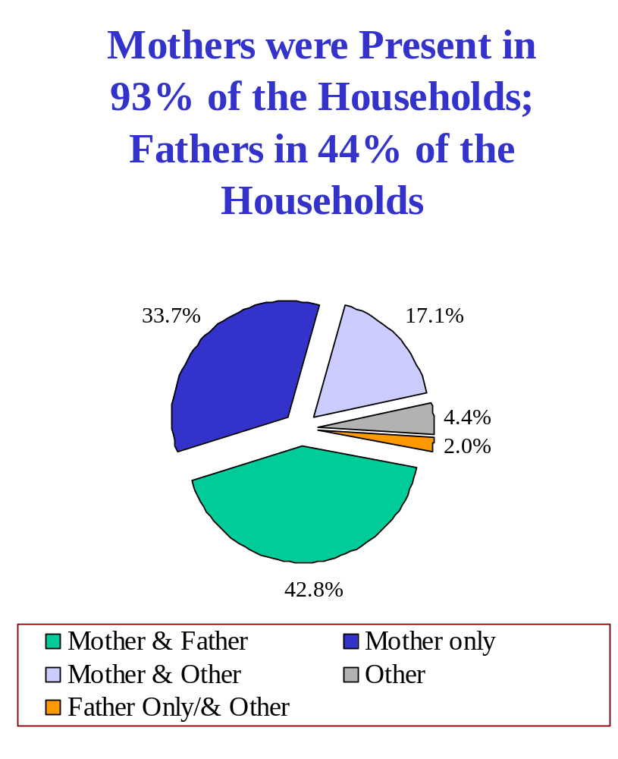
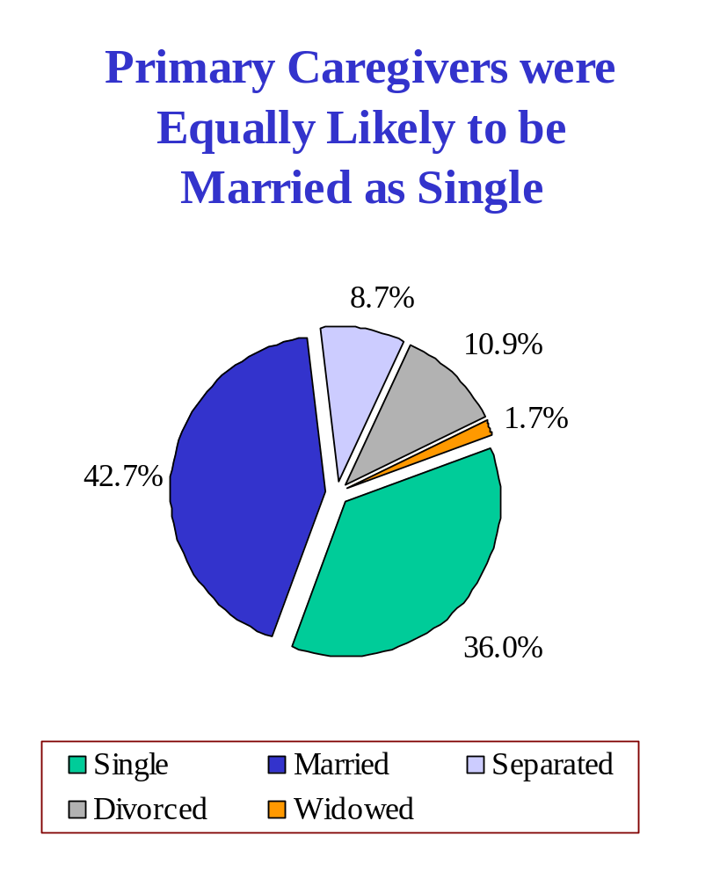
Households had a mean of 4.47 people
(range = 2 to 15)

Slide 9
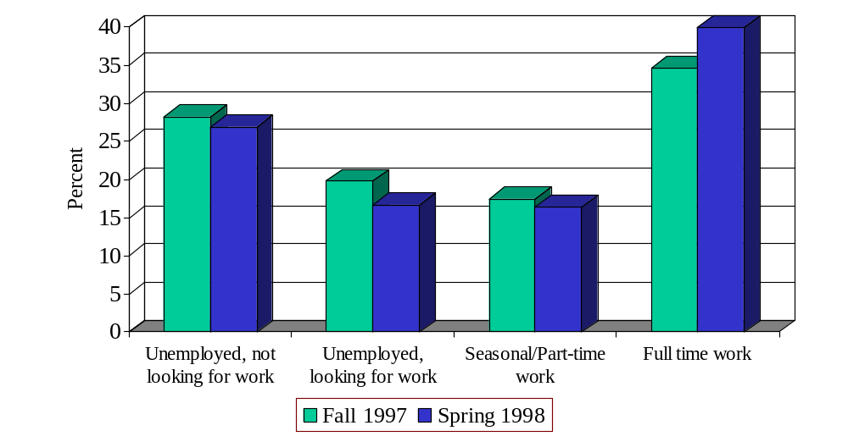
More Than 50% of the
Primary Caregivers Were Employed
52.1% of the Primary Caregivers reported having a job in fall 1997; 56.4% reported employment in spring 1998

Slide 10
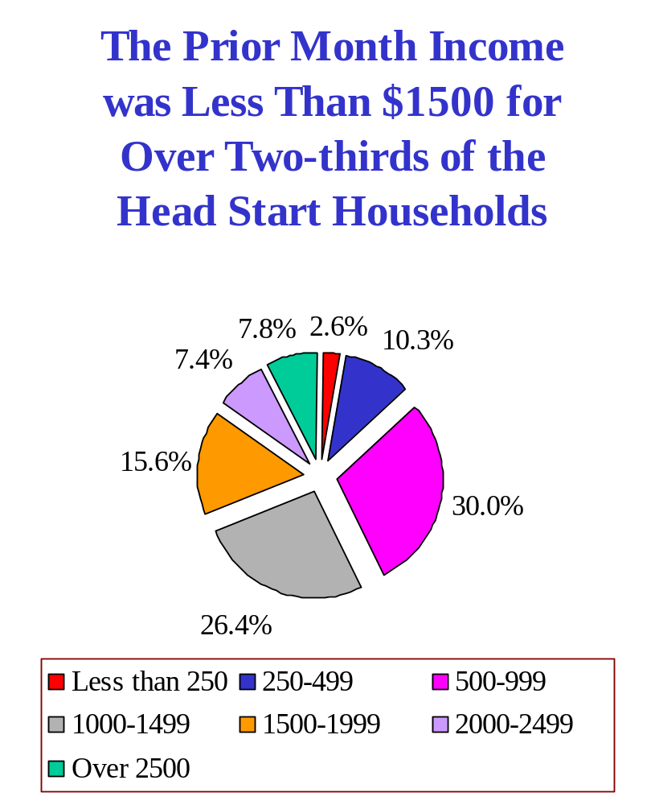
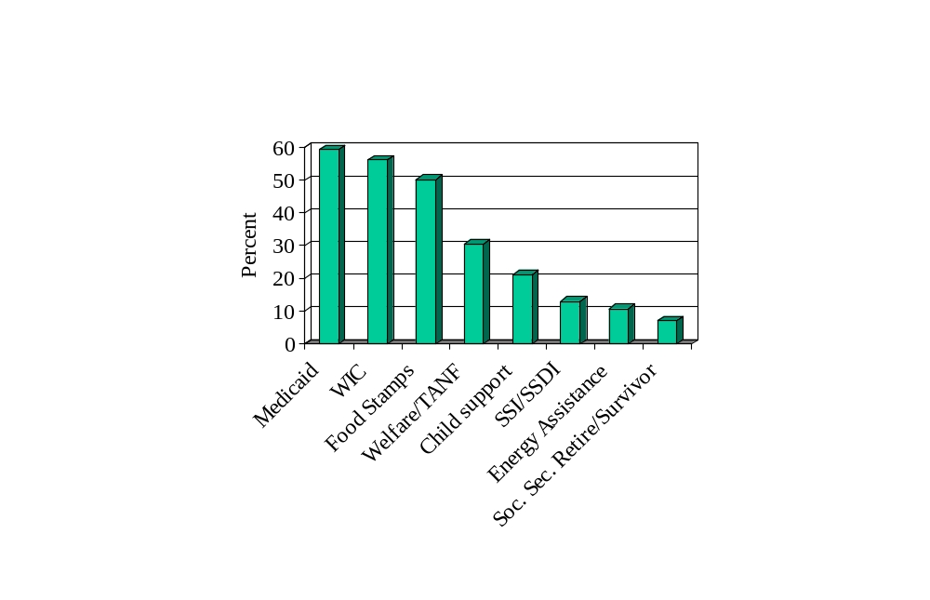
Supplemental Sources of Income are Received in 85% of the
Head Start Households
30.6% of the Primary Caregivers reported receiving TANF in fall 1997; 25.5% reported receiving TANF in spring 1998

Slide 11
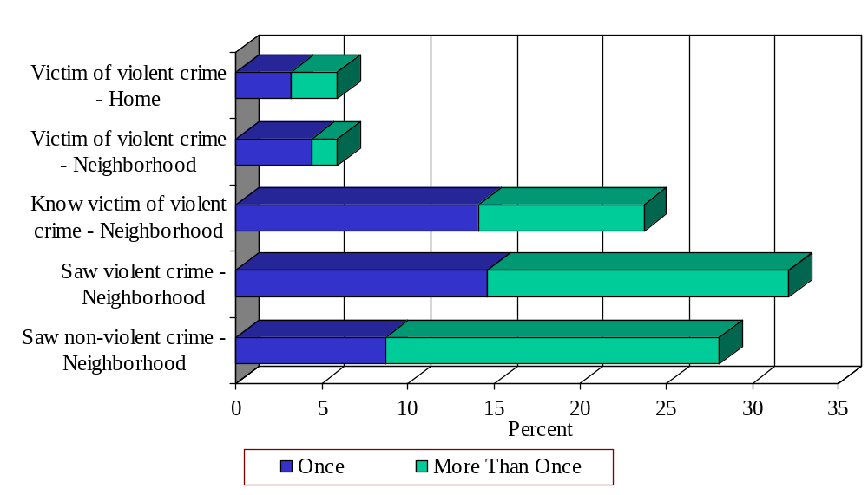
Over 30% of Primary Caregivers had Some Exposure to Violence During the Past Year

Slide 12
One-Fifth of Head Start Children
Have Been Exposed to Violence
Children as witnesses to violent crime or domestic violence
  In fall 1997, 17.4% of the children were reported to have witnessed a violent crime or domestic violence in their life.
  In spring 1998, 6.8% were reported to have witnessed domestic violence in the past year
  In spring 1998, 3.7% were reported to have witnessed violent crime in the past year
Children as victims of violent crime or domestic violence
  In fall 1997, 2.9% of the children were reported to have been the victims of a violent crime or domestic violence in their life
  In spring 1998, 0.8% were reported to have been the victims of domestic violence in the past year
  In spring 1998, 0.6% were reported to have been the victims of violent crime in the past year

Slide 13
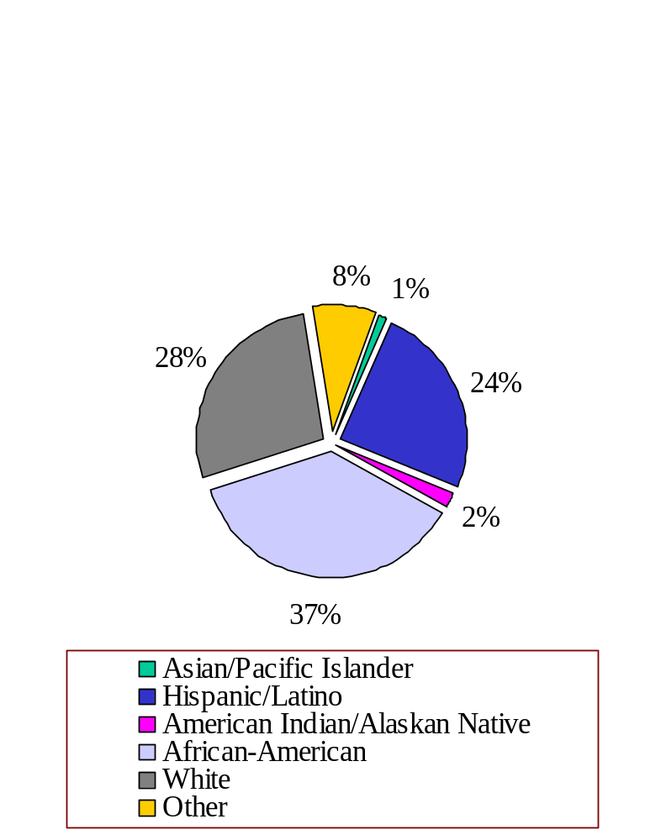
Head Start Serves a Diverse Group of Children
60.3% of the children were 4-year-olds; 39.7% were 3 year-olds
50.6% were male; 49.4% were female
98.3% of the children were born in the United States
80.6% of the children were in their first year of Head Start

Slide 14
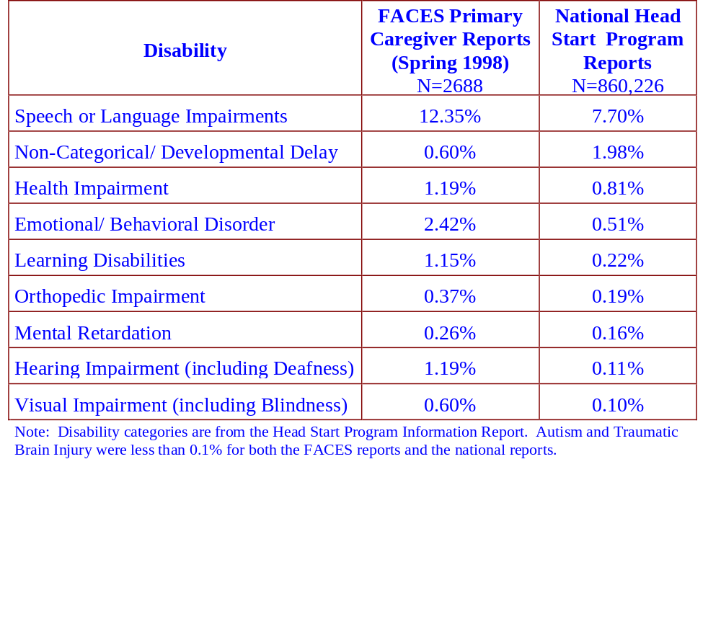
Disabilities and Health Problems Were Reported for Less Than 20% of Head Start Children

Slide 15
More Than a Quarter of the Primary Caregivers Reported That the Child Was in Child Care in Addition to Head Start
49.3% of the children were in child care (defined as 10 or more hours a week) prior to Head Start enrollment
28.1% of the children were in child care in addition to attending Head Start
  68.7% were in settings where they are cared for by a friend or relative
  13.9% were in a child care center
  8.5% were in family day care
  8.0% received child care at Head Start, separate from the regular classes
84.8% of the respondents who reported a need for child care were employed
These Head Start children were in child care for a mean of 19.2 hours per week

Slide 16
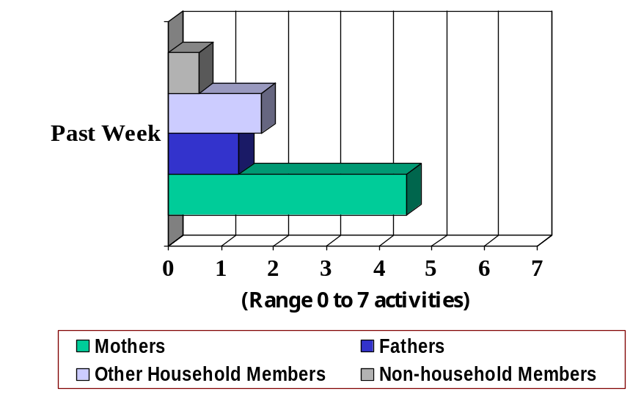
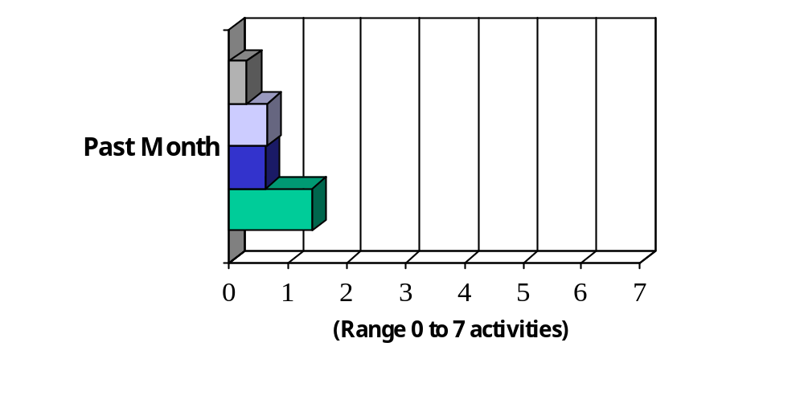
Most Activities with the Children
Were Undertaken by the Mother
Past Week Activities:
  Telling a story; Teaching letters, words, or numbers; Teaching songs or music; Arts and crafts; Playing games (indoors or outdoors); Household chores; Doing errands
Past Month Activities
  Visiting a library; Going to a live show; Going to an art gallery or museum; Discussing family heritage; Visiting a zoo or aquarium; Attending a community, ethnic, or religious event; Attending a sporting event

Slide 17
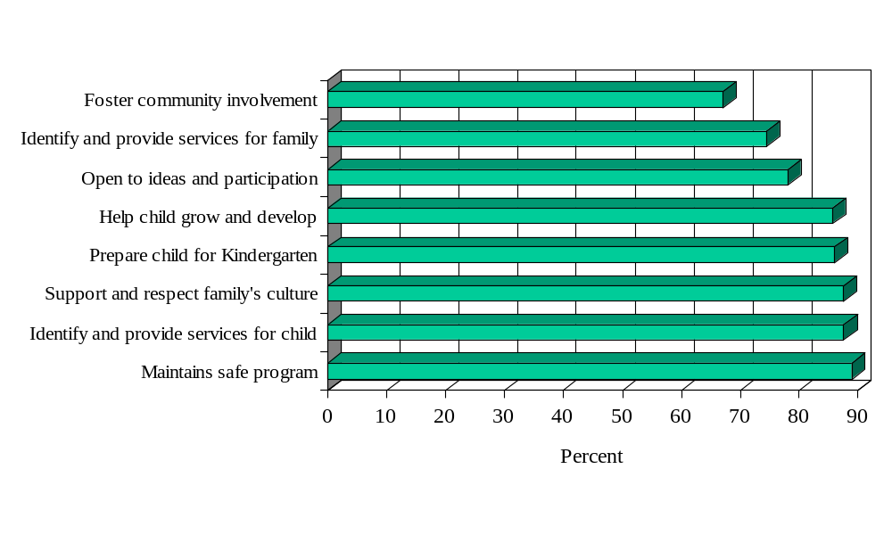
Primary Caregivers Were Very Satisfied with the Head Start Program

Slide 18
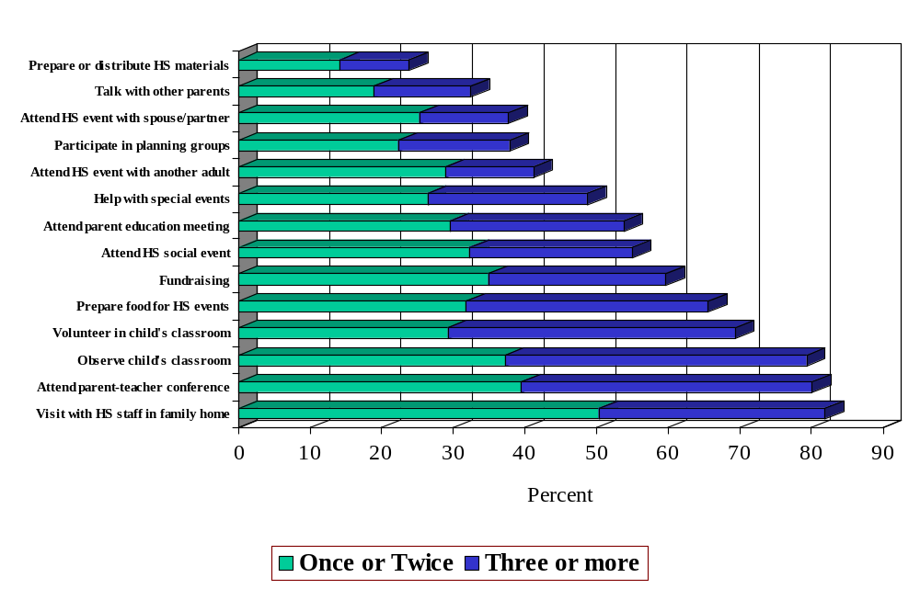
Most Primary Caregivers Were
Very Active Within Head Start

Slide 19
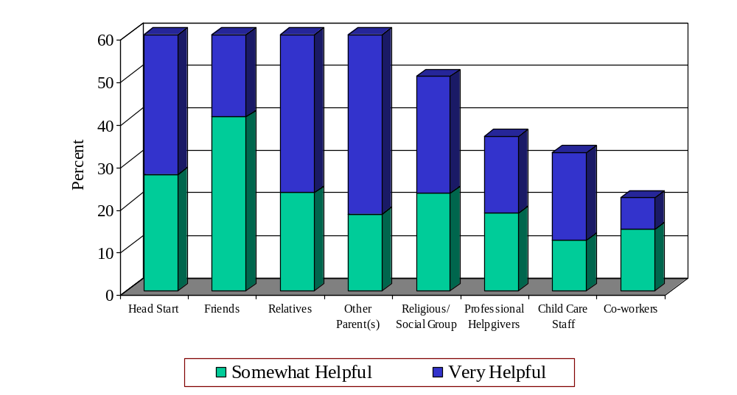
In Spring ‘98, Primary Caregivers Reported
That Head Start Was Important
As a Source of Support for Raising Their Child

Slide 20
Summary
In addressing Head Start’s need for information on children and their families, in depth data have been collected in a number of areas from a large, nationally representative sample of enrolled families. Project reports and papers will contain more detailed descriptions of these families.
Descriptive findings on these families are very valuable for local Head Start programs and the Head Start Bureau in determining the distribution of program resources. For example, understanding the challenges families face will help Head Start staff, particularly teachers and family advocates, know where to target resources, to be better trained to help needy families get required services, help families move towards self- sufficiency, and strengthen parents’ behavior in their role as primary nurturers of their children.
Subsequent data collections and analyses will focus on the changes that families present over time. Family change may be due to societal factors (e.g. welfare reform), typical family maturation (e.g., experience), or more extraordinary family circumstances (e.g., divorce, a parent completing school or a training program). It is also possible that family or individual change is due to the efforts of Head Start. It will be our challenge to find where change can be attributed to the efforts of Head Start staff to serve these families.

