Slide 1

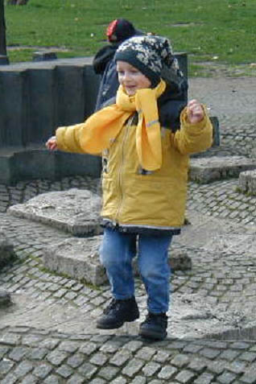
California’s
Safe Routes to School Initiative
Department of Health Services
  Anne Seeley
  Barb Alberson
  Rosanna Jackson

Slide 2
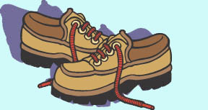
Safe Routes to Schools the 20 minute overview
Definitions
Public health potential
Partnerships
Programs
Moving forward

Slide 3
Safe Routes to Schools
Definitions
Promoting non-motorized trips
to and from school
  Feet
  Bikes
  Skateboards & scooters
Normalizing incidental physical activity
  Using the “spectrum of prevention”

Slide 4
Safe Routes to Schools
Definitions
SR2S programs help
  Children who already bike & walk
and
  Enable more children to safely bike
and walk
    Whatever the barriers
Ultimately: create places and a culture for all to safely walk & bike

Slide 5
Safe Routes to Schools
Definitions
The Three “E”s
  Education
  Engineering
  Enforcement
Additional “E”s for comprehensive SR2S programs
  Environment
  Equity
  Encouragement
  Enrichment

Slide 6
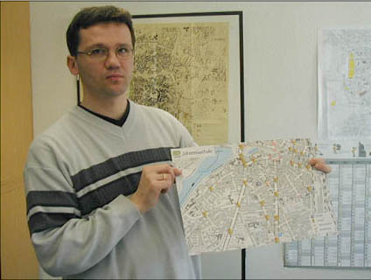
Education:
Maps with Designated Routes
Maps:
The “original” Safe Routes to School program.

Slide 7
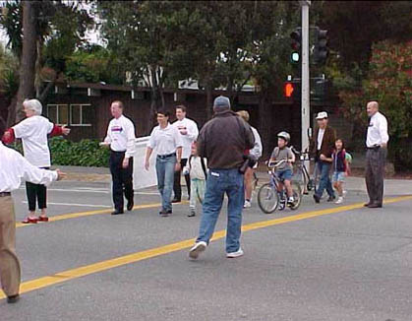
Education:
Skill Building for Children
Traffic skills
Social skills
Independent
problem solving

Slide 8
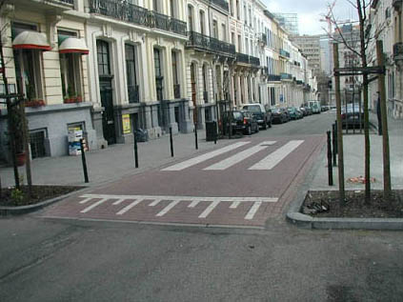
Engineering
Sidewalks
Bike paths
Crosswalks
More comprehensive engineering solutions:
“Traffic calming”

Slide 9
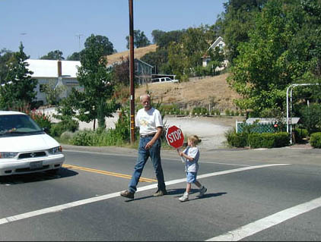
Enforcement
Law enforcement
  Signs & lights
  (passive enforcement)
  Tickets
  Stings
Community
involvement
  Patrols
  Safe houses
  Crossing guards

Slide 10
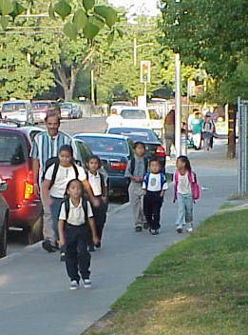
Environment
Litter
Visibility
Dogs
People
  Social
  Anti-social

Slide 11
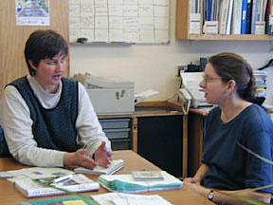
Policies and Legislation
School siting & size
Busing
Transportation funding
Liability
Roadway maintenance
Classroom curricula
After-school programs
Crossing guards
Storage for bikes and books

Slide 12

Safe Routes to Schools
Public health potential

Slide 13
Potential:
The Public Health Benefits
Lifelong health
24% of U.S. children are now obese,
  a 55% increase from 1963
Asthma
Diabetes
Bone health
Mental health

Slide 14
Potential:
The Public Health Benefits
Children’s skill development
Traffic skills for safe mobility
Socialization
Independence
Children’s academic performance
Concentration, problem solving ability and mood are enhanced by physical activity

Slide 15
Potential:
The Public Health Benefits
Community livability
Active community environments (ACEs)
  Safety, Access, Aesthetics, Functionality
Traffic safety
Congestion
  Parents driving their children to school comprise 20% - 25%
  of the morning commute and vehicle emissions
Community cohesiveness
Small schools serving a neighborhood
Environmental stewardship

Slide 16
Research Potential
Demonstration projects
  England, Canada, U.S.
Transportation surveys
  for example: children’s trip distances and modes
Community audits
  Walkability checklists

Slide 17
Research Potential
Walkability Checklists from California’s Walk to School Day have provided data:
  Drivers don’t yield to children on foot
  Children want to bike
  By 3rd grade, walk trips are in decline
  Bus riders are the children most likely to perceive dangers along the route when they do walk
  Thank you Cathy Staunton @ CDC !

Slide 18
Grassroots Potential
“We will use walk-day checklists to show our town places we need more safety measures along the main routes to school.”
Malcolm Clark
parent at Bullis Purissima Elementary
Los Altos

Slide 19
Grassroots Potential
“Children should be able to walk to school.
It’s a basic right.”
Helen Kwan, co-coordinator at John Yehall Chin Elementary
San Francisco
San Francisco Independent 10/9/01

Slide 20
Safe Routes to Schools
Partnerships
Health departments
Walking advocates
Parks & recreation
Academy of Pediatricians
Parent-Teacher associations
Traffic officers
Department of Education
  School health
  School safety
Bicycle advocates
Trails advocates
Safe Kids Coalitions
CA legislature
Federal Express
Environmental Protection Agency
Transportation & public works departments
Environmentalists
Local government officials
Automobile insurance companies

Slide 21
Common agenda for multiple partners
In California ...
  Dept of Health Services
    Traffic-Related Injury Prevention
    Active Community Environments
    Cancer Prevention & Nutrition
  Rails to Trails Conservancy
  Surface Transportation Policy Project
  California Bicycle Coalition
  Local Government Commission
  CA Highway Patrol

Slide 22
Safe Routes to Schools
Program activities in California
Caltrans grants
  Engineering
Community planning grants
  DHS
  Marin County
Walk to School Day
  500+ schools every October

Slide 23
The “Caltrans program”
Construction grants to public works
Eligible projects
  Sidewalks & crosswalks
  traffic control devices
  bike lanes & off-street trails
$500,000 maximum per award

Slide 24
Safe Routes to Schools through Safe Communities
Office of Traffic Safety
  federal “402” safety funds
Nine local lead agencies
$25,000 ~ 18 months
CA Department of Health Services
  Project management & technical assistance
NHTSA’s “Safe Communities” model

Slide 25
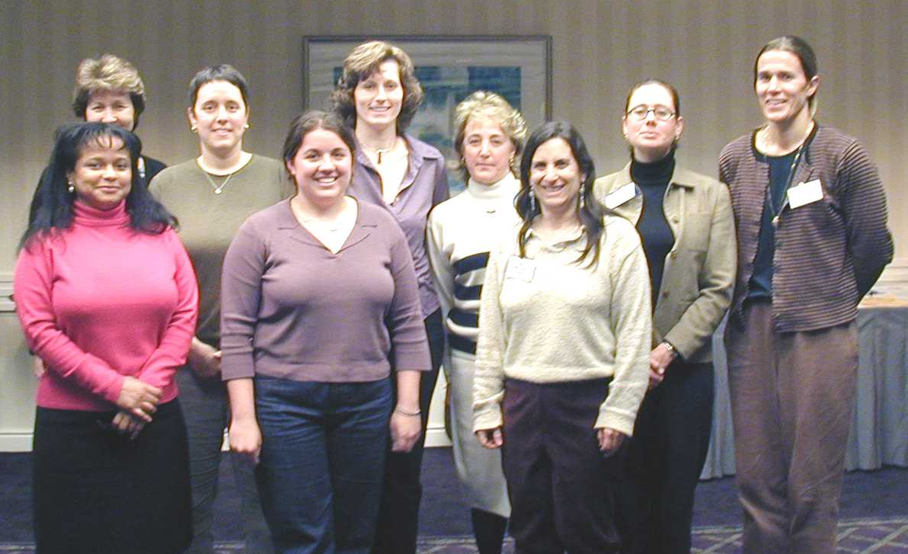
Safe Routes to Schools through Safe Communities
Local lead agencies for SR2S projects:
  community clinic
  hospital community outreach office
  city transportation department
  county health department
  bicycle coalitions
  child abuse prevention council
  county public works department

Slide 26
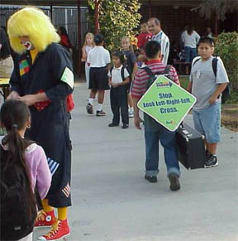
Walk to School Day

Slide 27
Walk to School Day
Simple, turn-key event
Media worthy
Raise awareness … or call to action
Start of school year
Prior to fall elections
Potential to rally allies for ongoing projects

Slide 28
Walk to School Day
Highlights a variety of health and safety issues:
  Overweight and obesity epidemic
  Traffic, crime and violence hazards
  Insufficient pedestrian and bicycle facilities
  Air quality ~ asthma
  Bicycle helmets

Slide 29
Walk to School Day
“We had a lot of fun and can’t wait for next
year. In 2002 we hope to make this a week
long event so we can fit more schools in.”
Lisa Scates
Public Safety Officer
City of Palmdale

Slide 30
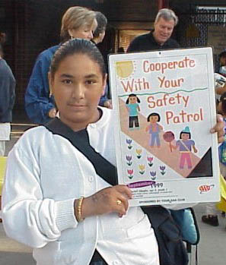
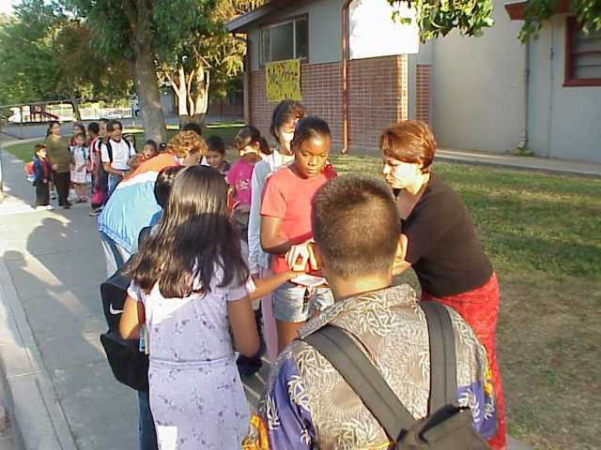
Example:
Noralto School in Sacramento

Slide 31
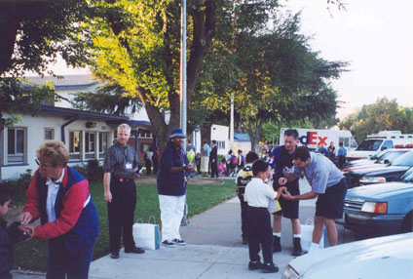
Example:
Safe Kids Coalitions
National partnership for pedestrian safety
  Federal Express
  LL Bean

Slide 32
Walk Day Headquarters @ DHS
Resources
  Checklists
  Promotion
  Activity ideas
www.cawalktoschool.com

Slide 33

Walk Day Headquarters @ DHS
Registration
Advocacy network
  Support legislation
  Idea exchange

Slide 34
Examples of support for Walk to School Day
Department of Education mailing
  10,000 school principals and district superintendents
Spanish language translations produced by DHS’s Latino 5-a-day program
7th grade class at a Chinese immersion school translated the checklist into Chinese
Local health departments got volunteers to translate the checklist into Spanish and Hmong

Slide 35
Moving Forward:
Recommendations to Public Health agencies
Set a comprehensive definition
Harness a complex agenda
Adopt Precautionary Principle (act now!)
Link chronic disease control with injury control
Promote Walk to School Day
  National website: www.walktoschool-usa.com
    Resources
    Registration

Slide 36
Moving Forward:
Support “Caltrans” legislation
Federal transportation bill
  “TEA-3”
State transportation program
  9 states have similar SR2S bills
  For info: www.transact.org
  Surface Transportation Policy Project

Slide 37
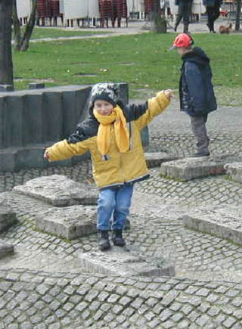
Safe Routes to Schools create Healthier Communities
Many gatekeepers
Many stakeholders
Multiple benefits
Common agenda
Highly adaptable
Positive
Profound
Sustainable

