Slide 1

How the Pennsylvania County Justice Information Exchange Pilot (CJIEP) Project Successfully Implemented the Administrative Office of Pennsylvania Courts GJXDM Compliant Court Case Event Message
Nicholas Melnick, Jr.
MDJS Project Manager
Administrative Office of Pennsylvania Courts
David L. Woolfenden
County Architect
Pennsylvania Commission on Crime and Delinquency (PCCD)

Slide 2
Topic Summary
Case Management Systems used by Pennsylvania’s Unified Judicial System.
Pennsylvania’s Justice Network (JNET) and XML History
The Court Case Event Philosophy
An XML Example
The CJIEP Project
Outcomes
Future Efforts

Slide 3
The Court Case Event
Event Driven, Multi Purpose Messaging
Nicholas Melnick, Jr.
MDJS Project Manager
Administrative Office of Pennsylvania Courts

Slide 4
The Unified Judicial System of Pennsylvania
Magisterial District Judge System (MDJS)
  Case Management for 549 offices and the Pittsburgh Municipal Court including summary, criminal and limited civil dockets.
  Continues to operate on software initially developed over 15 years ago.
  Currently based on an IBM iSeries 825.
  Using Java, MQ Series and DB2 to move data.

Slide 5
The Unified Judicial System of Pennsylvania
Common Pleas Criminal Court Case Management System (CPCMS)
  Criminal case management system for 67 counties including Philadelphia.
  Multi Tiered approach using VB.NET, Sybase, Citrix, Java and Sun technologies.
  Deployment to be completed in September 18, 2006.
  Event/Next Event Processing
DataHub
  Central facility for data interchange with trading partners.
  Uses replication and messaging to maintain data.
  Provides for consolidation of information access for AOPC based systems.

Slide 6
Pennsylvania’s Justice Network (JNET) and XML History
JNET is a consortium of criminal justice agencies focused on the collaboration and integration of criminal justice information. 1997 marked the initial installations of LiveScan devices, the development of an arrest message and the development of disposition message named LivePost.
JNET established the “plumbing” through a hub and spoke messaging system using JMS, MQ Series and custom database adaptors.
DTDs were defined for a variety of documents. The lack of a standardized approach created conflict at the element level.

Slide 7
Pennsylvania’s Justice Network (JNET) and XML History
JXDM and GJXDM
  Initial work started in January 2003 to accomplish an eFiling initiative.
  JNET and PennDOT establish the first pre release compliant message.
  AOPC, JNET and Commission on Sentencing establish the first 3.0 IOC release. This message is the ground work for Court Case Event.
  AOPC, JNET, PSP, CCAP continue to work toward eFiling and Court Case Event messaging.

Slide 8
Court Case Event
Many documents, similar information.
  The courts produce a number of documents or are asked to provide agencies with documents that contain like data. For example, disposition documentation is similar for corrections, criminal history and sentencing use.
  Since 1985, courts commonly passed a docket transcript from initial arraignment to sentencing. The document was automated on the MDJS in 1991. With CPCMS, the data is immediately available from the lower courts through interconnected systems.

Slide 9
Court Case Event
Many documents, similar information.
  Web based docket sheets provide an easy to read outline of the court case as it stands at that point in time. Similar stored procedures are used to develop the Court Case Event.
  MDJS and CPCMS are standardizing the data and documents statewide.
  Court Case Event is a reusable message that will provide information to federal, state and local agencies.

Slide 10
Court Case Event – The Information Exchange Package
Schemas – All the necessary schemas needed to validate the exchange.
Information Exchange Package Documentation (IEPD) – The purpose of the exchange
Mapping Spreadsheet – Common names mapped to the GJXDM or extension elements with descriptions
Sample XML
Other Information Documentation

Slide 11
Court Case Event – The Schemas
The Envelope Schema – Provides addressing and a document content description.
The Document, Constraint and Extension Schema – Provides the payload of data.
Other Included Schema – Subsets of code lists from GJXDM or local codes.

Slide 12
Court Case Event – The IEPD
Scope – The purpose of the exchange.
Artifacts – An inventory of the exchange.
XML Schemas – A listing of the included. schemas and what they represent.
Other Information relevant to the exchange.

Slide 13
Court Case Event – The Mapping Spreadsheet
Field – A common name of the represented data.
Description – Language that defines the field.
XML Element – Element name including complete namespace.
Other Mapping Parameters – Include system specific mapping and business logic.

Slide 14
Court Case Event – Other Pieces
Sample XML – Provide a valid sample(s) of relevant XML. The sample must pass validation!
Model – UML or other
Documentation that includes business logic or other descriptions.

Slide 15
An Overview of the County Justice Information Exchange Pilot (CJIEP) Project
David L. Woolfenden
County Architect
Pennsylvania Commission on Crime and Delinquency (PCCD)

Slide 16
Agenda
Background and History
Pilot Exchange Project
2006 and beyond Next Steps

Slide 17
The Pennsylvania Commission on Crime and Delinquency (PCCD)
Coordination
  PCCD utilizes advisory committees and similar strategies to bring together knowledgeable individuals representing a broad range of state level, local government and private sector expertise to address problems and issues affecting the justice system.
Administration of State and Federal Monies
  PCCD utilizes federal and state monies to assist units of government and private organizations to prevent and reduce crime; enhance the quality of justice for all Pennsylvanians; and help alleviate the financial burdens resulting from the commission of a crime. PCCD uses fourteen federal funding authorizations (is the DOJ State Administering Agency (SAA)) and eight state funding authorizations.

Slide 18
PCCD Strategy for Integrated Justice at the county and local levels
The Pennsylvania Commission on Crime and Delinquency (PCCD), Office of Criminal Justice System Improvements’ has defined a strategic goal to promote communication and information sharing through the implementation and effective use of technology.
To further endorse achieving this goal, PCCD strongly believes that direct collaborative efforts between local, municipal, county, and state agencies are key to building secure integrated justice systems.
The PCCD is committed to fostering technical innovation and ensuring the use of business and technical best practices by the Commonwealth’s entire criminal justice community.

Slide 19
A Brief History of County Justice Integration in Pennsylvania
1998
  With PCCD’s support, a County steering committee was formed by the County Commissioners' Association of PA (CCAP) to discuss sharing of criminal justice data within the county.
2001
  A pilot project started to test an approach (BizTalk based “Justice Hub”) that would allow counties to query and receive notifications from county criminal justice systems.
2004
  There were implementation concern and discussions occurred around the Justice Hub based data exchange approach being designed.
  County stakeholder meeting facilitated by PCCD to help refocus the project.
  Integration effort re-focused on intra-county information exchanges.
  3 pilot counties identified to participate in JIEM analysis, design, development and implementation of pilot intra-county information exchanges.

Slide 20
A Brief History of County Justice Integration in Pennsylvania
Feb – Mar 2005
  PCCD led Justice Information Exchange Model (JIEM) analysis sessions conducted to identify key county level criminal justice information exchanges and thus the information exchange driven “business need” for information sharing.
April 2005 – Feb 2006
  CCAP County Justice Information Exchange Pilot (CJIEP) project driven by JIEM results with new technology approach (service-oriented architecture).
  Five high priority document/information exchanges identified for pilot implementation in 2 of the 3 pilot counties.
  All document exchanges originated from the statewide AOPC Court of Common Pleas CMS and end in county level DA, AP or Jail RMSs.
March 2006 – August 2006
  Pilot exchanges implemented in the 3rd pilot county which went live on new AOPC Court of Common Pleas CMS during Feb 2006. (the 2 other pilot counties had already gone live pre-2006)

Slide 21
Agenda
Background and History
Pilot Exchange Project
2006 and beyond Next Steps

Slide 22
CJIEP Executive Summary
Focus
  Use JIEM Analysis methodology, which is critical to
    Understanding the specific transactions in the environment.
    Identifying common transactions and conditions.
  Identify “as-is” information exchanges between county justice agencies in the each pilot county.
  Develop a common “to-be” model of the information exchanges across all 3 counties.
  Select a subset of high-value information exchanges, based on agreed-upon criteria, for implementation.

Slide 23
CJIEP Executive Summary
Goals
  Use the JIEM results to determine priority of data exchanges.
  Test the use of a service-oriented architecture approach.
  Test data exchanges using Web services.
  Create detailed documentation that can be reusable by counties regardless of their county department software application (vendor-independent).
  Engage county Subject Matter Experts to determine business needs.

Slide 24
CJIEP Executive Summary
Objectives
  Implement a project based on business needs, not technologies or technical requirements.
  To use JIEM for analysis of a small, a medium and a large PA county for identification of key county criminal justice business needs.
  To utilize industry standard technology approach – Service Oriented Architecture (SOA) and GJXDM.

Slide 25
CJIEP Executive Summary
Roles and Responsibilities
  Business Need Direction: Comes from county subject matter experts.
  Architectural Direction: Comes from Pennsylvania Commission on Crime and Delinquency (PCCD)
  Oversight Direction: Comes from County Commissioners Association of Pennsylvania (CCAP)
  Solution Development: Comes from an application-independent vendor for infrastructure and from an application-specific vendor for end-points.

Slide 26
CJIEP Executive Summary
Cooperative effort:
  Allegheny, Lancaster and Warren Counties
  County Agency Participants
    Adult Probation and Parole
    Clerk of Courts
    District Attorney
    Jail
  AOPC
  JNET
  PA District Attorneys Association
  CCAP
  PCCD

Slide 27
CJIEP Executive Summary
Exchanges
  The JIEM analysis identified more than 100 information exchanges in each county.
  The pilot scope focused on data exchanges within bind case over and sentencing through identified business needs.
      Bind Case Over
      Report Probation Sentence
      Non-Compliance Sentence Modification Service
      Sentence Modified Service
      Provide Parole Decision Service (on hold for future development)

Slide 28
CJIEP Executive Summary
Pilot Exchanges
  Bind Case Over
    Source Documents – AOPC Affidavit of Probable Cause, Bail/Bond, Criminal Complaint, Docket Transcript
    Receiving agencies – County Jail, Adult Probation and Parole, District Attorney
  Report Probation Sentence
    Source Document – AOPC Court order
    Receiving agency – Adult Probation and Parole

Slide 29
CJIEP Executive Summary
Pilot Exchanges (cont’d)
  Non-Compliance Sentence Modification
      Source Document – AOPC Court order
      Receiving agency – District Attorney
  Sentence Modified
      Source Document – AOPC Court order
      Receiving agency – Adult Probation and Parole
  Provide Parole Decision (on hold for future development)
      Source Document – Parole Order
      Receiving agency – County Jail

Slide 30
PA CJIEP Project Outputs
JIEM Modeling Tool Output
  Standard Reports
  Excel Exports
Unified Modeling Language (UML) Artifacts
  Use Case Diagrams and Descriptions
  Class Diagrams
  Sequence Diagrams
  State Diagrams
  Activity Diagrams
  Collaboration Diagrams
Notes:
Use Case Diagrams – mapped the flow or the business process
Class Diagrams – mapped more detail, including sample data fields
SOA – standards to be used in developed

Slide 31
PA CJIEP Project Analysis and Design Documentation
Service Oriented Architecture (SOA) Solution and Technical Requirements Document
UML & Service Semantics for Pilot Scope
Pilot Detailed Design Document
GUI Interface Design Prototypes
All of these documents and more (including the Initial Business Impact Analysis Document) are available at:
http://tinyurl.com/mcmpn
Notes:
Use Case Diagrams – mapped the flow or the business process
Class Diagrams – mapped more detail, including sample data fields
SOA – standards to be used in developed

Slide 32









SERVICE ORIENTED ARCHITECTURE (SOA) LAYERS
Functional Domain
Information Exchange
Business
Business Process
Conversation
Layer
Business Services
Exchange
1
Exchange
2
Exchange
3
Service
Software Services
Web Service
Service
Layer
Layer
Component
Software Components
Exchange
1
Exchange
2
/
3
Component
Component
Component
Layer
Layer

Slide 33
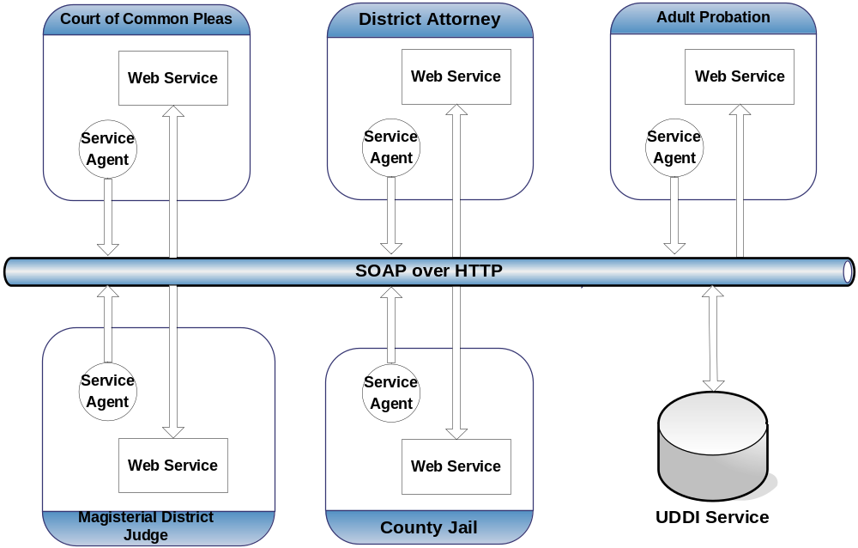
CJIEP SOA – HIGH LEVEL

Slide 34
Data Exchange Process (manual intervention)
AOPC, via the CPCMS system, sends county specific Court Case Event Message(s) to the county Court of Common Pleas service agent through the JNET MI.
The service agent queries the county UDDI and calls the appropriate web services residing in the county and delivers/exchanges the message.
Data validation occurs before being the message content can be displayed into an optional graphic user interface (GUI) for user acceptance / rejection.
Once user acceptance / rejection occurs, the appropriate (based on JIEM identified documents and exchanges) data is inserted into the county RMS database(s).

Slide 35
Data Exchange Process (automated or as simple and easy as 1, 2, 3…..)
AOPC, via the CPCMS system, sends county specific Court Case Event Message(s) to the county Court of Common Pleas service agent through the JNET MI.
The service agent queries the county UDDI and calls the appropriate web services residing in the county and delivers/exchanges the message.
The web service executes and the appropriate (based on JIEM identified documents and exchanges) data is inserted into the county RMS database(s).
If needed, the GUI is used to manually handle rejects and unmatched messages.

Slide 36
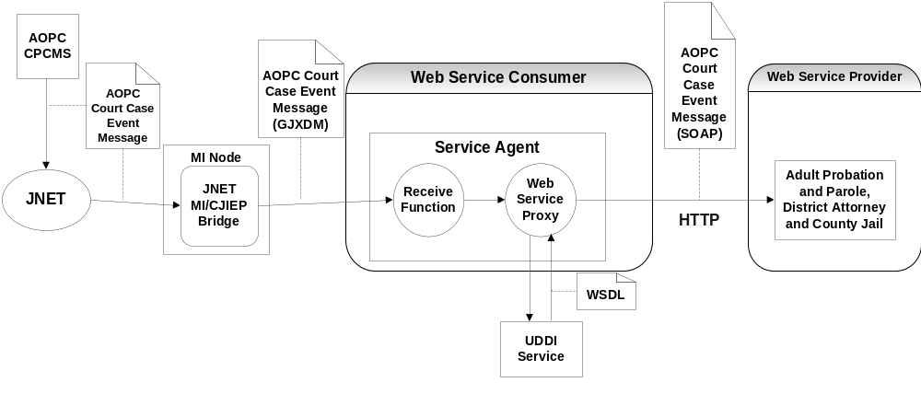
PROCESS OVERVIEW

Slide 37
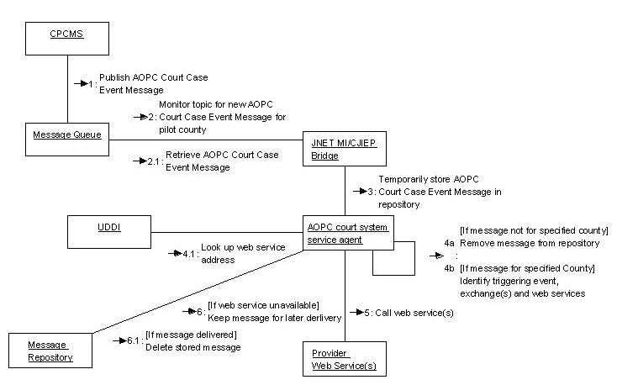
INFORMATION EXCHANGE COLLABORATION DIAGRAM

Slide 38
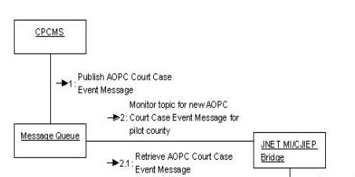
INFORMATION EXCHANGE COLLABORATION DIAGRAM (cont.)

Slide 39
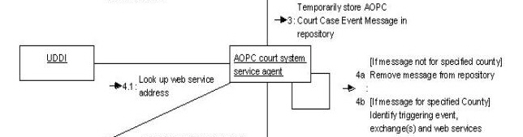
INFORMATION EXCHANGE COLLABORATION DIAGRAM (cont.)

Slide 40
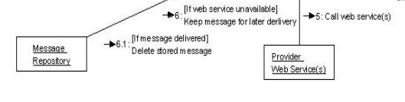
INFORMATION EXCHANGE COLLABORATION DIAGRAM (cont.)

Slide 41
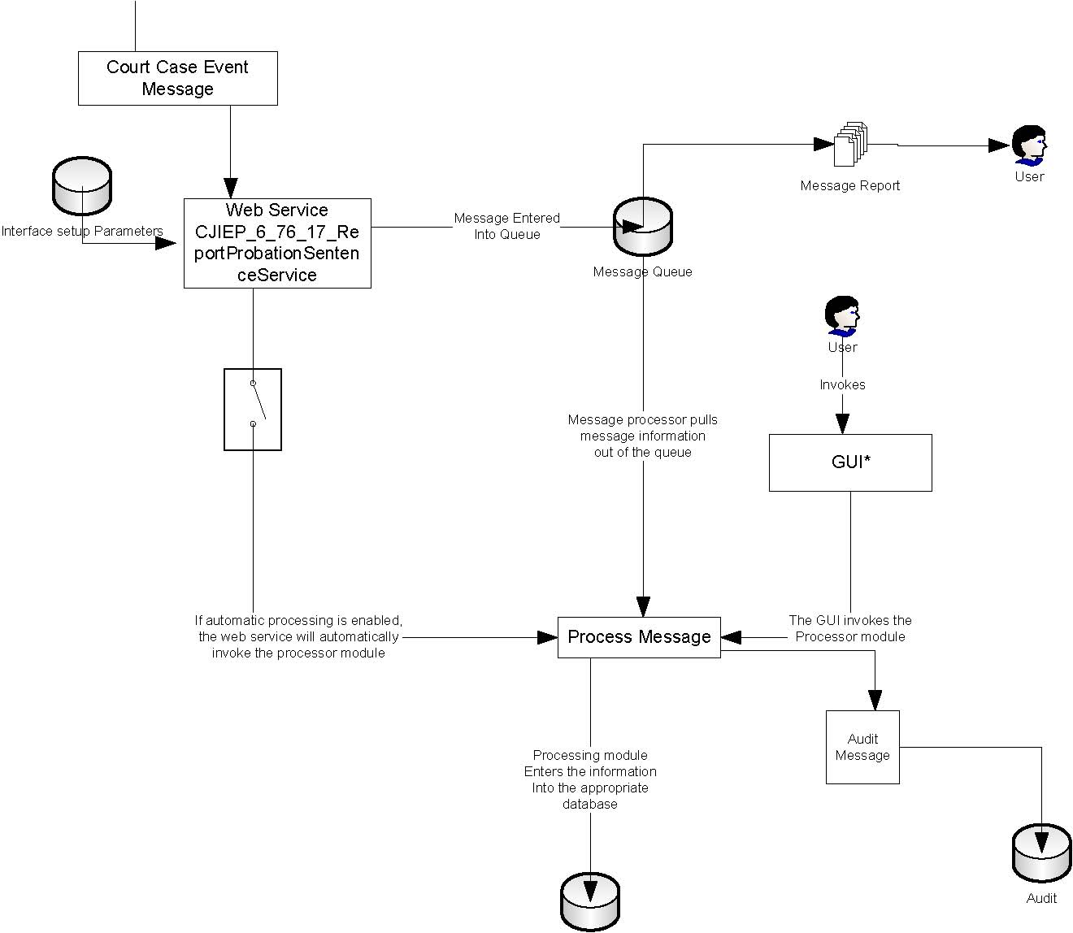
MESSAGE PROCESSING DETAIL
Court Case Event Message
Adult Probation
Adult Probation
Audit
Audit

Slide 42
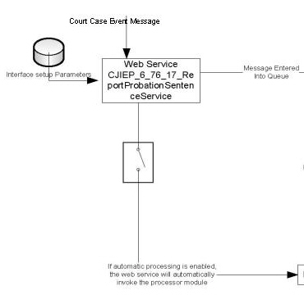
MESSAGE PROCESSING DETAIL (cont.)

Slide 43
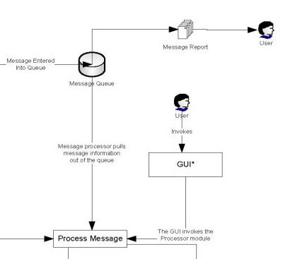
MESSAGE PROCESSING DETAIL (cont.)

Slide 44
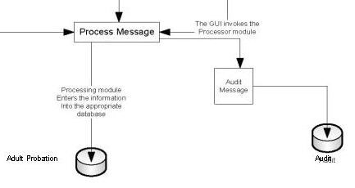
MESSAGE PROCESSING DETAIL (cont.)

Slide 45
DATA VALIDATION
Adult Probation and Parole System
  SID
  Last Name + DOB
  Last Name + SSN
  Docket Number
District Attorney System
  Docket Number
  SID
  Last Name + SSN
  Last Name + DOB
Jail System
  SID
  Last Name + SSN
  Last Name + DOB

Slide 46
Agenda
Background and History
Pilot Exchange Project
2006 and beyond Next Steps

Slide 47
COUNTY JUSTICE & PUBLIC SAFETY INFORMATION SHARING (CJPSIS) PROGRAM
The PCCD’s Office of Criminal Justice Systems Improvement has been developing a County Justice and Public Safety Information Sharing (CJPSIS) program to build information sharing capabilities within and between county and local agencies for improved justice and public safety operations.
The CJPSIS program is designed to identify common information exchanges that are universal among county justice agencies throughout Pennsylvania and build standards-based reusable components that enable real-time, secure information sharing.
Notes:
PHASE I (JULY 1, 2006 – JUNE 30, 2007)
1. Begin implementing the CJPSIS portfolio of components in high population, high case volume communities:
a. Announce availability of the CJPSIS program to counties and qualifications to participate;
b. Develop CJPSIS County Readiness Assessment Device (RAD) for qualification of potential implementation sites;
c. Train and begin implementation of the CJPSIS portfolio of components;
d. Document the experiences of the communities in implementation of the CJPSIS portfolio of components, and make changes in the program, where necessary to promote success and sustain the program.
2. Develop long term support strategies for the CJPSIS program:
a. Technical support that will be needed for counties as they implement, and who will be providing that technical support;
b. Standard Operating Procedures, Data Standards, Business Standards, Documentation Standards that will be needed for the long term development, implementation and support of the CJPSIS program.
3. In a parallel effort to implement the CJPSIS program, begin focusing JIEM analyses on earlier stages in the justice process (arrest, booking, etc.) and select candidate counties for this research endeavor:
a. Announce the availability of the program and define requirements to participate;
b. Identify potential candidate counties and qualify the counties based on a JIEM-specific Readiness Assessment Device;
c. Begin training and technical assistance for the expanded JIEM analysis in qualified counties;
d. Collect and analyze information exchange research based on work in the selected counties, and formulate a strategy for expanding the CJPSIS portfolio of components to address these additional justice information exchanges.
4. Begin developing a Communications Plan for the CJPSIS program that will describe objectives, approach, business value, experience, implementation strategy and next steps:
a. General marketing and information pieces describing the vision, goals and objectives of the program, and describing the process and business value for information sharing;
b. Outreach activities to spread the word to potential counties, including xxx
c. Announce availability of the CJPSIS JIEM analysis to counties and qualifications to participate;
d. Develop CJPSIS County Readiness Assessment Device (RAD) for qualification of potential JIEM analysis sites;
e. Train and begin implementation of the JIEM methodology;
f. Conduct research assessing the potential business value of identified exchanges and the extent to which identified exchanges are in fact universal and likely to have broad, Commonwealth-wide application.
5. Develop and implement a comprehensive Performance Management Plan to track, document and management performance measures, business value and benefits realization associated with broad program goals:
a. Achievement of greater efficiency, effectiveness, and return on investment (ROI);
b. Improvements in public safety;
c. Enhancements in the quality of justice.

Slide 48
COUNTY JUSTICE & PUBLIC SAFETY INFORMATION SHARING (CJPSIS) PROGRAM (cont)
This program can be extended to communities throughout the Commonwealth to facilitate information sharing for justice and public safety in both horizontal (intra-county and inter-county) and vertical (local-to-state) dimensions, with linkage where appropriate to state resources and systems (e.g., JNET, AOPC), and federal/national systems (e.g., NCIC, IAFIS, NLETS).
By building county-level justice integration capabilities, the CJPSIS program will improve operations among the key local and county agencies and, in doing so, will establish an operational foundation for improving justice and public safety throughout Pennsylvania.
Notes:
PHASE I (JULY 1, 2006 – JUNE 30, 2007)
1. Begin implementing the CJPSIS portfolio of components in high population, high case volume communities:
a. Announce availability of the CJPSIS program to counties and qualifications to participate;
b. Develop CJPSIS County Readiness Assessment Device (RAD) for qualification of potential implementation sites;
c. Train and begin implementation of the CJPSIS portfolio of components;
d. Document the experiences of the communities in implementation of the CJPSIS portfolio of components, and make changes in the program, where necessary to promote success and sustain the program.
2. Develop long term support strategies for the CJPSIS program:
a. Technical support that will be needed for counties as they implement, and who will be providing that technical support;
b. Standard Operating Procedures, Data Standards, Business Standards, Documentation Standards that will be needed for the long term development, implementation and support of the CJPSIS program.
3. In a parallel effort to implement the CJPSIS program, begin focusing JIEM analyses on earlier stages in the justice process (arrest, booking, etc.) and select candidate counties for this research endeavor:
a. Announce the availability of the program and define requirements to participate;
b. Identify potential candidate counties and qualify the counties based on a JIEM-specific Readiness Assessment Device;
c. Begin training and technical assistance for the expanded JIEM analysis in qualified counties;
d. Collect and analyze information exchange research based on work in the selected counties, and formulate a strategy for expanding the CJPSIS portfolio of components to address these additional justice information exchanges.
4. Begin developing a Communications Plan for the CJPSIS program that will describe objectives, approach, business value, experience, implementation strategy and next steps:
a. General marketing and information pieces describing the vision, goals and objectives of the program, and describing the process and business value for information sharing;
b. Outreach activities to spread the word to potential counties, including xxx
c. Announce availability of the CJPSIS JIEM analysis to counties and qualifications to participate;
d. Develop CJPSIS County Readiness Assessment Device (RAD) for qualification of potential JIEM analysis sites;
e. Train and begin implementation of the JIEM methodology;
f. Conduct research assessing the potential business value of identified exchanges and the extent to which identified exchanges are in fact universal and likely to have broad, Commonwealth-wide application.
5. Develop and implement a comprehensive Performance Management Plan to track, document and management performance measures, business value and benefits realization associated with broad program goals:
a. Achievement of greater efficiency, effectiveness, and return on investment (ROI);
b. Improvements in public safety;
c. Enhancements in the quality of justice.

Slide 49
COUNTY JUSTICE & PUBLIC SAFETY INFORMATION SHARING (CJPSIS) PROGRAM (cont)
PCCD has identified the following four service areas that need to be implemented by the CJPSIS Subcommittee, during the coming year, in order to make this effort successful:
  1) Toolkit Development, Enhancement and Support Services,
  2) New Site Implementation Services,
  3) Infrastructure Services,
  4) Information Exchange Analysis and Support Services.
Notes:
PHASE I (JULY 1, 2006 – JUNE 30, 2007)
1. Begin implementing the CJPSIS portfolio of components in high population, high case volume communities:
a. Announce availability of the CJPSIS program to counties and qualifications to participate;
b. Develop CJPSIS County Readiness Assessment Device (RAD) for qualification of potential implementation sites;
c. Train and begin implementation of the CJPSIS portfolio of components;
d. Document the experiences of the communities in implementation of the CJPSIS portfolio of components, and make changes in the program, where necessary to promote success and sustain the program.
2. Develop long term support strategies for the CJPSIS program:
a. Technical support that will be needed for counties as they implement, and who will be providing that technical support;
b. Standard Operating Procedures, Data Standards, Business Standards, Documentation Standards that will be needed for the long term development, implementation and support of the CJPSIS program.
3. In a parallel effort to implement the CJPSIS program, begin focusing JIEM analyses on earlier stages in the justice process (arrest, booking, etc.) and select candidate counties for this research endeavor:
a. Announce the availability of the program and define requirements to participate;
b. Identify potential candidate counties and qualify the counties based on a JIEM-specific Readiness Assessment Device;
c. Begin training and technical assistance for the expanded JIEM analysis in qualified counties;
d. Collect and analyze information exchange research based on work in the selected counties, and formulate a strategy for expanding the CJPSIS portfolio of components to address these additional justice information exchanges.
4. Begin developing a Communications Plan for the CJPSIS program that will describe objectives, approach, business value, experience, implementation strategy and next steps:
a. General marketing and information pieces describing the vision, goals and objectives of the program, and describing the process and business value for information sharing;
b. Outreach activities to spread the word to potential counties, including xxx
c. Announce availability of the CJPSIS JIEM analysis to counties and qualifications to participate;
d. Develop CJPSIS County Readiness Assessment Device (RAD) for qualification of potential JIEM analysis sites;
e. Train and begin implementation of the JIEM methodology;
f. Conduct research assessing the potential business value of identified exchanges and the extent to which identified exchanges are in fact universal and likely to have broad, Commonwealth-wide application.
5. Develop and implement a comprehensive Performance Management Plan to track, document and management performance measures, business value and benefits realization associated with broad program goals:
a. Achievement of greater efficiency, effectiveness, and return on investment (ROI);
b. Improvements in public safety;
c. Enhancements in the quality of justice.

Slide 50
Outcomes – Lessons Learned
Pennsylvania has established that GJXDM will be the standard. A standardized methodology has been developed.
GJXDM is based on federal standards. Local standards and code sets differ significantly.
Requirements analysis needs to be thorough from both the document and system perspective.
An Envelope/Header is key to routing.

Slide 51
Outcomes – Lessons Learned
Version control changes have minimal effect to the implementers.
GJXDM provides a common language between government agencies and vendor assisted development.
JIEM provides for the identification of document exchanges, an exchange may be one standard GJXDM compliant message containing data to satisfy multiple document exchanges.
Availability of data may be constrained by current documents and systems. Implementers should move forward with current data with the expectation of full data availability as systems continue to evolve.

Slide 52
Outcomes – Return on Investment
Infrastructure Independence
  Using J2EE based technology, the Databroker software will run on any platform that supports Java.
  Web Services and Open Standards allow county pilot project to be successful.
Ease of Development/Deployment
  The MDJS and CPCMS are event driven. Using event/next event processing allows triggers to be placed at a specific points in the case lifecycle.

Slide 53
Outcomes – Return on Investment
Reusable standard
  Court Case Event is a transcript of court information upto the event that is triggering its creation.
Pennsylvania’s Justice Network
  Provides the messaging infrastructure linking AOPC to the 67 counties.
  Provides a secure infrastructure with guaranteed delivery to multiple subscribers using a variety of techniques.
  Provides technical oversight with respect to GJXDM conformance.

Slide 54
AOPC Future Enhancements
Warrants
  Using the Court Case Event, we are working toward automated CLEAN and NCIC warrant entry.
Court Filing
  AOPC and PSP have created a separate eFiling citation schema. The PSP files over 500,000 citations annually. In addition, we are working with municipal law enforcement to establish the same citation through CNET.
Request/Reply
  Create the ability to receive a requested document in XML format based on the Court Case Event.

Slide 55
Questions

