Slide 1
KCA Certificates for Linux Firefox
How to import KCA Certificates in
Scientific Linux Fermi Firefox
Connie Sieh
csieh@fnal.gov

Slide 2
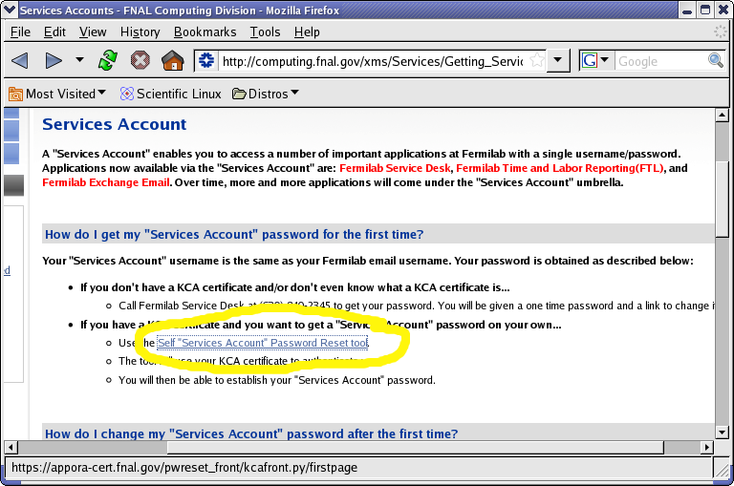
Firefox – Try to access a page

Slide 3
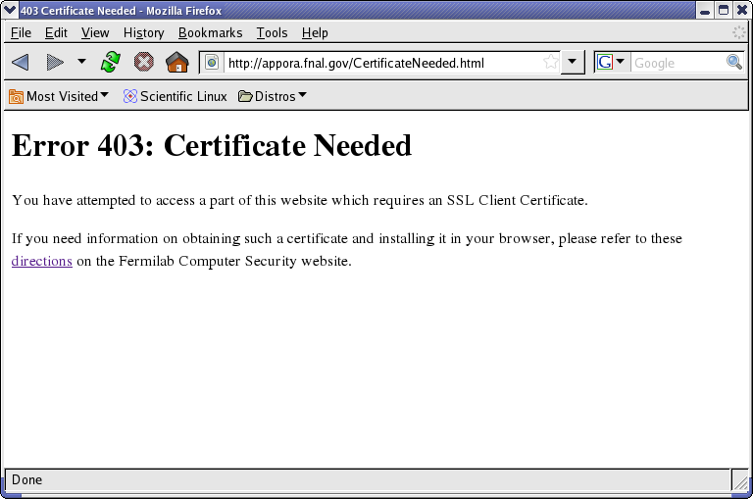
Firefox – Try to access a page

Slide 4
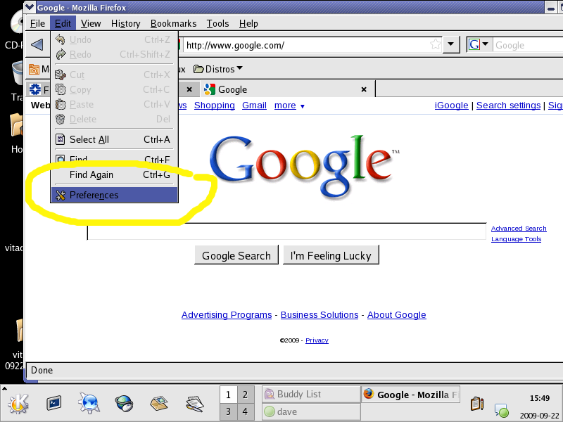
Firefox – view certificates

Slide 5
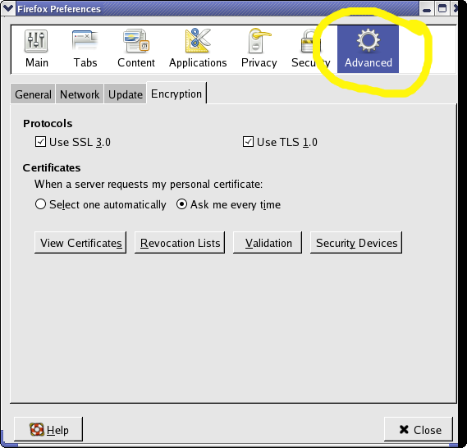
Firefox – view certificates

Slide 6
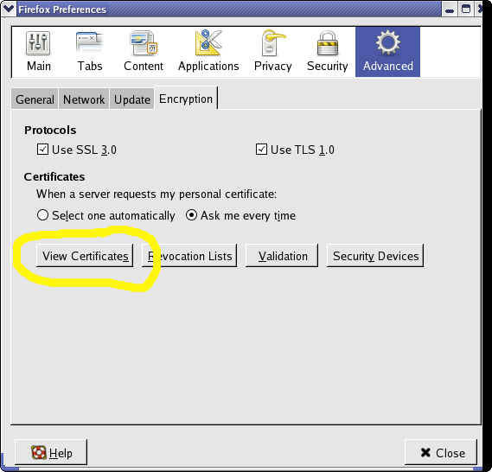
Firefox – View Certificates

Slide 7
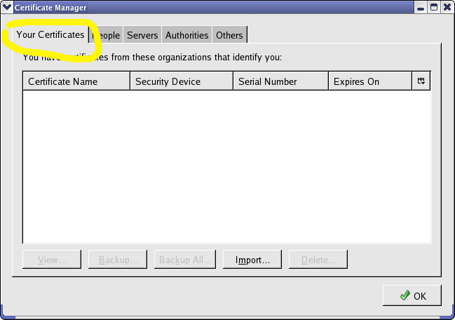
Firefox – Your certificates before

Slide 8
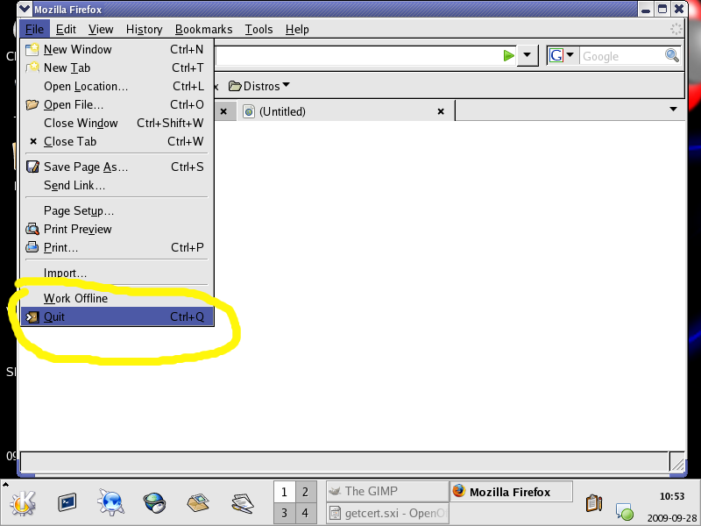
Firefox – STOP FIREFOX

Slide 9
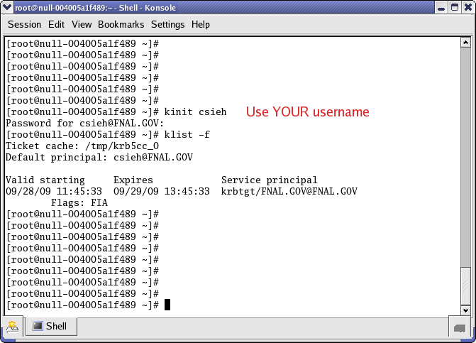
Firefox – kinit <username>

Slide 10
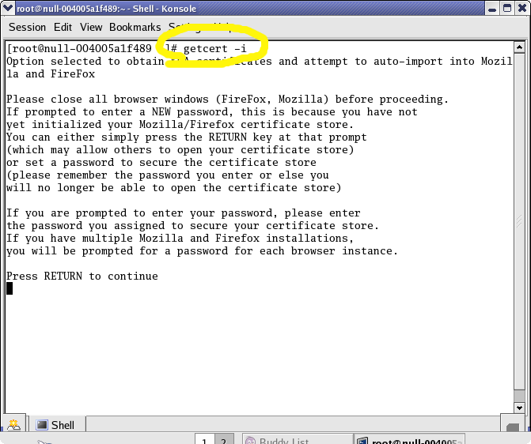
Firefox – getcert waiting for user

Slide 11
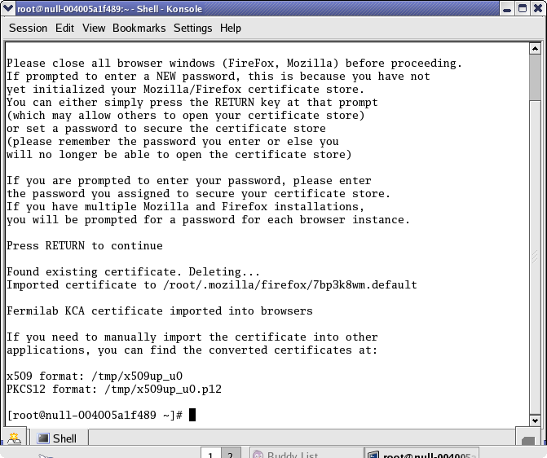
Firefox – getcert done

Slide 12
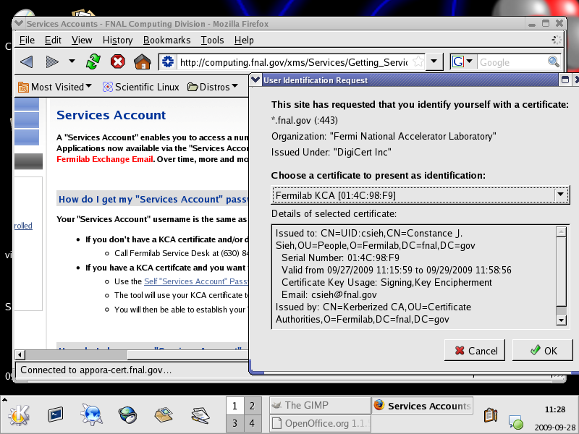
Firefox – after getcert

Slide 13
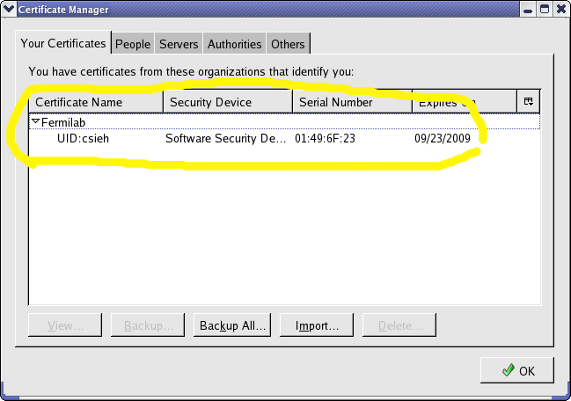
Firefox – view certs after

Slide 14
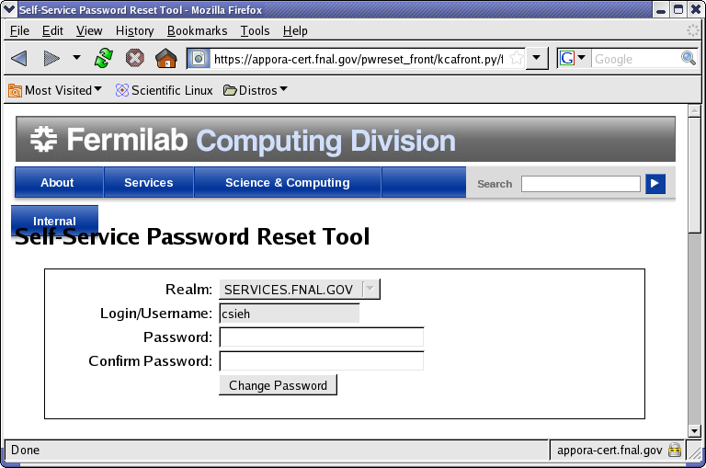
Firefox – have cert – page loads

