Slide 1
State of Washington
Washington State Ferries
Merit 5 Employees Only
Human Resource
Management Report
Plan & Align Workforce
Hire Workforce
Deploy Workforce
Reinforce Performance
Develop Workforce
October 2007
FY2007 07/01/06 to 06/30/07

Slide 2
Managers’ Logic Model for Workforce Management
Outputs
Initial Outcomes
Intermediate Outcomes
Plan & Align Workforce
Articulation of managers HRM accountabilities. HR policies. Workforce planning. Job classes & salaries assigned.
Managers understand HRM accountabilities. Jobs, staffing levels, & competencies aligned with agency priorities.
Foundation is in place to build and sustain a productive, high performing workforce.
Hire
Workforce
Qualified candidate pools, interviews & reference checks. Job offers. Appts & per-
formance monitoring.
Best candidate hired & reviewed during appointment period. Successful performers retained.
The right people are in the right job at the right time.
Ultimate Outcomes
Employees are committed to the work they do & the goals of the organization
Productive, successful employees are retained
State has workforce depth & breadth needed for present and future success
Deploy
Workforce
Work assignments& requirements defined. Positive workplace environment created. Coaching, feedback, corrections.
Workplace is safe, gives capacity to perform, & fosters productive relations. Staff know job rqmts, how they’re doing, & are supported.
Time & talent is used effectively. Employees are motivated & productive.
Develop Workforce
Individual development plans. Time/ resources for training. Continuous learning environment created.
Learning environment created. Employees are engaged in develop-
ment opportunities & seek to learn.
Employees have competencies for present job & career advancement
Agencies are better enabled to successfully carry out their mission. The citizens receive efficient government services.
Reinforce Performance
Clear performance expectations linked to orgn’al goals & measures. Regular performance appraisals. Recognition. Discipline.
Employees know how performance contributes to success of orgn. Strong performance rewarded; poor performance eliminated
Successful perf is differentiated & strengthened. Employees are held accountable.

Slide 3
Standard Performance Measures
Plan & Align Workforce
Percent supervisors with current performance expectations for workforce management
Management profile
Workforce planning measure (TBD)
Percent employees with current position/competencies descriptions
Time-to-fill funded vacancies
Candidate quality
Hiring Balance (Proportion of appointment types)
Separation during review period
Percent employees with current performance expectations
Employee survey ratings on “productive workplace” questions
Overtime usage
Sick leave usage
Non-disciplinary grievances/appeals filed and disposition (outcomes)
Worker safety
Percent employees with current individual development plans
Employee survey ratings on “learning & development” questions
Competency gap analysis (TBD)
Percent employees with current performance evaluations
Employee survey ratings on “performance & accountability” questions
Disciplinary actions and reasons, disciplinary grievances/appeals filed and disposition (outcomes)
Reward and recognition practices (TBD)
Ultimate Outcomes
Hire
Workforce
Employee survey ratings on “commitment” questions
Turnover rates and types
Turnover rate: key occupational categories
Workforce diversity profile
Retention measure (TBD)
Deploy
Workforce
Develop Workforce
Reinforce Performance

Slide 4
Plan & Align Workforce
Outcomes:
Managers understand workforce management accountabilities. Jobs and competencies are defined and aligned with business priorities. Overall foundation is in place to build & sustain a high performing workforce.
Performance Measures:
Percent supervisors with current performance expectations for workforce management
Management profile
Workforce Planning measure (TBD)
Percent employees with current position/ competency descriptions
Workforce Management Expectations
Percent supervisors with current performance expectations for workforce management = 100%
Analysis:
The methods which are utilized are adequate for communication expectations
However, whether the methods utilized, in the frequency utilized, are sustained adequately, needs to be tracked
Action Steps:
Line HR Representatives assigned to Deck, Vessel Preservation & Maintenance, and Terminals are tracking the frequency of use of a sampling of areas to help determine sustainability. At this point in time we see no issues
Total # of supervisors with current performance expectations for workforce management as of 06/30/07 = 187
Total # of supervisors as of 06/30/07 = 187
Only FASPAA, MEBA Licensed, MM&P, and Metal Trades Collective Bargaining Units (CBU’s) have Supervisory positions:
FASPAA: Terminal Supervisor; MEBA Licensed: Staff Chief Engineer, Chief Engineer; MM&P: Staff Master, Master; Metal Trades: General Forman
Performance Expectations Functional Equivalents
New Hire Orientation
Tracking and Publication of WSF System Wide Metrics
Quick Notices
Fleet Advisory
Fleet Focuses
Weekly Meeting with Staff
Staff Master, Staff Chief Meetings
Attendance Records (quarterly reports)
Safety Management Systems (SMS) (including internal audits)
Training Records
Safety Management System (SMS) (including annual internal audits)
Bi-Monthly Training log
“Initial Vessel Familiarization” for licensed deck personnel
“Detailed Vessel Familiarization List” for specified deck personnel
“Performance notifications”
“Performance Log” for terminals employees
Data as of June 2007
Source for data: HRMS, Org Charts
Source for performance appraisal equivalents information: Operating Departments; Communications Department; HR Department Records; Safety Management System (SMS), Automated Operating Support System (AOSS) Dispatch System.

Slide 5
Plan & Align Workforce
Outcomes:
Managers understand workforce management accountabilities. Jobs and competencies are defined and aligned with business priorities. Overall foundation is in place to build & sustain a high performing workforce.
Performance Measures:
Percent supervisors with current performance expectations for workforce management
Management profile
Workforce Planning measure (TBD)
Percent employees with current position/ competency descriptions
Management Profile
Number of WMS employees = 0
Percent of WSF (Merit 5) workforce that is WMS = 0%
Number of all Managers = 0
Percent of WSF (Merit 5) workforce that is Managers* = 0%
* Headcount in positions coded as “Manager” (includes EMS, WMS, and GS)
Analysis:
There are no “Manager” positions (EMS, WMS, GS) in Merit 5
All management oversight of Merit 5 employees is performed exclusively by Merit 1 employees
Data as of June 2007
Source: HRMS, Organization Charts

Slide 6
Plan & Align Workforce
Outcomes:
Managers understand workforce management accountabilities. Jobs and competencies are defined and aligned with business priorities. Overall foundation is in place to build & sustain a high performing workforce.
Performance Measures:
Percent supervisors with current performance expectations for workforce management
Management profile
Workforce Planning measure (TBD)
Percent employees with current position/ competency descriptions
Current Position/Competency Descriptions
Percent employees with current position/competency descriptions = 100%
Analysis:
We have adequate numbers/methods of job descriptions (at least two types per position in each of nine collective bargaining units)
Action Steps:
Line HR Representatives will determine last updates of each job description and method by which they are updated and make determination as to whether frequency is adequate, and whether it is sustainable. At this point in time we see no issues for this area
Total # of employees with current position/competency descriptions as of 06/30/07 = 1,649
Total # of employees as of 06/30/07 = 1,649
Job Descriptions are Available in the following Formats:
Position Descriptions (including Essential Job Functions)
Classification Questionnaires
Safety Management System Documents
Collective Bargaining Agreement Language
Data as of June 2007
Source for data: HRMS
Source for all descriptions: Operating & HR Departments; Safety Management System (SMS), Collective Bargaining Agreements (CBA’s)

Slide 7
Hire Workforce
Outcomes:
Best candidates are hired and reviewed during appointment period. The right people are in the right job at the right time.
Performance Measures
Time-to-fill vacancies
Candidate quality
Hiring Balance (proportion of appointment types)
Separation during review period
Time-to-fill / Candidate Quality
Time-to-fill Funded Vacancies
July 1, 2006 – June 30, 2007
Average Number of Days to fill*: 30.54
Number of vacancies filled: 276
*Equals # of days from job posting/advertisement (or equivalent) to start date
Analysis:
Time-to-fill for first six months depends primarily upon bid timing process for each bargaining unit, because numbers for first six months of fiscal year was weighted toward internal bids
Number for second six months of fiscal year was weighted toward external hires, so time to fill number for complete year is higher than first six months
Office jobs were 80+ days in first six months and has grown to 99+ days for year
Recent realignment of HR department to assign HR generalists for each work group may help reduce the time to fill number for fleet employees
Action Steps:
Have assigned HRC-Recruiting to analyze data to track: 1) internal, 2) external, and 3) combined numbers, for ability to perform more detailed analysis
Have assigned to the Office HR Manager to analyze and develop plan to track office separately and develop plan to lower these numbers. Will analyze whether “start on 1st or 16th of month only” has affected/will affect the numbers. Preliminary work to be presented at “Recruiting Retreat” on October 23rd
A “Recruiting Plan” template is being developed by the HRC-Recruiting and office HR Manager to be utilized as a base to develop written recruiting plans for office positions; more management/professional input will be gained for sourcing and screening ideas
Labor Relations Manager will continue to analyze numbers bargaining unit-by-bargaining. Example: eliminating IBU closed shop on 07/01/07 could reduce their number; continuing to have a MEBA closed shop will help to maintain their low number
Data as of June 2007
Source: WSF HR Department Recruiting Function Records

Slide 8
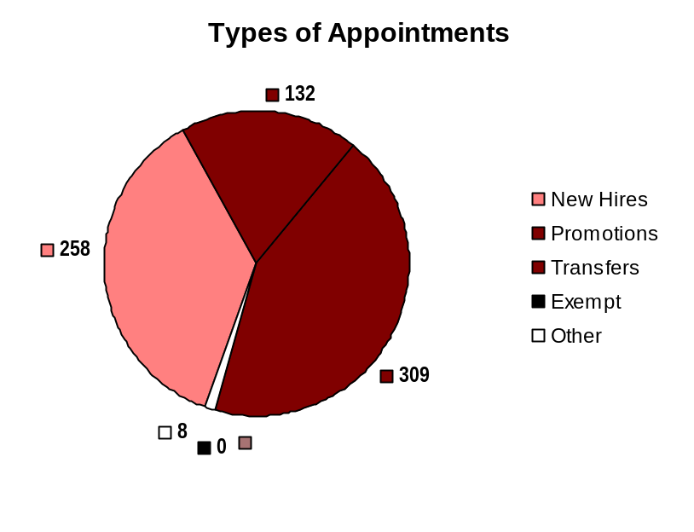
Hire Workforce
Outcomes:
Best candidates are hired and reviewed during appointment period. The right people are in the right job at the right time.
Performance Measures
Time-to-fill vacancies
Candidate quality
Hiring Balance (proportion of appointment types)
Separation during review period
Hiring Balance / Separations During Review Period
Analysis:
WSF HR recently began to distribute, once per month, a “Probationary Employee Status Chart”, to ensure visibility to directors of the status of probationary employees, highlighting when they will complete probation. We need to track to see if this may actually raise the “involuntary” separation numbers of employees during their probationary periods
Action Steps:
Line HR Representatives will continue to analyze detail of the probationary separations. With the HR Director, will develop action plan by 12/31/07, if they determine action plan needed beyond current action being taken
Task force being developed by HR Director to examine options, including financial aspects and legal issues of “on call” positions. If eventually move to a “guaranteed minimum hours of work” system, may help to reduce overtime by having more readily available employees. Process for task force to be set up at planned October 23rd “Recruiting Retreat”
Total number of appointments = 707
Time period = 7/06 through 06/07
Includes appointments to permanent vacant positions; also permanent transfers to vacant positions through the bidding process.
“Other” = Demotions, re-employment, reversion & RIF appointments
Separation During Review Period
Probationary separations - Voluntary 24
Probationary separations - Involuntary 15
  Total Probationary Separations 39
Trial Service separations - Voluntary 0
Trial Service separations - Involuntary 0
  Total Trial Service Separations 0
Total Separations During Review Period 39
Time period = 7/06 through 06/07
Data as of June 2007
Source: ACCESS Reports, AOSS

Slide 9
Deploy Workforce
Outcomes:
Staff know job expectations, how they’re doing, & are supported. Workplace is safe, gives capacity to perform, & fosters productive relations. Employee time and talent is used effectively. Employees are motivated.
Performance Measures
Percent employees with current performance expectations
Employee survey ratings on “productive workplace” questions
Overtime usage
Sick leave usage
Non-disciplinary grievances/appeals filed and disposition (outcomes)
Worker safety
Current Performance Expectations
Percent employees with current performance expectations = 100%
Analysis:
The methods which are utilized are adequate for communication expectations
However, whether the methods utilized, in the frequency utilized, are sustained adequately, needs to be tracked
Action Steps:
Line HR Representatives assigned to Deck, Vessel Preservation & Maintenance, and Terminals will track the frequency of use of a sampling of areas to help determine sustainability. Does not appear to be an issue at this point in time
Total # of employees with current performance expectations as of 06/30/07 = 1,649
Total # of employees as of 06/30/07 = 1,649
Performance Expectations
Functional Equivalents:
New Hire Orientation
Tracking and Publication of WSF System Wide Metrics
Quick Notices
Fleet Focuses
Weekly Meeting with Staff
Staff Master, Staff Chief Meetings
Attendance Records (quarterly reports)
Safety Meetings & Records
Training Records
Safety Management System (SMS) (including annual internal audits)
Bi-Monthly Training log
“Initial Vessel Familiarization” for licensed deck personnel
“Detailed Vessel Familiarization List” for specified deck personnel
“Performance Notifications”
“Performance Log” for terminals employees
Data as of June 2007
Source for data: HRMS, Org Charts
Source for performance appraisal equivalents information: Operating Departments; Communications Department; HR Department Records; Safety Management System (SMS), Automated Operating Support System (AOSS) Dispatch System.

Slide 10
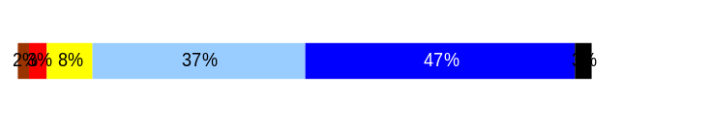
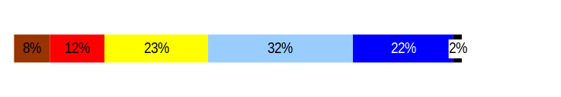
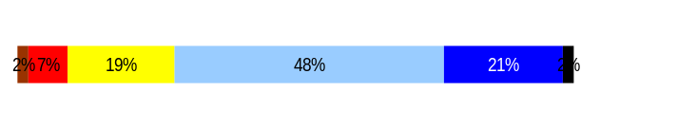
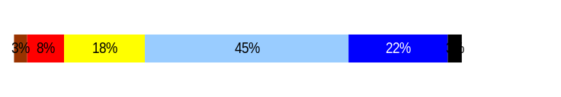
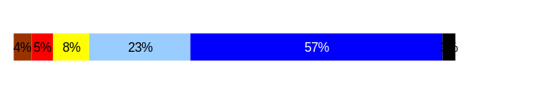
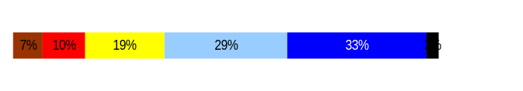
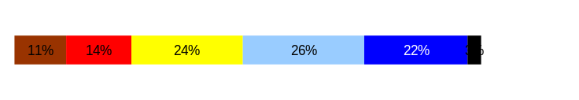
Deploy Workforce
Outcomes:
Staff know job expectations, how they’re doing, & are supported. Workplace is safe, gives capacity to perform, & fosters productive relations. Employee time and talent is used effectively. Employees are motivated.
Performance Measures
Percent employees with current performance expectations
Employee survey ratings on “productive workplace” questions
Overtime usage
Sick leave usage
Non-disciplinary grievances/appeals filed and disposition (outcomes)
Worker safety
Employee Survey “Productive Workplace” Ratings
Avg
Q4. I know what is expected of me at work.
Q1. I have opportunity to give input on decisions affecting my work.
Q2. I receive the information I need to do my job effectively.
Q6. I have the tools and resources I need to do my job effectively.
Q7. My supervisor treats me with dignity and respect.
Q8. My supervisor gives me ongoing feedback that helps me
improve my performance.
Q9. I receive recognition for a job well done.
4.3
3.5
3.8
3.8
4.3
3.7
3.3
Never
Seldom
Occasionally
Usually
Always
Analysis:
These results are a combination of Merit System 1 and Merit System 5. Therefore, we anticipate the ratings will improve when the number of Performance Evaluations completed increases.
Action Steps:
Action steps identified in other areas (e.g. “Workforce Management Expectations”, “Current Position/Competency Descriptions”, “Current Performance Expectations”, “Non-Disciplinary Grievances”, “Individual Development Plans”, and “Turnover Rates”) should all be factors in potentially improving these numbers
Data as of June 2007
Source: HQ HR Department

Slide 11
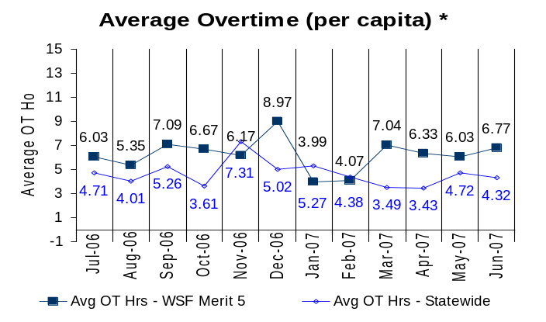
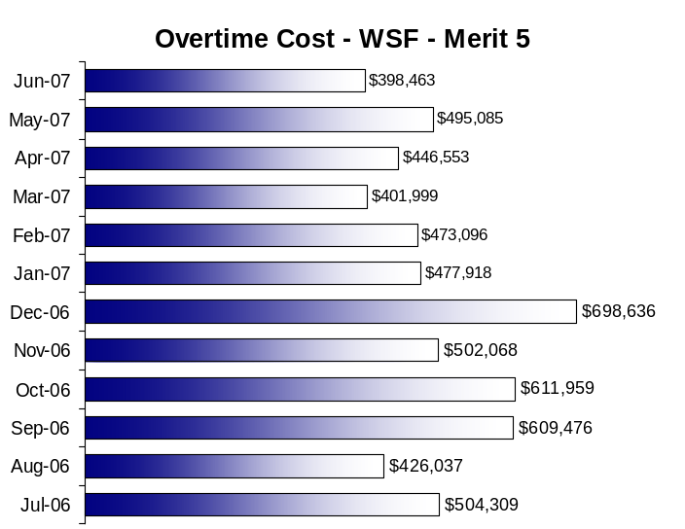
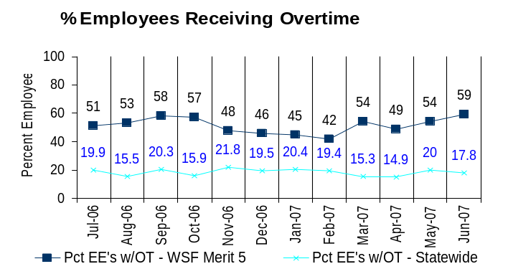
Deploy Workforce
Outcomes:
Staff know job expectations, how they’re doing, & are supported. Workplace is safe, gives capacity to perform, & fosters productive relations. Employee time and talent is used effectively. Employees are motivated.
Performance Measures
Percent employees with current performance expectations
Employee survey ratings on “productive workplace” questions
Overtime usage
Sick leave usage
Non-disciplinary grievances/appeals filed and disposition (outcomes)
Worker safety
Overtime Usage
Overall Merit 5 average overtime usage – per capita, per month: 6.21
Action Steps:
Payroll Manager, with support of Labor Relations Manager and Line HR Representatives, will research, obtain more detailed data, and then analyze further, concentrating on two areas: 1) Breaking down overtime to reflect overtime not directly related to a particular shift issue (e.g. vessel realignments, training assignments), or that are directly related to a particular shift issue (e.g. shift employee covering for an employee who calls in sick), 2) Periodic unpaid time off at request of employees (e.g. in lieu of sick day when calling in sick).
Other steps are being taken (details mentioned on other pages of report) to address: 1) Negotiations with the IBU on methodology/process used for dispatch of employees in the IBU (recently successfully completed), 2) Task force being developed to examine options, including financial aspects and legal issues of “on call” positions. If eventually move to a “guaranteed minimum hours of work” system, may help to reduce overtime by having more readily available employees
Overall Merit 5 average employees receiving overtime per month: 51
Analysis:
Collected Merit 5 overtime data from IT, by month, for FY 2007 and created Excel spreadsheet to calculate the averages
Note: 100% of Merit 5 employees are eligible for overtime, therefore “% of employees receiving overtime” may not be an appropriate comparator between Merit 5 and other State entities
Data as of June 2007
Source: HRMS; WSF IT; Payroll Records

Slide 12
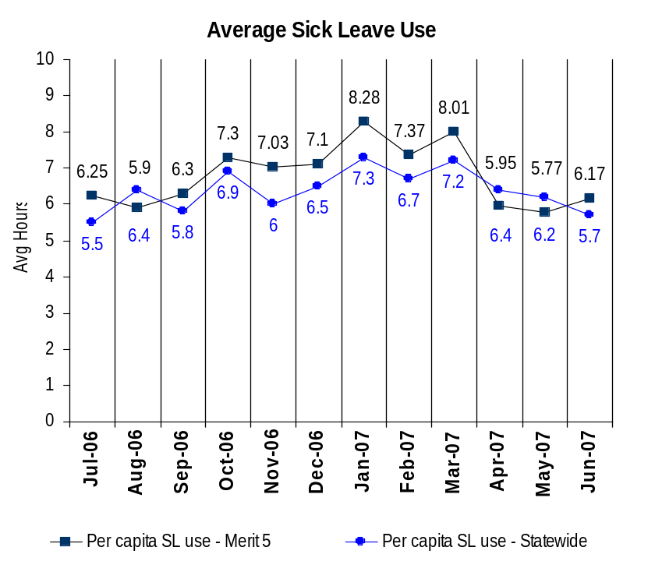
Deploy Workforce
Outcomes:
Staff know job expectations, how they’re doing, & are supported. Workplace is safe, gives capacity to perform, & fosters productive relations. Employee time and talent is used effectively. Employees are motivated.
Performance Measures
Percent employees with current performance expectations
Employee survey ratings on “productive workplace” questions
Overtime usage
Sick leave usage
Non-disciplinary grievances/appeals filed and disposition (outcomes)
Worker safety
Sick Leave Usage FY2007
Analysis:
Note: On Jones Act injuries, employees can utilize full sick days in addition to maintenance payments. L & I employees will only use sick days (hours) to fill in “gap” between their L & I partial wages payment and full salary. May skew numbers somewhat higher for Merit 5
Note: New IBU employees in “on call” status do not earn sick days until they have worked 1,040 hours. May skew numbers slightly lower for Merit 5
Action Steps:
Payroll Manager, with support of Labor Relations Manager and Line HR Representatives, will research, obtain more detailed data, and then analyze further, concentrating on the “periodic unpaid time off at request of employee” issue to see if any impact on these numbers as well as breaking down data by bargaining unit and area.
Other steps are being taken (details mentioned on other pages of report) to address: 1) Negotiations with the IBU on methodology / process used for dispatch of employees in the IBU (negotiations recently completed), 2) Task force being developed to examine options, including financial aspects and legal issues of “on call” positions. If eventually move to a “guaranteed minimum hours of work” system, may help to reduce sick leave usage by having more readily available employees
Negotiated new leaves policy into most CBA’s. This may ultimately positively affect numbers. Employee Risk Management/HR Services Manager and Labor Relations Manager must complete full implementation (updating, communicating, supervisory education, dissemination, etc.)
Sick Leave Hrs Used / Earned (per capita)
Avg Hrs SL Used WSF Merit 5 | % of SL Hrs Earned WSF Merit 5
6.52 Hrs | 94.04%
Avg Hrs SL Used Statewide* | % of SL Hrs Earned Statewide*
6.4 Hrs | 82.5%
Sick Leave Hrs Used / Earned (those who took SL)
Avg Hrs SL Used WSF Merit 5 | % SL Hrs Earned WSF Merit 5
18.51 Hrs | 107.60%
Avg Hrs SL Used Statewide* | % SL Hrs Earned Statewide*
11.9 Hrs | 148.4%
* Statewide data does not include DOL, DOR, L&I, and LCB
Source: Payroll; HRMS & IT Records As of June 2007

Slide 13
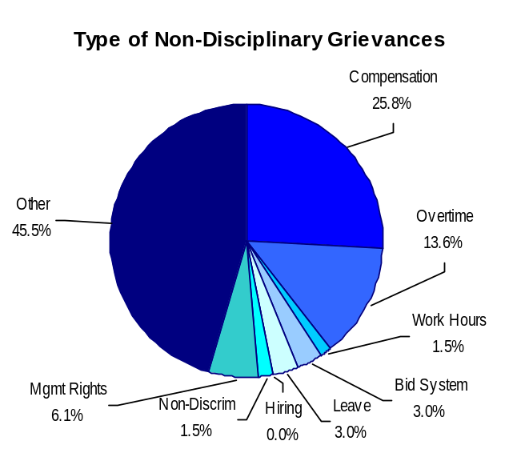
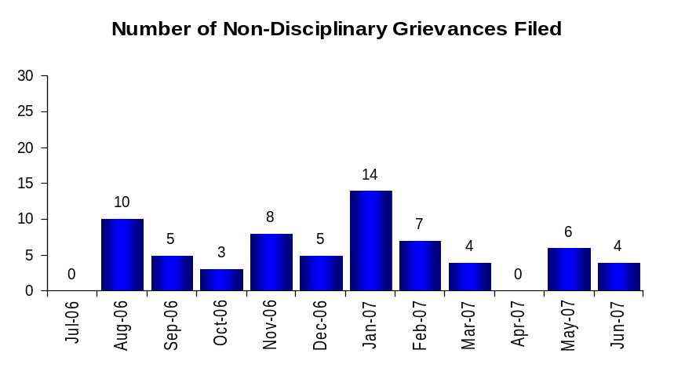
Deploy Workforce
Outcomes:
Staff know job expectations, how they’re doing, & are supported. Workplace is safe, gives capacity to perform, & fosters productive relations. Employee time and talent is used effectively. Employees are motivated.
Performance Measures
Percent employees with current performance expectations
Employee survey ratings on “productive workplace” questions
Overtime usage
Sick leave usage
Non-disciplinary grievances/appeals filed and disposition (outcomes)
Worker safety
Non-Disciplinary Grievances (Represented Employees)
Total Non-Disciplinary Grievances = 66
Analysis:
WSF currently tracks and reports on the progress of every Merit 5 alleged contract violation and disciplinary grievance, resulting from management disciplinary action, from initial filing of the grievance through final resolution which would involve an ultimate appeal in an arbitration decision
Action Steps:
LRO will be implementing a statewide grievance tracking system which WSF will adopt when it is fully implemented- bugs need to be worked out for CBU’s that are different than state-wide ones. Until the above occurs, WSF will maintain its current system of monitoring the progress of grievances. Although goal for use of system was 07/01/07, issues still need to be resolved which are dependent upon employees outside WSF/WSDOT
WSF has developed a “Labor/Employee Relations Strategy Framework” to spend more time/effort on non-adversarial/proactive activities. Labor Relations Manager is tracking and analyzing whether this will help us sustain some of the successes we have had over the past 2+ years in grievances and unfair labor practice filings and labor relations climate
We will keep doing the work we have been doing to build on the success that we have had to sustain our positive momentum
Disposition (Outcomes) of Non-Disciplinary Grievances
Time period = 07/01/06 through 06/30/07
Settled/Resolved: 18
Withdrawn: 0
Denied: 40
Denied, MEC/Private Arbiter Resolution: 14
  Pending: 4
  Withdrawn: 2
  Settled: 7*
  WSF won: 0
  WSF lost: 0
  *Two grievances were consolidated into one MEC Case
* There may not be a one-to-one correlation between the number of grievances filed (shown top of page) and the outcomes determined during this time period. The time lag between filing date and when a decision is rendered can cross the time periods indicated.
Data as of June 2007
Source: WSF Labor Relations section of WSF HR Department, Grievance Logs

Slide 14
Deploy Workforce
Outcomes:
Staff know job expectations, how they’re doing, & are supported. Workplace is safe, gives capacity to perform, & fosters productive relations. Employee time and talent is used effectively. Employees are motivated.
Performance Measures
Percent employees with current performance expectations
Employee survey ratings on “productive workplace” questions
Overtime usage
Sick leave usage
Non-disciplinary grievances/appeals filed and disposition (outcomes)
Worker safety
Not Applicable to WSF Merit 5

Slide 15
Deploy Workforce
Outcomes
Staff know job expectations, how they’re doing, & are supported. Workplace is safe, gives capacity to perform, & fosters productive relations. Employee time and talent is used effectively. Employees are motivated.
Performance Measures
Percent employees with current performance expectations
Employee survey ratings on 'productive workplace' questions
Overtime usage
Sick leave usage
Non-disciplinary grievances/appeals filed and disposition outcomes
Worker Safety
Not Applicable to WSF Merit 5
Notes:
HRMR Safety Report Overview
The HRMR Safety Reports are:
- PowerPoint slides created by the Department of Labor and Industries
- Created for each state agency that is reporting their employee safety program results bi-
annually as part of their Human Resources Management Report (HRMR).
- Snapshots of five years of worker’s compensation claim data specific to that agency, as
well as a comparison to the combined data for agencies completing HRMR reports.
- There is a two quarter lag at the end of the five years.
This allows each agency’s payroll data to be entered into L&I’s computer system. This
payroll data is used to compute the number of workers per agency and quarter.
Definitions
Claim – When a covered worker sustains an occupational injury or illness, that worker files a
'claim’ for benefits. A 'claim number' is assigned, and all wage replacement payments, medical
provider bills, etc, for that worker and injury, are associated with that claim number.
Report Detail
'Allowed Annual Claim Rate'
This chart shows your agency's rate of injuries resulting in allowed
claims, by injury quarter, for on-the-job injuries and occupational illnesses. The rate for all
reporting agencies is shown for comparison.
- The rate is the number accepted claims per 200,000 annual worker hours (100 workers)
Three rates are included in this chart:
A)The total rate for all injuries resulting in a claim; the two groups listed below are
exclusive of each other.
B)The rate of injuries which required medical care, but no compensation for lost
time.
C)The rate of injuries which resulted in compensation for lost time in addition to
medical care.
'Injuries by Occupational Injury and Illness Classification (OIICS) Event’
This section contains a pie chart which shows your agency's injuries by type* and a table which
shows the percent and number of accepted claims by OIICS Event description and code.
This information is useful in identifying what causes injuries so prevention can occur. Prevention
might include root cause analysis, education, and hazard mitigation.
* Injury Type is based on the 2 digit Major Group code of the Event or Exposure section of the Occupational
Injury and Illness Classification System (OIICS). Groups with less than 3% of the
total injuries are combined into the 'Misc' category.
How to get this report for your agency:
All worker compensation reports will be available on the L&I website by the 20th of September or
the 20th of March of each year. The data will be provided in a PowerPoint slide to which you will
add your own analyses and action plans.

Slide 16
Develop Workforce
Outcomes:
A learning environment is created. Employees are engaged in professional development and seek to learn. Employees have competencies needed for present job and future advancement.
Performance Measures
Percent employees with current individual development plans
Employee survey ratings on “learning & development” questions
Competency gap analysis (TBD)
Individual Development Plans
Analysis:
Determined what processes and measures are in place in order for a WSF Merit 5 employee to be able to identify a development plan; determined what is needed for a WSF Merit 5 employee to advance in his/her area
Development plans exist for positions in each of the nine CBU’s
WSF Merit 5 employees make career advancements primarily through seniority and by training and certifications (e.g. USCG)
OPEIU employees receive individual development plans through the use of their performance appraisals
Action Steps:
Although development plans exist for individual jobs, need to evaluate how well these are communicated to individual employees. Line HR Representatives will develop an informal methodology to do this, to be used for their Vessel, Terminal, Eagle Harbor visits
Training & Development Manager is leading his department in developing “One Sheeters” on steps necessary for employees to take to advance to the next level, for use aboard vessels and in terminals. Line HR Representatives are developing a “Tick List” of what should be aboard vessels and in terminals, which will include these “One Sheeters”. They will monitor use
Percent employees with current individual development plans =100%
Total # of employees with current IDP’s as of 06/30/07 = 1,649
Total # of employees as of 06/30/07 = 1,649
Data as of June 2007
Source: Operations Departments; Training Department Office; Collective Bargaining Agreements (CBA’s)

Slide 17
Reinforce Performance
Outcomes:
Employees know how their performance contributes to the goals of the organization. Strong performance is rewarded; poor performance is eliminated. Successful performance is differentiated and strengthened. Employees are held accountable.
Performance Measures
Percent employees with current performance evaluations
Employee survey ratings on “performance and accountability” questions
Disciplinary actions and reasons, disciplinary grievances/appeals filed and disposition (outcomes)
Reward and recognition practices (TBD)
Current Performance Evaluations
Percent employees with current performance evaluations
as of 06/30/07
OPEIU 15.25%
Probationary 22.40%
Sellers 100%
All Others N/A
Analysis:
The only Merit 5 employees who we can legally do a full official performance evaluation on are the members of the OPEIU Collective Bargaining Unit
We are allowed to do performance appraisals on the sales performance aspects of the sellers at the terminals, on a continuing basis
We are also allowed to do full performance appraisals on Probationary employees
The percents indicated are the total of OPEIU, Sellers, or probationary employees who have a completed performance evaluation 06/30/07
Conditions:
The OPEIU CBA allows a performance evaluation to be given and therefore WSF is continuing to process these evaluations as we are for Merit 1 employees
Metal Trades have performed performance evaluations in the past but a moratorium through 6/09 has been placed on the practice by agreement between the LRO and Metal Trades CBU
The remaining seven CBU’s are silent on performance evaluations, therefore may not be performed as a term and condition of employment unless negotiated into each CBA. Probationary employees do not fall under the CBA in this aspect. There has been a past practice of doing the performance evaluation of the sellers on a quarterly basis
Action Steps:
OPEIU members due a performance appraisal are listed on “Due” sheets handed out at director meetings once per month. This is a new practice. HR Director will publish and monitor results from this point on
Probationary employees due a performance appraisal are listed on “Probationary” sheets handed out at director meetings once per month. This is a new practice. HR Director will publish and monitor results from this point on
Total # of OPEIU employees as of 06/30/07= 59
Total # of OPEIU employees with current performance evaluations for as of 06/30/07 = 9
Total # of Merit 5 Probationary employees as of 06/30/07 = 125
Total # of Merit 5 Probationary employees with current performance evaluations as of 06/30/07 = 28
Total # of Sellers as of 06/30/07 = 117
Total # of Sellers with current performance evaluations as of 06/30/07= 117
Data as of June 2007
Source: HR Services Tracking

Slide 18
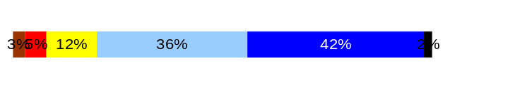
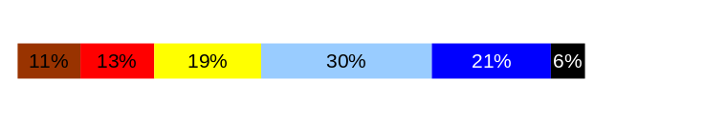
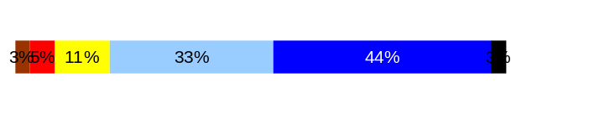
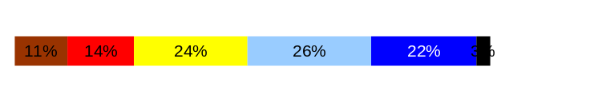
Reinforce Performance
Outcomes:
Employees know how their performance contributes to the goals of the organization. Strong performance is rewarded; poor performance is eliminated. Successful performance is differentiated and strengthened. Employees are held accountable.
Performance Measures
Percent employees with current performance evaluations
Employee survey ratings on “performance and accountability” questions
Disciplinary actions and reasons, disciplinary grievances/appeals filed and disposition (outcomes)
Reward and recognition practices (TBD)
Employee Survey “Performance & Accountability” Ratings
Avg
Q3. I know how my work contributes to the goals of my agency.
Q10. My performance evaluation provides me with meaningful information about my performance.
Q11. My supervisor holds me and my co-workers accountable for performance.
Q9. I receive recognition for a job well done.
4.1
3.4
4.1
3.3
Never
Seldom
Occasionally
Usually
Always
Analysis:
Majority of Merit 5 employees do not receive a formal performance appraisal, therefore, #10 results will be difficult to move up for this group
Action Steps:
Action steps identified in other areas (e.g. “Workforce Management Expectations”, “Current Position/Competency Descriptions”, “Current Performance Expectations”), “Non-Disciplinary Grievances”, “Individual Development Plans”, and “Turnover Rates”) should all be factors in potentially improving these numbers
Data as of June 2007
Source: HQ HR Department

Slide 19
Reinforce Performance
Outcomes:
Employees know how their performance contributes to the goals of the organization. Strong performance is rewarded; poor performance is eliminated. Successful performance is differentiated and strengthened. Employees are held accountable.
Performance Measures
Percent employees with current performance evaluations
Employee survey ratings on “performance and accountability” questions
Disciplinary actions and reasons, disciplinary grievances/appeals filed and disposition (outcomes)
Reward and recognition practices (TBD)
Formal Disciplinary Actions
Analysis:
WSF HR Labor Relations department tracks and reports on the condition of every Merit 5 grievance, appeal and disciplinary action from inception to finalization
There has been a modest reduction in formal disciplinary actions in the second half of the fiscal year
However, since we are now enforcing, or have begun to enforce newly negotiated provisions in collective bargaining agreements effective at beginning of the present calendar and new fiscal year, the number of formal disciplinary actions may actually rise in the near future
Action Steps:
Labor Relations Manager will compile and analyze more detailed information for the 21 disciplinary actions (e.g. what specifically was discipline for, by CBU). Action plan will be developed, if warranted
Continue to support Operations and Maintenance Departments, along with others, in processing employee discipline – this needs to be recognized as a cultural change at WSF for less than major issues
WSF will adopt the LRO Statewide tracking system as soon as system issues are identified and resolved. LRO/IT are working on it
Disciplinary Action Taken
Time period = FY2007
Dismissals | 12
Demotions | 0
Suspensions | 9
Reduction in Pay* | 0
Total Disciplinary Actions* | 21
* Reduction in Pay is not currently available in HRMS/BW.
Issues Leading to Disciplinary Action
  Attendance
  Code of Conduct
  Performance
Data as of June 2007
Source: WSF Labor Relations section of WSF HR Department, Discipline Log

Slide 20
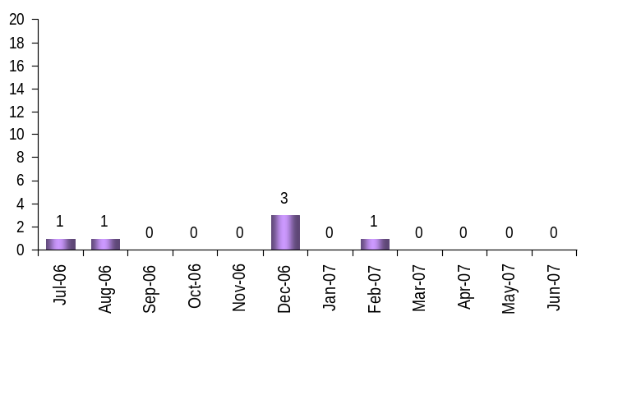
Reinforce Performance
Outcomes:
Employees know how their performance contributes to the goals of the organization. Strong performance is rewarded; poor performance is eliminated. Successful performance is differentiated and strengthened. Employees are held accountable.
Performance Measures
Percent employees with current performance evaluations
Employee survey ratings on “performance and accountability” questions
Disciplinary actions and reasons, disciplinary grievances/appeals filed and disposition (outcomes)
Reward and recognition practices (TBD)
Disciplinary Grievances and Appeals
Disciplinary Grievances
(Represented Employees)
Analysis:
LRO’s statewide grievance tracking system has been put on hold until they can meet and discuss how to make the system more “user friendly”. At this point there is no training offered on how to navigate through the many screens of the new tracking system. Until the above occurs, WSF will maintain its current system of monitoring the progress of grievances
Total # Disciplinary Grievances Filed in FY2007: 6
There is no one-to-one correlation between the filings shown above and the outcomes displayed in the charts below. The time lag between filing date and when a decision is rendered can cross the time periods indicated.
Disposition (Outcomes) of Disciplinary Grievances
Time period = 07/01/06 through 12/31/06
Settled/Resolved: 0
Withdrawn: 0
Denied: 6
Denied, MEC/Private Arbiter for Resolution: 2
  Pending: 0
  Withdrawn: 1
  Settled: 1
  WSF won: 0
  WSF lost: 0
Data as of June 2007
Source: WSF Labor Relations section of WSF HR Department, Grievance Log
Note: WSF will be utilizing statewide grievance tracking system, as soon as some “bugs” in system are worked out to reconcile with process for non-statewide unions

Slide 21
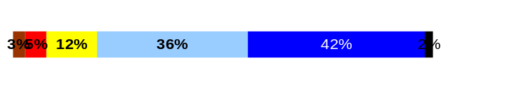
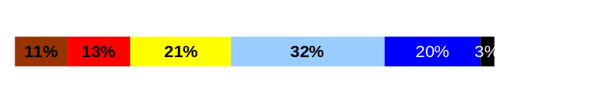
ULTIMATE OUTCOMES
Employees are committed to the work they do and the goals of the organization
Successful, productive employees are retained
The state has the workforce breadth and depth needed for present and future success
Performance Measures
Employee survey ratings on “commitment” questions
Turnover rates and types
Turnover rate: key occupational categories
Workforce diversity profile
Retention measure (TBD)
Employee Survey “Employee Commitment” Ratings
Avg
Action Steps:
WSF is currently reviewing and revamping its employee recognition programs, lead by the Office HR Manager
WSF has developed a “Labor/Employee Relations Strategy Framework” to spend more time/effort on non-adversarial/proactive activities. We believe this will help us sustain some of the successes we have had over the past three years in grievances and unfair labor practice filings and the labor relations climate. This may have a positive influence on the numbers, but is a continuous improvement process with no end date
In particular, the “Employee Relations” segment and the “Employee Communications” segment of the Labor /Employee Relations Strategy, headed up by the Line HR Rep for Vessel Maintenance & Preservation, and the Director of HR, respectively, are doing continuous improvement work that may improve these numbers
In short, we need to keep building on the success that we have had to sustain our positive momentum
Q3. I know how my work contributes to the goals of my agency.
Q12. I know how my agency measures its success.
Q9. I receive recognition for a job well done.
4.1
3.4
3.3
Never
Seldom
Occasionally
Usually
Always
Data as of June 2007
Source: HQ HR Department

Slide 22
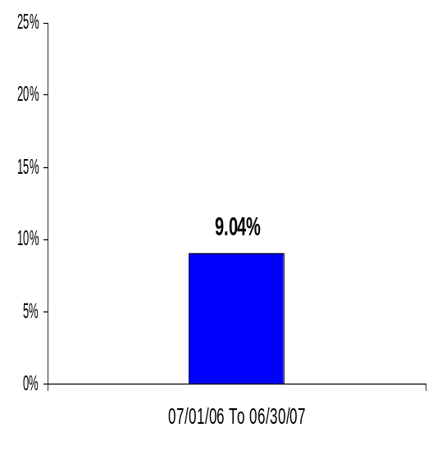
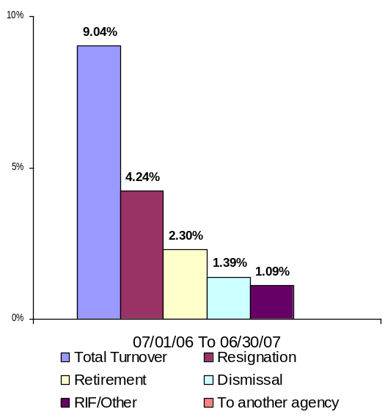
ULTIMATE OUTCOMES
Employees are committed to the work they do and the goals of the organization
Successful, productive employees are retained
The state has the workforce breadth and depth needed for present and future success
Performance Measures
Employee survey ratings on “commitment” questions
Turnover rates and types
Turnover rate: key occupational categories
Workforce diversity profile
Retention measure (TBD)
Turnover Rates
Analysis:
We have a high concern on retirements and upcoming retirements; however, in this group, about double the number of employees resign or are dismissed
Action Steps:
Task force being developed by HR Director to examine options, including financial aspects and legal issues of “on call” positions. If eventually move to a “guaranteed minimum hours of work” system, may help to reduce turnover by sustaining employees’ interest in their jobs and WSF
Recent realignment of HR provides individual HR Reps for Vessel Maintenance & Preservation, Terminals, and Deck, who are intimately involved in this year’s recruitment process. They will provide recommendations on the recruiting process, sourcing, screening, and initial retention at a “Recruiting Retreat” scheduled for October 23, 2007. HR Director will assist Line HR Reps in developing statistical screening models to help them predict “applicant-to-hire” ratios
There is no quantifiable data regarding the reliability and validity of most of our current screening methods for Merit 5 fleet employees. The Line HR Reps and the HRC-Recruiting have been assigned to review the screening devices for possible testing, with goal to identify areas to test before next recruiting season. Will review at “Recruiting Retreat” scheduled for October 23, 2007
Long-term workforce/manpower planning programs need to be developed on a greater and more in-depth scale. HR Director will work with Line HR Reps to develop models and train in analysis and methodology, so models may be utilized beginning in 2008, in particular addressing analysis of expected retirements over the next 10-15 years
Several segments of the “Labor/Employee Relations Framework” (e.g. “Employee Communications”, “Employee Relations”) lend themselves to a continuous improvement process in enhancing the employee relations climate. These are permanent efforts to be proactive rather than reactive
WSF Merit 5 Turnover
Leaving WSF (Merit 5)
WSF Merit 5 Workforce
Turnover Breakdown
Data as of June 2007
Source: HRMS, ACCESS Reports

Slide 23
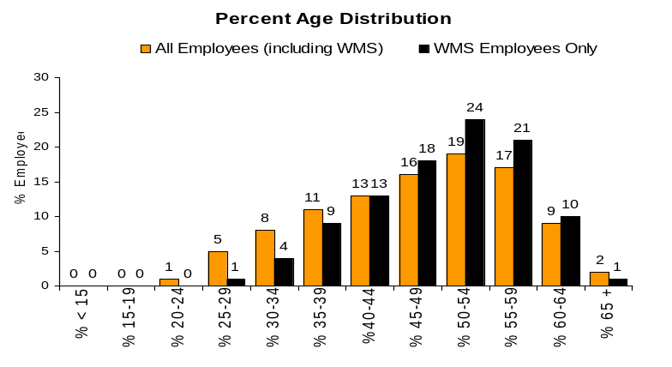
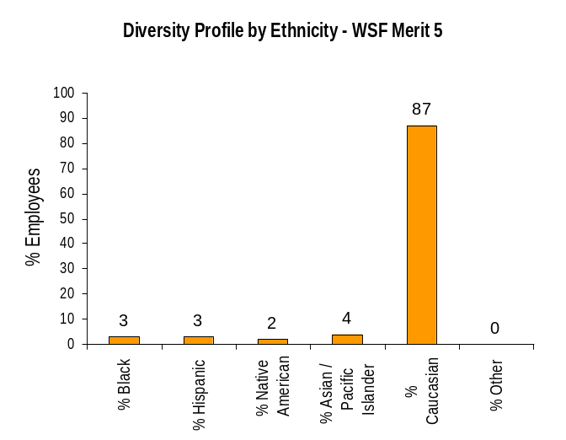
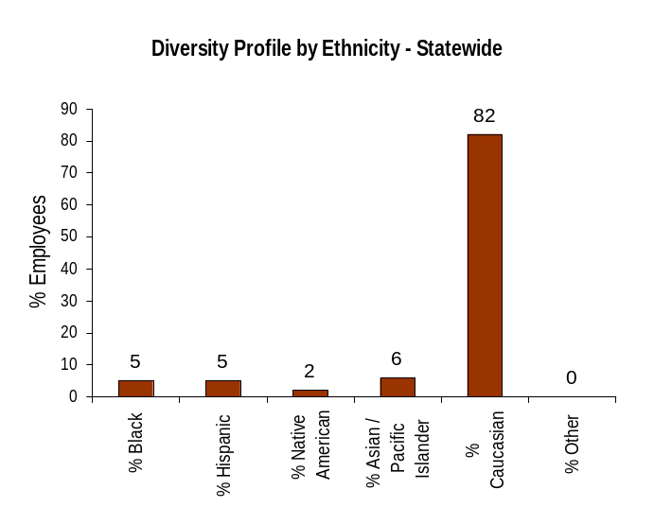
ULTIMATE OUTCOMES
Employees are committed to the work they do and the goals of the organization
Successful, productive employees are retained
The state has the workforce breadth and depth needed for present and future success
Performance Measures
Employee survey ratings on “commitment” questions
Turnover rates and types
Turnover rate: key occupational categories
Workforce diversity profile
Retention measure (TBD)
Workforce Diversity Profile
WSF Merit 5 State
Female 23% 53%
Disabled 03% 5%
Vietnam Vet 03% 7%
Disabled Vet 03% 2%
People of color 12% 18%
Persons over 40 86% 75%
Analysis
We believe that the number of employees who would self-identify as “disabled” is much higher with employees, currently, than when they were hired, which is the only time they had opportunity to self-identify. That said, most of the fleet positions do not correlate well with “Persons with Disabilities” or “Disabled Veterans”
Action Steps
Work with OEO Representative and Fleet Line HR Reps to develop and execute a plan to allow employees to self-identify their current status as disabled, by 12/31/07
WSF has developed seven “Action Items” from its Affirmative Action Plan (AAP). The HR Director has assigned specific HR personnel to lead each action item, and is conducting quarterly meetings with the assigned personnel, OEO reps, and Line WSF management to evaluate progress. These will remain in affect until/unless next AAP identifies higher importance objectives
Data as of June 2007
Source: HRMS, WSF OEO Office, WSF HR Department

