Slide 1
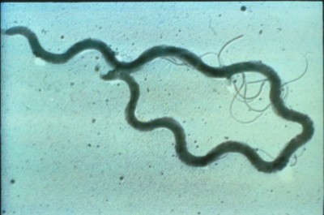
Syphilis in Detroit, Michigan:
Population Dynamics
& Effective Interventions
Carla Merritt, MPH
March 10, 2004

Slide 2
Disease Trends
& Background

Slide 3
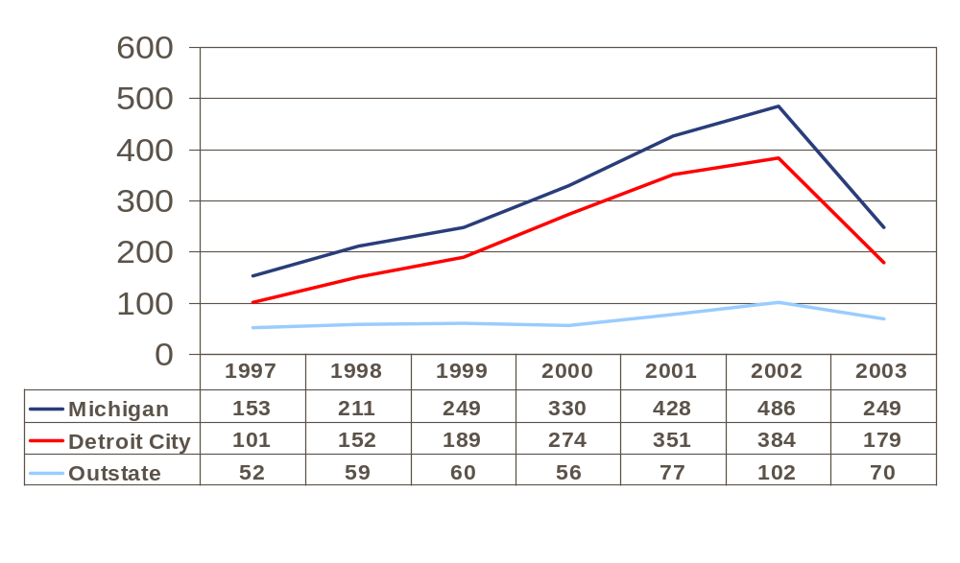
P&S Syphilis by Region
1997-2003
Number of Cases
Source: MDCH
Notes:
Year Rank # of Cases
16th 101
10th 152
7th 189
5th 274
1st 351
2nd 384
? 179

Slide 4
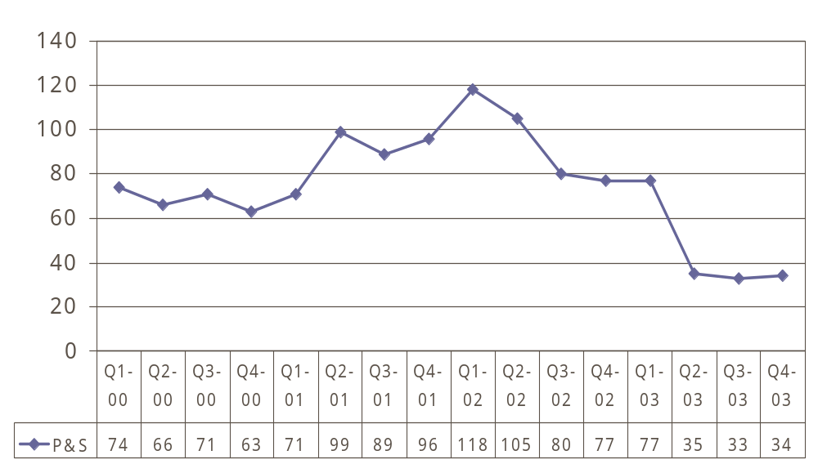
Quarterly Decline 2000-2003
Number of Cases
Notes:
Mention that this is a statistically significant decline.

Slide 5
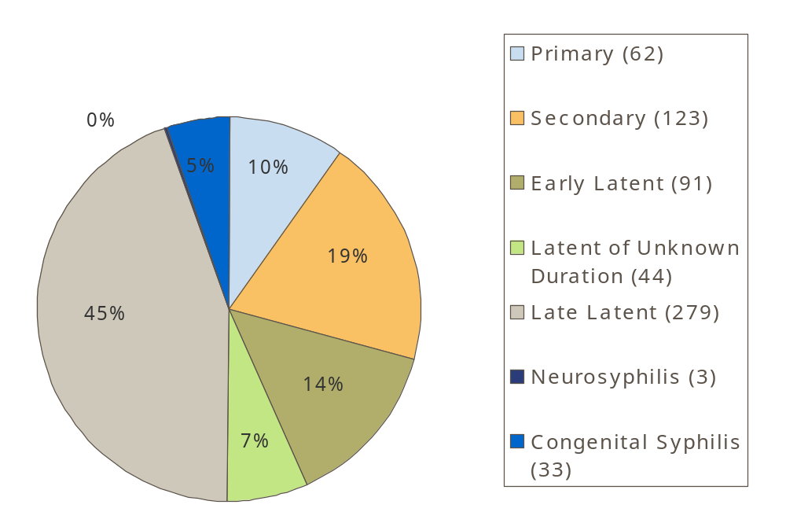
2003 Detroit
Reported Syphilis
Data includes: Detroit, Harper Woods, Highland Park, Hamtramck and the Grosse Pointes

Slide 6
Population
Profile

Slide 7
Who gets Syphilis in Detroit?
Detroit’s Overall Population
  76% Black
  0.89:1
  Male:Female Ratio
  21% between the ages of 15 and 29
  52% between the ages of 20 and 59
  Average Age, μ=30.9
    Males, μ= 29.2
    Females, μ= 32.5
Detroit’s Syphilis Population
  Disproportionately Black (92%)
  Disproportionately Male (59%)
  Heavily affect the middle ages between 20 and 59 (95%)
    When people are most sexually active
  Older on Average, μ=37.0
    Male, μ=38.7
    Female, μ=34.4
Data Includes Detroit, Harper Woods, Hamtramck, Highland Park, and the Grosse Pointes
Source 2003 P&S Data: MDCH/DDHWP
Source Detroit Population Data: 2000 Census Figure

Slide 8
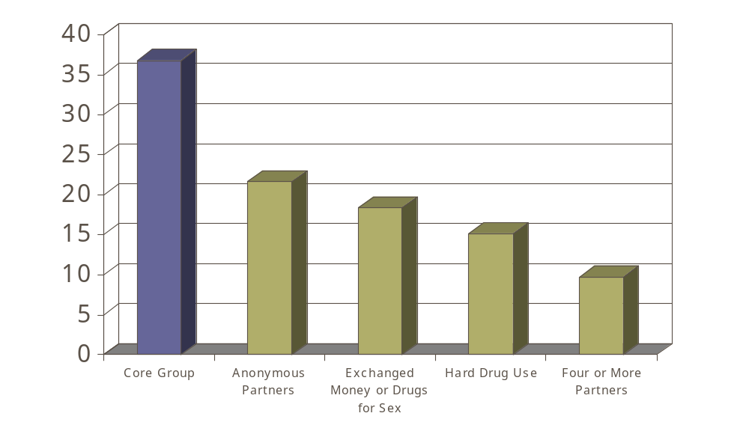
Risk Factor Profile
Core Group Characteristics
Percent of Cases
Notes:
Multiple Partners
2001: 64%
2002: 61%
2003: 48%
Anonymous
2001: 25%
2002: 26%
2003: 21%
4 + Partners
2001: 19%
2002: 22%
2003: 11%
Hard Drug Use
2001: 14
2002: 15
2003: 15
Exchange $ Drugs
2001: 23%
2002: 24%
2003: 18%
Give $ Drugs
2001: 19%
2002: 17%
2003: 14%
Received $ or Drugs
2001: 8%
2002: 9%
2003: 5%

Slide 9
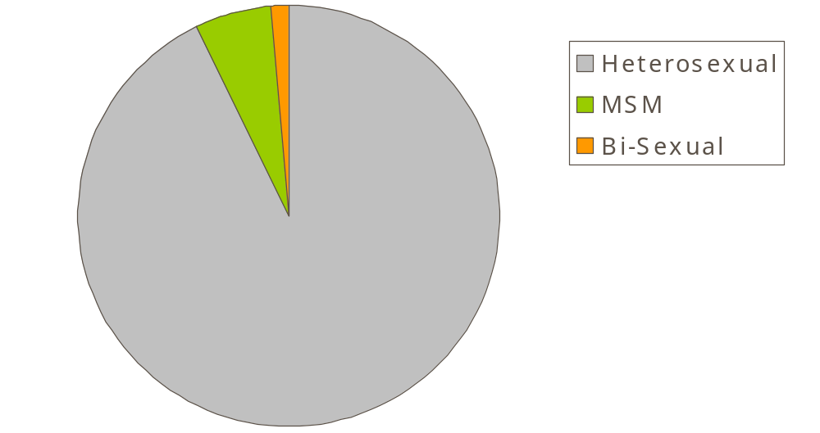
Sexual Orientation, P&S Syphilis Cases, Detroit 2003
1%
5%
93%
Notes:
Self Reported. Of those who reported sexual orientation.

Slide 10
HIV/Syphilis Co-Infection Significant Trends
60% of HIV/Syphilis co-infected cases were diagnosed with HIV prior to acquiring syphilis
73% of HIV/ Early Syphilis co-infected cases reported MSM activity while only 4% of early syphilis cases did
Among 2003 male early syphilis cases the odds of HIV co-infection was 133 times higher for those self-reporting MSM than those self-reporting only heterosexual sex
(OR: 133.0, 95% CI: {15.1, 1168.9})

Slide 11
HIV/Syphilis Co-Infection
Implications for Program and Policy
Some HIV infected individuals continue high-risk sexual behavior regardless of HIV status
HIV testing should be encouraged for all syphilis cases but especially those self-reporting MSM behavior
Education should be provided to clinicians treating HIV positive patients on the recognition of and screening for syphilis, as well as the promotion of safer sex practices as HAART extends and improves quality of life

Slide 12
Effective
Interventions

Slide 13
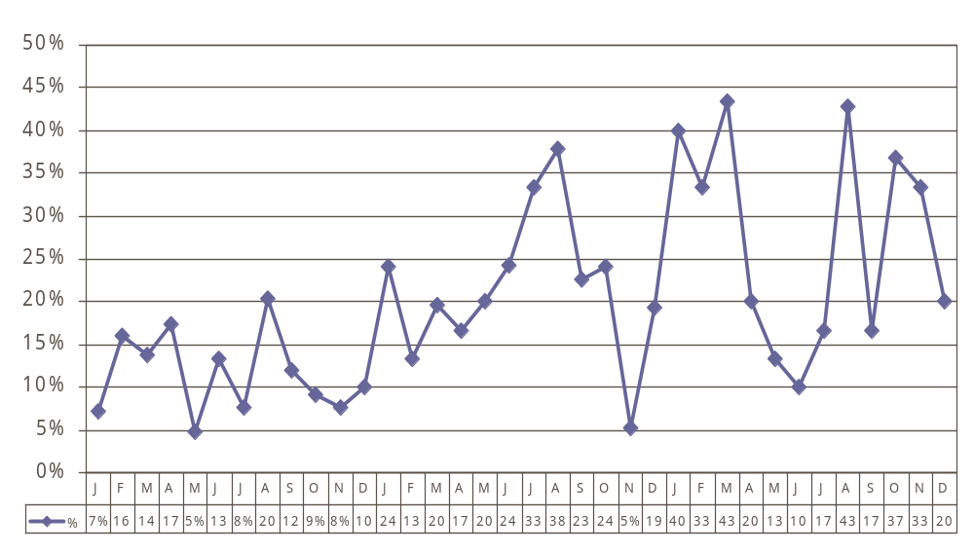
Emergency Room Visits
ER Case Detection Before and After Intervention
Intervention
October 2001
Percent of Cases
m=.00461
m_{overall}=.00546
m=.00006
2001
2002
2003
Notes:
Using the line of best fit model, on average the ER detected 0.5% more cases per month from Jan 2001 to Dec 2003. Prior to the intervention there was little if any increase. After the intervention there was an increase of about 0.5% per month.
The positive slope here indicates that the intervention was successful.

Slide 14
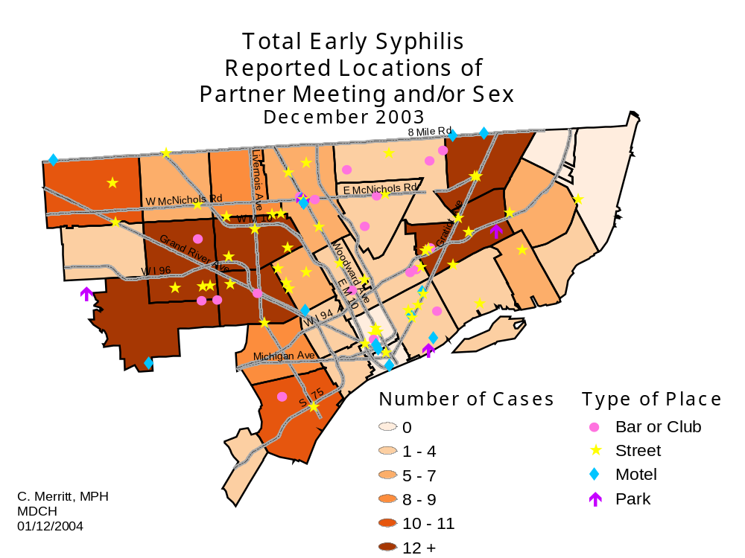
Geographic Targeting
High Morbidity Regions and Risk Space Interventions

Slide 15
Acknowledgements
Dawn Jackson, Co-Author
Bruce Nowak, Co-Author
Kathryn Macomber, MPH
The Detroit Department of Health and Wellness Promotion Sexually Transmitted Disease Surveillance and Intervention Program Staff
The Michigan Department of Community Health HIV/STD and Other Blood borne Pathogens Division

