Slide 1
Archived File
The file below has been archived for historical reference purposes only. The content and links are no longer maintained and may be outdated. See the OER Public Archive Home Page for more details about archived files.

Slide 2

INNOVATION REVIEW CRITERION
David Armstrong, Ph.D.
Chief, Review Branch
National Institute of Mental Health
National Institutes of Health
SEPTEMBER 26, 2005

Slide 3
AGENDA ITEMS
DEFINE INNOVATION
NIH EFFORTS TO PROMOTE RECEIPT AND REVIEW OF INNOVATIVE APPLICATIONS (e.g., R21, RFAs/PAs)
POSSIBLE NEW INITIATIVES

Slide 4
INNOVATIVE (HIGH-RISK) RESEARCH:
A CHALLENGE FOR THE NIH
Excessively conservative peer review process that places more emphasis on feasibility than innovation
NIH seen as risk-averse
Funding decisions are too conservative and slow
Many innovative applications are not submitted to the NIH
This threatens to deplete the NIH of a vital set of investments that are critical to its future successes

Slide 5
NIH RESPONSE TO THIS CHALLENGE
NIH Roadmap for Medical Research
NIH Neuroscience Blueprint

Slide 6
INNOVATION DEFINED
Innovation¹: 1. the action of innovating; the introduction of novelties; the alteration of what is established by the introduction of new elements or forms. 2. A change made in the nature or fashion of anything; something newly introduced; a novel practice, method, etc. 3. Comm. The action of introducing a new product into the market; a product newly brought into the market.
¹Oxford Dictionary
Notes:
REMOVE THIS SLIDE

Slide 7
Definitions
Creativity
Ability to solve problems, generate possibilities, create products
Within a specific domain (e.g. cooking, engineering, law, music, science)
Initially novel but eventually broadly accepted
The definitions are provided by Merton C. Flemings, Toyota Professor Emeritus, MIT
and Director, Lemelson-MIT Program. The definitions are based on William Middendorf’s,
What Every Engineer Should Know About Inventing, Marcel Dekker, New York, New York, 1981
and Howard Gardner’s, Intelligence Reframed: Multiple Intelligences for the 21st Century, Basics Books,
New York, New York, 1999.
Notes:
Note: Inventiveness is a form of creativity leading to invention.

Slide 8
Definitions
Invention
Process of devising & producing something which is useful and not previously known or existing
Developed through independent investigation, experimentation, & mental activity
Notes:
Note: An invention involves such high order of mental activity that the inventor is usually acclaimed even if the invention is not a commercial success.

Slide 9
Definitions
Innovation
Process of introducing novel ideas into use or practice
Includes entrepreneurship as integral part
Usually considered noteworthy if commercially successful
May or may not include invention
Notes:
Note: Innovation is usually considered noteworthy only if it is a commercial success. Thus, society benefits from innovation, not from invention alone, and often there is a significant lapse of time from invention to innovation.

Slide 10
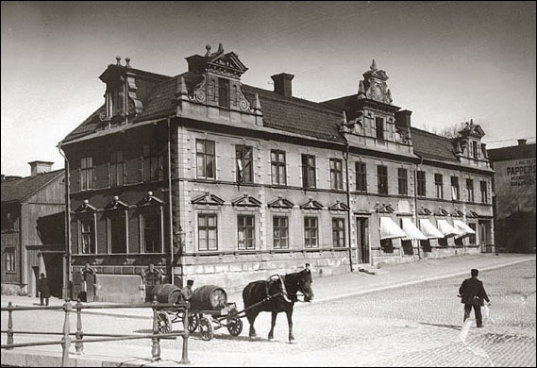
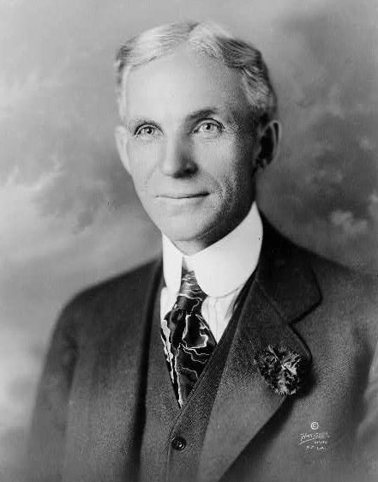


INNOVATION IS A PROCESS
problem
creativity
inventiveness
innovation
invention
innovativeness

Slide 11
INNOVATION DEFINED - NIH
Innovation – Is the project original and innovative? For example: Does the project challenge existing paradigms or clinical practice; address an innovative hypothesis or critical barrier to progress in the field? Does the project develop or employ novel concepts, approaches, methodologies, tools, or technologies for this area?

Slide 12
NIH Promotion of Innovative Science
Interviews with ICs/Centers
How does NIH promote receipt and review of innovative science?
13 ICs interviewed
Completed by Chana Rabiner, PhD (Emerging Leaders Program) and David Armstrong, PhD
Notes:
Note: Chana Rabiner, Ph.D. a participant in the Emerging Leaders Program (ELP) conducted structured interviews with representatives from 9 Institutes (NIDA, NIDCR, NIAID, NHLBI, NIEHS, NIAAA, NIDCD, NEI, NHGRI). In addition, Dr. Armstrong interviewed representatives from NINDS, NIA, and CSR.

Slide 13
INTERVIEW STRUCTURE
Current/past efforts to promote receipt and review of innovative grant applications
Future initiatives being considered to promote innovation
Major impediments
Recommendations

Slide 14
Summary of Interviews
RFAs and PAs
  Used to invigorate underserved areas or solicit innovative applications
  Reviewed in-house and resulting from IC-sponsored workshops
Trans-NIH R21 may fall short of intended goal
IC authority to fund poorly scored applications rarely used
Notes:
Note: Although the trans-NIH R21 mechanism is used by several of the ICs, there is the general belief that it falls short of its intended goal of supporting “exploratory or developmental research allowing investigators to conduct research on innovative ideas or develop new concepts or technologies.”
Most ICs have the authority to fund poorly scored applications, but this rarely occurs. Funding decisions rely almost exclusively on priority scores and percentiles.

Slide 15
Interview Conclusions and Recommendations
Need more explicit language in PAs
CSR perceived as conservative
SRAs should educate reviewers on different mechanisms’ emphasis on innovation
NIH generally needs to be seen as willing to take greater risks
“A highly structured bureaucracy is innovation’s worst enemy.”
Notes:
Note:
Program Announcements (e.g., R21) require more explicit language particularly when describing high-risk, potentially high impact research. As currently written the R21 mechanism fails to attract truly innovative (i.e., paradigm shifting) research.
CSR is often perceived as conservative with a mindset that focuses largely on the R01. SRAs should be encouraged prior to the meeting to educate their reviewers on the different mechanisms with an emphasis on innovation when appropriate.

Slide 16
INITIATIVES FOR CONSIDERATION
Establish a working group to develop new language for the trans-NIH R21 grant mechanism with greater emphasis on innovation and paradigm shifting research.
Increase communication in the area of innovation (e.g., workshops, seminar series, national meetings)
Establish working group to evaluate scoring of individual review criterion (e.g., innovation)

Slide 17
Project Innovation
Trans-NIH initiative to promote funding of high-risk, potentially high-impact grant applications that fail to meet the payline
Involves collaboration between CSR and all funding ICs
Nominations evaluated and prioritized by Innovation Committee specific for each IC
Notes:
Note (point 2): SRAs will identify applications based upon written critiques, discussion and/or variance in individual scores and notify program staff within the respective IC. Program staff may also nominate applications.
Note: Using the R56 mechanism, and/or ‘discretionary’ funds, each IC will provide partial support for a limited period of time to one highly innovative, paradigm shifting application each round.
The goal of Project Innovation is to provide limited support to about 75 highly innovative grant applications per year which otherwise would have gone unfunded.

Slide 18
Project Innovation
Using the R56 mechanism and/or “discretionary” funds each IC/Center will provide partial support for a limited period of time to one highly innovative, paradigm shifting application/round.
The goal of PROJECT INNOVATION is to provide limited support to circa 75 highly innovative grant applications per year which otherwise would have gone unfunded.

Slide 19
PROJECT INNOVATION: BENEFITS
Provide strong encouragement to investigators particularly if new to the NIH
Unprecedented collaboration between CSR and the ICs/Center.
Increase awareness of innovation within NIH and extramural scientific communities
Important step to changing public perception about NIH and its willingness to take risk, accept failure and support truly paradigm shifting research.

