Slide 1

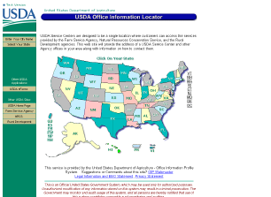
Module 6:
Data Sources – Office Information Profile (OIP) and Congressional Districts
Notes:
One of the “I” in Integrated is associated with use of data from Office Information Profile or OIP.
Congressional Districts are another import external data source.

Slide 2
Module 6 Objective – OIP and Conservation District Data in CIS
Many reports in CIS report data by office location ( i.e. worked ) or County or Congressional District
OIP is NRCS’s Official source for all office names
County and Congressional District names are maintained in Service Center’s Master Reference Tables
Notes:
In this training session we will look at how OIP and CD data is linked to the critical to the CIS system

Slide 3
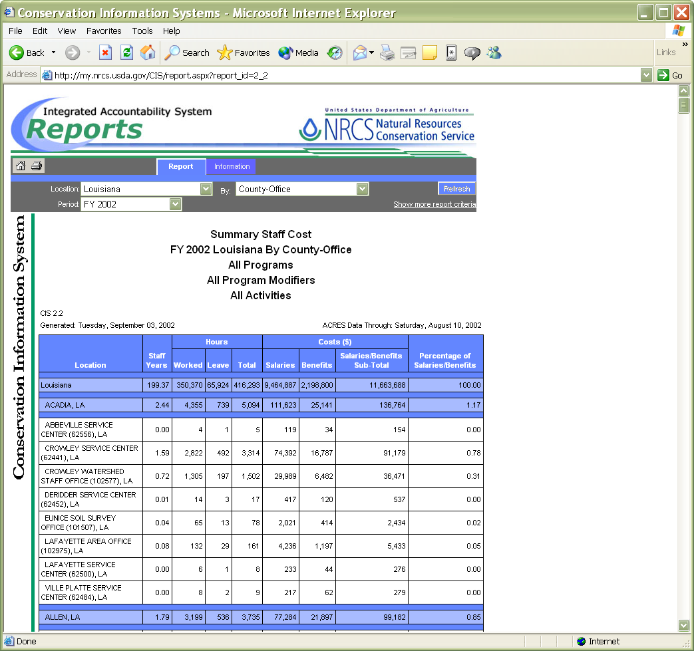
Example of OIP Data
County
Lafayette Service Center (62500)
Notes:
In any report where you find location information at office level, the office description should include Office Name, Office ID, and State as currently found in OIP.

Slide 4
USE of OIP Data in CIS
The name used on CIS reports is the Office Name itself, not the Service Center.
Some CIS reports are by office type. The office type of an office also comes from OIP.

Slide 5
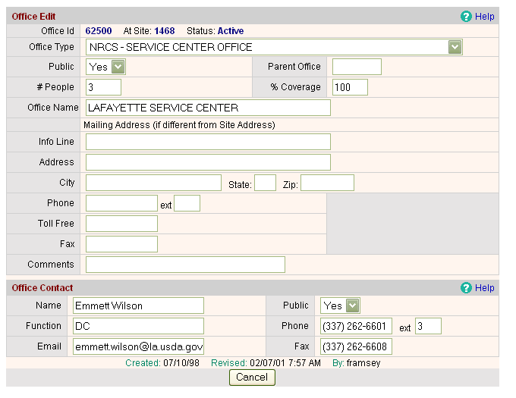
Where does CIS get Office Name?
Most CIS reports use Office Names from OIP (exception CIS report 2.4 uses Office Type)
Notes:
Since OIP has many names for offices such as Office Type, Site name, and Office name in addition to Site ID and Office ID, it is important to know that CIS uses the Office ID and Office Name

Slide 6
USE of OIP Data in CIS
Several CIS reports are based upon WebTCAS hours. One of the attributes of hours is the duty station office of the employee.
The duty station office comes from employee’s iCAMS record and is recorded as an OIP office id.

Slide 7
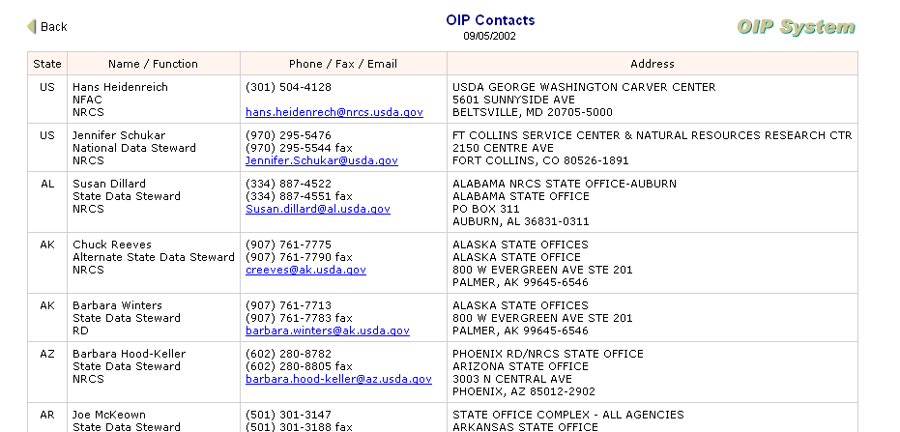
Corrections to Office Name
State Data Steward
OIP Manager (oip@itc.nrcs.usda.gov)
Notes:
From OIP we can identify the State Data stewards. Corrections to Office Names are made by State OIP Data Stewards. A list of these stewards can be found on the OIP web or contact the OIP Manager via email (oip@itc.nrcs.usda.gov)

Slide 8
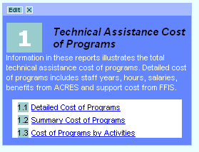

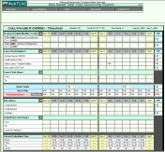
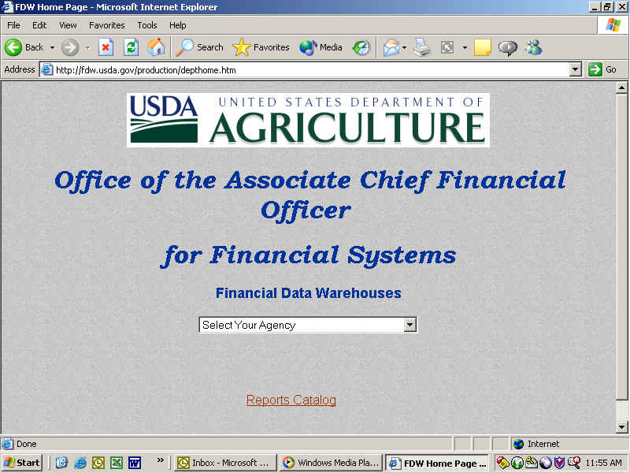
Location Data in WebTCAS links with OIP data when imported into CIS
WebTCAS/ACRES
Worked and Leave hours by program, activity, modifier, and county
Nightly update
CIS
Database
Cube
End of Pay Period Data Feed
FFIS
OIP
Monthly Data Feed
Real Time Feed
Support Costs by State
Office Information
Notes:
WebTCAS database uses office ID to associate location worked or duty station. When WebTCAS data is merged into CIS an Office name is derived from OIP.

Slide 9
USE of OIP Data in CIS
OIP has more than one office id, one for the service center, and another for the office itself. For example a service center can have more than one office in it such as the NRCS county office, the SWCD office, and perhaps an RD or FSA office.
When updating an office name in OIP, be sure to check both of these.

Slide 10
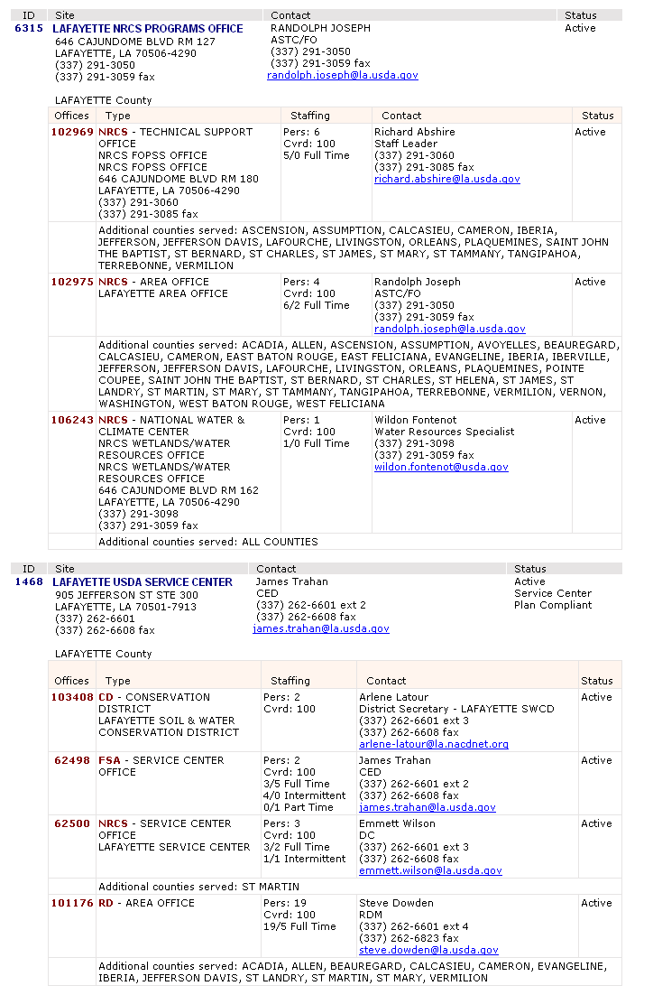
OIP Sites can have numerous Offices
Notes:
These reports from OIP show the relationship of sites to Offices. Each site generally have multiple offices in them.

Slide 11
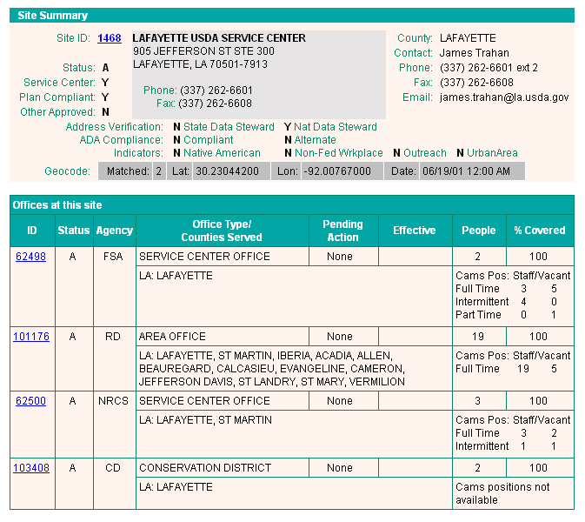
OIP Maintains an Office ID and a Site
Site ID
Office ID
Notes:
Since OIP maintains an Office ID and a Site ID, it is important to know that CIS uses the Office ID and Name

Slide 12
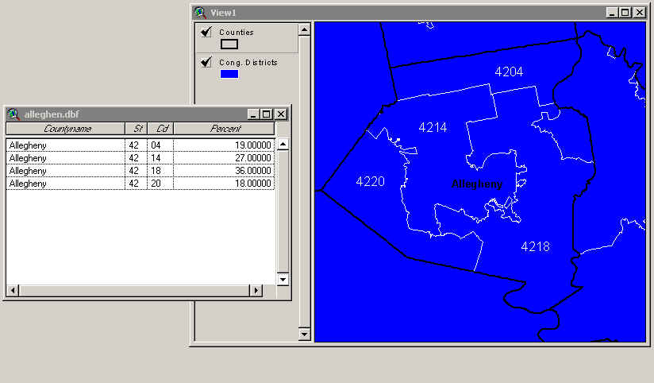
How is Congressional Data Prorated from County data?
Congressional District Boundary
4220
18% of Allegheny County is in Congressional District 20
Allegheny County Boundary
Notes:
Many reports in CIS present data by Congressional District. While PRMS collects most data by Congressional District, other CIS data sources may only have data to State or County level. In these later cases Congressional District values are derived using what percentage of the county acreage fall within the CD.
In the example above 18% of Allegheny County is in Congressional District 20. If Allegheny County had Salary Costs of $200,000, $36,000 would be prorated to CD 20 in Congressional District reports.

Slide 13
Thank you!

