Slide 1
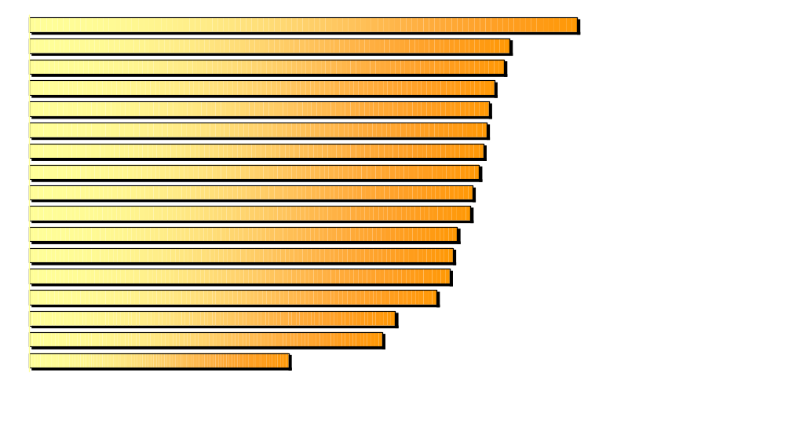
Adult Smoking Rates Vary Widely
Across the State
Grays Harbor, Lewis, Pacific
Thurston
Yakima
Chelan, Douglas, Kittitas, Okanogan
Island, San Juan, Skagit
Pierce
Spokane
Snohomish
Clallam, Jefferson, Mason
Cowlitz, Klickitat, Skamania, Wahkiakum
Adams, Ferry, Grant, Lincoln, Pend Oreille, Stevens
Clark
Kitsap
Whatcom
Benton, Franklin
King
Asotin, Columbia, Garfield, Walla Walla, Whitman
29.2%
25.6%
25.3%
24.8%
24.5%
24.4%
24.2%
24.0%
23.6%
23.5%
22.8%
22.6%
22.4%
21.7%
19.5%
18.8%
13.8%
WASHINGTON STATE DEPARTMENT OF HEALTH SEPTEMBER 1999

