Slide 1
Deploying and Operating the SAM-Grid: lesson learned
Gabriele Garzoglio for the SAM-Grid Team
Sep 28, 2004

Slide 2

Overview
Introduction to the SAM-Grid
The SAM-Grid deployment and operations
Lesson learned
  Cluster
  Grid/Fabric interface
  Grid services

Slide 3
The SAM-Grid Project
Mission: enable fully distributed computing for DZero and CDF
Strategy: enhance the distributed data handling system of the experiments (SAM), incorporating standard Grid tools and protocols, and developing new solutions for Grid computing (JIM)
History: SAM from 1997, JIM from end of 2001
Funds: received some funding from the Particle Physics Data Grid (US) and GridPP (UK)
People: Computer scientists and Physicists from Fermilab and the collaborating Institutions

Slide 4
What is SAM-Grid used for?
Montecarlo production for DZero
  From March 2004 produced > 2,000,000 events, equivalent to 11 yrs GHz computation
Other Activities:
  Extending the infrastructure to enable data reconstruction for DZero
  Montecarlo production for CDF at the prototypical stage

Slide 5
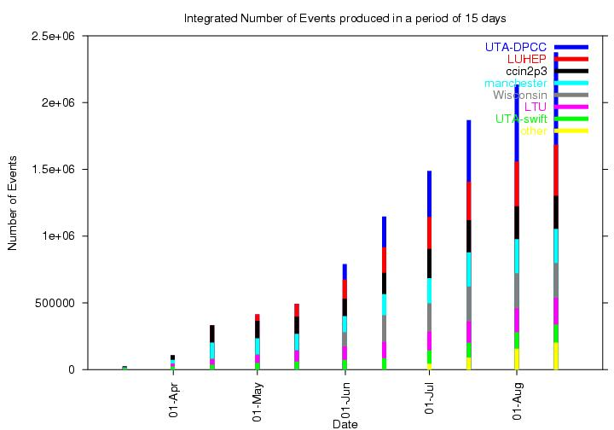
Montecarlo Production Events

Slide 6
Overview
Introduction to the SAM-Grid
The SAM-Grid deployment and operations
Lesson learned
  Cluster
  Grid/Fabric interface
  Grid services

Slide 7

The Deployment Phase
The initial deployment took 3 months: Jan - Mar 2004
The inefficiency in event production due to the grid infrastructure improved from 40% to 1-5%
  Inefficiency of the infrastructure =
  1 - (events produced / events requested)
This talk focuses on the main sources inefficiencies and how we mitigated them

Slide 8

Service Architecture
Flow of:
job
data
meta-data
User Interface
User Interface
User Interface
User Interface
Submission
Submission
Global Job Queue
Resource Selector
Grid
Grid Client
Match Making
Global DH Services
Info Gatherer
SAM Naming Server
Fabric
Info Collector
SAM Log Server
Resource Optimizer
MSS
Cache
Site
SAM DB Server
Cluster
RC
MetaData Catalog
Data Handling
Local Job Handling
Bookkeeping Service
SAM Station
(+other servs)
Grid Gateway
Info Manager
Grid/Fabric Interface
MDS
Web Serv
SAM Stager(s)
Info Providers
Grid Monitoring
JIM Advertise
XML DB server
User Tools
Dist.FS
Worker Nodes
Site Conf.
AAA
Glob/Loc JID map
Site
Site
Site
...
Notes:
The services are naturally divided in Grid-level and Fabric-level services.
Most of our work has been in the Grid-Fabric interface: how to coordinate the site’s services and resources to handle jobs from the grid (see later)
By deployment we intend the installation of the Grid/Fabric interface + SAM-Grid Fabric-level services at the collaborating sites.
Submission site is responsible for maintaining the queue of grid jobs submitted from the user interface AND to mediate the interaction between users and resource.
Resource Selector is responsible for recommending to the submission site the “best” site, according to enhanced (call-out-enabled) match making techniques.

Slide 9
The Deployment Model
Every site provides a gateway node where experts + local contacts can install the SAM-Grid software:
  Standard middleware (VDT), Grid/Fabric interface, VO Services client code
VO-specific services run at the site:
  SAM, JIM Monitoring, Local Scheduler, Local Storage
No software/daemon required at the worker nodes of the cluster
Notes:
The gateway can be shared with other grid infrastructures, such as OSG
VDT = Virtual Data Toolkit

Slide 10
Status of the Deployment
A dozen institutions currently part of the grid
~50% stable enough to be used for production
US Institutions
  FNAL, UW Madison, UTA, LUHEP, LTU, OSCER, OUHEP
Non-US Institutions
  IN2P3 (Fr), Oxford (UK), Manchester (UK), Prague (Cz), GridKa (De), Sprace (Br)
Notes:
UTA: Univesity of Texas at Arlington
LUHEP: Langston University
LTU: Luisiana Tech
Oscer: computing center in Oklahoma city
OUHEP: University of Oklahoma

Slide 11
The Operation/Support Model
A few production users can submit from their laptop to any SAM-Grid site
The software at each site is uniform and adapts to the local fabric configuration
The JIM infrastructure is currently maintained by 1 FTE + local contacts.
  This improves the previous model, where an expert per site was necessary to maintain the specific local production mechanisms

Slide 12
Overview
Introduction to the SAM-Grid
The SAM-Grid deployment and operations
Lesson learned
  Cluster
  Grid/Fabric interface
  Grid services
Notes:
Lesson learned on “Cluster” discusses a series of administrative practices at the level of the systems (batch systems, administrative tools e.g. ntpd, network configuration, etc.)

Slide 13
System Configuration Problems 1
Time synchronization of the worker nodes
  The Grid Security Infrastructure relies on the machine clock to determine the validity of the security tokens
  Administrators: please run ntpd !
  We also introduced artificial delays at the worker nodes to avoid “Proxy not yet valid” errors

Slide 14
System Configuration Problems 2
The Black Hole effect
  Even if a single node in the cluster is mis-configured and makes its jobs crash, the batch system keeps sending idle jobs to it: the whole queue of jobs will crash.
The Batch System does not immediately show up the jobs submitted to it or it times out
  When the Grid asks the status of the jobs and cannot find them, it thinks that they are finished: resource leak!
Both problems have been solved writing an “idealizer” (level of abstraction) in front of the batch system. In this code we can exclude statistically bad nodes, retry polling commands, etc.
Notes:
Problem 3 is a applies only for the grid, not for interactive job submission, where a user simply retry the polling command a minute later. It typically happens when the batch system is stressed (e.g. 200 jobs submitted at the same time) and happened for bqs, pbs and condor.

Slide 15
System Configuration Problems 3
The worker nodes do not know their domain name
  Our infrastructure wants to know… is this really SAM-Grid specific?
Running gridftp transfers between worker and head node within a private network is tricky
  Gridftp works in active mode only: the server at the head node may not be able to open the port to the client at the worker node
  Solution: give the head node a private network interface
Notes:
4. sam_cp needs to know the domain name to select the best protocol

Slide 16
System Configuration Problems 4
Plan the OS upgrades with the system administrators… or be resilient to it
  “We upgraded the worker nodes to RH9 and forgot to tell you…”
Negotiate/Study the policy limits
  Jobs have been killed or slowed down by batch system CPU limits, data handling file transfers limits, probability of job preemption ~1, …
Notes:
6 can also be overcome using OS matching techniques (this is what I mean with “be resilient to it”)

Slide 17
Overview
Introduction to the SAM-Grid
The SAM-Grid deployment and operations
Lesson learned
  Cluster
  Grid/Fabric interface
  Grid services

Slide 18
Gateway and VO Problems
Most of our work went in the interface between the Grid and the Fabric
The standard Globus job-managers are not sufficiently…
  …flexible: they expect a “standard” batch system configuration. None of our sites was that standard.
  …scalable: a process per grid job is started up at the gateway machine. We want/need aggregation.
  …comprehensive: they interface to the batch system only. How about data handling, local monitoring, databases, etc.
  …robust: if the batch system forgets about the jobs, they cannot react. We have written the “idealizers” for this.
To address these issues we had to write a “thick” Grid/Fabric interface (jim-job-manager). The drawback of this approach is that it complicates the local configuration.
Notes:
Examples
Lack of flexibility:
at IN2P3 (Lyon) there was a special flag at submission to let the infrastructure cope with the downtimes of the HPSS storage system: the batch system client interface no standard
at Wisconsin we could submit to 2 clusters from the same head node: for one we had dedicated resources, for the other we had to live with preemption. The job description file of the submit command was absolutely unique to the site
Lack of scalability:
For the typical linux box 300 processes is about the limit
Lack of comprehensiveness: When the job enters the site you may want to:
let the data handling system know in order to pre-stage files, while the job sites idle in the queue
Let the monitoring system know, so that it can report that the job is sitting idle: the job itself cannot report it because it is not running yet
Talk to a central service, such as a database (SAM DB Server), to gather information common to all the processes, thus reducing the communication burden that would occur if all the processes were connecting to the service at the same time
Lack of robustness:
The grid clients (in our case the Submission sites) poll regularly the status of the jobs. Right after submitting a job, bqs was not showing it for about a minute and condor was so busy that was timing out: the grid though the jobs were finished.

Slide 19
Overview
Introduction to the SAM-Grid
The SAM-Grid deployment and operations
Lesson learned
  Cluster
  Grid/Fabric interface
  Grid services

Slide 20
Grid Services Problems 1
Scalability of the semi-central services
  access to the central data handling database is organized in a 3-tiers architecture
  the middle tier couldn’t cope with 200 jobs starting up at the same time, asking for data
  we had to introduce retrials with exponential back off to mitigate the problem. We also aggregate access from the gateway node for the information that is common to all processes.

Slide 21
Grid Services Problems 2
Firewalls: understand the network topology of your grid
  System administrators generally are willing to open ports to a certain list of nodes when the software is installed
  Maintaining the configuration up to date as new installation are deployed is difficult
  For core services, such as data movement, the SAM-Grid can route data via delegation if direct transfers are not possible
Notes:
Site A opens ports to machine B,C,D. We install the infrastructure on machine E: going back to all the sites and asking to open the ports to E is a burden. In general you need a proxy mechanism and some routing established.

Slide 22
Conclusions
The SAM-Grid is an integrated grid system for job, data and information management for HEP
It is used in “production” for DZero montecarlo since March 2004.
  We are working on data reconstruction for DZero and montecarlo generation for CDF
During deployment and operations we had to overcome problems at the level of
  the systems: careful administration is crucial
  the Grid/Fabric interface: we need a “thick” interface
  the Grid services: be careful about scalability and network topology
Notes:
If I have time I’ll add the number of test jobs that we have run to check the consistency of the whole infrastructure.

