Slide 1
AWIPS II Status and Plans for
National Offshore and High Seas Meeting
October 14, 2009
Scott Jacobs
NCEP Central Operations
Systems Integration Branch

Slide 2
AGENDA
AWIPS II Status and Plans
  AWIPS Brief History
  AWIPS II Technology Infusion Scope and Milestones
  AWIPS I to AWIPS II Migration Status
  AWIPS II Architecture Overview
NAWIPS Migration Plans and Status

Slide 3
AWIPS
A Brief History
The original prime contract for system development was awarded to PRC, Inc on December 29, 1992
  To replace Automation of Field Operations and Services (AFOS)
  PRC, Inc later acquired by Northrop Grumman IT (NGIT)
  Commissioned - 2000
Operations phase of original contract expired on September 30, 2005
Re-compete contract awarded to Raytheon Technical Services (RTS) on August 17, 2005
  Proposal included a high level plan to re-engineer AWIPS software into a Service Oriented Architecture (SOA), AWIPS II

Slide 4
AWIPS II Technology Infusion Scope
AWIPS II Technology Infusion (FY2005 – FY2015)
  A long-term project which delivers a modern, robust software infrastructure that provides the foundation for future system level enhancements for the entire NWS enterprise
Phase 1: (FY2006-FY2011)
  Migration of WFO/RFC AWIPS (AWIPS I) to a modern Service Oriented Architecture (SOA) infrastructure executed incrementally through a series of task orders
Phase II: (FY2009-FY2012) – AWIPS SOA Extension
  Creation of a seamless weather enterprise spanning NWS operations
    Migration of NAWIPS into the AWIPS II SOA
    Delivery of thin client to support the Weather Service Offices, Center Weather Support Units, Incident Meteorologists, (e.g., Fire Weather, backup support for RFCs and National Centers)
    Integration of Weather Event Simulator
    CHPS Integration into AWIPS SOA
Phase III: (FY2009 – FY2015) – Enterprise Level Enhancements
    Data delivery enhancements: “Smart push-smart pull” data access
    Integrated visual collaboration
    Information generation enhancements
    Visualization enhancements

Slide 5
AWIPS I to AWIPS II
Re-Architecture Approach
Perform “black-box” conversion
  Preserve existing functionality, look and feel on top of new infrastructure
Thorough field validation and acceptance before deployment
  Incremental releases via task orders for test and evaluation strategy
No loss of functionality
  Deployed system current with deployed AWIPS capability (i.e., OB9)
Use open source projects - No proprietary code
  JAVA and open source projects enable AWIPS II to be platform and OS independent
Objective is to make AWIPS II available for collaborative development

Slide 6
AWIPS Migration Schedule
Task Order | Target
Develop AWIPS SW Product Improvement Plan (TO1) | June 2006
Conduct Initial system analysis (TO2) | October 2006
Develop ADE/SDK (TO3-6) | July 2007
Plan baseline application migration (TO7) | October 2007
Migrate primarily D2D/Warngen capabilities (TO8) | February 2008
Migrate primarily GFE capabilities (TO9) | September 2008
Migrate primarily hydrologic capabilities and infrastructure improvements (TO10) | February 2009
Complete AWIPS SOA Release 1.0 (TO11) | March 2010
System Operational Test and Evaluation (OTE) | March - August 2010
Field (OTE) Target deployment | Sept- Dec 2010 2011

Slide 7
Task Order 11 Schedule
Slice 1 – April 8 Delivered
  D2D Display (Non-Derived Satellite data, Maps & Warngen locations), Data (SBN ingest, Selected Decoders), Hydrological Functions (XDAT, IHFS, SSHP), Cron Management, Guardian, Command Line Interface, Notification Server
Slice 2 – May 6 Delivered
  D2D Display (Upper Air Rendering), Decoders (BufrMOS), Text Triggers, GHG, Radar ORPG Ingest, Dam Break Model, Data Purging
Slice 3 – June 3 Delivered
  WarnGen, Warngen Service Backup, Hydroview, XNAV, ACARS data, Model/Satellite Soundings
Slice 3.1 (DR fixes) – July 1 Delivered
  76 DRs - 49 Graphical Forecast Editor (GFE), 15 Display Two-Dimensional (D2D)
Slice 4/5 – August 26 Delivered
  AvnFPS (except climate), D2D Display (Obs, Radar/Radar Apps/Radar Mosaic, Volume Browser Standard Model Parameters, Time Matching+4 panel), GFE (except DFC, Service Backup), MPE, Text Workstation Scripting, Radar Plug-in, SigWx/highDensityWinds/ncwf,ascat,soundings Plug-in, Satellite Precipitation Estimate (SPE) Data Retrieval
Slice 6 – October 21
  AvnFPS (climate), D2D Display (Satellite, Upper Air, NCEP Outlook Grids Rendering, SigWx/LSR/VAA Rendering, Volume Families, Skew-T, Hydro Rendering), GFE (DFC, Service Backup), NDFD Grid Transmission, Text Workstation Alarm/Alert, FFMP, Fog Monitor, SCAN, SNOW, SAFESEAS, Advisory Decoder Plug-in, SIGMET Plug-in, Version Purging, Archival/Backup of Data, Failover, Localization Infrastructure, Hydro - Build Precip Reports, Hydro - Flood Archiver, Cron management, TMCP, HazCollect, NWWS, Comms, HWR, LDAD, RFC applications, HPE, HPN, FSI, AWIPS System Monitor
Start Performance Testing – December 2009, RTS
Snap-Up – Dec 9
  OB9.2 DR fixes, Volume Browser (Radar & Tilt, Derived Fields, Derived Levels)
Start Stability Testing – Feb 2010, RTS

Slide 8
AWIPS II Architecture Overview
Consists of AWIPS Development Environment (ADE), the Common AWIPS Visualization Environment (CAVE) and Enterprise Data Exchange (EDEX)
Service Oriented Architecture (SOA)
Primarily Java based
Integrates many Open Source Projects
ANT | ADE build scripting
JAVA | ADE Java virtual machine
PostgresSQL | RDBMS for metadata
Jibx | Java Object to XML mapping
JEPP | Java embedded Python libraries
Jhdf5 | Java API to HDF5
Hibernate 3 | Relational to object mapping
Geotools | GIS libraries and tools
Velocity | Template engine
Openfire | Collaborator server
Eclipse RCP | Visualization framework
Jogl | Open GL Java API for CAVE
Batik | SVG tool library
Activemq | ADE Java Messaging Service
Camel ESB | ADE Enterprise Service Bus

Slide 9
AWIPS II Primary Standards & Formats
Ingested Data Formats
  GRIB1/GRIB2 – Gridded data
  NetCDF3 – Support AWIPSI/II interoperability
  BUFR – Observational Data, e.g., soundings
  METAR, SHEF – Surface and hydrological data
  GINI – Satellite Imagery
  OPRG L3 – Radar Imagery
  Text Messages – Text products
Data Store Formats
  PostGres – Metadata and select data type store, e.g., text
  HDF5 – Binary store for grids, imagery and select observations
Product Distribution
  NetCDF3 – NDFD Grids
  ASCII Text – Text products

Slide 10
NAWIPS Migration Project
Goals
Full NAWIPS capabilities ported to AWIPS II architecture
Software ready for Operational Testing and Evaluation by Q1FY11
No changes to the forecaster workflow
  “Gray box” migration
  Some visual differences may be unavoidable
Capitalize on new technology

Slide 11
NAWIPS Migration Project
Focus
Migration activities in four primary areas
  GUI program integration into CAVE
    NMAP
    NWX
    NTRANS
    NSHARP
  Product Generation (PGEN)
  Decoders
  GEMPAK
Testing and Test Plans
  Developed by the Centers based on operational concepts

Slide 12
National Centers Perspective
Previous development
  Developed a perspective in CAVE to match the legacy NMAP user interface
  Most tools and menu items are fully functional
Current Development
  Focusing on data management, selection and display
  Starting to integrate multi-loop and multi-panel displays
Future development
  Continue to add data resource types
  Begin timeline and time matching

Slide 13
Product Generation
Fully integrated set of drawing and editing tools with derived product creation capabilities
  Text, Graphics, Grids, etc.
Generic objects complete
Meteorological objects
  Severe weather watch, SIGMETs, TCAs, Outlooks, etc.
Product-centric infrastructure
Conversion utilities
  Legacy VG format to new XML-based format

Slide 14
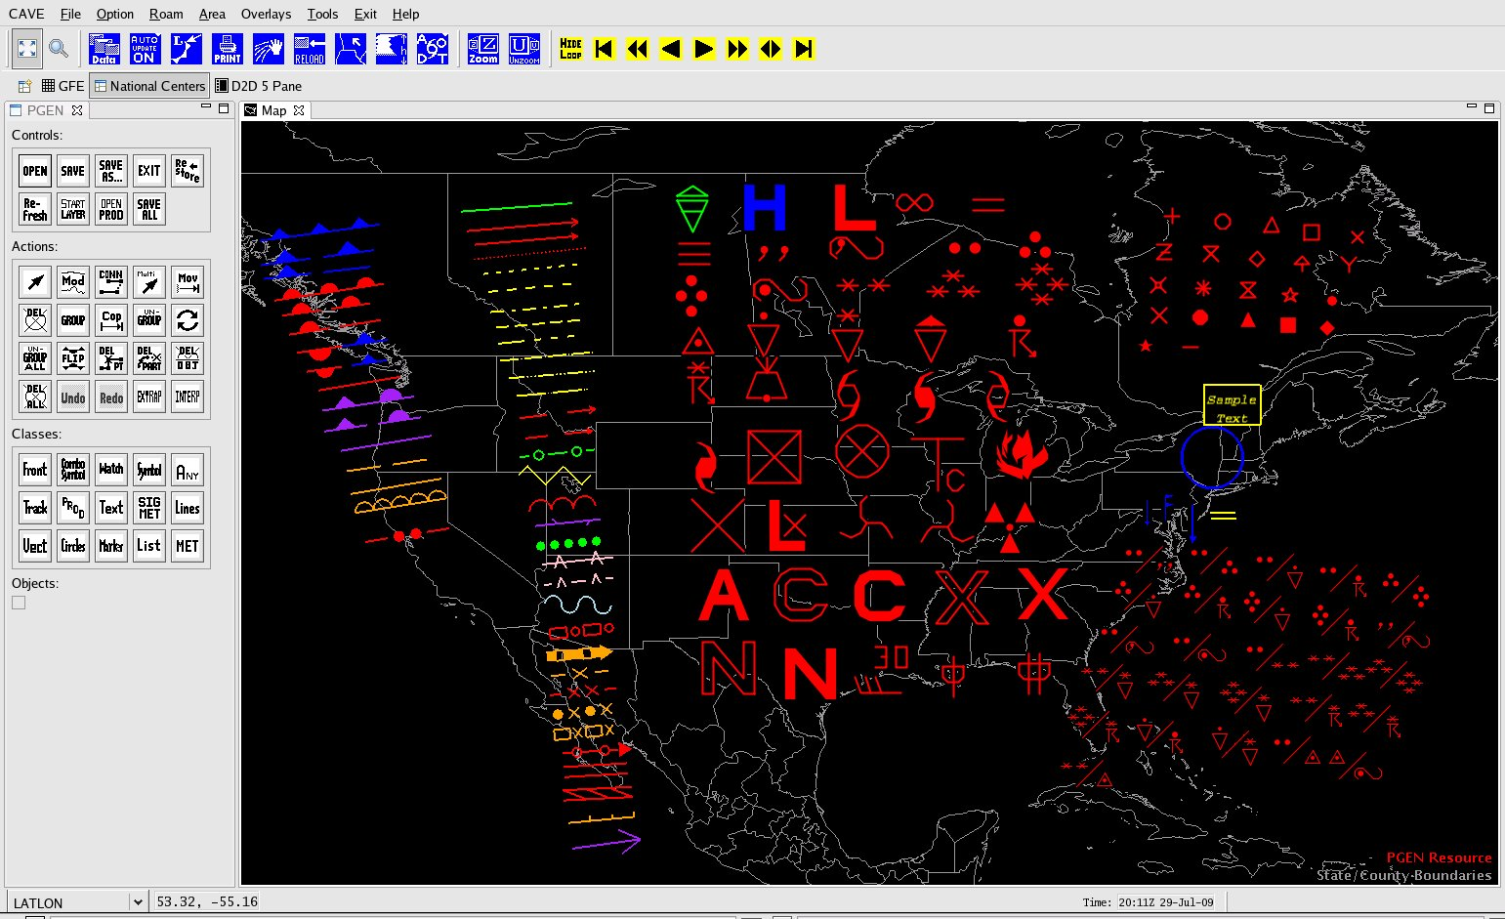
Generic PGEN Objects

Slide 15
Decoders
Completed
  Flash Flood Guidance
  Watch Corner Points
  Supplemental Climatological Data
  SIGMETs (Convective, Non-convective, International)
  AIRMETs
  Advisory-Watch-Warning
  Ice Drift
  TAMDAR
  Hurricane Advisory
Ongoing
  Large datasets that leverage HDF5
    Imagery, Grids, QuikScat, etc.

Slide 16
GEMPAK
Forward compatibility
  Allows legacy applications to access AWIPS II database
  Risk mitigation for NC local GEMPAK applications
Completed
  Surface data
  Upper Air data
  Imagery
Next
  Grid data
GEMPAK 6.0 – Q1FY10

Slide 17
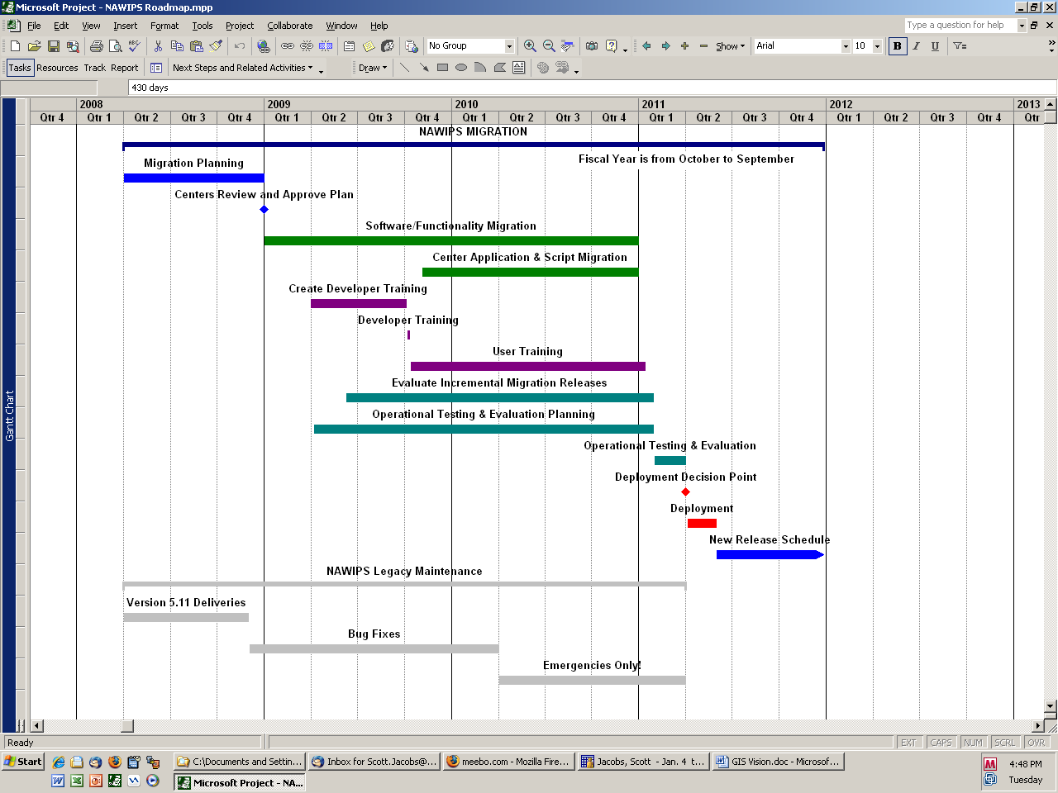
NAWIPS Migration Roadmap
You are here

Slide 18
QUESTIONS ????

