Slide 1
Writing EPICS Channel Access Clients in Python
Geoff Savage
March 2003

Slide 2
Contents
EPICS concepts
  EPICS architecture
  Channel access (CA)
EPICS CA and Python
  Motivation
  Examples
  Software architecture
  CaChannel
  caPython

Slide 3
EPICS Architecture
Operating systems:
VxWorks
Linux
WindowsNT
Host
Network
Hardware and
Software Devices
Input Output
Controller
Data Bus
Control and monitor devices

Slide 4
Channel Access
The EPICS Software Bus –
Client-server protocol
Network or local communication path
Host
CAS
CAC
Network
Input Output
Controller
CAS
CAC
CAS
Channel Access Server
CAC
Channel Access Client

Slide 5
CA Communication
CA Client –
Connects with a record by name
Access individual fields in a record
Read/write, post events on value change, …
Host
CAC
Network
CA Server –
A record connects data with a name
Fields in each record specify how to manipulate the data
Fields for conversions, alarm limits, …
Input Output
Controller
CAS

Slide 6
CA Services
Dynamic channel creation
Automatic channel reconnect
Read
Write
Monitoring
  Generates callbacks
  Events
  Access control
  Connection
Data type conversions
Composite data structures

Slide 7
Channel Creation
Host
IOC
IOC
IOC
Who has channel ‘XXXX’?
(udp broadcast)
Host
IOC
IOC
IOC
I have channel ‘XXXX’.
Host
IOC
IOC
IOC
Negotiate connection.
(point-to-point tcp)

Slide 8
CA Buffering
“All requests which require interaction with a CA server are accumulated (buffered) and not forwarded to the IOC until one of ca_flush_io(), ca_pend_io(), ca_pend_event(), ca_sg_pend() are called allowing several operation to be efficiently sent over the network in one message.”
Read/write transactions can not be in the same message as the connection request

Slide 9
CA Request Status
“If the server for a channel is located in a different node than the client then the operations that communicate with the server return status indicating the validity of the request.”
“In other words, success returned from the client library routine indicates that it checked your request, it appeared to be valid, and it forwarded it to the server.”
Check the status when the transactions have completed

Slide 10
CA Transaction Status
“Any process variable values written into your program’s variables by ca_get() should not be referenced by your program until ECA_NORMAL has been receied from ca_pend_io().”
Upon receipt of a callback the transaction is complete and the transaction status is available from within the callback.

Slide 11
CA Operation
“For proper operation CA must periodically be allowed to take care of background activity. This requires that your application must either wait in one of ca_pend_event(), ca_pend_io(), or ca_sg_block(), or it must call ca_pend_event() at least every 15 seconds.”

Slide 12
EPICS CA Summary
EPICS software bus
Client-server architecture
Library functionality
  Create and maintain connections
  Synchronous transactions
  Asynchronous transactions
  Transaction status reporting
  Buffering for efficiency
Details follow in the discussion of CaChannel.

Slide 13
Why Python?
“Python is an interpreted, interactive, object-oriented programming language”
Fermilab experience
  Reduced development time
  Portable (Linux, NT, OSF1)
  Graphics (Tcl/Tk)
  Powerful extension library
  Easy to extend (SWIG)
  Short learning curve
www.python.org

Slide 14
Using CA from Python
Maintain full CA functionality
  Callbacks
  Data types
Map each connection to an object
Two step process
  caPython – make the CA library callable from Python (wrapping)
  CaChannel – use the wrapped functions in caPython to create channel objects

Slide 15
Simple Interpreter Example
[savage@d0ol30 ~]$ setup d0online
[savage@d0ol30 ~]$ python
Python 2.1 (#3, May 16 2001, 15:15:15)
[GCC 2.95.2 19991024 (release)] on linux2
Type "copyright", "credits" or "license" for more information.
>>> from CaChannel import *
>>> ch = CaChannel('catest')
>>> ch.searchw()
>>> ch.putw(123.456)
>>> ch.getw()
123.456
Make a connection via a name.
Create the connection.
Write a value.
Read a value.

Slide 16
Simple Script Example
#! /bin/env python
from CaChannel import *
def main():
try:
catest = CaChannel('catest')
catest.searchw()
catest.putw(123.456)
print catest.getw()
except CaChannelException, status:
print ca.message(status)
main()
Print the error string.

Slide 17
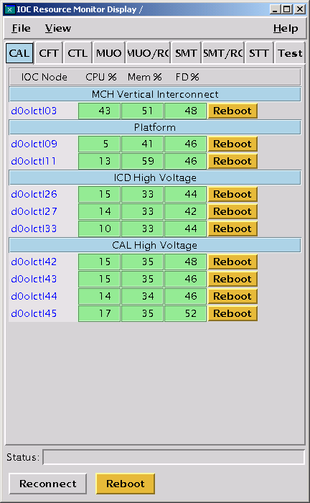
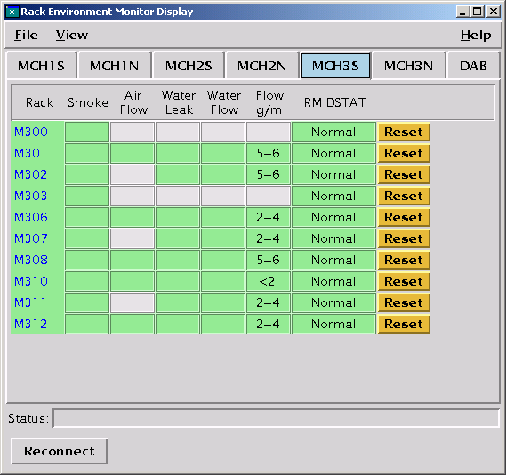
Graphical Interfaces

Slide 18
Architecture
Move from C functions to a Python class interface.
CaChannel
Python class
Calls caPython functions
caPython
Python wrapper around the C library
Collection of python functions
EPICS channel access C library
Collection of C functions and macros
Distributed with EPICS

Slide 19
CaChannel
Methods
Data types
Synchronous I/O
Asynchronous I/O
Monitoring
Use with Tkinter

Slide 20
CaChannel Construction
CaChannel is constructed from caPython and the SWIG pointer library
“SWIG is an interface compiler that connects programs written in C and C++ with scripting languages such as Perl, Python, Ruby, and Tcl.”
caPython – CA functions, macros, and helper functions wrapped using SWIG
SWIG pointer library – manipulation of C pointers from Python

Slide 21
CaChannel Methods …
Connection
  search
  search_and_connect
  clear_channel
Synchronization
  pend_io
  pend_event
  poll
  flush_io
Write
  array_put
  array_put_callback
Read
  array_get
  array_get_callback
  getValue
Monitors
  add_masked_array_event
  clear_event

Slide 22
… CaChannel Methods
Simple and slow
  searchw = search + pend_io
  getw = array_get + pend_io
  putw = array_put + pend_io
Information
  field_type
  element_count
  name
  state
  host_name
  read_access
  write_access

Slide 23
Synchronous I/O
>>>
>>> ch.search()
>>> ch.pend_io()
>>>
>>> ch.array_put(123.456)
>>> ch.pend_io()
>>>
>>> ch.array_get()
>>> ch.pend_io()
>>> ch.getValue()
123.456
pend_io = flush request buffer and wait for CA requests to complete for all CaChannel objects
Multiple requests can be issued before each pend_io
All connections must be made before get or put
On a get a value is not valid until pend_io has returned with no errors

Slide 24
Data Types …
>>> ch.getw()
123.456
>>> ch.getw(ca.DBR_INT)
123
>>> ch.getw(ca.DBR_STRING)
'123'
>>> ch.field_type()
6
>>>ca.dbr_text(ch.field_type())
'DBR_DOUBLE‘
>>>
Each PV has a native type
Different data types can be requested
Requests using the native type are most efficient
Not all caPython functions are implemented as methods of CaChannel.

Slide 25
… Data Types …
>>> scan = CaChannel('catest.SCAN')
>>> scan.searchw()
>>> scan.getw()
6
>>> scan.getw(ca.DBR_STRING)
'1 second'
>>> scan.putw(5)
>>> scan.getw(ca.DBR_STRING)
'2 second‘
>>> ca.dbr_text(scan.field_type())
'DBR_ENUM'
>>>
The SCAN field of a record identifies how often the record is processed
There is an enumerated list of possible SCAN field values

Slide 26
… Data Types
>>> scan.putw('1 second')
Traceback (innermost last):
File "<stdin>", line 1, in ?
File "CaChannel.py", line 383, in putw
count, pval = self.__setup_put(value, req_type)
File "CaChannel.py", line 131, in __setup_put
CaChannel.dbr_d[req_type]['convert'](value),
ValueError: invalid literal for int(): 1 second
>>> scan.putw('1 second', ca.DBR_STRING)
>>> scan.getw(ca.DBR_STRING)
'1 second'
Writing the enumerated identifier (5) works on the previous slide and writing a value (‘1 second’) fails.

Slide 27
Request Data Types
Request type | Python type | Comments
DBR_STRING | String
DBR_ENUM | Integer | Enumerated
DBR_CHAR | Integer | 8 bits
DBR_INT | Integer | 16 bits
DBR_LONG | Integer | 32 bits
DBR_FLOAT | Float
DBR_DOUBLE | Float
Array of DBR | List of type

Slide 28
Asynchronous I/O …
No waiting for CA requests to complete
A user written callback function is executed when the request has completed
ca_pend_event = flush the request buffer and wait for timeout or until all CA background activity is processed
ca_poll = ca_pend_event with a short timeout
ca_flush_io = flush the request buffer

Slide 29
… Asynchronous I/O
Asynchronous callbacks do not preempt the main thread
Instead ca_pend_io, ca_pend_event, or ca_poll must be called at least every 15 seconds to allow background activity to process

Slide 30
Connection Callback
ch.search_and_connect('catest', connectCb)
while 1: ch.pend_event()
def connectCb(epics_args, user_args):
print ‘name =‘, ca.name(epics_args[0])
print ‘state =‘, epics_args[1]
epics_args = 2 element tuple
  epics_args[0] = channel identifier, used to get the channels name
  epics_args[1] = connection state
    ca.OP_CONN_UP
    ca.OP_CONN_DOWN
user_args = tuple containing all python objects specified after the callback in the method

Slide 31
Put Callback
ch.array_put_callback(3.3, None, None, putCb)
while 1: ch.pend_event()
def putCb(epics_args, user_args):
print ca.name(epics_args['chid'])
print ca.dbr_text(epics_args['type'])
print epics_args['count']
print ca.message(epics_args['status'])
print user_args
Default element count
Native data type
epics_args is a dictionary with keys:
  chid = channel identifier
  type = request type (DBR_XXXX)
  count = element count
  status = transaction status code from server

Slide 32
Get Callback
ch.array_get_callback(None, None, getCb1)
while 1: ch.pend_event()
def getCb1(epics_args, user_args):
print "pvName = ", ca.name(epics_args['chid'])
print "type = ", ca.dbr_text(epics_args['type'])
print "count = ", epics_args['count']
print "status = ", ca.message(epics_args['status'])
print "user args = ", user_args
print "value(s) = ", epics_args['pv_value']
Default element count
Native data type
value(s) = data returned by the server. Multiple data elements are returned in a tuple.

Slide 33
Compound Data Types
Only supported in asynchronous mode
Extra information with the value
  Status – alarm values
  Time – status + timestamp
  Graphics – status + alarm limits + display limits
  Control – graphics + control limits
Routines are provided to convert DBR type to compound type

Slide 34
Get Status Callback
ch.array_get_callback(ca.dbf_type_to_DBR_STS(ch.field_type()), None, getCb2)
while 1: ch.pend_event()
def getCb2(epics_args, user_args):
print "pvName = ", ca.name(epics_args['chid'])
print "type = ", ca.dbr_text(epics_args['type'])
print "count = ", epics_args['count']
print "status = ", ca.message(epics_args['status'])
print "user args = ", user_args
print "value(s) = ", epics_args['pv_value']
print ca.alarmSeverityString(epics_args['pv_severity'])
print ca.alarmStatusString(epics_args['pv_status'])
Default element count
pv_severity = alarm severity
pv_status = alarm status

Slide 35
Monitoring …
Asynchronous I/O originated at the server
Client requests notification from the server when
  the channel’s value changes by more than the value dead band or alarm dead band
  the channel’s alarm state changes
Monitor callbacks match those described under asynchronous I/O

Slide 36
… Monitoring …
def eventCb(epics_args, user_args):
print ca.message(epics_args['status'])
print "new value = ", epics_args['pv_value']
print ca.alarmSeverityString(epics_args['pv_severity'])
print ca.alarmStatusString(epics_args['pv_status'])
try:
chan = CaChannel()
chan.searchw('catest')
chan.add_masked_array_event(
ca.dbf_type_to_DBR_STS(chan.field_type()),
None, ca.DBE_VALUE | ca.DBE_ALARM, eventCb)
except CaChannelException, status:
print ca.message(status)

Slide 37
… Monitoring
Monitor mask | Notification condition
ca.DBE_VALUE | when the channel’s value changes by more than MDEL
ca.DBE_LOG | when the channel’s value changes by more than ADEL
ca.DBE_ALARM | when the channel’s alarm state changes

Slide 38
Functions Not Implemented
ca_change_connection_event
  use ca_search_and_connect
ca_add_exception_event
ca_replace_printf_handler
ca_replace_access_rights_event
ca_puser macro
  not used
ca_test_event
Scan groups

Slide 39
Tkinter and CaChannel
EPICS CA is not thread safe
All CaChannel activity must be performed in the main thread
Use the Tkinter after method to interrupt the mainloop at regular intervals to allow CA backgroud activity to execute
Execute CaChannel calls from the update function called by after

Slide 40
caPython
Maintain full CA functionality
SWIG handles the wrapping of functions not associated with callbacks without intervention
  Label the functions with the C function name minus the ca_ prefix
  ca_pend_io -> pend_io
Additional C functions were added to handle callbacks
Access to constants in the header files
Macros are wrapped in functions

Slide 41
caPython Initialization
Provide access to constants in header files
  DBF_XXXX types – native field types
  DBR_XXXX types – transaction request types
  ECA_XXXX – transaction status codes
  Connection states
  Event masks
When the ca module is imported into python execute ca_task_initialize()

Slide 42
caPython Callbacks
1. Python callback function
Python script
Key:
C function
2. Register the callback
3. Synchronize with pend_event
4. Execute C function
5. Execute callback function
6. Cleanup reference counts
7. Resume python code

Slide 43
Callback Example
int ca_search_and_connect(
char *CHANNEL_NAME,
chid *PCHID,
void (*USERFUNC)(struct connection_handler_args ARGS),
void *PUSER);
When ca_search_and_connect() completes it calls USERFUNC with one argument of type struct connection_handler_args
connectCallback is the C function always called
The python callback function and user data are combined and passed in through PUSER

Slide 44
Callback Functions
Convert the channel access C data for return to the Python callback function
Separate the python callback function and user data found in PUSER
Call the Python function with two arguments
  CA data
  User data - if no user data is specified then the user data tuple is empty
Cleanup reference counts

